Slide 1
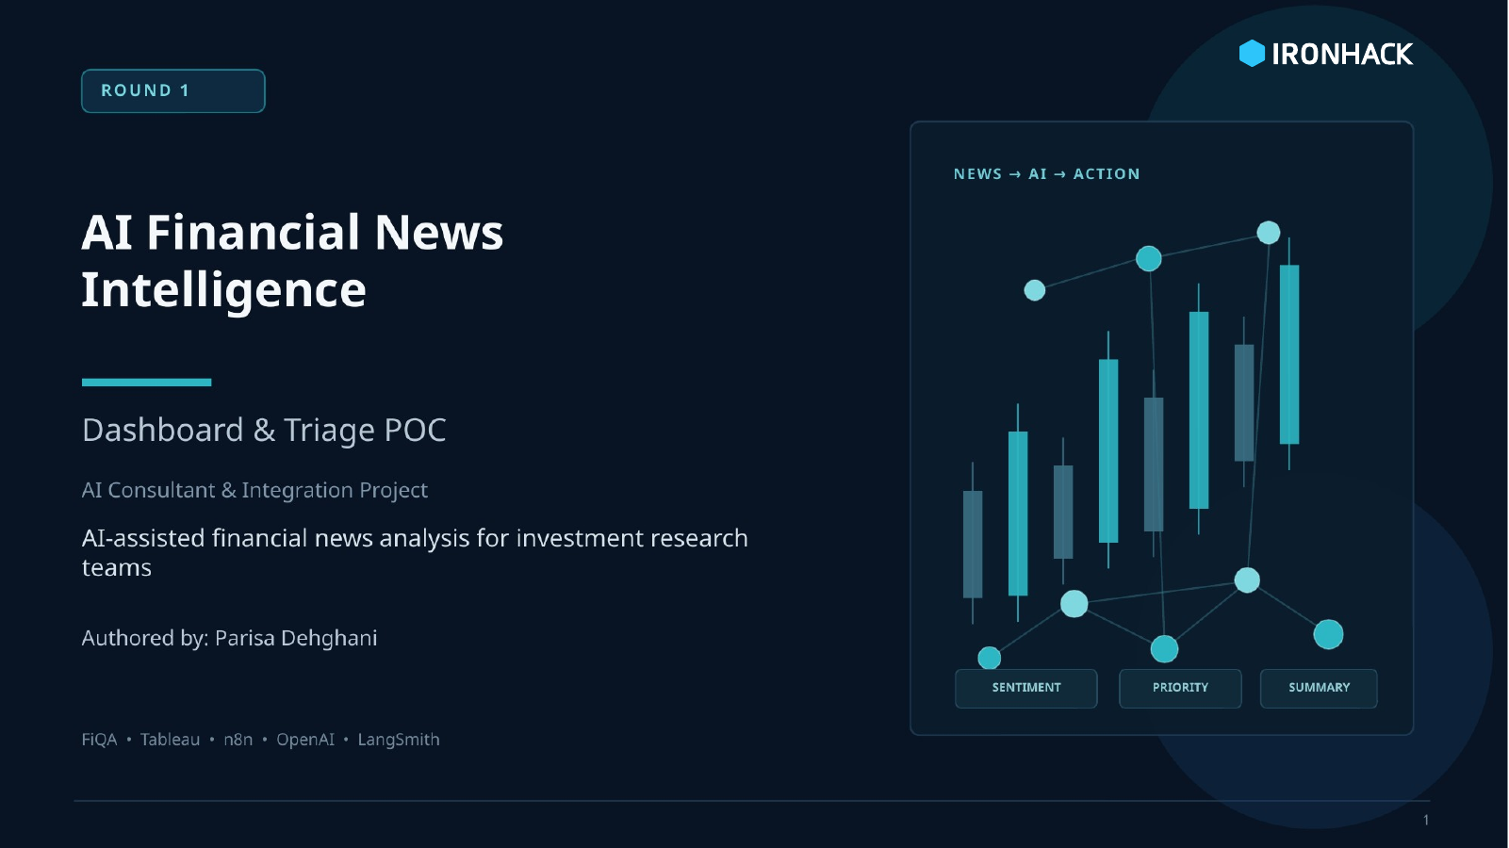
Notes:
Timing: about 30 seconds. Hi everyone. My project is AI Financial News Intelligence Dashboard and Triage POC. The goal is to explore how AI can help investment research teams analyze financial information faster, but still keep a human analyst in control. In Round 1, I worked offline first using the FiQA dataset, built a Tableau dashboard to understand the data, then created an n8n and OpenAI proof of concept that classifies a new financial sentence and routes it based on priority. I also used LangSmith to monitor the AI calls and evaluate the output on a small FiQA test sample.

Slide 2
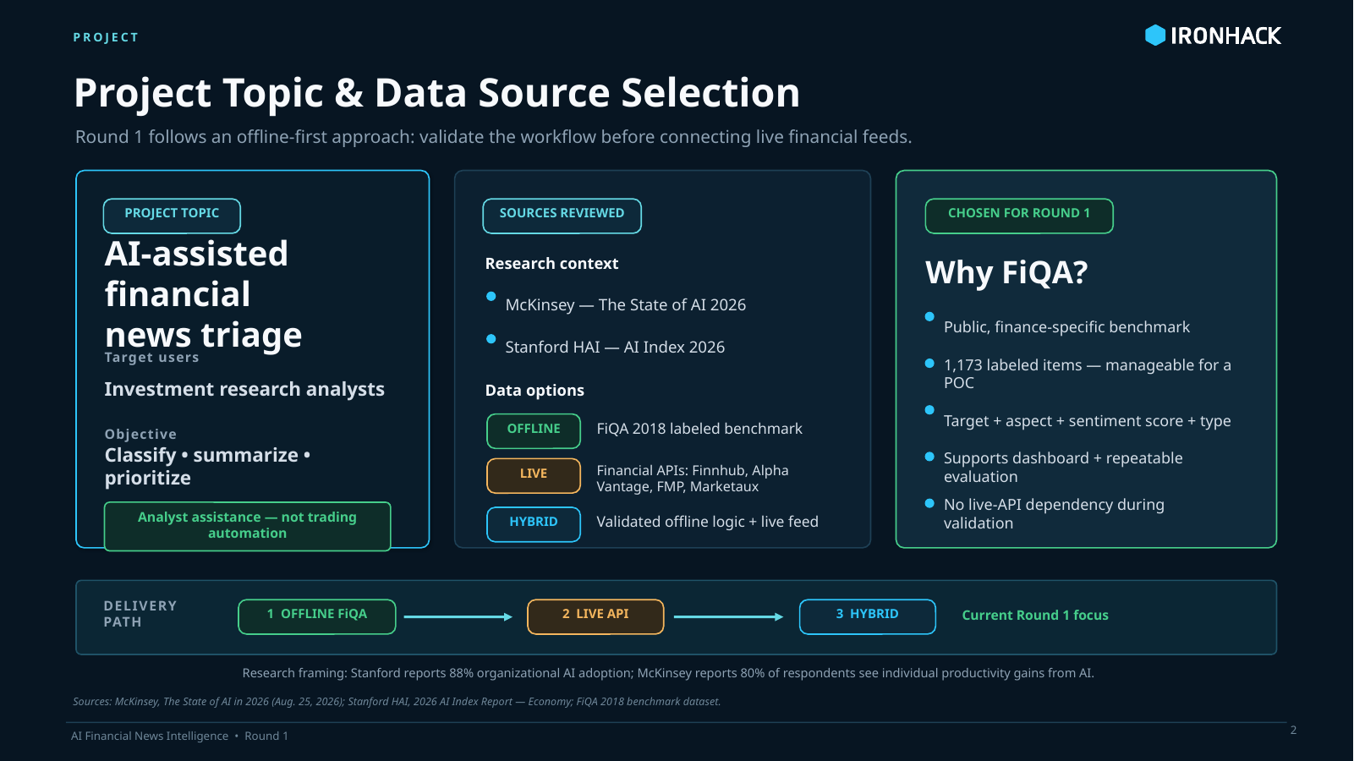
Notes:
Timing: about 1 minute. Before choosing the dataset and solution, I reviewed broader AI adoption research and data options. McKinsey and Stanford show that AI is now moving from experimentation toward real business workflows, which supports the relevance of this project. I considered live financial APIs such as Finnhub, Alpha Vantage, Financial Modeling Prep, and Marketaux. However, for Round 1 I selected FiQA because it is finance-specific, offline, repeatable, and already contains financial text, target entities, aspects, sentiment scores, and train/test splits. This made it suitable for both dashboard analysis and evaluation. Following the instructor's guidance, the project path is offline first, then live API, then a hybrid version.

Slide 3
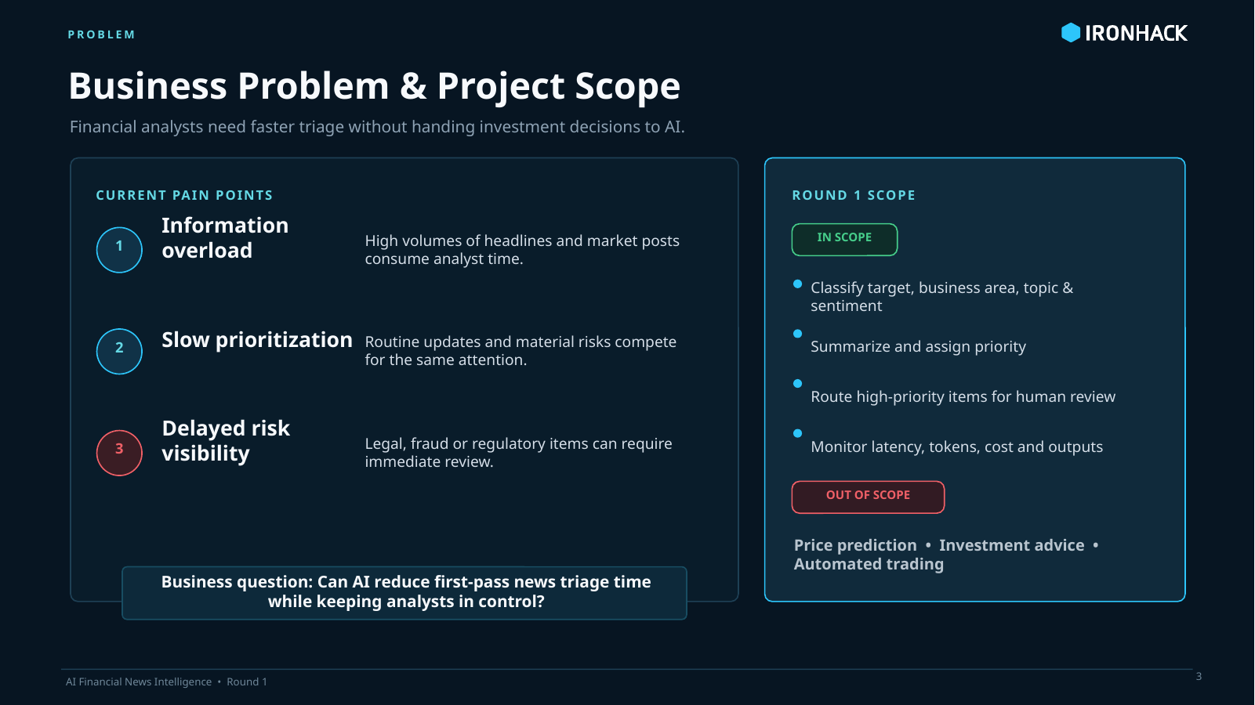
Notes:
Timing: about 1 minute. The business problem is information overload in investment research. Analysts may need to review many headlines, news items, and social posts, but not all information has the same urgency. Some items are routine, while others are legal, regulatory, or risk-sensitive and need faster attention. The scope of this project is not stock-price prediction or automated trading. Instead, the scope is triage: identifying the target, business area, topic, sentiment, priority, and summary. The intended user is an analyst or investment research team. The AI supports the workflow, but final decisions remain human-reviewed.

Slide 4
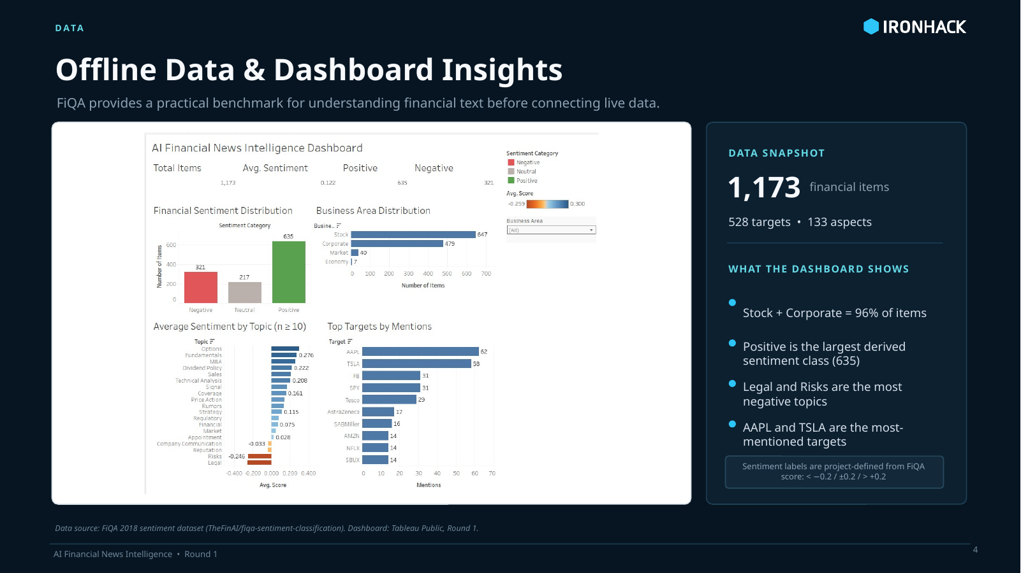
Notes:
Timing: about 1 minute 15 seconds. This dashboard is based on the offline FiQA dataset. It contains 1,173 financial items. The overall average sentiment is slightly positive, at 0.122, with 635 positive, 321 negative, and 217 neutral items. Most records are related to Stock and Corporate areas, which makes the dataset relevant for investment research. The topic chart shows which themes are more positive or negative. For example, options, fundamentals, and M&A are more positive on average, while legal and risks are negative. The top targets chart shows that AAPL and TSLA are the most frequently mentioned targets in this sample. This dashboard helped me understand the historical data before designing the AI use case.

Slide 5
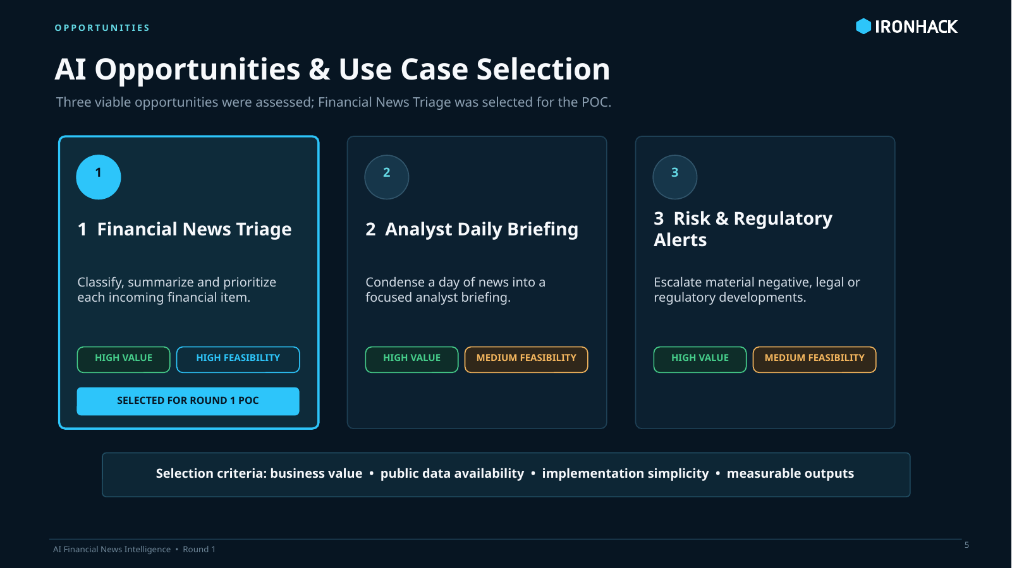
Notes:
Timing: about 1 minute. From the dashboard and research, I identified three AI opportunities. First, financial news triage and prioritization: automatically structure each item by target, topic, sentiment, and priority. Second, analyst daily briefing: summarize many items into top positive developments, negative developments, and risk items. Third, risk and regulatory alerting: escalate legal, regulatory, or high-risk items. I selected Financial News Triage for the Round 1 POC because it has high business value, strong public data availability, and clear measurable outputs. It also connects directly to the fields in the FiQA dataset and to the dashboard insights.

Slide 6
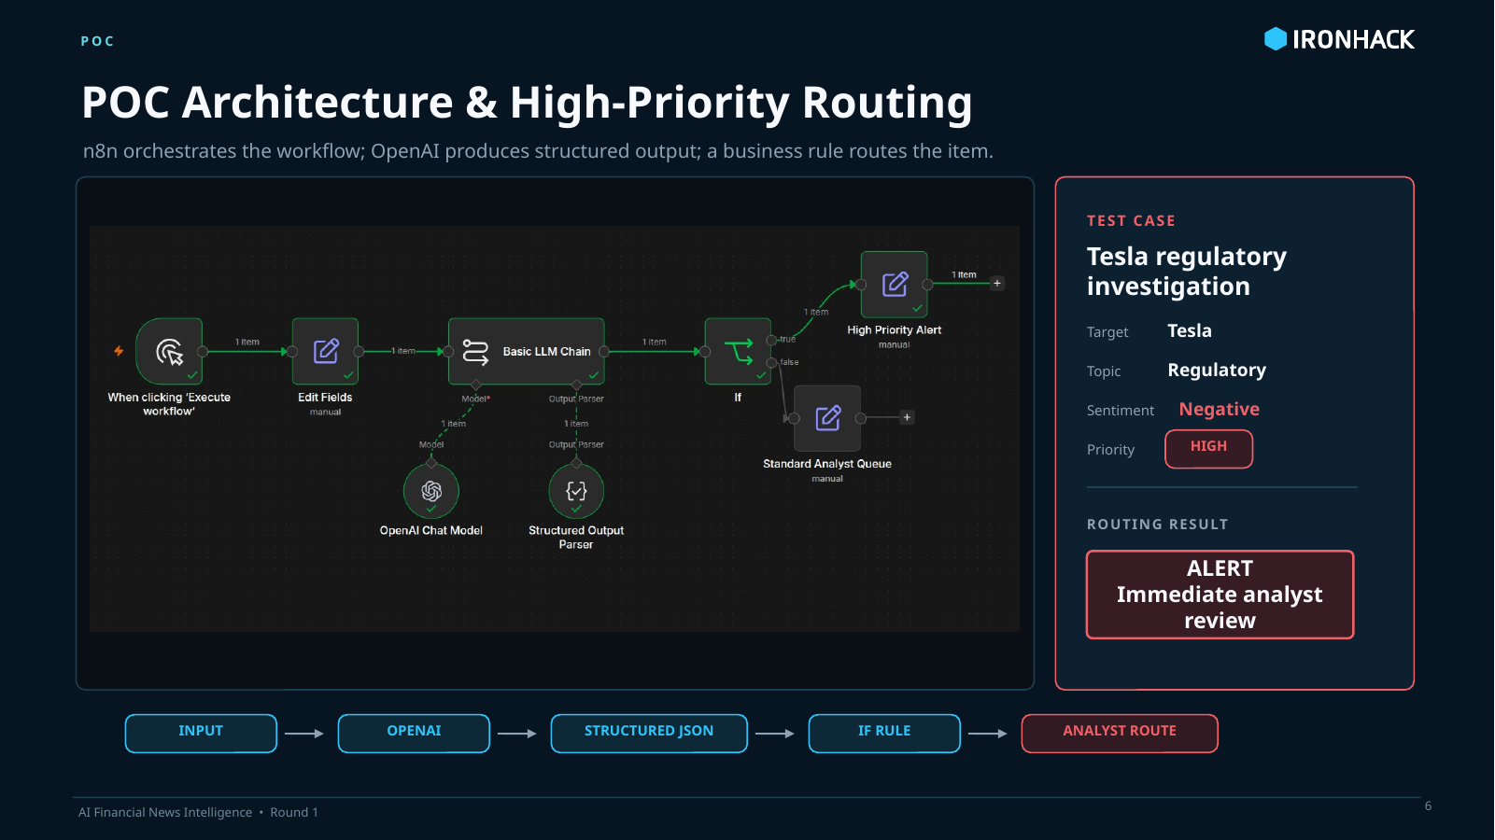
Notes:
Timing: about 1 minute 30 seconds. This is the n8n proof of concept. A financial sentence is entered manually, then sent to an OpenAI chat model through a Basic LLM Chain. The model returns structured output using a parser: target, business area, topic, sentiment, priority, and summary. Then an IF node checks whether priority equals High. If yes, the item goes to a High Priority Alert path. If not, it goes to the Standard Analyst Queue. The Tesla example demonstrates the high-priority path: a regulatory investigation and alleged fraud are classified as Corporate, Regulatory, Negative, and High priority. This shows that the AI output is not just text; it drives workflow logic.

Slide 7
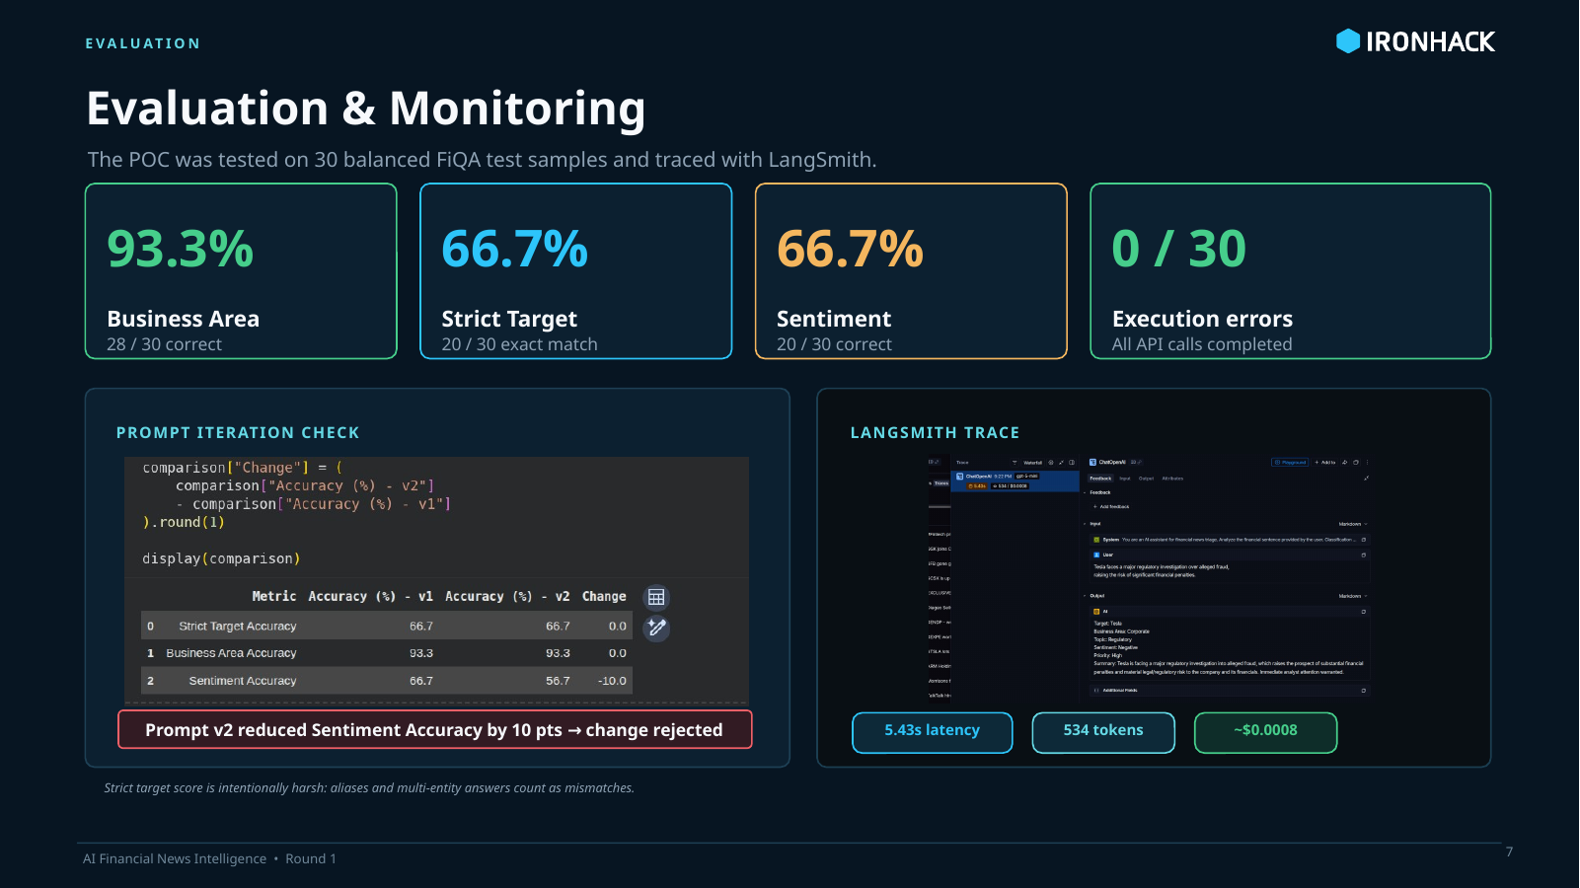
Notes:
Timing: about 1 minute 30 seconds. For evaluation, I used a balanced 30-item sample from the FiQA test split: 10 negative, 10 neutral, and 10 positive examples. The first evaluation had zero execution errors. Business area classification was strong at 93.3 percent. Strict target accuracy was 66.7 percent, but manual review showed that some mismatches were caused by aliases or multiple entities, for example one target versus two related entities. Sentiment accuracy was 66.7 percent. I also tested a second prompt iteration for sentiment thresholds, but it reduced sentiment accuracy to 56.7 percent, so I rejected that change. This is an important AI workflow lesson: prompt changes must be evaluated before deployment. LangSmith was used to monitor the calls, including input, output, latency, token usage, and cost.

Slide 8
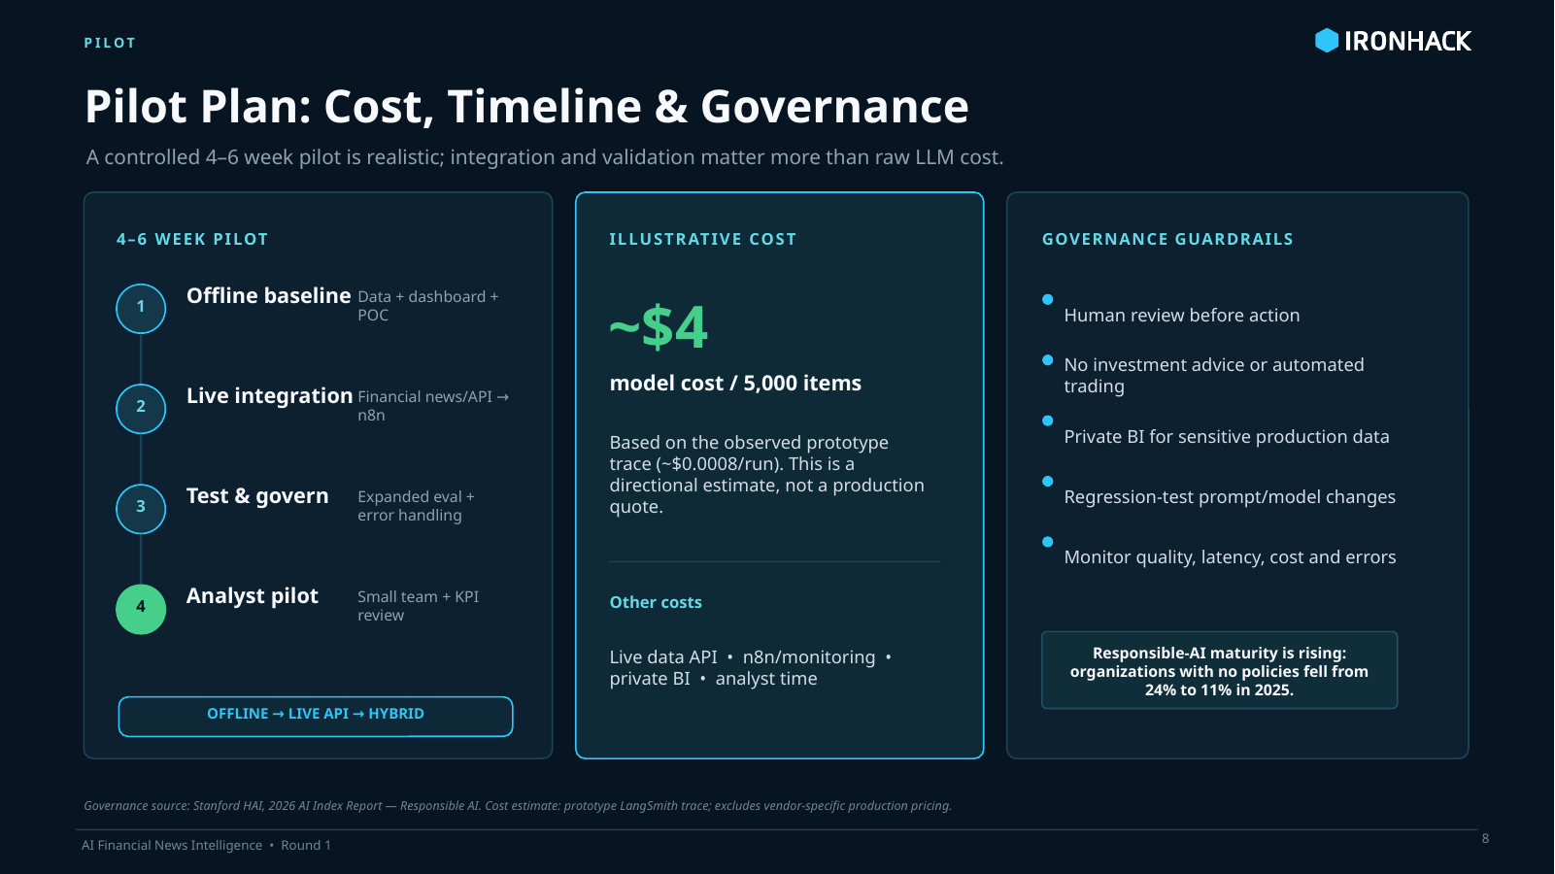
Notes:
Timing: about 1 minute. For a realistic pilot, I recommend a controlled 4 to 6 week implementation. The first weeks cover offline data, dashboard, AI workflow, evaluation, and monitoring. Then the system can be connected to a live financial API and tested with a small analyst group. The software cost for a limited pilot is expected to be relatively low. The larger effort is integration, testing, governance, and analyst validation. Governance is very important: the AI output should be labeled as AI-generated, analysts should be able to review and override classifications, and any model or prompt change should be regression-tested before release. Tableau Public is fine for Round 1 with public data, but private BI should be used for confidential data.

Slide 9
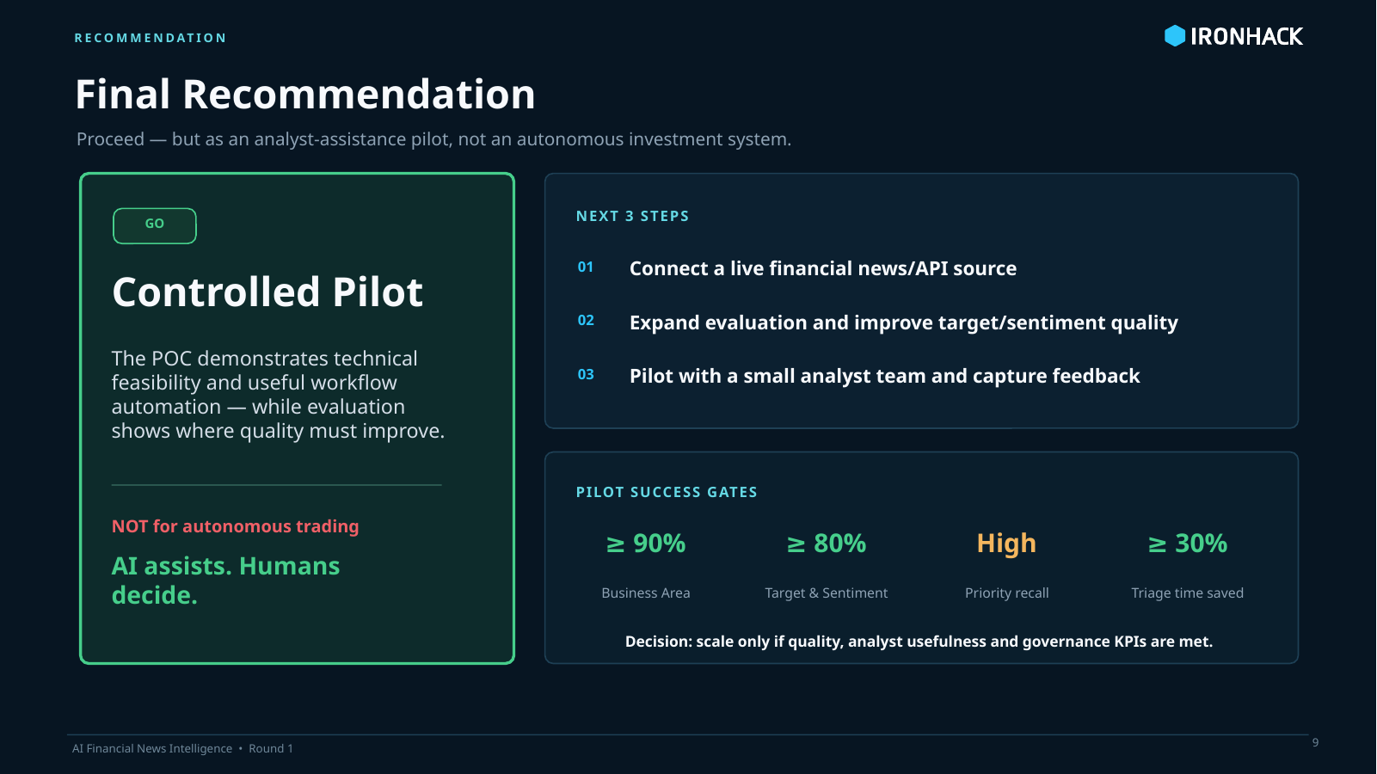
Notes:
Timing: about 1 minute. My recommendation is to proceed with a controlled pilot, but not to use this system for autonomous investment decisions. The Round 1 results show that the workflow is technically feasible: the dashboard works, the n8n POC routes items correctly, LangSmith monitoring works, and the evaluation produced measurable results. However, target and sentiment classification still need improvement before production. The next steps are to connect a live financial news API, expand the evaluation set, improve target normalization and sentiment calibration, and run the tool with human analysts. My final position is: AI should assist investment research triage, but humans should remain responsible for investment decisions.

