Slide 1

ROUND 2
FinRadar AI
Financial News Intelligence for Stock & Financial Analysts
Prepared by Parisa Dehghani
AI Assists - Humans Decide
Financial News Triage & Risk / Regulatory Alerting
Capstone Round 2
01
Notes:
Timing: about 30 seconds. Good morning Chleo. Today I am proposing FinRadar AI: an AI-assisted financial-news intelligence solution for your analyst team. The key principle is simple: AI assists, humans decide. I will focus on the business problem, the working MVP, the evidence, the risks, and the controlled pilot decision I recommend.

Slide 2


FinRadar AI | Round 2
The Problem: Access to News not equal to Understanding it
News
overload
Manual
triage
Inconsistent
priority
Missed risk
signals
Time
repetitive review
Quality
inconsistent tagging
Risk
signals can be missed
Trust
AI must be transparent
Why it persists: financial news is unstructured, fast-moving and context-heavy — exactly where assisted classification can help.
AI Assists - Humans Decide
02
Notes:
Timing: about 1 minute. Chleo, the problem is not that your analysts cannot find news. They already have access to feeds and market tools. The problem is that every article still needs human triage: what company is involved, what is the topic, what is the sentiment, does it create regulatory or legal risk, and does it require immediate attention. This consumes time, creates inconsistency, and can make important risk signals easier to miss.

Slide 3
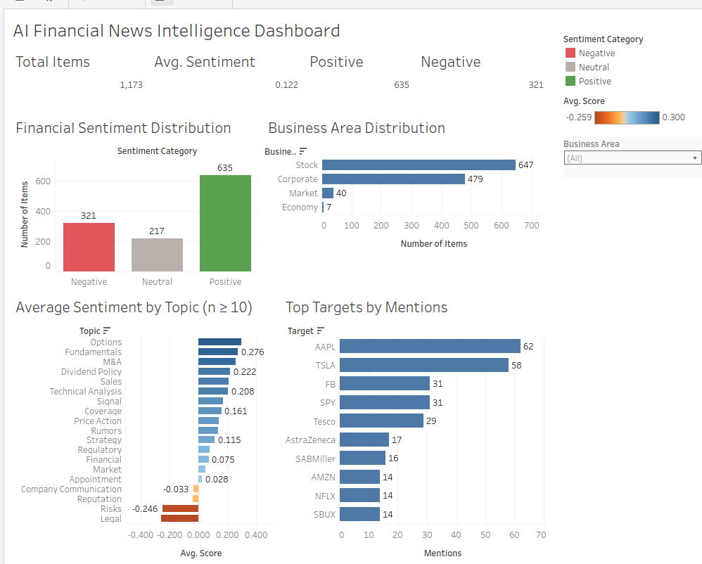
FinRadar AI | Round 2
From Tableau Exploration to AI Taxonomy
How Round 1 analysis shaped the structured labels used by the Round 2 MVP
ROUND 1 TABLEAU WORK
CLASSIFICATION LEARNING
FINRADAR AI TAXONOMY
In Short:
FiQA provided the financial text, target, aspect and sentiment score.
Those fields used as a foundation, then created the FinRadar AI taxonomy and business rules required for the use cases
AI output fields
Purpose for analysts
Target
who / what is affected
Business Area
Corporate · Stock · Market · Economy
Topic
earnings, M&A, regulation, risk…
Sentiment
Positive · Neutral · Negative
Priority
Low · Medium · High
Important lesson: Target aliases and multi-entity news can be ambiguous, so exact-match evaluation is not enough.
Risk Type
Regulatory · Legal · Fraud · Compliance · None
Summary
short analyst-readable explanation
Design decision
Tableau insight → AI-ready taxonomy → structured output → deterministic escalation → human analyst review
Not price prediction.
Not automated trading.
AI Assists - Humans Decide
Parisa Dehghani | FinRadar AI
03
Notes:
Chleo, this slide explains how the Round 1 Tableau work informed the Round 2 AI taxonomy. I used the offline FiQA financial-sentiment dataset first because it gave me a repeatable way to explore financial text before connecting live APIs. In Tableau, I looked at sentiment distribution, business areas, topics and top-mentioned targets. The main lesson was that financial news classification is not only about positive, neutral or negative sentiment. Analysts need to know who is affected, what the business context is, what topic is involved, whether the item is routine or urgent, and whether it creates a risk signal. That is why the final FinRadar taxonomy includes target, business area, topic, sentiment, priority, risk type and summary. Tableau helped move the project from raw financial text to business-readable categories. In Round 2, those categories became the structured AI output used by the MVP and the deterministic escalation logic. The goal remains triage and risk awareness, not stock-price prediction or automated trading.

Slide 4
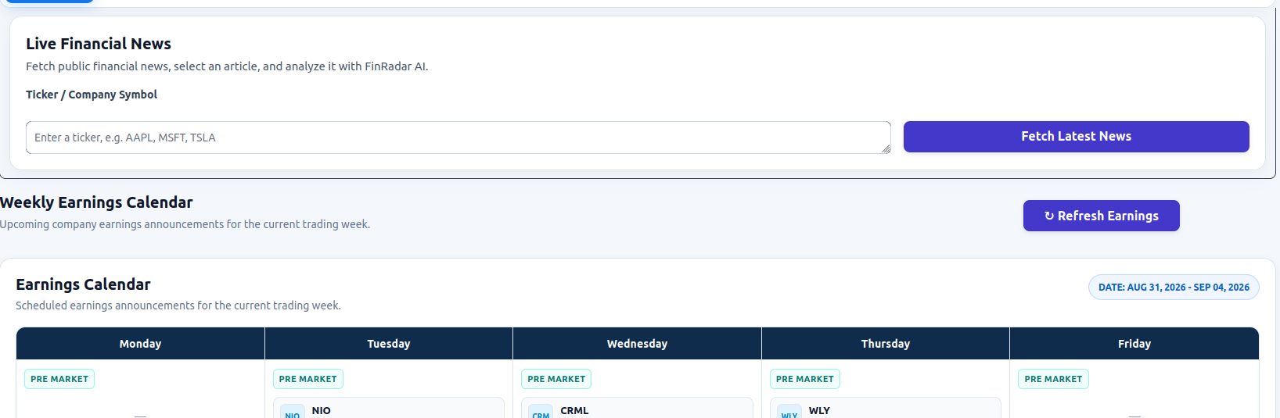
FinRadar AI | Round 2
The Proposed AI Solution:
An intelligence layer Not a replacement
FinRadar sits between public news feeds and human analyst review.
Capabilities: NLP classification, summarisation, risk tagging and deterministic escalation.
Public
News
FinRadar
Interface
GPT-5 Mini
Structured AI
Explicit
Rules
Human
Analyst
Transparency by design
The analyst sees the source, the structured AI output and the escalation outcome. The AI suggests; The rule routes; The analyst decides.
Working MVP interface
AI Assists - Humans Decide
04
Notes:
Timing: about 1 minute. The solution I am proposing is an intelligence layer. FinRadar does not need to replace your current portal or market-data subscriptions. It can sit between the public news feed and analyst review. It uses natural-language analysis to classify and summarise news, then deterministic rules determine whether something should be escalated. This is designed to directly address transparency: the output fields are visible, the routing rule is visible, and the analyst stays in control.

Slide 5
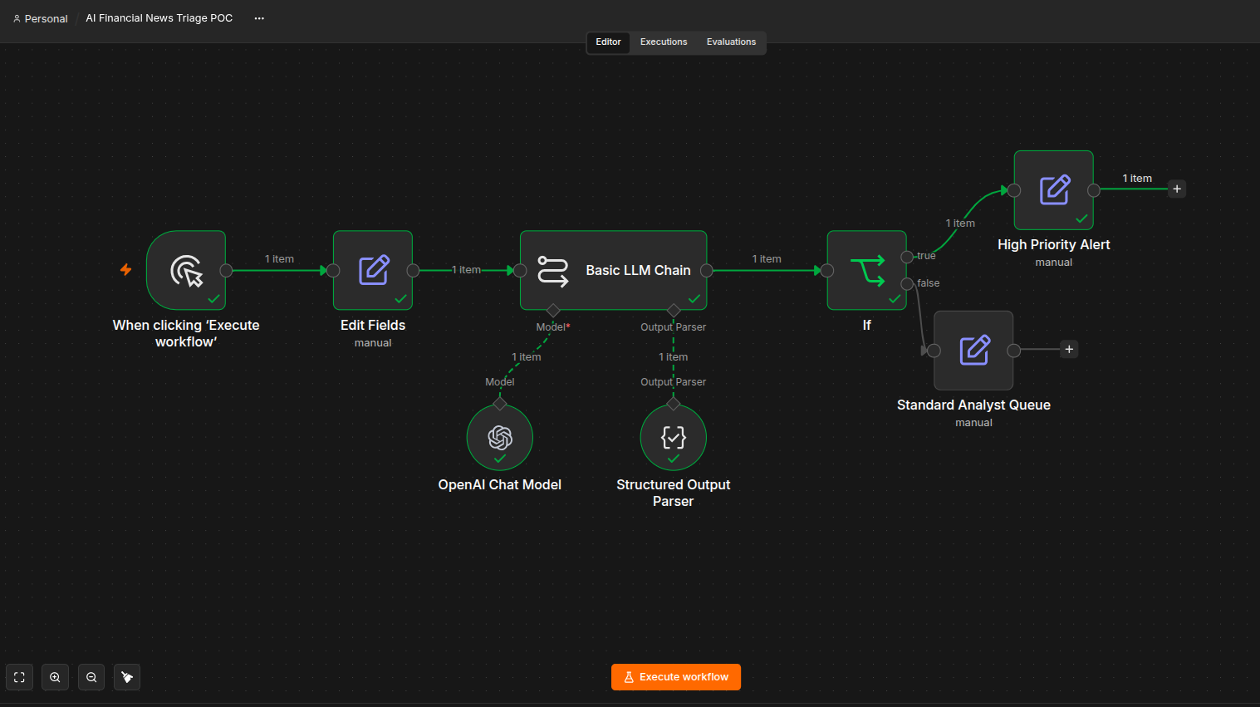
FinRadar AI | Round 2
POC Demo: Round 1 proof of concept and what changed
Bridge from Round 1 to Round 2
Industry retained
scope refined
Daily Briefing removed
Risk & Regulatory Alerting added
Built a working analyst-facing MVP
What the POC proves
Feasibility of structured AI output and priority routing.
What it does not prove
Production accuracy, security, reliability or scalability.
Play recorded n8n POC here
AI Assists - Humans Decide
05
Notes:
Timing: about 2 minutes including the recording. This is where I play or refer to the n8n recording. I show the whole workflow, point to the input, open the GPT-5 Mini analysis node, show the structured output, then open the IF node. The key message for Chleo is transparency: the AI produces the classification, but the routing logic is explicit. Round 1 proved feasibility. Round 2 turned that proof into a working analyst-facing MVP.

Slide 6
FinRadar AI | Round 2
Prompt Engineering in app.py
Controlled financial-news classification, not a free-form chatbot
Layered control design
Public
Financial News with Marketaux api
System
Prompt
FinRadar
Taxonomy
GPT-5 Mini
Classification
Explicit Rule
+ Analyst Review
Strict JSON
Schema
1. Role + boundaries
2. Human-defined taxonomy
3. Jason Structured output
Target, business area, topic, sentiment, priority, risk type and summary
Analyze public financial news ONLY
NO investment advice, trading calls or price prediction
Model must return allowed fields and labels; no extra free-form categories
Design outcome for Chleo:
The model maps news into predefined labels; Python escalation rules route high-risk cases; the analyst makes the final decision.
SYSTEM_PROMPT + FINANCIAL_ANALYSIS_SCHEMA → structured classification → requires_escalation()
AI Assists - Humans Decide
06
Notes:
Chleo, this slide summarizes the prompt engineering in the Round 2 app.py file. The important point is that FinRadar is not using GPT as a free-form chatbot. First, the system prompt defines the role and boundaries: public financial-news triage only, with no investment advice, no trading recommendations and no price prediction. Second, the taxonomy is defined by the project: target, business area, topic, sentiment, priority, risk type and summary. Third, a strict JSON schema forces the model to return only the required fields and allowed labels. After that, escalation is not left to the model alone. Python rules decide whether the item becomes a High Priority / Risk Alert or stays in Standard Analyst Review. This is how the design supports transparency: the AI classifies, the rule routes, and the analyst decides.

Slide 7
FinRadar AI | Round 2
Business Case: Positive ROI if pilot assumptions hold
Planning estimates — actual value should be validated during the controlled pilot.
€47.5k
estimated annual value
€20.1k
upfront build cost
Design & Integration, MVP, Pilot, Testing, governance setup, configuration, initial onboarding
€8.8k
ongoing annual cost
maintenance & support, api cost etc
6.2 months
break-even compensation
Estimated ROI
12-month ROI
64.4%
36-month ROI
206.0%
Core value driver
Investment decision
Less repetitive manual triage — not fewer analysts.
Fund a small pilot to validate time savings, adoption and reliability before scaling.
AI Assists - Humans Decide
07
Notes:
Timing: about 1 minute. Chleo, the financial case is intentionally presented as a planning estimate. The base case estimates around 47.5 thousand euros in annual value, with about 20.1 thousand euros upfront and 8.8 thousand euros in ongoing annual cost. That gives a 64.4 percent estimated 12-month ROI, 206 percent over 36 months, and a break-even point around 6.2 months. These are not realised savings. The pilot would validate the time saved and the reliability of the workflow.

Slide 8
FinRadar AI | Round 2
Risk Assessment: Top Risks & Mitigations
The full matrix covers more than six regulatory, technical, ethical and operational risks. These are the key pilot blockers.
Risk
Likelihood / Impact
Mitigation
AI output error
Medium / High
Human review, deterministic escalation, pilot evaluation before deployment, KPI pass
Compliance scope creep
Medium / High
Keep system advisory; reassess EU AI Act/GDPR if portfolio data is added
External API dependency
Medium / Medium
Manual fallback, vendor review, monitoring and production SLAs before rollout(vendor committed to have clear uptime)
Risks are manageable - if the pilot includes governance, monitoring and clear scope limits.
AI Assists - Humans Decide
08
Notes:
Timing: about 1 minute. The main risks are not ignored. First, AI output can be wrong, so high-risk outputs require human review and deterministic routing. Second, the compliance position could change if the scope expands to client portfolios or personalised advice, so the pilot must keep a clear scope. Third, external APIs can fail, so the MVP includes a manual fallback, while production would require stronger vendor controls and monitoring. These risks are manageable, but not if we skip governance.

Slide 9
FinRadar AI | Round 2
Compliance Summary: Classification & Safeguards
Current scope: public financial-news triage. NO trades, NO personalised investment advice, NO autonomous decisions.
EU AI Act
GDPR
Before production
Current intended use: Non-high-risk AI system
Reason:
advisory news triage with human review,
NOT autonomous financial decision-making.
Public financial news only, BUT public articles may still contain personal data.
Assessment covers data flows, legal basis, retention, rights and vendors.
Add authentication
Audit logging,
Monitoring,
Vendor governance,
Prompt/model versioning
DPIA review if scope expands.
Compliance message: FinRadar can be piloted responsibly because it is scoped as analyst assistance with visible controls.
AI Assists - Humans Decide
09
Notes:
Timing: about 1 minute. For the legal and compliance audience, the key point is scope. Under its current intended purpose, FinRadar is assessed as non-high-risk because it supports news triage and human review rather than making autonomous financial decisions. For GDPR, the system uses public financial information, but public news can still contain personal data, so the documentation covers data flows, legal basis, retention, rights and providers. This is a preliminary capstone assessment, not a legal certification, and production would require formal review.

Slide 10
FinRadar AI | Round 2
Strategic Deployment Plan: Pilot Before Production
Recommendation: move from working MVP to a controlled analyst pilot, then decide on production.
Round 1
POC
Round 2
MVP
60-day
Pilot
Production
Decision
Pilot greenlight criteria
Commercial model
Time reduction >= 30-40%
Priority accuracy >= 80%
Risk type accuracy >= 85%
Escalation accuracy >= 90%
Processing success >= 95%
0 critical compliance incidents
Internal pilot first; future SaaS or managed service for investment research teams
Decision principle
Chleo decides after evidence but not AI hype
AI Assists - Humans Decide
10
Notes:
Timing: about 1 minute. Strategically, I would not recommend jumping into full production. The right path is POC, working MVP, 60-day analyst pilot, then a production decision. The pilot should have measurable greenlight criteria: time saved, priority and risk accuracy, escalation reliability, processing reliability, and zero critical compliance incidents. Commercially, this could start as an internal tool and later become a SaaS or managed service for investment research teams.

Slide 11
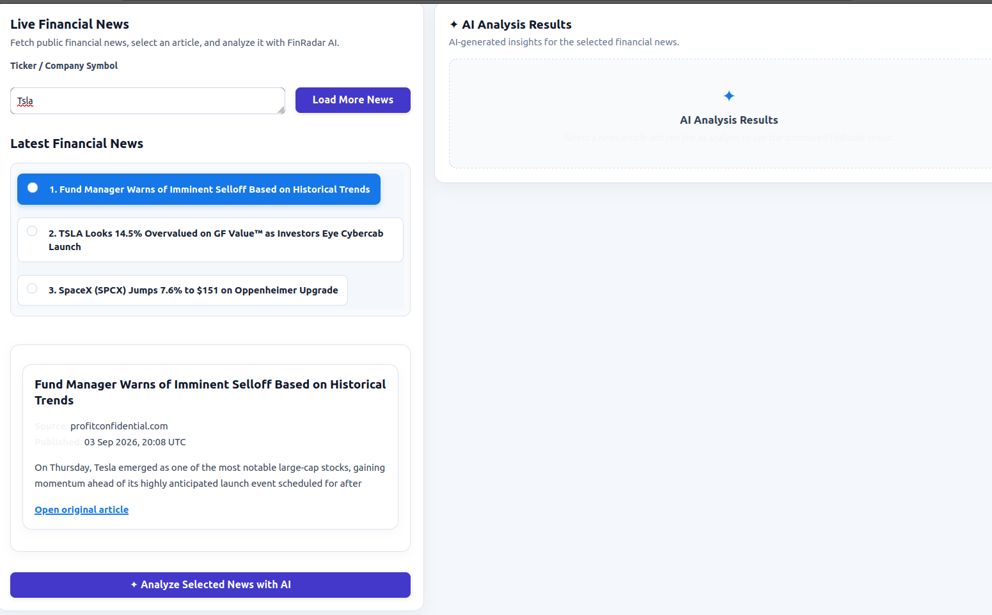
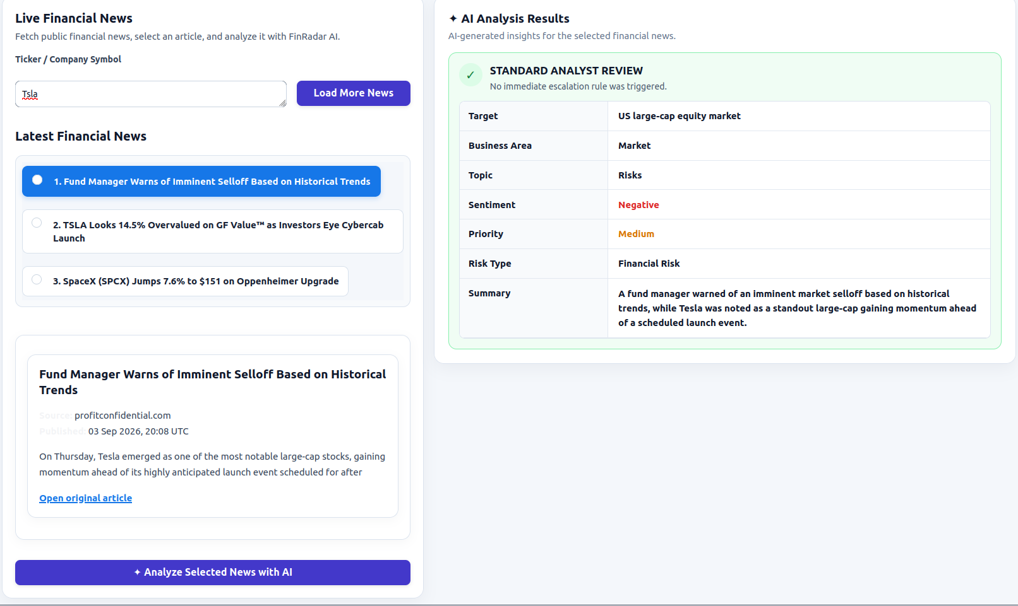
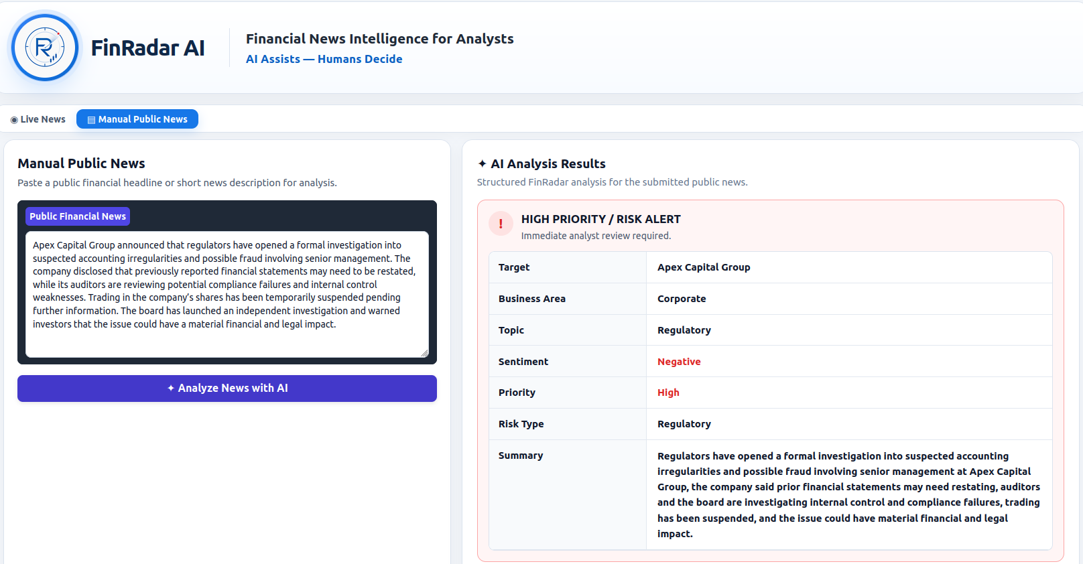
FinRadar AI | Round 2
MVP Demo + Evaluation: from workflow to analyst-facing product
Demo path: search ticker → retrieve live news → analyst selects article → structured AI analysis → review outcome.
1. Human selection before AI
2. Structured analyst review
3. Risk alert fallback path
Evaluation evidence
90.0%
Business Area
86.7%
Priority
93.3%
Risk Type
100%
Escalation
80.0%
Consistency
(10 usecase, tried 3 time
= 30 API call)
Strict Target Accuracy: 23.3%; alias-aware matching reached 80.0%. Small test sets mean pilot validation is still required.
AI Assists - Humans Decide
11
Notes:
Timing: about 1 to 2 minutes. This is the MVP demo slide. I should show live news retrieval, then article selection, then the structured AI result. If time is tight, I can use these screenshots instead of a live run. Chleo, this shows the upgrade from POC to product. The analyst searches a ticker, chooses which article to review, and then explicitly runs AI analysis. The evaluation results are also important: business area, priority, risk type, escalation and consistency all support a controlled pilot. Strict target accuracy is lower due to exact string matching, so I present this honestly as pilot evidence, not a production guarantee.

Slide 12
FinRadar AI | Round 2
Recommendation to Chleo
Proceed to a controlled 60-day analyst pilot — not autonomous production deployment.
Business value
Reduce repetitive news-triage work and surface risk signals faster.
Compliance posture
Current intended use is analyst assistance with human review and clear limits.
Next step
Validate ROI, accuracy, workflow adoption and governance before production.
AI Assists - Humans Decide
AI Assists - Humans Decide
12
Notes:
Timing: about 30 seconds. Chleo, my recommendation is clear: proceed to a controlled 60-day analyst pilot, not autonomous production deployment. FinRadar can reduce repetitive triage and improve visibility of potentially important risk information, but the pilot should validate ROI, accuracy, operational adoption and compliance controls before any full rollout. The principle remains: AI assists, humans decide.

