Slide 1
Generative Adversarial Networks or Variational Auto Encoders to produce digit images from the MNIST dataset?
PARISA IZADIYAR
February 2026

Slide 2
Benchmark
Dataset Name: The standard MNIST (Modified National Institute of Standards and Technology) database.
Volume: 60,000 training images and 10,000 testing images.
Format: Grayscale images with a resolution of 28x28 pixels.
Objective: Serve as a foundational baseline to test generative capabilities without the overwhelming complexity of high-resolution color datasets.

Slide 3
Benchmark
Tensor Conversion: All images were converted to PyTorch tensors to enable GPU acceleration.
Normalization Strategy: Pixel values were shifted from a standard [0, 1] range to a [-1, 1] range.
Mathematical Reasoning: This specific normalization optimizes the Generative models, as their final layers utilize Tanh activation functions which naturally output values between -1 and 1.
Batching: Data was processed in batches of 128 to maintain stable gradient updates.

Slide 4
Involved Approaches
Core Challenge: How do we teach a machine to create completely new, realistic handwritten digits?
Approach 1 (VAE): A probabilistic method focused on data compression, reconstruction, and mathematical smoothness.
Approach 2 (GAN): An adversarial method focused on game theory, competition, and visual realism.

Slide 5
Involved Approaches
Mechanism: The Variational Autoencoder learns to map input images into a "latent space" defined by a mean and a variance.
Reconstruction: It samples from this space and attempts to perfectly rebuild the original image.
Loss Function: Relies on Mean Squared Error (MSE) for pixel accuracy, combined with Kullback-Leibler (KL) Divergence to keep the latent space organized.

Slide 6
Involved Approaches
Mechanism: The Generative Adversarial Network pits two separate neural networks against each other in a zero-sum game.
The Forger and the Detective: The Generator creates fake images from pure noise, while the Discriminator tries to classify images as real or fake.
Loss Function: Utilizes Binary Cross-Entropy (BCE) loss to simultaneously update both networks.

Slide 7
Considered Model(s) - VAE Architecture
Network Type: Multilayer Perceptron (MLP).
Encoder: Flattens the 784-pixel input into a 400-neuron hidden layer, branching into a 20-dimensional mean vector and a 20-dimensional log-variance vector.
Decoder: Takes a 20-dimensional sampled vector, expands it through a 400-neuron layer, and outputs 784 pixels using a Tanh activation.

Slide 8
Considered Model(s) - GAN Architecture
Network Type: Multilayer Perceptron (MLP) with LeakyReLU activations to prevent dead gradients.
Generator: Takes a 20-dimensional noise vector (matching the VAE for fairness) and expands it into 784 pixels.
Discriminator: Compresses the 784-pixel image down to a single probability output using a Sigmoid activation.

Slide 9
Considered Model(s) - The Evaluator (Judge)
Network Type: A custom Convolutional Neural Network (CNN).
Training Phase: Trained on the real MNIST training set until it achieved ~99% accuracy.
Evaluation Phase: Weights were permanently frozen.
Outputs Modified: The network was engineered to output both softmax probabilities and deep hidden-layer features for our final metrics.

Slide 10
Comments and Discussion before - Visuals & Stability
Visual Quality Hypothesis: It is expected the GAN, produces much sharper, high-contrast digits. And VAE produces smoother but slightly blurrier images due to its MSE reconstruction loss.
Training Stability Hypothesis: In prediction, the VAE would show a smooth, textbook loss convergence, while the GAN would display volatile, oscillating loss curves due to its adversarial nature.

Slide 11
Comments and Discussion before - Diversity
Mode Collapse Hypothesis: GANs are notorious for finding one "easy" output and repeating it to trick the discriminator.
Diversity Prediction: As a hypothesis, the VAE's KL Divergence would force a well-rounded latent space, resulting in a perfect representation of all 10 digits. It is expected the GAN, show signs of partial mode collapse.

Slide 12
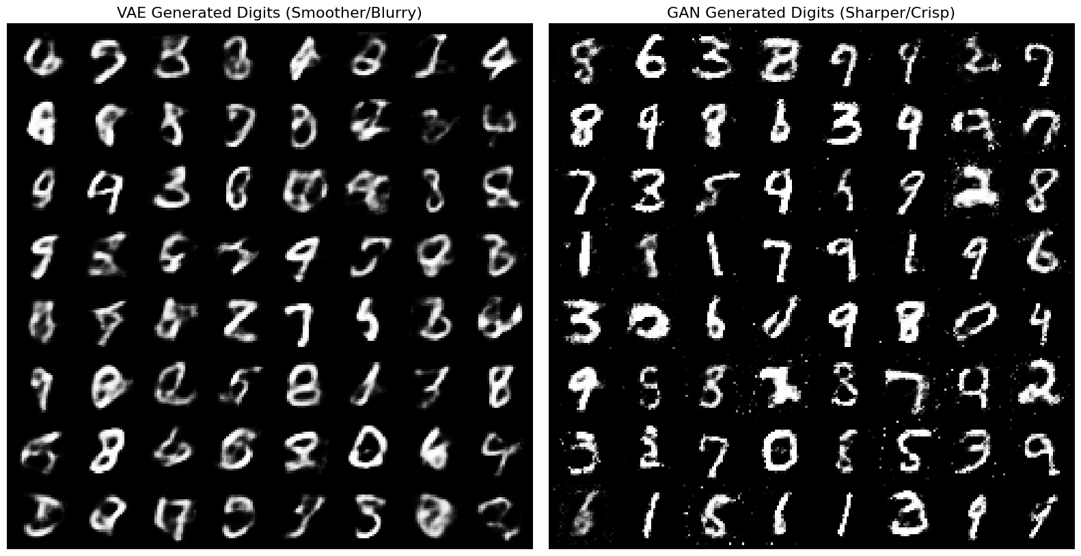
Results - Visual Comparison
Side-by-side comparison of 64 generated digits from identical random noise inputs.

Slide 13
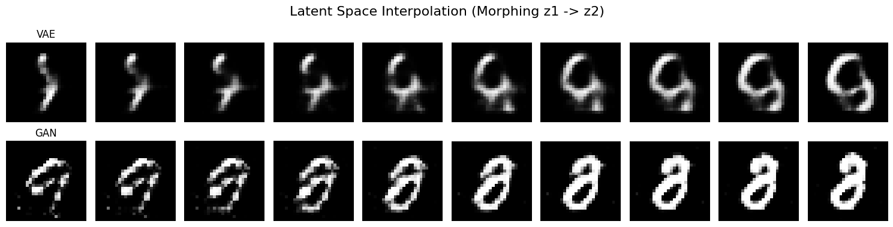
Results - Latent Space Interpolation
Interpolating between two random points in the 20-dimensional latent space.

Slide 14
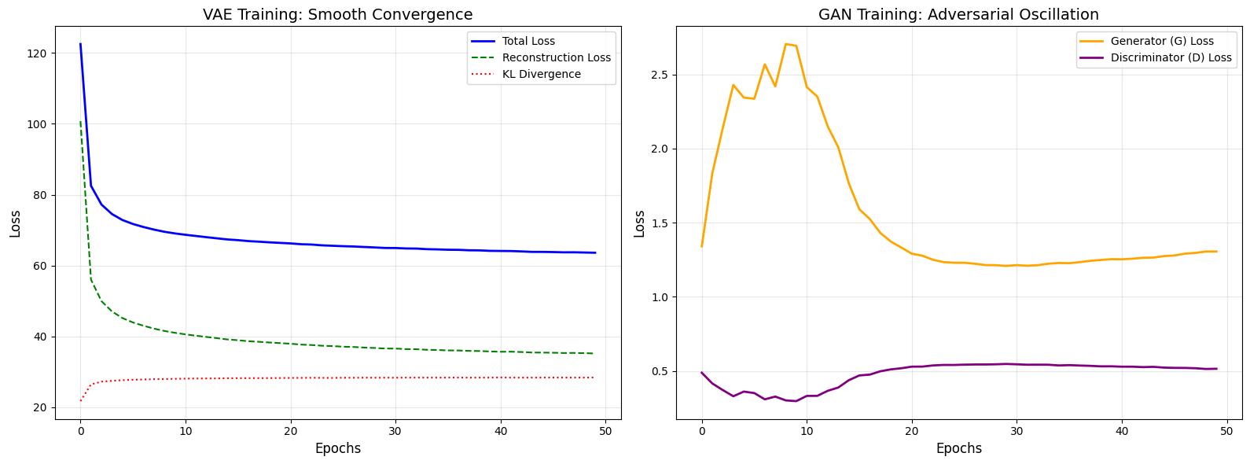
Results - Training Loss Curves
Tracking the loss functions over the training epochs.

Slide 15
Discussion of the results - Confidence Score
Metric Objective: Measure visual realism by passing 5,000 generated images through our frozen CNN Judge.
VAE Performance: Achieved an average confidence score of [78.67%].
GAN Performance: Achieved an average confidence score of [90.25%].
Analysis: The GAN's sharp, high-contrast edges are mathematically much more convincing to a standard classifier than the VAE's softer edges.

Slide 16
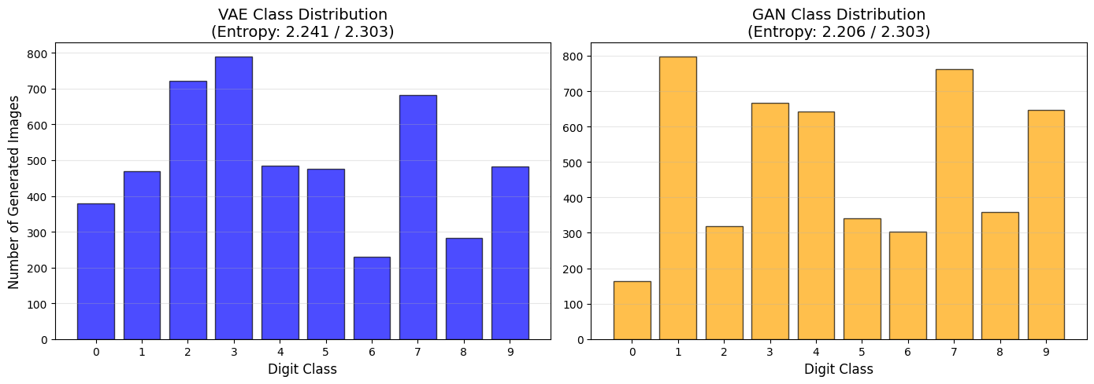
Discussion of the results - Diversity
Metric Objective: Measure class distribution to check for mode collapse using Shannon Entropy (Max ideal score = 2.30).
VAE Score: [2.241/2.303] (Highly uniform distribution).
GAN Score: [2.206/2.303] (Prone to uneven distribution).

Slide 17
Discussion of the results - Fréchet Inception Distance
Metric Objective: Calculate the statistical distance between the deep features of real MNIST images and generated images. Lower scores indicate higher quality.
VAE FID Score: [162.69].
GAN FID Score: [64.61].

Slide 18
Conclusions - The Final Verdict
Summary: There is no single "best" model; the choice depends entirely on the requirements of the specific task.
When to choose GANs: When maximum visual sharpness, high contrast, and photorealism are required, and you can afford to tune hyperparameters to fight instability.
When to choose VAEs: When you need a smooth latent space for mathematical interpolation, guaranteed training stability, and a reliable representation of the entire dataset without mode collapse.

