Slide 1

Retrieve data from websites with Python
And Load in Postgres

Slide 2
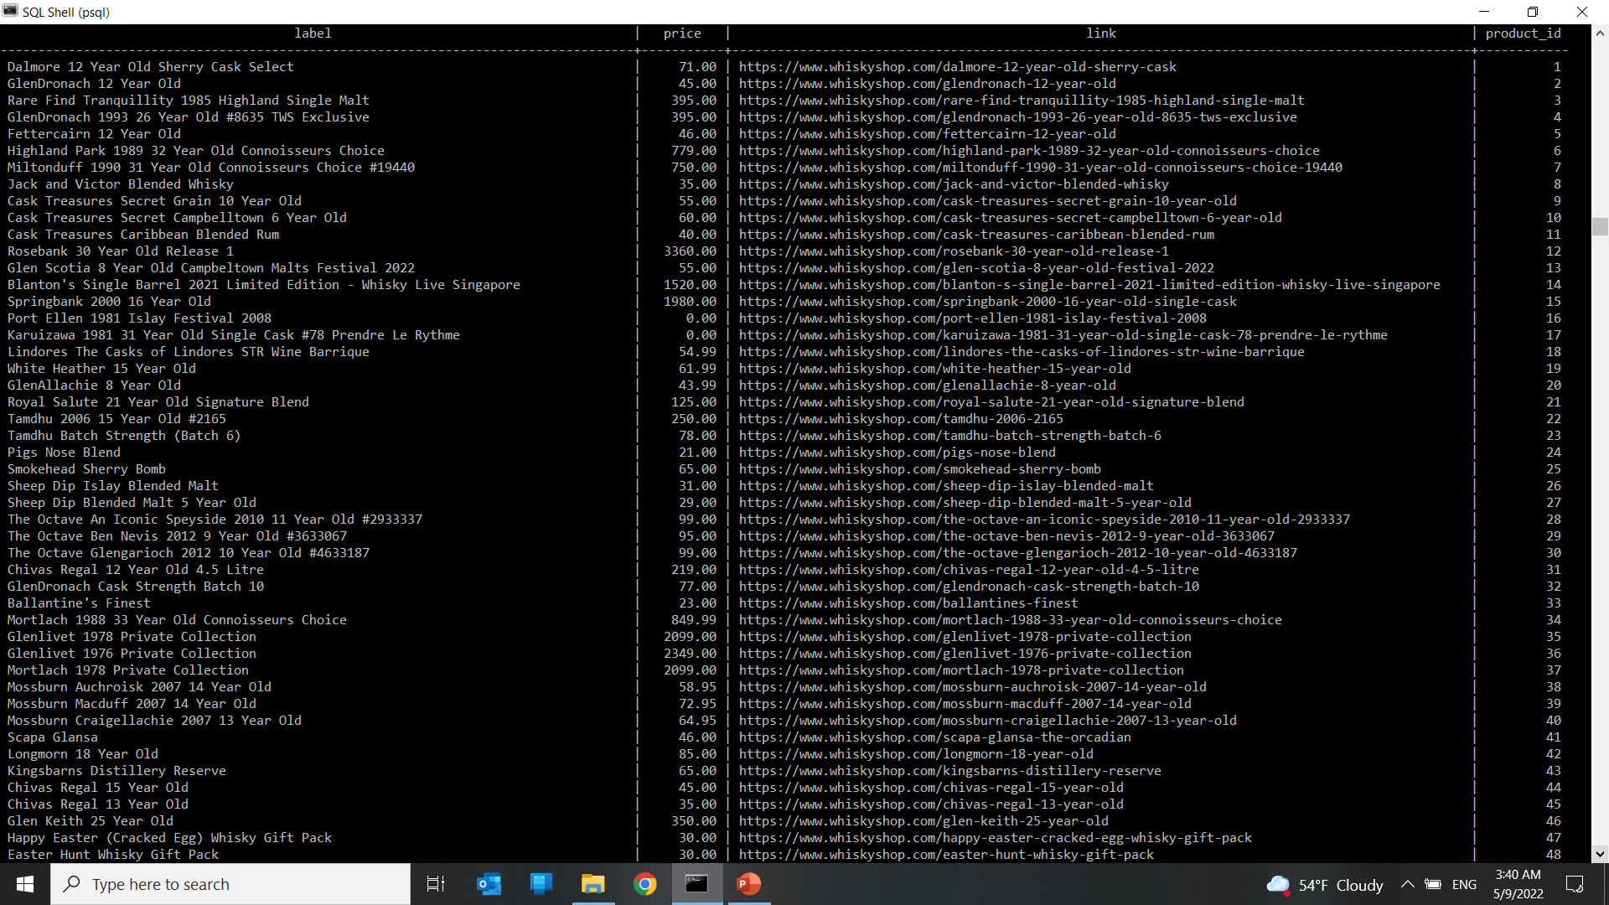
Extracted Column of:
1- Label
2- Price
3- Link
product_id (PK)

Slide 3
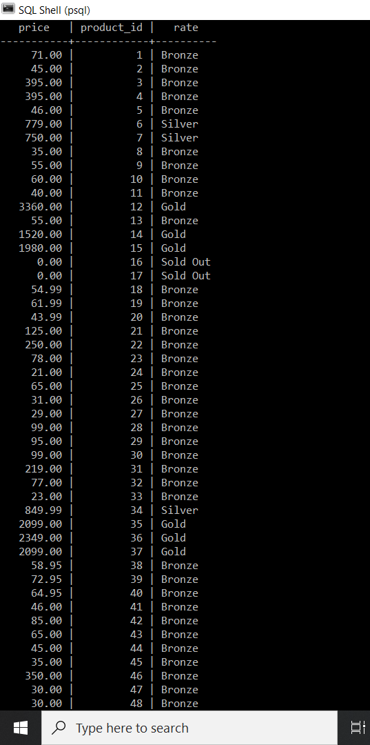
Categorizing items based on its price:
Sold Out Price = 0
Gold Price>1000
Silver Price>500
Bronze Price>0

Slide 4
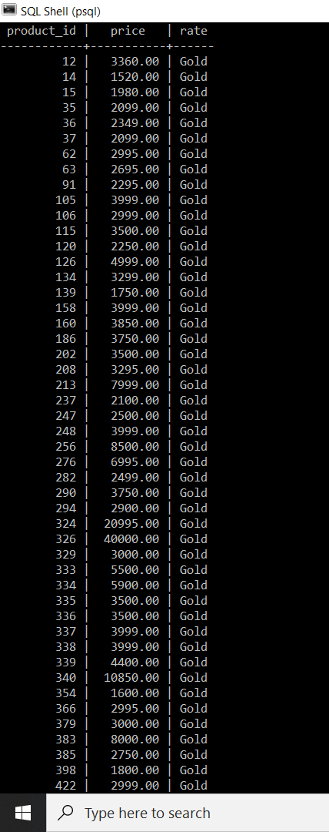
Combine conditions:
Conditions:
Rate = “Gold”
Price>1500

Slide 5
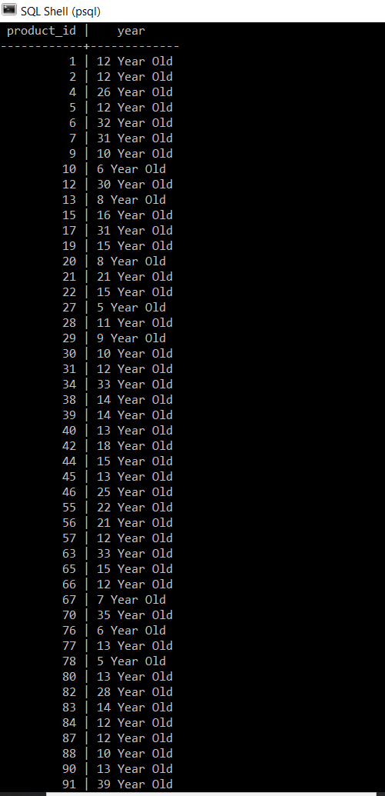
Extract from String:
Challenges:
- Messy combination of one digit, two digits and 4digits of year!

Slide 6
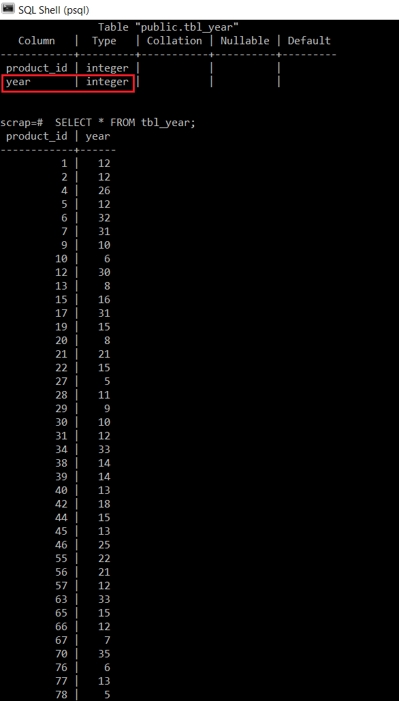
Convert data type:
Convert from String to Numeric in order to have comparison of “year”.

Slide 7
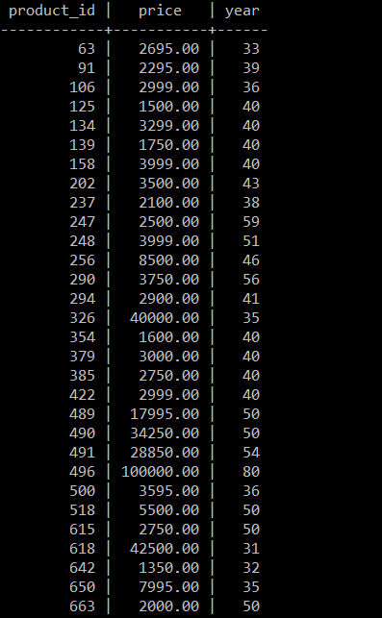
Join queries:
1- Price>1000
2- Year>10

