Slide 1

Recommendation Engine
Parisa Gandomkar Yarandi
Data Incubator

Slide 2
Introduction
Recommendation engines are becoming a critical part of many e-commerce sites. The approach uses complex algorithms to analyze large volumes of data and determine what products that potential consumers might want to buy based on their stated preferences, online shopping choices, and the purchases of people with similar tastes or demographics. Recommendation technology must also be able to reach out to small and medium-size businesses and be robust and cost-effective.

Slide 3
Some Applications of Recommendation Engines
Amazon (selling & retail),
Netflix (visual media),
Linkedin (people you know),
Google (search),
TV (find relevant TV content)

Slide 4
Problem statement
Groceries-on-demand startup Instacart has released a dataset containing 3 million orders from 200,000 (anonymized) users. For each user, Instacart provides between 4 and 100 of their orders, with the sequence of products purchased in each order.
Instacart’s scientists use transactional data to develop models that predict which products a user will buy again, try for the first time, or add to their cart next during a session.

Slide 5
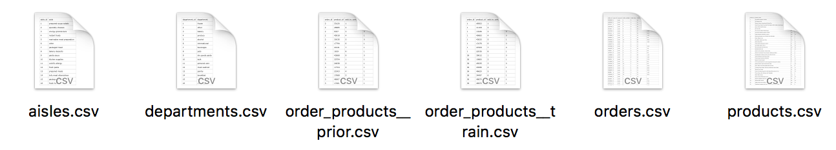

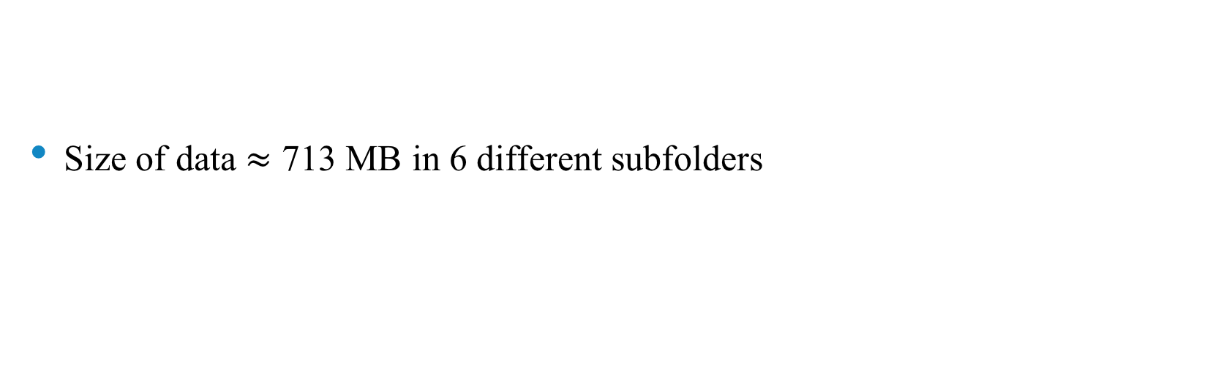
Data
Size of data $≈$ 713 MB in 6 different subfolders

Slide 6
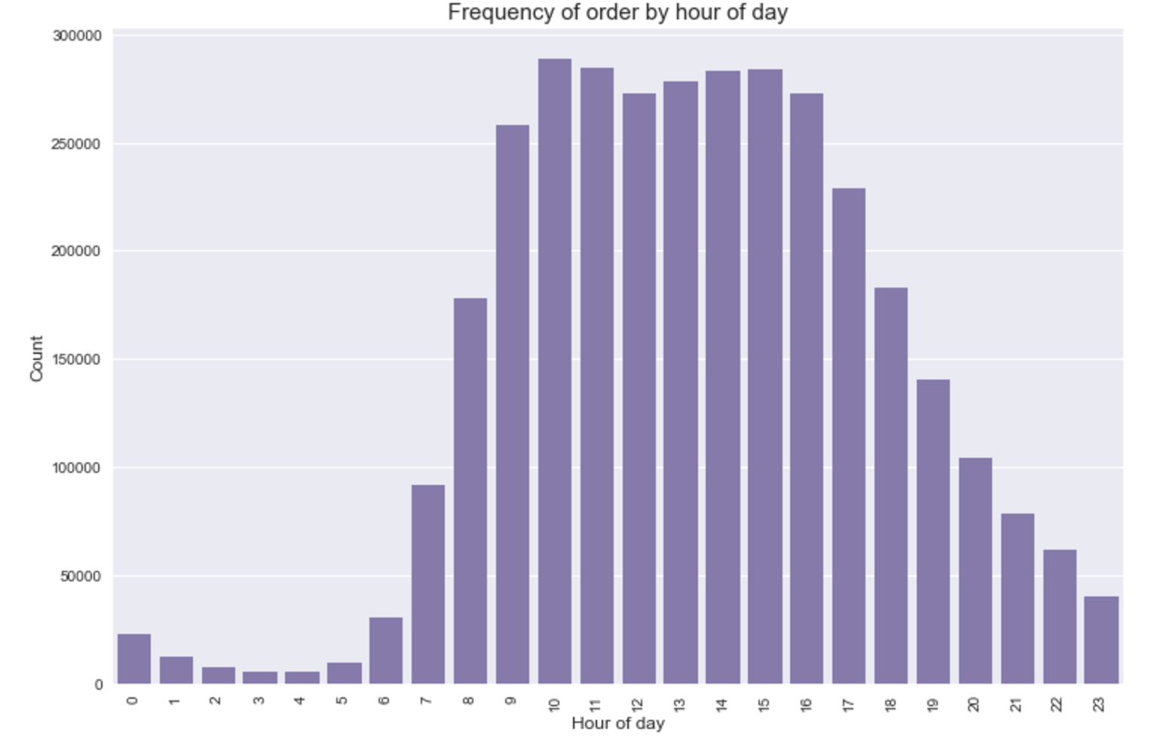
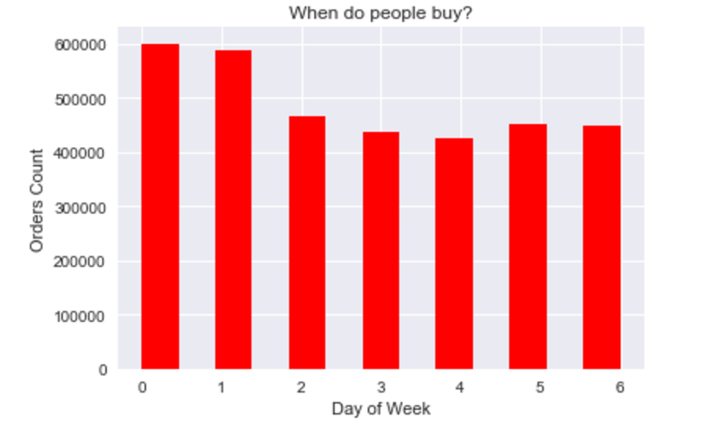
Data Exploration

Slide 7
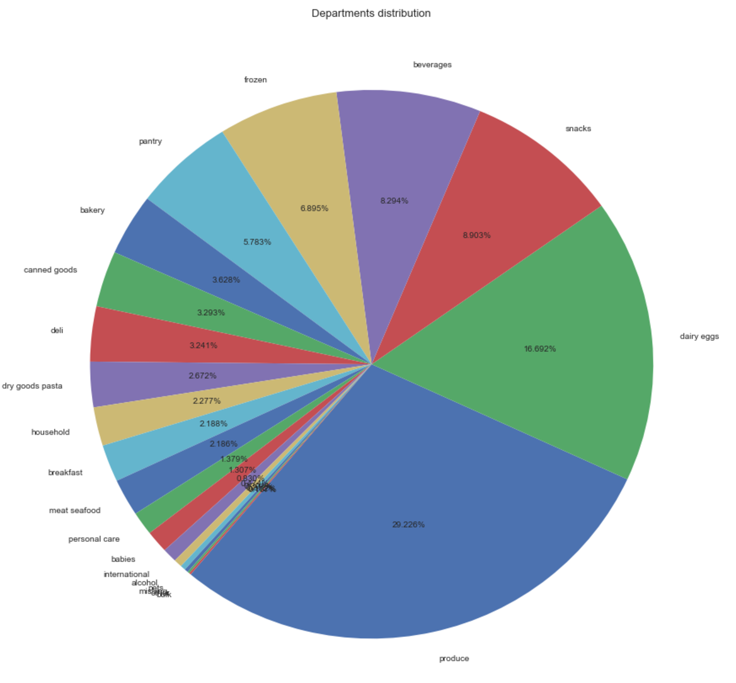
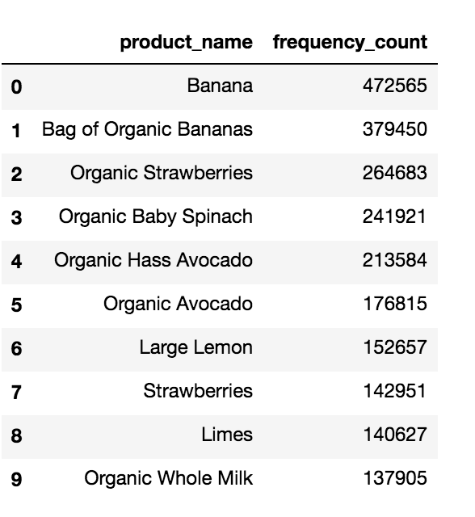
Data Exploration

Slide 8
Future work
Explore data and find patterns between different datasets.
Apply machine learning algorithms to find which order will be reordered.

