Slide 1
Data Analysis with Python
Parisa Gandomkar Yarandi
Montgomery College
April 2017

Slide 2
Agenda
Python
Pandas
Merge, join, append and concatenate
Conclusion

Slide 3
What is Python?
Python is a widely used high-level programming language
Python created by Guido van Rossum and first released in 1991.
Python emphasizes code readability and a syntax
Python provides constructs intended to enable writing clear programs on both a small and large scale.

Slide 4
What is Pandas
The Pandas module is a massive collaboration of many modules along with some unique features to make a very powerful module. Pandas is great for data manipulation, data analysis, and data visualization.

Slide 5
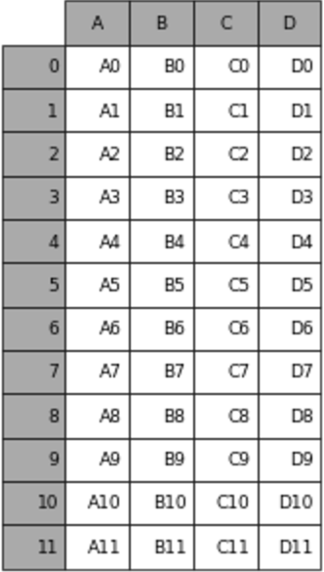
What is data frame?
Columns , keys
A data frame is a table, or two-dimensional array-like structure, in which each column contains measurements on one variable, and each row contains one case.
Rows, indexes

Slide 6
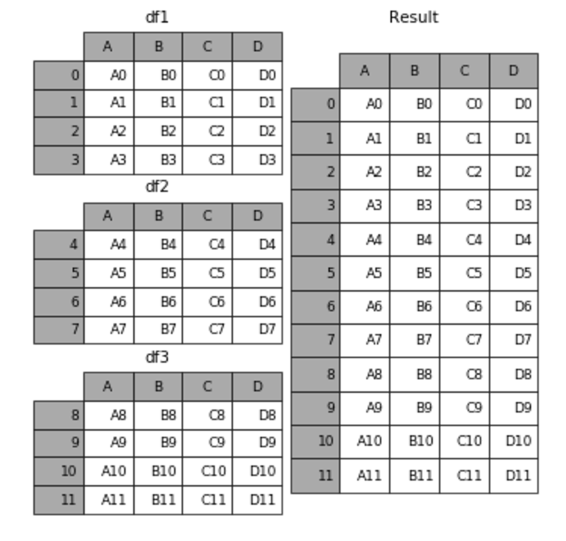
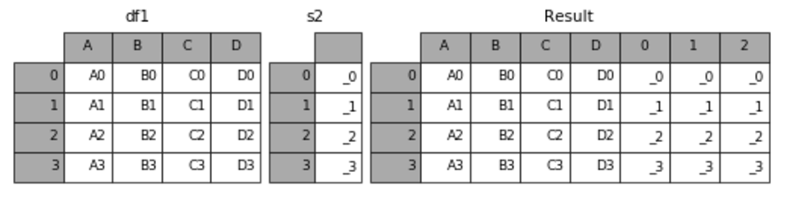
Join, merge and concat, append
www.github.io

Slide 7
lookup on right table: df1.join(df2) always joins via the index of df2, but df1.merge(df2) can join to one or more columns of df2 (default) or to the index of df2(with right_index=True).
lookup on left table: by default, df1.join(df2) uses the index of df1 and df1.merge(df2)uses column(s) of df1. That can be overridden by specifying df1.join(df2, on=key_or_keys) or df1.merge(df2, right_index=True).
left vs inner join: df1.join(df2) does a left join by default (keeps all rows of df1), but df.merge does an inner join by default (returns only matching rows of df1 and df2).

Slide 8
Conclusion
Python is a very fast growing programming language which is very common between data scientists.
Pandas is a python’s module which makes it easy to work with dataframes.
Merge, join, concat and append are methods to make a big data frame from some small data frames.

