Slide 1
Data Analysis with Python
Parisa Gandomkar Yarandi
Montgomery College
April 2017

Slide 2
Agenda
Python
Pandas
Merge, join, append and concatenate
Conclusion
https://github.com/ParisaGY/MontgomeryCollege/blob/master/Presentation.pptx

Slide 3
What is Python?
Python is a widely used high-level programming language
Python created by Guido van Rossum and first released in 1991.
Python emphasizes code readability and a syntax
Python provides constructs intended to enable writing clear programs on both a small and large scale.

Slide 4
What is Pandas
The Pandas module is a massive collaboration of many modules along with some unique features to make a very powerful module. Pandas is great for data manipulation, data analysis, and data visualization.

Slide 5
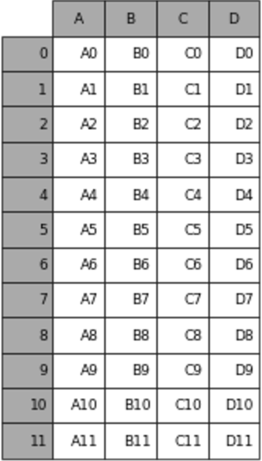
What is data frame?
Columns , variables
A data frame is a table, or two-dimensional array-like structure, in which each column contains measurements on one variable, and each row contains one case.
Rows, indexes

Slide 6
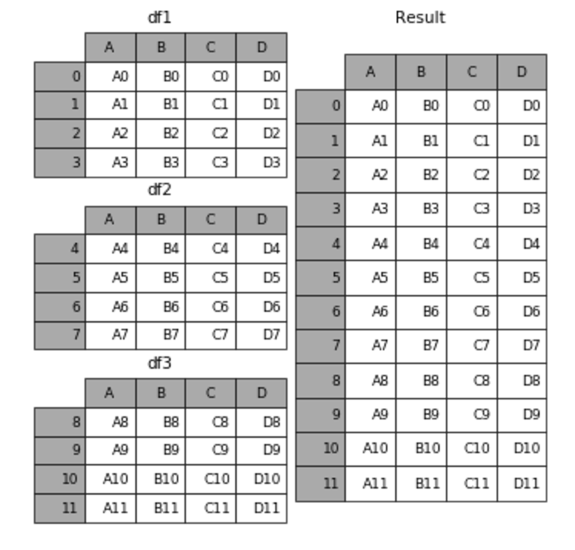
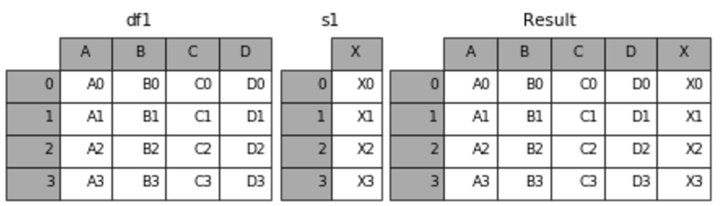
Join, merge, concat and append

Slide 7
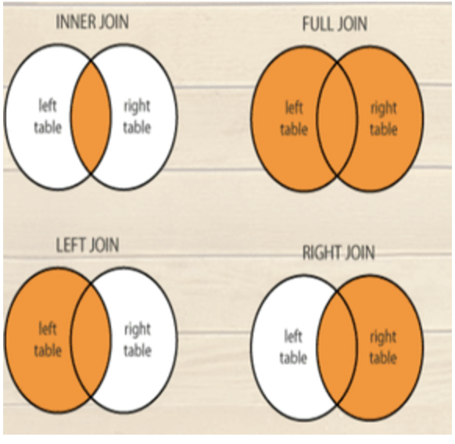
Merging data – different types
https://github.com/ParisaGY/MontgomeryCollege/blob/master/Join-Merge-Concate.ipynb

Slide 8
Conclusion
Python is a very fast programming language which is very common between data scientists.
Pandas is a python’s module which makes it easy to work with data frames.
Merge, join, concat and append are methods to make a big data frame from some small data frames.

Slide 9
Q/A? Thank you!

