Slide 1
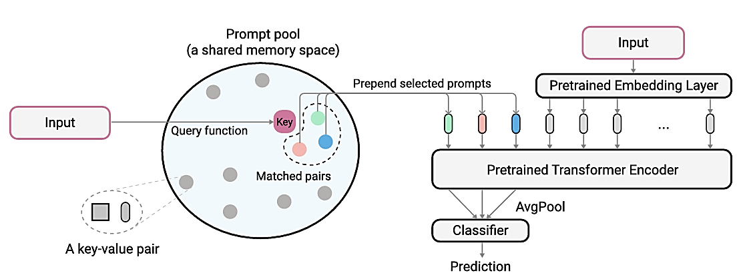

Slide 2

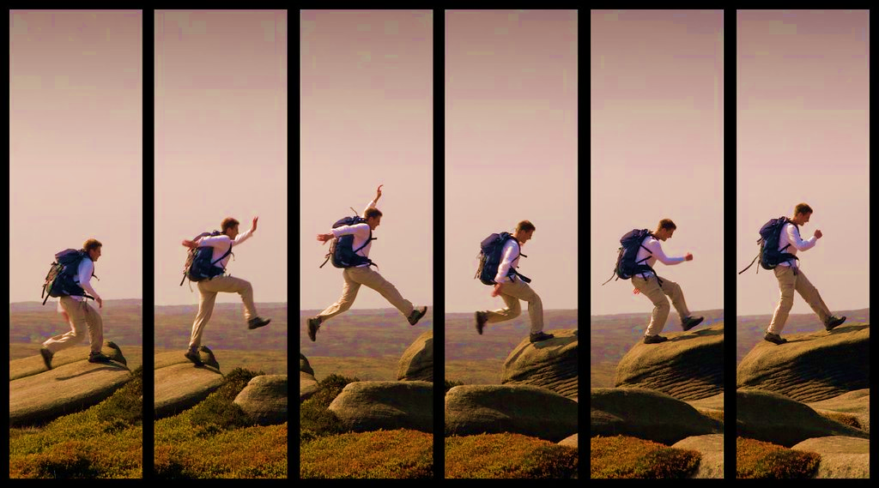







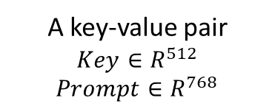

Frozen
Training
ProActionCLIP
video encoder
$$Input: X∈R^{T×H×W×C }, T=frames$$
Open-VCLIP
video
encoder
Conv2D
$$Patch Size:P×P$$
$$Output ∈R^{\frac{H}{P}×\frac{W}{P}×768}$$
Prepend selected prompts (N)
Prompt selection
…
$$\text{CLS} \text{feature}∈R^{D}$$
$$D=512$$
CLS
$S=$ $\frac{H}{P}×\frac{W}{P}+1+N∈R^{T×S×768}$
Matched pairs
(Top N)
Open-VCLIP
Transformer encoder
$$cls ∈R^{T×512}$$
Average
A key-value pair
$$Key∈R^{512}$$
$$Prompt∈R^{768}$$
Prompt pool
CLS
$$Output∈R^{512}$$

Slide 3
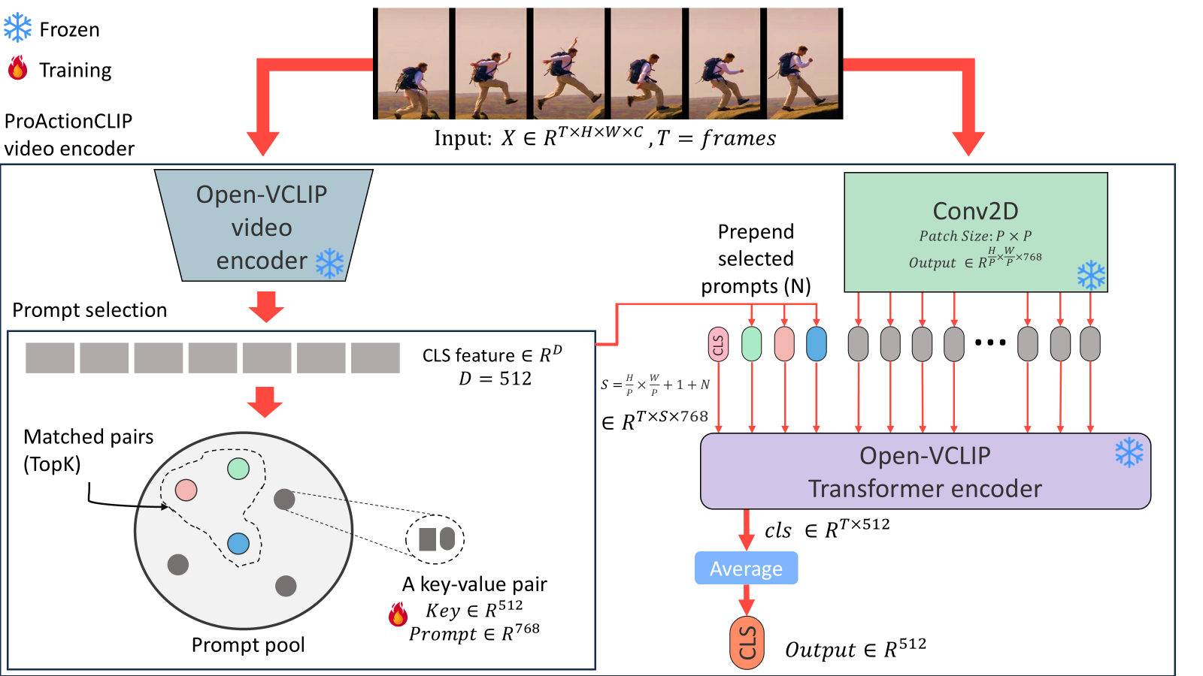


Slide 4
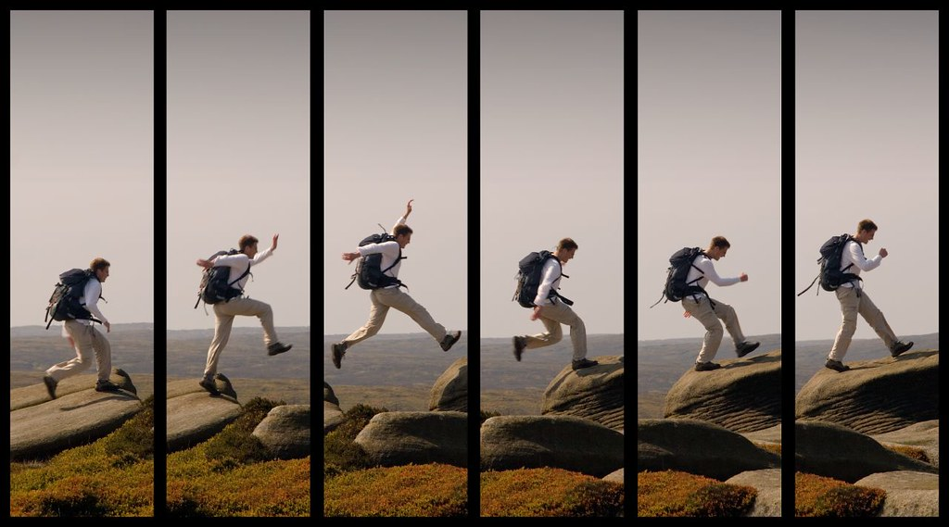

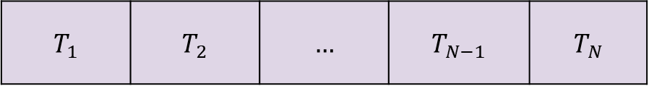

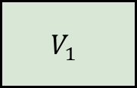

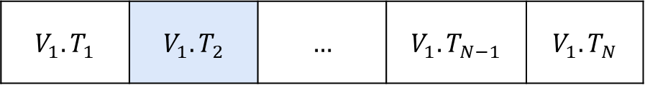
Typing | Walking | … | Jumping | Playing Guitar
A video of action {object}
Text encoder
$${∈R}^{N×512}$$
$$T_{N}$$ | $$T_{N−1}$$ | $$…$$ | $$T_{2}$$ | $$T_{1}$$
Our
video
encoder
$${∈R}^{512}$$
$$V_{1}$$
$${V_{1}.T}_{N}$$ | $${V_{1}.T}_{N−1}$$ | $$…$$ | $${V_{1}.T}_{2}$$ | $$V_{1}.T_{1}$$
A video of action Jumping
$$X∈R^{T×H×W×C },$$
$$T=frames$$

Slide 5
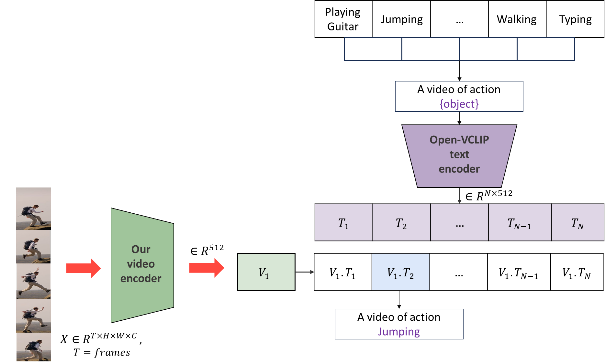

Slide 6
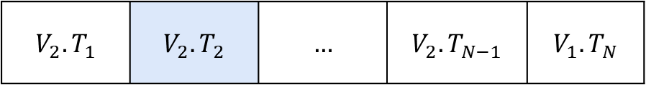

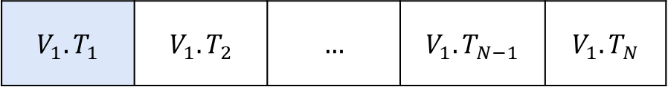

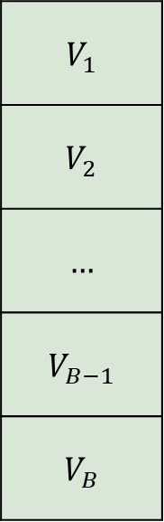
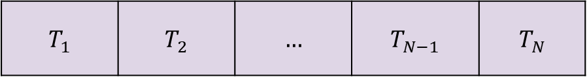
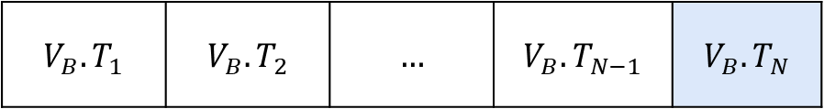
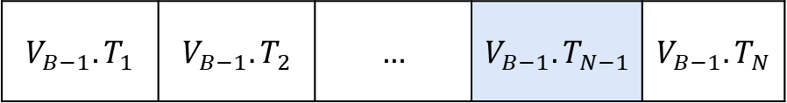


Typing
Walking
…
Jumping
Playing Guitar
Frozen
Training
Text
encoder
$${∈R}^{N×512}$$
A video of action {object}
$$T_{N}$$ | $$T_{N−1}$$ | $$…$$ | $$T_{2}$$ | $$T_{1}$$
$$V_{1}$$
$$V_{2}$$
$$…$$
$$V_{B−1}$$
$$V_{B}$$
$${V_{1}.T}_{N}$$ | $${V_{1}.T}_{N−1}$$ | $$…$$ | $${V_{1}.T}_{2}$$ | $$V_{1}.T_{1}$$
$${V_{1}.T}_{N}$$ | $${V_{2}.T}_{N−1}$$ | $$…$$ | $${V_{2}.T}_{2}$$ | $$V_{2}.T_{1}$$
Our
video
encoder
$${∈R}^{B×512}$$
$$…$$ | $$…$$ | $$…$$ | $$…$$ | $$…$$
$${V_{B−1}.T}_{N}$$ | $${V_{B−1}.T}_{N−1}$$ | $$…$$ | $${V_{B−1}.T}_{2}$$ | $$V_{B−1}.T_{1}$$
$${V_{B}.T}_{N}$$ | $${V_{B}.T}_{N−1}$$ | $$…$$ | $${V_{B}.T}_{2}$$ | $$V_{B}.T_{1}$$
$$X∈R^{B×T×H×W×C },$$
$$T=frames, B=batch size$$

Slide 7
Typing
Walking
…
Jumping
Playing Guitar
Frozen
Training
Text
encoder
$${∈R}^{N×512}$$
A video of action {object}
$$T_{N}$$ | $$T_{N−1}$$ | $$…$$ | $$T_{2}$$ | $$T_{1}$$
$$V_{1}$$
$$V_{2}$$
$$…$$
$$V_{B−1}$$
$$V_{B}$$
$${V_{1}.T}_{N}$$ | $${V_{1}.T}_{N−1}$$ | $$…$$ | $${V_{1}.T}_{2}$$ | $$V_{1}.T_{1}$$
$${V_{1}.T}_{N}$$ | $${V_{2}.T}_{N−1}$$ | $$…$$ | $${V_{2}.T}_{2}$$ | $$V_{2}.T_{1}$$
Our
video
encoder
$${∈R}^{B×512}$$
$$…$$ | $$…$$ | $$…$$ | $$…$$ | $$…$$
$${V_{B−1}.T}_{N}$$ | $${V_{B−1}.T}_{N−1}$$ | $$…$$ | $${V_{B−1}.T}_{2}$$ | $$V_{B−1}.T_{1}$$
$${V_{B}.T}_{N}$$ | $${V_{B}.T}_{N−1}$$ | $$…$$ | $${V_{B}.T}_{2}$$ | $$V_{B}.T_{1}$$

Slide 8
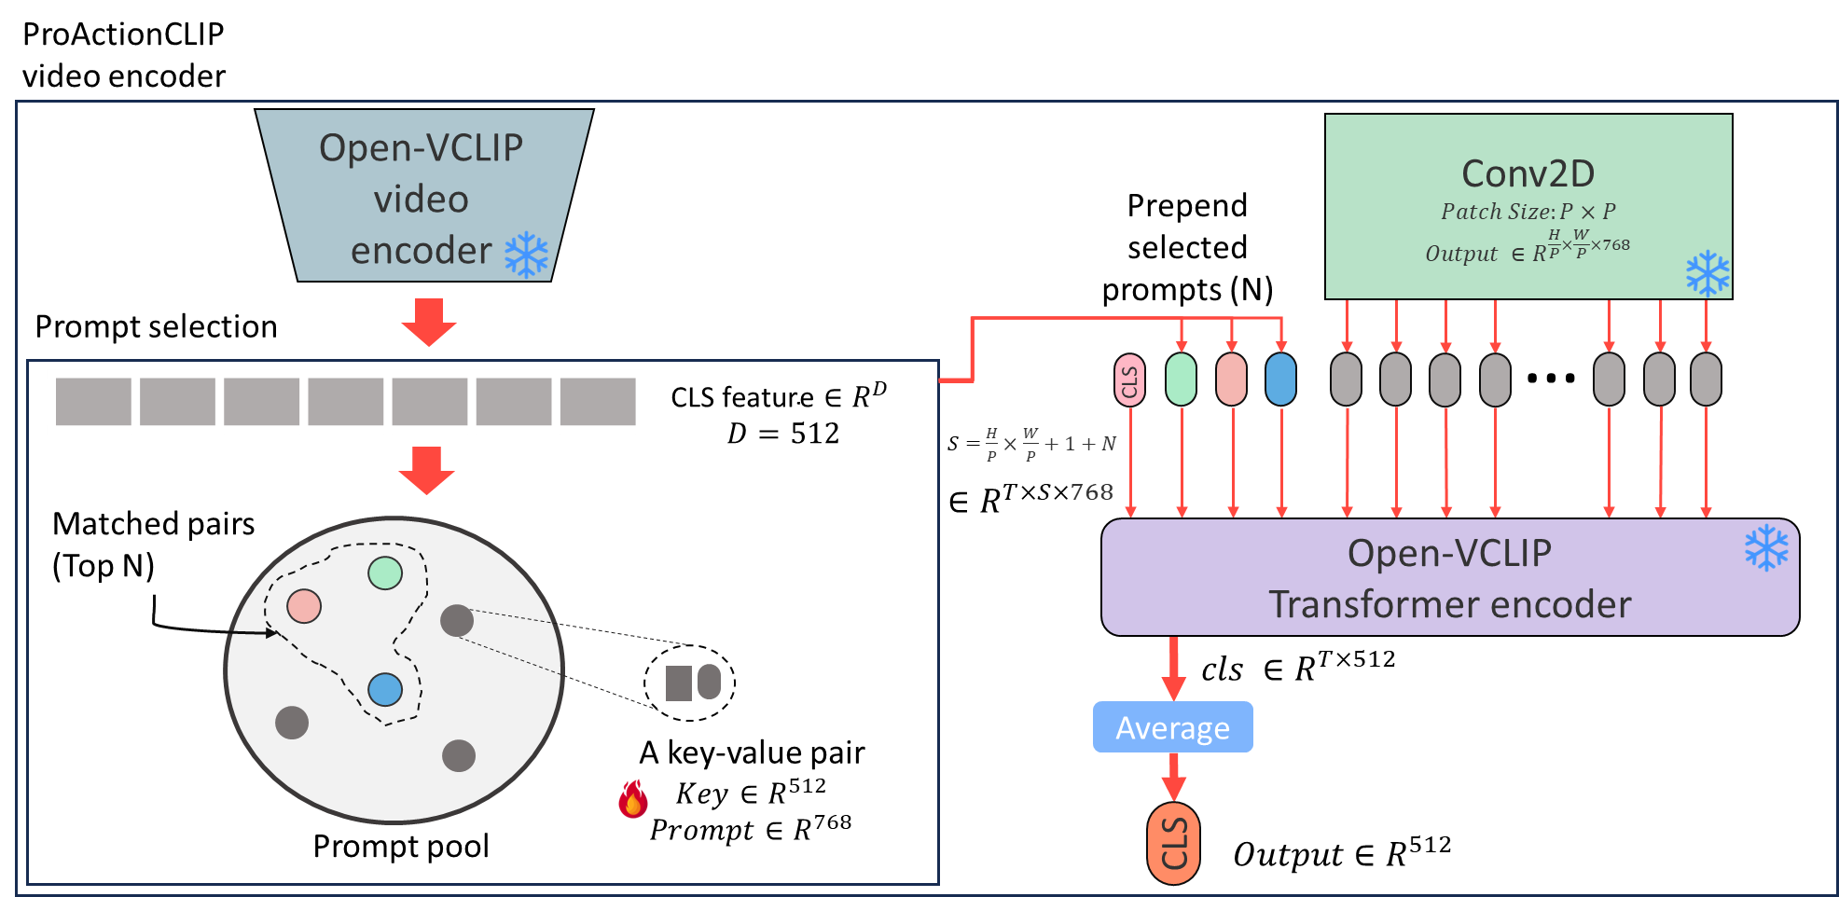



Typing | Walking | … | Jumping | Playing Guitar
A video of action {object}
Frozen
Training
Text encoder
$${∈R}^{N×512}$$
$$T_{N}$$ | $$T_{N−1}$$ | $$…$$ | $$T_{2}$$ | $$T_{1}$$
$$Input: X∈R^{T×H×W×C }, T=frames$$
$$V_{1}$$
$$V_{2}$$
$$…$$
$$V_{B−1}$$
$$V_{B}$$
$${V_{1}.T}_{N}$$ | $${V_{1}.T}_{N−1}$$ | $$…$$ | $${V_{1}.T}_{2}$$ | $$V_{1}.T_{1}$$
$${V_{1}.T}_{N}$$ | $${V_{2}.T}_{N−1}$$ | $$…$$ | $${V_{2}.T}_{2}$$ | $$V_{2}.T_{1}$$
$${∈R}^{B×512}$$
$$…$$ | $$…$$ | $$…$$ | $$…$$ | $$…$$
$${V_{B−1}.T}_{N}$$ | $${V_{B−1}.T}_{N−1}$$ | $$…$$ | $${V_{B−1}.T}_{2}$$ | $$V_{B−1}.T_{1}$$
$${V_{B}.T}_{N}$$ | $${V_{B}.T}_{N−1}$$ | $$…$$ | $${V_{B}.T}_{2}$$ | $$V_{B}.T_{1}$$

Slide 9
Typing
Walking
…
Jumping
Playing Guitar
Frozen
Training
CLIP Text
encoder
$${∈R}^{N×512}$$
A video of action {object}
$$T_{N}$$ | $$T_{N−1}$$ | $$…$$ | $$T_{2}$$ | $$T_{1}$$
$$V_{1}$$
$$V_{2}$$
$$…$$
$$V_{B−1}$$
$$V_{B}$$
$${V_{1}.T}_{N}$$ | $${V_{1}.T}_{N−1}$$ | $$…$$ | $${V_{1}.T}_{2}$$ | $$V_{1}.T_{1}$$
$${V_{1}.T}_{N}$$ | $${V_{2}.T}_{N−1}$$ | $$…$$ | $${V_{2}.T}_{2}$$ | $$V_{2}.T_{1}$$
Video
encoder
$${∈R}^{B×512}$$
$$…$$ | $$…$$ | $$…$$ | $$…$$ | $$…$$
$${V_{B−1}.T}_{N}$$ | $${V_{B−1}.T}_{N−1}$$ | $$…$$ | $${V_{B−1}.T}_{2}$$ | $$V_{B−1}.T_{1}$$
$${V_{B}.T}_{N}$$ | $${V_{B}.T}_{N−1}$$ | $$…$$ | $${V_{B}.T}_{2}$$ | $$V_{B}.T_{1}$$
$$X∈R^{B×T×H×W×C },$$
$$T=frames, B=batch size$$

Slide 10
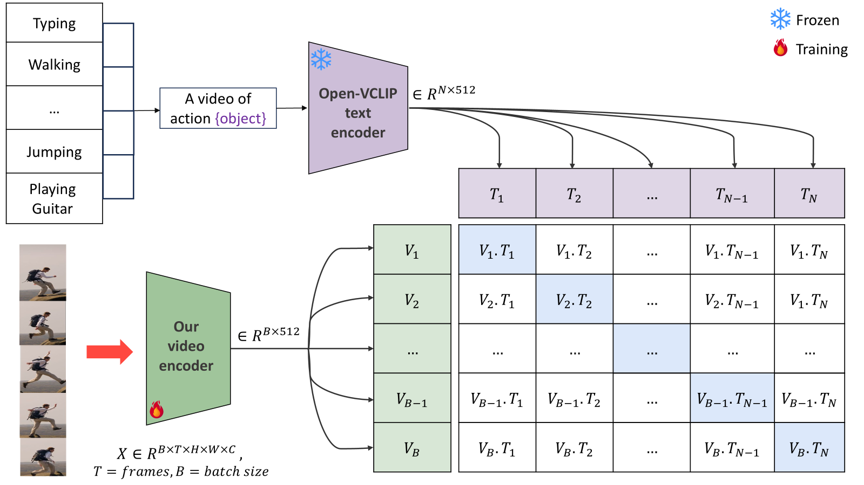

Slide 11
Input
Input
Open-VCLIP video encoder
CNN layer
Prompt selection
Input labels
Open-VCLIP text encoder
Attach prompt to input
Transformer encoder
Contrastive loss

