Slide 1
Synchronous Machine
Unit -V

Slide 2
Construction
Stationary armature, rotating field type of construction is preferred.
High speed alternators have non-salient pole rotor (Turbo alternators) and they have either 2-pole or 4-pole.(Dia:1.2m; V_{a} about 175m/sec)
Slow speed alternators have salient pole rotor (water wheel alternators) and they have more than 4 poles.(Speed : 50 to 500RPM; V_{a} is limited to 80m/sec)
Motors provided with damper windings
Compensators with rating upto 100MVAr and speed upto 3000RPM.

Slide 3
Runaway Speed:
It is the speed which the prime mover would have, if it is suddenly unloaded, when working at its rated load.
Runaway speeds of various water wheel turbines:
Salient pole machines: Designed to withstand mechanical stresses encountered at runaway speeds
Turbines | Water Head | Runaway Speed
Pelton Wheel | 400m & above | 1.8 times of rated speed
Francis Turbine | Upto 380m | 2-2.2 times of rated speed
Kaplan turbine | Upto 50m | 2.5-2.8 times of rated speed

Slide 4
Output Equation
Q = C_{o} . D² L n_{s}
where, C₀ – 11 B_{av} .ac.K_{ws} X 10⁻³

Slide 5
Choice of Specific Magnetic Loading(B_{av}):
Iron loss: High B_{av} → high flux density in the teeth and core → high iron loss → higher temperature rise.
Transient Short Circuit Current: High B_{av} → low T_{ph} → low leakage reactance (X_{l} )→ high short circuit current
Voltage Rating: In high voltage machines slot width required is more to accommodate thicker insulation →smaller tooth width → small allowable B_{av}
Stability : P_{max} =VE/X_{s} . Since high B_{av} gives low T_{ph} and hence low X_{l} increases P_{max} and improves stability.
Parallel operation : P_{s} = (VE sinδ)/X_{s} ; where δ is the torque angle. So low X_{s} gives higher value for the synchronizing power leading stable parallel operation of synchronous generators.
Guide lines :
  Non-salient pole alternator : 0.54 – 0.65 Wb/m²
  Salient – pole alternator : 0.52 – 0.65 Wb/m²

Slide 6
Choice of Specific Electric Loading:
Copper loss and temperature rise: High value of ac → higher copper loss leading high temperature rise. So choice of depends on the cooling method used.
Operating voltage : High voltage machines require large insulation and so the slot space available for conductors is reduced. So a lower value for ac has to be chosen.
Synchronous reactance (X_{s}) : High value of ac results in high value of X_{s} , and this leads to a) poor voltage regulation b) low steady state stability limit.
Stray load losses increase with increase in ac.
Guide lines :
  Non-salient pole alternators : 50, 000 – 75,000 A/m
  Salient pole alternators : 20,000 – 40,000 A/m

Slide 7
Design of Salient Pole Machines:
Main Dimensions:
  D & L
D:Depends on type of pole & Va
Two types of salient poles:
  Round pole
  Rectangular Pole
Round Poles:
  Ratio: b/τ=0.6 to 0.7 (Sq.Pole Shoes)
  Length of pole,L=Width b_{s}
  Length of pole,L=Length of Stator Core
Rectangular Poles:
  Ratio: b/τ=1 to 5
  Maintained as 3 for economic field system
Peripheral Speed:
  Depends on type of pole attachment
  Bolted pole structure: 50m/s
  Dovetail construction: 80 m/s
Round Pole
Rectangular Pole

Slide 8
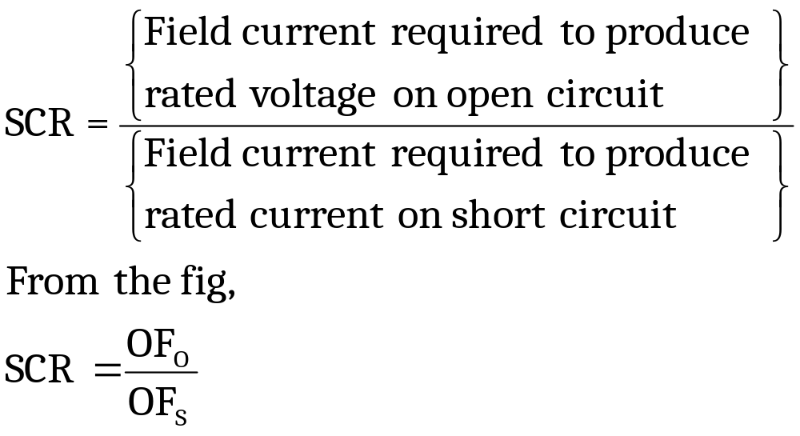

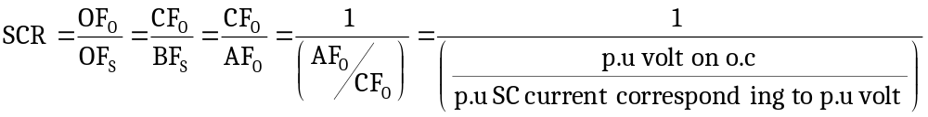
Short Circuit Ratio(SCR):
OF_{O}- p.u field current required to develop rated voltage on OCC
OF_{s}- p.u field current required to develop rated current on SCC
From the graph,
  OF_{O}=CF_{O} & OF_{S}=BF_{S}=AF_{O}
OCC
A
SCC
1.0
B
C
F_{s}
0
F₀
1.0
p.u field current

Slide 9
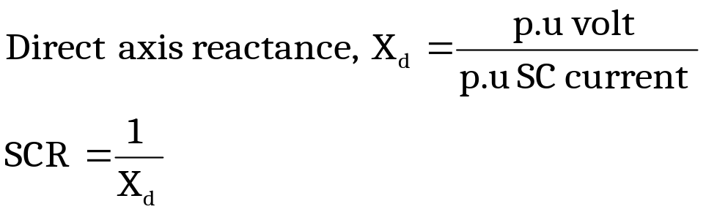
Short Circuit Ratio(SCR):
Thus SCR is the reciprocal of X_{d}
For Non-salient pole alternators : 1- 1.5
For Salient pole alternators : 0.5 – 0.7
Effect of SCR on machine performance
  Voltage regulation : A low SCR → high X_{d} → large voltage drop → poor voltage regulation..
  Parallel operation : A low SCR → high X_{d} → low synchronizing power → parallel operation becomes difficult.
  Short circuit current : A low SCR → high X_{d} →low short circuit current. But short circuit current can be limited by other means not necessarily by keeping a low value of SCR.
  Self excitation : Alternators feeding long transmission lines should not be designed with small SCR as this would lead to large terminal voltage on open circuit due to large capacitance currents.
High value of SCR → i) High stability limit, ii) Low voltage regulation, iii) High short circuit current and iv)Large air gap-large field-costlier.
Modern design is with low SCR.

Slide 10
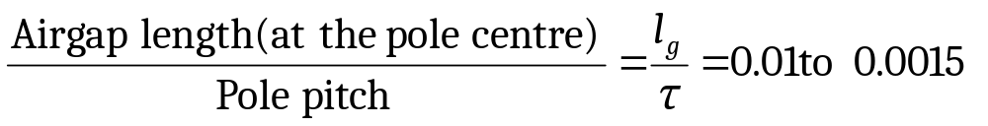
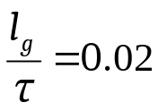
Length of Airgap
The length of air gap very much influences the performance of a synchronous machine.
A large airgap offers a large reluctance to the path of the flux produced by the armature MMF and thus reduces the effect of armature reaction.
Thus a machine with large airgap has a small X_{d} and so has,
  Small regulation
  High stability limit
  High synchronizing power which makes the machine less sensitive to load variations
  Better cooling at the gap surface
  Low magnetic noise and smaller unbalanced magnetic pull
But as the airgap length increases, a large value of Field MMF is required resulting in increased cost of the machine.
In salient pole machines, the airgap is not uniform throughout the pole arc.
Attempt is made to obtain sinusoidal distribution of flux by proper shaping and proportioning of pole shoe.
For salient pole machines with open slots,
For the machines designed for max. output equal to 1.5 times of rated output,

Slide 11
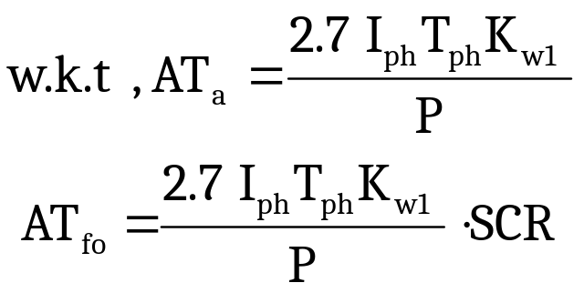
Length of Airgap
Estimation of air gap length:
No-load field MMF per pole =Armature MMF per pole X SCR
AT_{fo} =AT_{a}.SCR
Thus the value of no load MMF per pole can be estimated by assuming a suitable value of SCR
MMF required for air gap= 0.8AT_{fo}

Slide 12
Armature design
Windings used may be of single layer or double layer type
Machines with large value of flux per pole have small number of turns per phase and therefore double layer bar windings are used
High voltage machines and machines with small value of flux per pole have large number of turns per phase and therefore multi turn coils are used
In modern practice, it is employ double layer wave or lap winding
COIL SPAN:
Coil span for the winding are chosen such that harmonics are reduced.
Highest amplitude harmonics in the flux distribution curve of salient pole generators are likely to be 5th or 7th
Max reduction of this harmonics is given by coil span of 8.33 % of pole pitch

Slide 13
Armature design
Number of armature slots:
Balanced windings: number of arm slots must be such a number that a balanced windings is obtained
Cost : A smaller number of slots leads to a slight saving because there are fewer coils to wind, form insulate , place into slots and connect
Hot Spot Temperature: A smaller number of slots results in bunching of conductors, leaving smaller space for the circulation of air, gives rise to high internal temperatures
Leakage reactance: when the number of slots is small, leakage flux and therefore, leakage reactance is increased owing to conductors lying near each other
Tooth ripples: tooth ripples in field form and pulsation losses in the pole face decrease if a large number of slots are used
Flux density in iron: With larger number of slots , a greater space is taken up by the insulation, results in narrower teeth giving B beyond the limits

Slide 14
Armature design
Value of slot pitch(y_{s}) guides for choosing number of armature slots
  y_{s} – depends on the voltage of the machine
  y_{s} ≤ 25 mm for low voltage machines
  y_{s} ≤ 40 mm for 6 KV & low voltage machines
  y_{s} ≤ 60 mm for machines upto 15KV
In salient pole machines, number of slots per pole per phase is usually between 2 to 4
Fractional slot windings are invariably used in synchronous generators

Slide 15
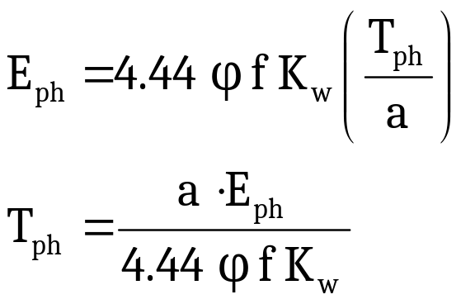
Armature design
Turns per Phase:
Flux per pole Ф = B_{av} τ L
Therefore, Turns/phase, T_{ph} = E_{ph}/(4.44 Ф f K_{w})
The above relation is applicable when all turns of a phase are connected in series. But if there are ‘a’ parallel paths per phase,

Slide 16
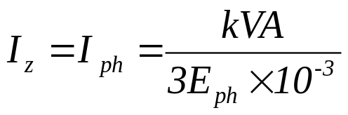
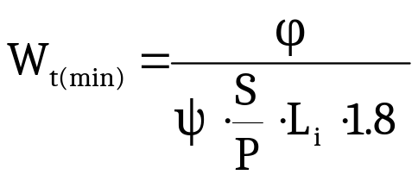
Armature design
Armature Conductors:
Current in each condcutor,
If there are ‘a’ parallel paths, then I_{z}= I_{ph}/a
For normally cooled machines , permissible δ_{a} - 3 to 5 A/mm²
∴ a_{s} =I_{z}/ δ_{a}
Slot dimensions:
B_{t} – 1.7 to 1.8 T;
Parallel sided slots are used
Max. permissible width of slot W_{s(max)} = y_{s}- W_{t(min)}
Depth of the slot = 3 W_{s}

Slide 17
Armature design
Length of the mean turn:
L_{mt} = 2L + 2.5τ + 0.06 KV + 0.2
Stator bore:
Depth of core, d_{c} – can be calculated by assuming a suitable value of B_{c}
B_{c} – 1.0 to 1.2T
d_{c} = Ф/(2 L_{i} B_{c})
Outer diatmeter = D_{o} = D + 2(d_{s} + d_{c})

Slide 18
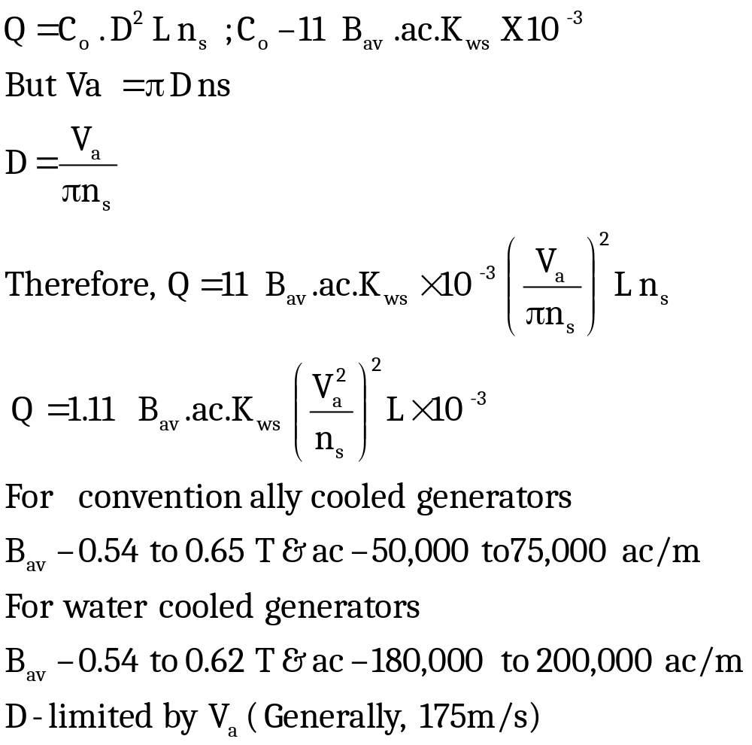
Design of Turbo Alternators
Output equation:

Slide 19
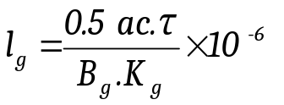
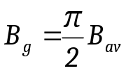
Design of Turbo Alternators
Length of the air gap:
Approx. value of ac per pole = ac.τ
Armature MMF per pole, AT_{a}= ac.τ/2
Therefore, No-load field MMF, AT_{fo} = SCR X AT_{a}
AT_{fo} = SCR X (ac.τ/2)
SCR ranges between 0.5 & 0.7
Assuming 80% of no-load MMF to be lost in the air gap
MMF required for air gap = 0.8 . AT_{fo}
= 0.8. SCR. ac.τ/2
But MMF required for air gap = 80000 B_{g}.l_{g}.K_{g}
From the above two expressions,
Taking sinusoidal distribution of flux ,
In general B_{g}= 1.5 B_{av} and K_{g} = 1.1

Slide 20
Design of Turbo Alternators
Stator Design:
No of stator slots per pole per phase – 2 to 4, but in case of turbo alternators it is – 8 or 9
Slot pitch – 25 to 60, but in case of large turbo alternators it may be even – 75 to 90mm
Single layer concentric winding or double layer short pitched winding may be used
Current density – 8 to 9.5 A/mm²

Slide 21
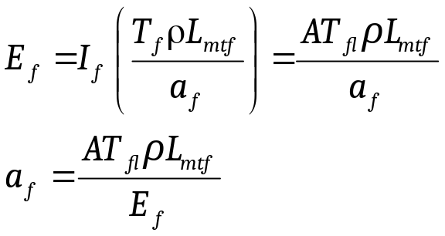
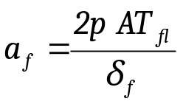
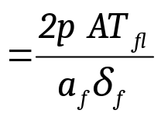
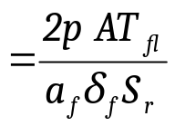
Procedure for rotor winding design
1. Full load field mmf AT_{fl} = 2 AT_{a}
where AT_{a} =2.7 . I_{ph}. T_{ph}. K_{w}/P
2. A standard exciter voltage may be taken. About 15 to 20% of this voltage is kept in reserve.
Let V_{e} –be the exciter votlage
Voltage across the field coil, E_{f} = (0.8 to 0.85)V_{e}/P
3. L_{mtf} = 2L + 2.3τ + 0.24
4. Voltage across field coil E_{f}= I_{f}.R_{f} →
5. Assume suitable value of δ_{f} for field winding
∴ Total area of field conductors,
∴ Number of field conductors
Conductors per slot

Slide 22
Computer Aided Design:
Advantages of CAD:
Capability to store amount of data, count registers, round off results down to integers, refers to tables, graphs ….
Possible to select an optimized design with a reduction in cost and improvement in performance
High speed , less duration
Automatic operation
Easier to compare different designs, out of which the best suited can be selected
Reduced error, more accurate and reliable
Less cost
Capable of taking logical decision itself, thereby saving the man hour of the design engineers

Slide 23
Computer Aided Design:
DIFFERENT METHODS:
  Analysis method
  Synthesis method
  Hybrid method

Slide 24
Computer Aided Design-Analysis Method:
Start
Human Decisions
Is Decision ok?
Input
Stop
Performance Calculations
Output

Slide 25
Computer Aided Design-Analysis Method:
In this method , the choice of dimensions , materials and types of construction are made by the designer and these are presented to the computer as input data.
Performance is calculated by the computer and is returned to the designer to examine
Designer examines the performance and makes another choice of input, if necessary and the performance is recalculated.
Procedure is repeated over and over again till the performance requirements are satisfied.
This method is an excellent for the beginners in computer aided design
Use computer only for the purposes of analysis leaving all exercises of judgment to the designer

Slide 26
Computer Aided Design-Synthesis Method:
start
Performance specifications
Assume suitable values for variables
Design calculations
Performance calculations
Adjust values for variables
Compare calculated and desired performance
Is Performance satisfactory?
No
Yes
Stop
Calculate total cost
Print design values

Slide 27
Computer Aided Design-Synthesis Method:
Desired performance is given as input to the computer
Logical decisions are taken by the computer
( given as set of instructions)
Satisfies a set of specifications or performance indices
Saves time
But takes too much of logic since the logical decisions are taken by PC
Too complex & high cost

