Slide 1

Analysis Report OF 10 YEARS Car sales data (analyticity)
Team Name : Data Hunters
Team Member 1:
Parisha Bhatia
NMIMS, Mumbai
B.Tech Data Science (Second Year)

Slide 2
Metadata And pre-processing
From the given data set we notice the following things :
There are 10 continents/subcontinents.
Out of 10 we have detailed information for 6 of them.
Time span – 10 years (2005 – 2014).
Na values – None
Duplicate values – None
Total countries/regions – 144

Slide 3
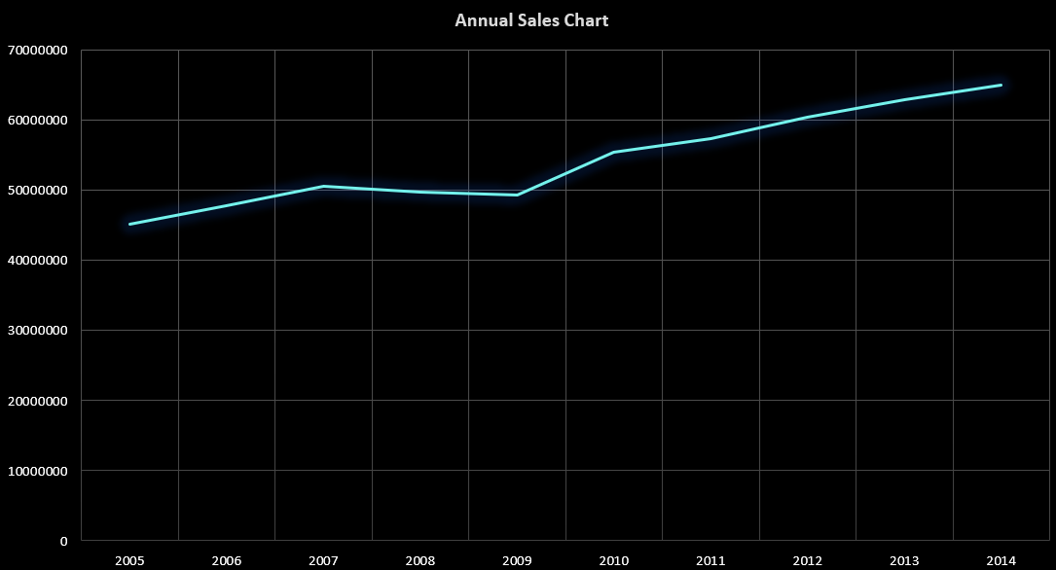
Year Wise Analysis and observations
Reasons for slump in sales in 2007 – 2009
The Great Recession
Bankruptcy Announcement of General Motors
Increase in price of Automotive Oil
Snowball Effect of Subprime Housing Crisis

Slide 4
Region-Wise INSIGHTS
When we look at the graph from region wise we can observe that the most impact of the Great Recession was felt on European and Asian sales
Specially the Europe new members subcategory sees a high variability in sales because of lesser economic stability.Data Hunter.xlsm
After detailed analysis we see that GERMANY AND UK car sales have risen up during the year 2008 which could be because of one of the following reasons
1)Data Entry Error (Outlier)
2) Heavy export for purchasers who saw it as an investment
The share of used cars on the Ukrainian market is 38% hence lesser sales in 2014
Reunion Island has the highest sale under the Africa category.

Slide 5
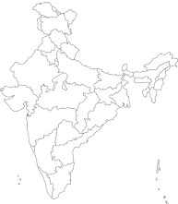


Per Capita Sales
To do justice to the lesser populated countries, we divide the given sales by the population of that country for that particular year to get the per capita sales
SALES / POPULATION*100000

Slide 6
GDP Insights
Observation
Great Recession directly affected car sales
Hypothesis
High Probability of GDP being a major factor of car sales
Analysis
Analysing the Graphs for GDP and sales simultaneously we see GDP plays an important role in car sales.
Hypothesis accepted Data Hunter.xlsm

Slide 7
Top 4
USA , GERMANY , JAPAN , CHINA ruled the car exporting industry in the year 2005-2014.
Leading to greater inflow of foreign currency – providing encouragement to the automobile industry to innovate and enabling greater sales.
A report by USA daily states how widely cars are used over public transit. Due to better financial resources, the citizens love to splurge excessively on cars.
Even in the top 4 countries the sales are shaken by a variance in the GDP which explains the high correlation between the two.

Slide 8
bottom 4
Macedonia GDP increased in 2013 and 2014 yet the sales of those years were pretty low.Data Hunter.xlsm
The reason for decreased sales was found out to be increased inflation
The main reason for such a sharp decline in car sales in Armenia is the decline in remittances to country from Russia
The sales of car in Iceland slumped in year 2008 – 2010 due to decrease in GDP owing to the Great Recession.

Slide 9
Forecasting
We plot the sum of sales of each country against each year.
Then forecast it using polynomial of degree 5 for the next 2 years.
The Predicted sales and Actual Sales of the year 2016 is compared and the error is displayed
Predicted Value – 80000000
Actual Value – 810000000
Error – 2%

Slide 10

Questions ?
Thank You

