Slide 1
Function & Integration Plotter
Department of Computer Science and Engineering
Khulna University of Engineering & Technology
CsE 2100:
Software development project 1

Slide 2
Developed by
Tamzid Rahman Oronno
ROLL NO : 1307032
Parisha Ahmed Prodhi
ROLL NO : 1307012
SUPERVISOR
Dr. K.M. AZHARUL HASAN
PROFESSOR,
Department of Computer Science and Engineering Khulna University of Engineering & Technology

Slide 3
PRESENTATION LAYOUT
OBJECTIVES
GRAPH
FEATURES
WORKFLOW
BENIFITS
LIMITATIONS
FUTURE PLANS
CONCLUSION

Slide 4
OBJECTIVES
To show the graph of some math functions
To show the variations of graphs
To show the graph of algebric equation
To show the graph of sine, cosine & logarithm

Slide 5
Why java???
Write Once, Run Anywhere
Security
Network-centric Programming
Dynamic, Extensible Programs
Multithreaded
Performance
Programmer Efficiency and Time-to-Market

Slide 6
FEATURES
Draw the graph of a Mathematical function f(x).
Calculate the definite integral of the function within two user defined limits
Highlight the area under the curve of the function bound by those limits

Slide 7
The Interface

Slide 8
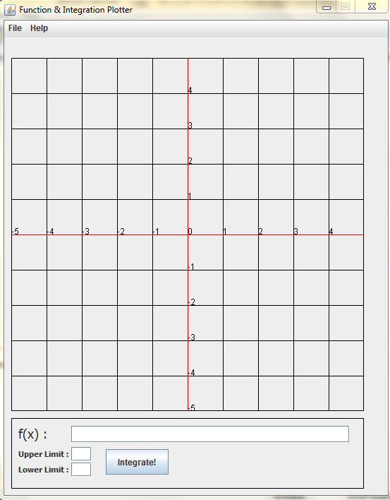
Graph Panel

Slide 10
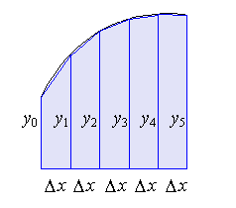
The Trapezoidal Rule
The area under a curve is divided into small trapezoids (trapeziums)

Slide 11
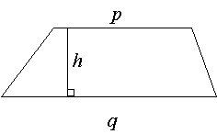
The Trapezoidal Rule
Now, the area of a trapezoid (trapezium) is given by:
Area=​​​h​​*(p+q)/2

Slide 12
The Trapezoidal Rule
So the approximate area under the curve is found by adding the area of the trapezoids
Area ≈ ½ (y​0​​+y​1​​)Δx +​ ½ (y​1​​+y​2​​)Δx+​ ½ ​​(y​2​​+y​3​​)Δx+…….
y​₁​​=f(a)
y₁ = f(a+h)
y₂ = f(a+2h)
y₃ = f(a+3h)
............
Y_{n} = f(b)
Here, Δx = h
For x = a to x = b
h = (a-b)/2
Area = ^{b}_{a}∫ f(x) dx ≈ Δx(​2​​y​ ₀​​​​+y ₁​​​+ y ₂ +…+​2​​y​ _{n}​​​​)

Slide 13
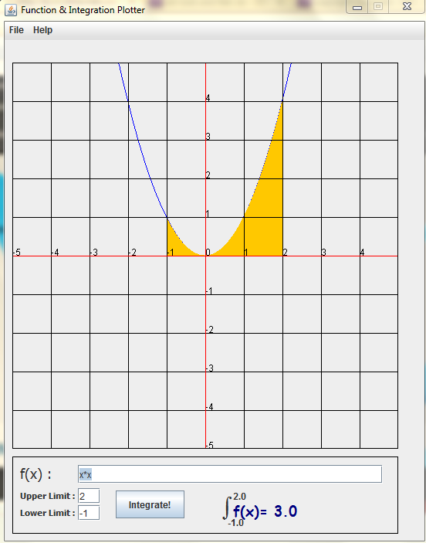
workflow
f(x) = x²
²
₋₁ ∫ f(x) = ?
²
So, ₋₁ ∫ f(x) = 3.0

Slide 14
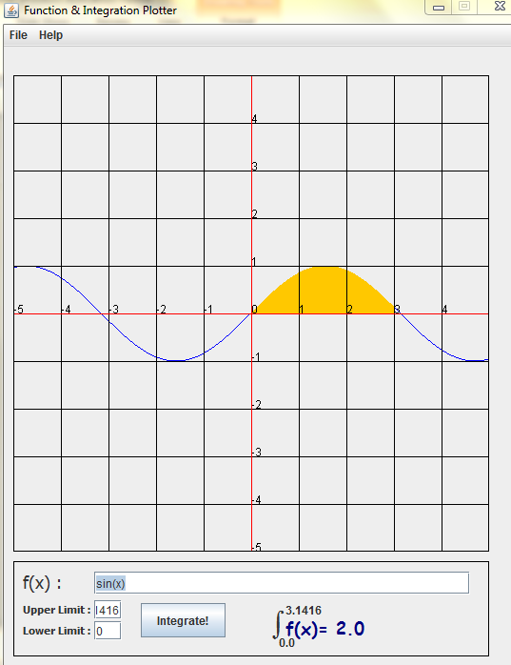
workflow
f(x) = sin(x)
π
₀ ∫ f(x) = ?
π
So, ₀ ∫ f(x) = 2.0

Slide 15
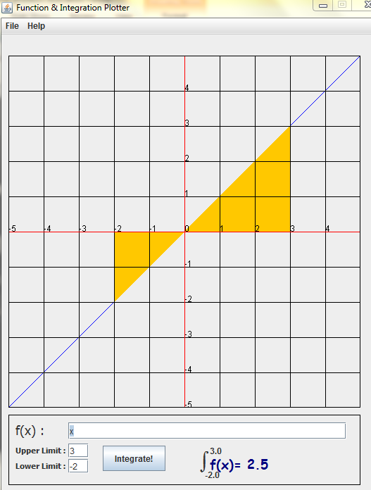
workflow
f(x) = x
3
₋₂ ∫ f(x) = ?
³
So, ₋₂ ∫ f(x) = 2.5

Slide 16
benefits
Easy way to see graphical change for different mathematical functions.
An interesting way to interact with math.
Easy way to calculate complex integral equations.
Less error-prone and mistakes.
Understanding the relation between area and integration.
Saves time giving faster output of any desired query.

Slide 17
limitations
All types of mathematical functions are not used.
Scale of the graphs are not used.
Users have no choice of saving the graph.
Graphical Interface is not resizable.
It does not handle discontinuous functions properly.
The graph panel is limited only for -5 <= x <= 5 and -5 <= y <= 5.

Slide 18
Future plans
To add more functions(like inverse functions, exponential) in it.
To convert the Function and Integration Plotter into an internet based software.
Add Scale changer on the graph.
Generate smoother graph showing floating numbers.

Slide 19
conclusion
Calculus is one of the most useful branch in mathematics concerned with questions of shape, size, relative position of figures, and the properties of space.
In science, engineering, technology, finance, and other areas, graphing tools are used for many purposes.
Specially, for computer science, we need the graphs & integral calculus very often in programming and other things.
For this reason we took this project which we found . We think this project may be helpful for the students.

Slide 20
Thank You All

