Slide 1
Software Development Project II - (CSE 3200) MOHAMMAD Insanur Rahman Shuvo Lecturer, Dept of CSE,KUET. Parisha ahmed Prodhi roll : 1307012
Pocket Witness

Slide 2
WHY ANDROID
OUTLINE
PROJECT BACKGROUND
IMPLEMENTATION
PROJECT DESCRIPTION
PROJECT METHODOLOGY
RESULTS
FUTURE DEVELOPMENT
CONCLUSION

Slide 3
WHY ANDROID
OUTLINE
PROJECT BACKGROUND
IMPLEMENTATION
PROJECT DESCRIPTION
PROJECT METHODOLOGY
RESULTS
FUTURE DEVELOPMENT
CONCLUSION

Slide 4
WHY ANDROID
Most people use android
Is very friendly to java developers
Friendly to work with

Slide 5
WHY ANDROID
OUTLINE
PROJECT BACKGROUND
IMPLEMENTATION
PROJECT DESCRIPTION
PROJECT METHODOLOGY
RESULTS
FUTURE DEVELOPMENT
CONCLUSION

Slide 6
PROJECT BACKGROUND
A witness is willing to report to the police.
Can get late enough to have done severe losses with the criminals escaped
It’s such an application with which people will get to report instantly

Slide 7
WHY ANDROID
OUTLINE
PROJECT BACKGROUND
IMPLEMENTATION
PROJECT DESCRIPTION
PROJECT METHODOLOGY
RESULTS
FUTURE DEVELOPMENT
CONCLUSION

Slide 8
IMPLEMENTATION
FIREBASE
Firebase by google is used here
It provides with database and storage system
Provides with web-hosting
Doesn’t need any server-side programming

Slide 9
WHY ANDROID
OUTLINE
PROJECT BACKGROUND
IMPLEMENTATION
PROJECT DESCRIPTION
PROJECT METHODOLOGY
RESULTS
FUTURE DEVELOPMENT
CONCLUSION

Slide 10
PROJECT DESCRIPTION
Track location and take picture of the occurrence
Witness
Police
Receives those data sent
by the witness and takes steps

Slide 11
WHY ANDROID
OUTLINE
PROJECT BACKGROUND
IMPLEMENTATION
PROJECT DESCRIPTION
PROJECT METHODOLOGY
RESULTS
FUTURE DEVELOPMENT
CONCLUSION

Slide 12

PROJECT METHODOLOGY
The Witness
has got
an interface

Slide 13
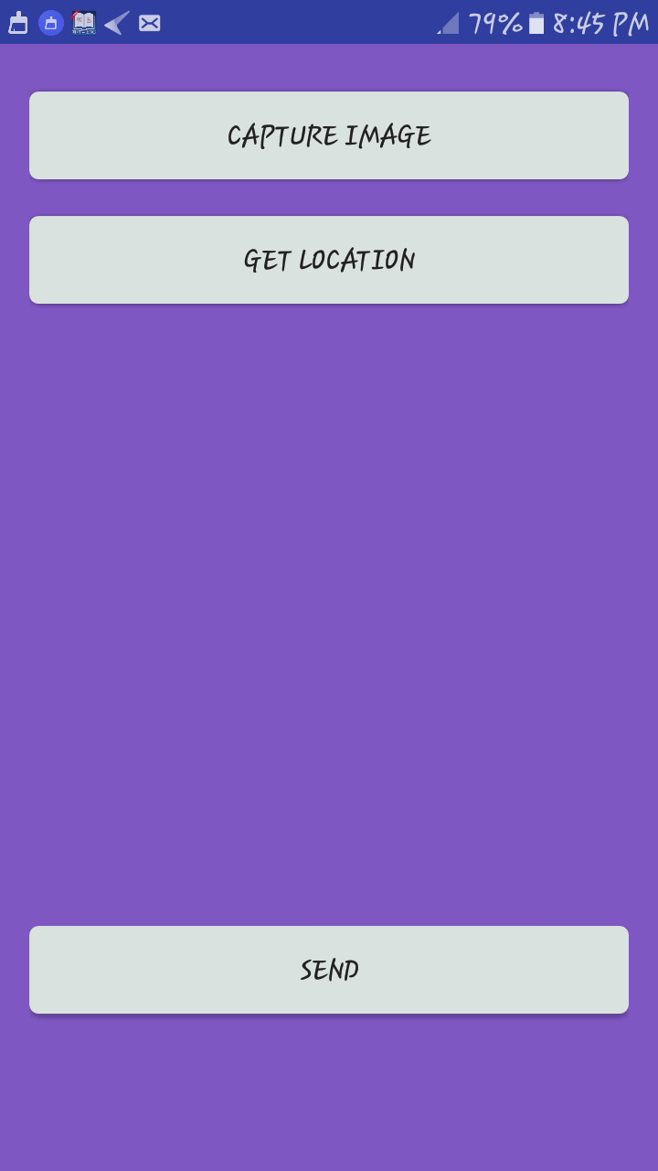
PROJECT METHODOLOGY
Got a button to capture image.
A button to track the location.
An imageview to show the
captured image.
A button to send data.

Slide 14
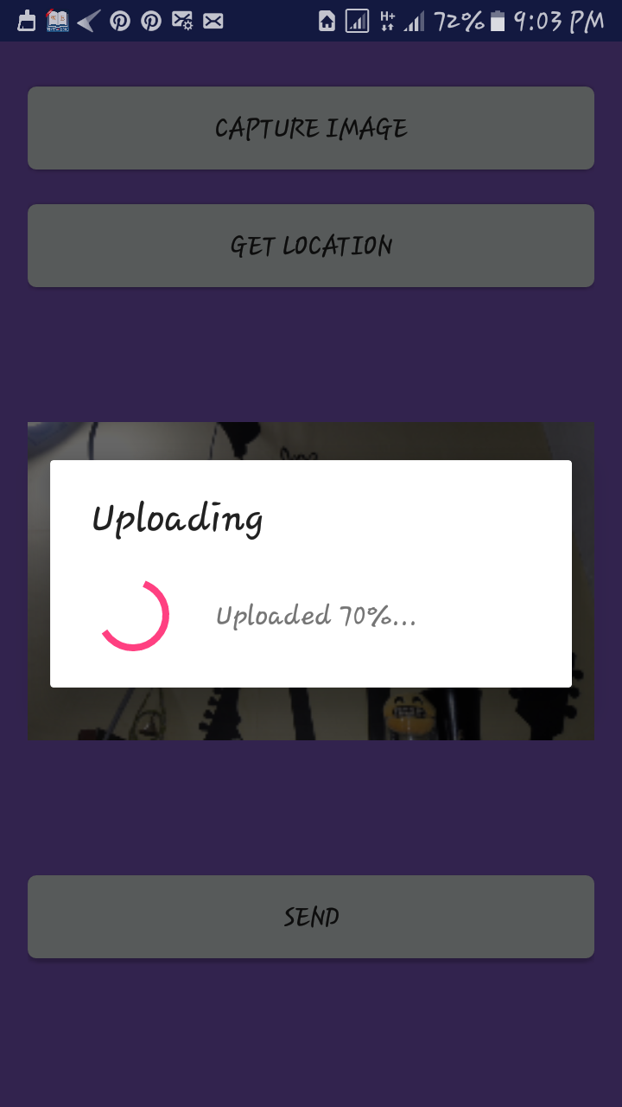
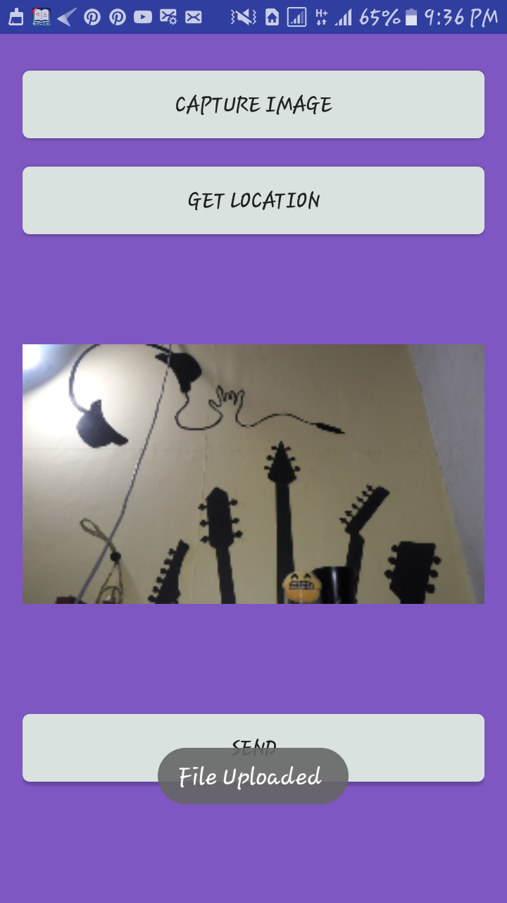
PROJECT METHODOLOGY
After capturing an
image, it will start uploading it.
-A progress bar with the
upload percentage will
show the progress.
And then it will report
the user that the
image is uploaded.

Slide 15
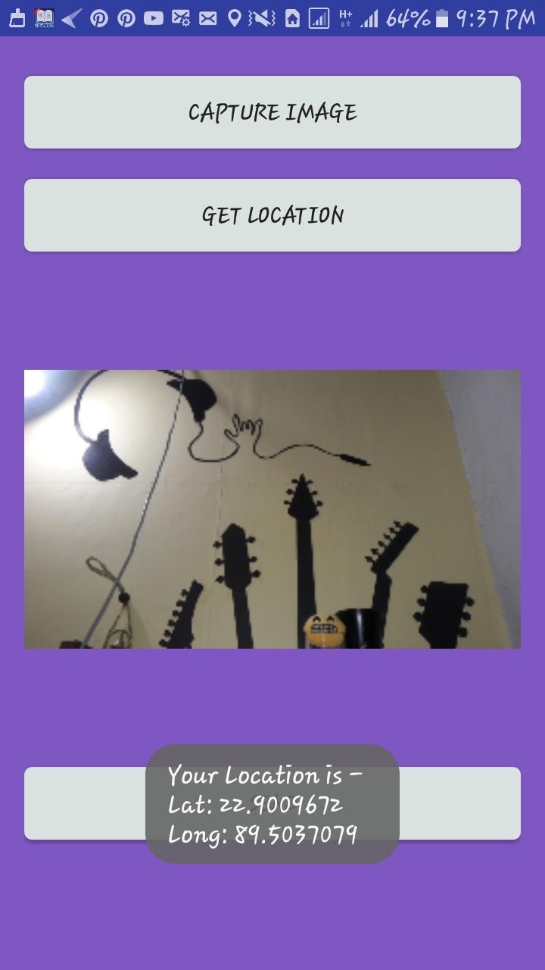
PROJECT METHODOLOGY
Location will be tracked
With the “get location” button.
And there will be a toast,
Showing the latitude and longitude
Of the location.

Slide 16
WHY ANDROID
OUTLINE
PROJECT BACKGROUND
IMPLEMENTATION
PROJECT DESCRIPTION
PROJECT METHODOLOGY
RESULTS
FUTURE DEVELOPMENT
CONCLUSION

Slide 17
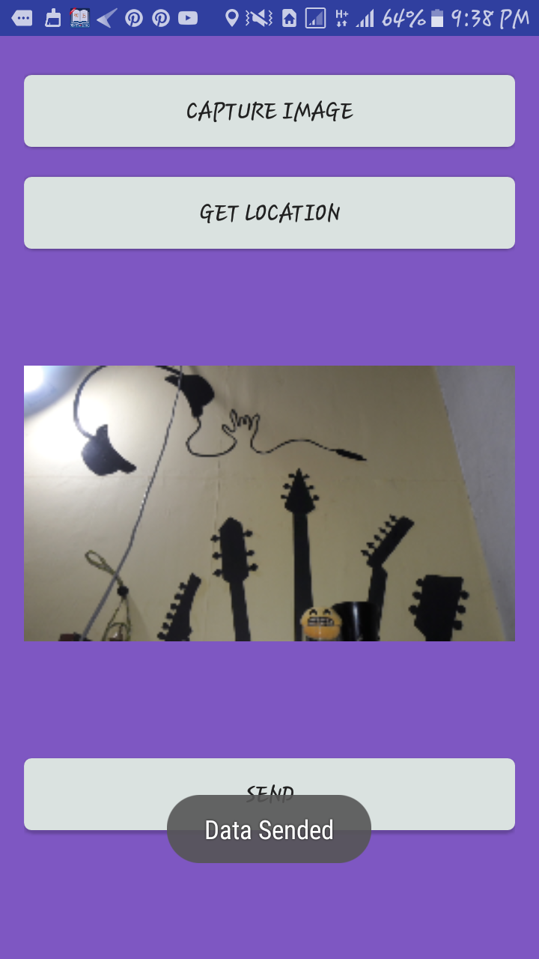
RESULTS
The send button
sends the image and
the location to
the police
interface
And a toast will
appear to assure that
the witness that it
has been sent.

Slide 18
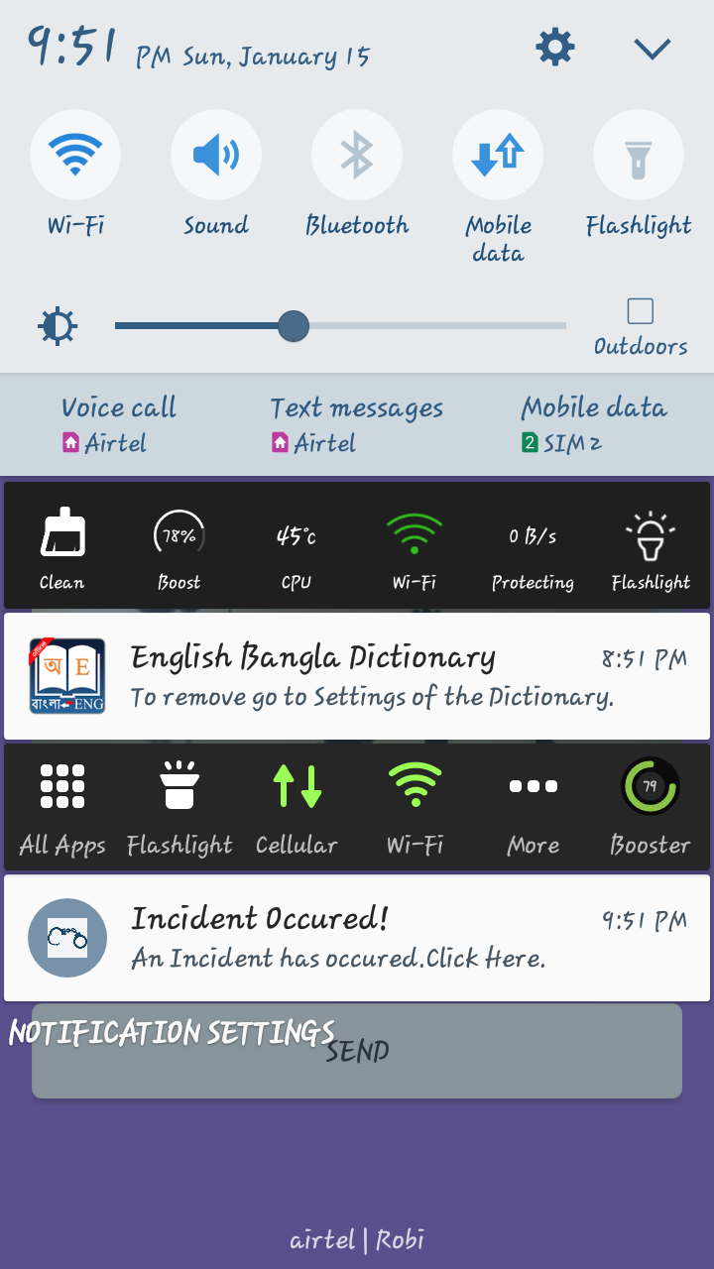
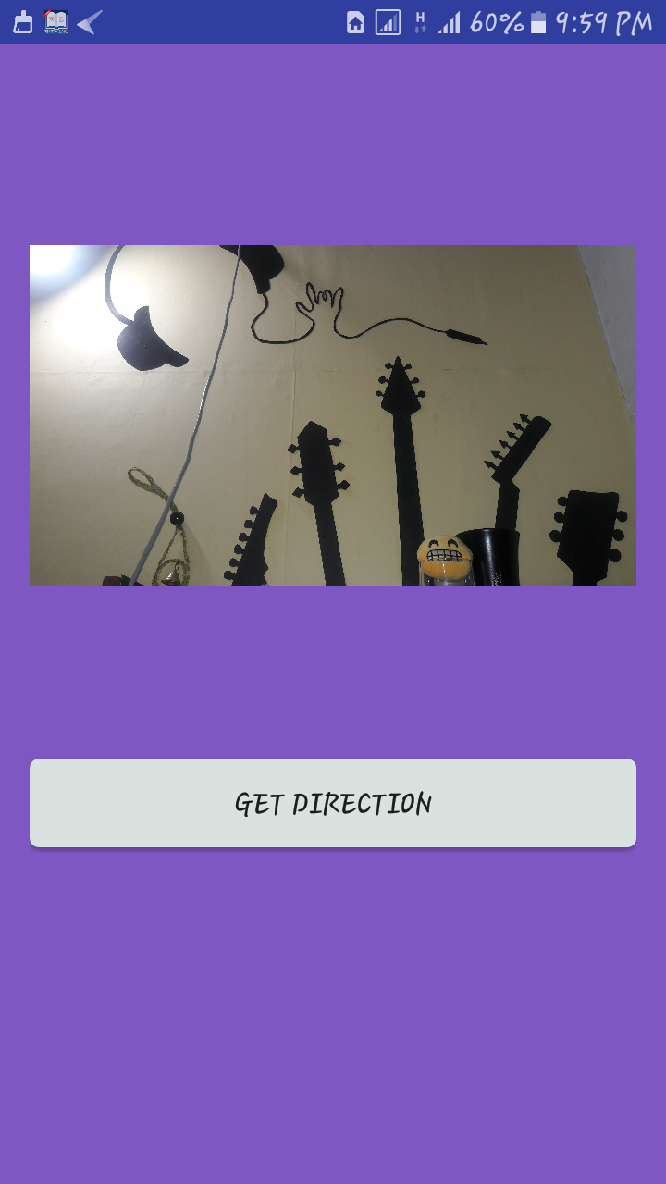
RESULTS
Then the policeman,
who has the app
installed,
will get a notification.
Clicking it, he will get an
interface with
the image received
and a button to
get the location.

Slide 19
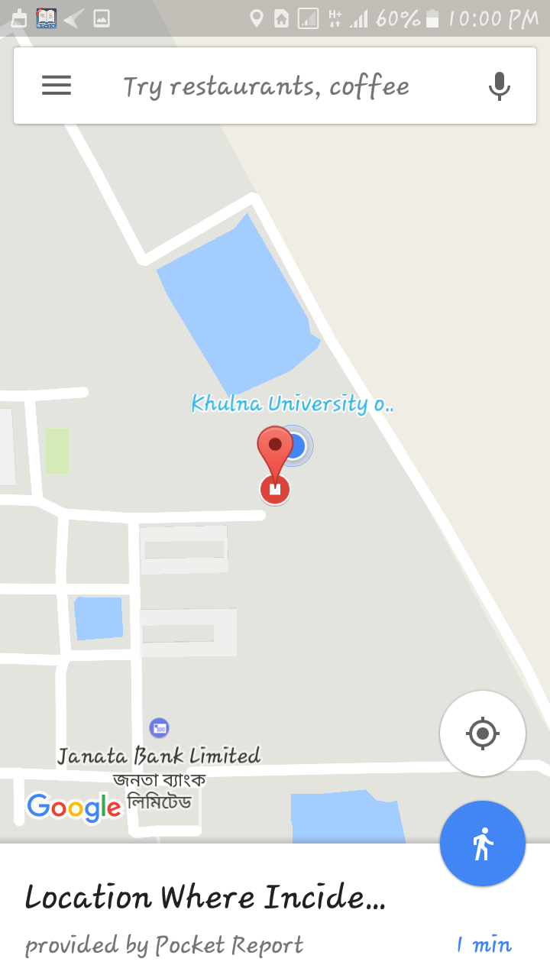
RESULTS
The “get direction”
button will redirect him to
Google maps,
indicating the place.

Slide 20
WHY ANDROID
OUTLINE
PROJECT BACKGROUND
IMPLEMENTATION
PROJECT DESCRIPTION
PROJECT METHODOLOGY
RESULTS
FUTURE DEVELOPMENT
CONCLUSION

Slide 21
FUTURE DEVELOPMENT
To send data to the police station nearer
to the location first
Police can respond or ignore the request
If ignored, data could be sent to another near police station

Slide 22
FUTURE DEVELOPMENT
When police from near station isn’t responding to the request, police from a little far will receive the request

Slide 23
WHY ANDROID
OUTLINE
PROJECT BACKGROUND
IMPLEMENTATION
PROJECT DESCRIPTION
PROJECT METHODOLOGY
RESULTS
FUTURE DEVELOPMENT
CONCLUSION

Slide 24
CONCLUSION
My target was to help people. Though I am a beginner in android app
Development, I tried my best to learn and do my best.
I hope, someday it serves some perpose.

