Slide 1
dimensionality reduction methods

Slide 2
TABLE OF CONTENTS
01
why we need dimensionality reduction?
02
PCA
03
LDA

Slide 3
why we need dimensionality reduction?
The curse of dimensionality occurs because the sample density decreases exponentially with the increase of the dimensionality this increase the potential of overfitting feature selection and feature extraction feature extraction project data from high dimension into lower dimension space feature selection return subset of original features

Slide 4
PCA
Standardization of the data (scale your features that has similar range) Computing the covariance matrix Calculating the eigenvectors and eigenvalues Computing the Principal Components Reducing the dimensions of the data set

Slide 5
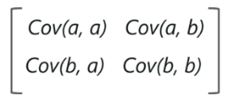
PCA (Computing the covariance matrix)
The covariance value denotes how co-dependent two variables are with respect to each other If the covariance value is negative, it denotes the respective variables are indirectly proportional to each other A positive covariance denotes that the respective variables are directly proportional to each other

Slide 6
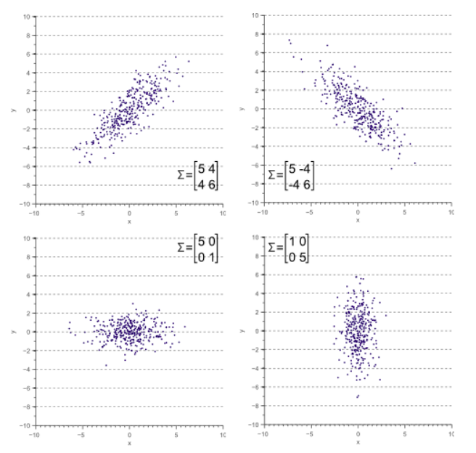
PCA (geometric interpretation of covariance matrix)

Slide 7

PCA (how we can calculate covariance matrix?)
1.
2. from first step, we know that mean of each feature is zero.
so to calculate covariance matrix we should use this formula:
np.matmul(X.T , X) / N
3. now if we sort the eigenvalues of this covariance matrix, the first eigenvector that related to biggest eigenvalue, is vector that our data has most variance in its direction.
4. for mapping or data from D dim to K dim. we get first k eigenvectors and put them as basis of our space. then we project all the points into the new space.

Slide 8
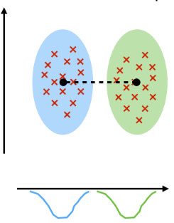
LDA
PCA interested to find axes that maximize variance but LDA is interested to find axes that maximize separability

Slide 9
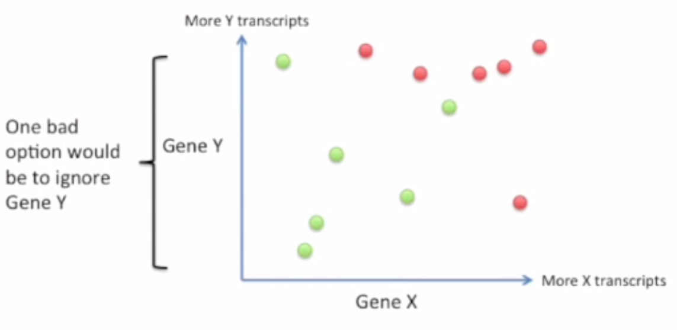
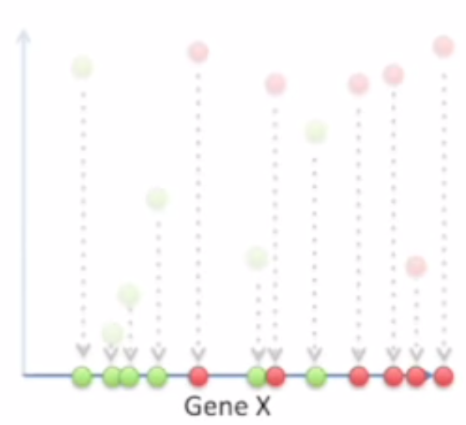
LDA

Slide 10
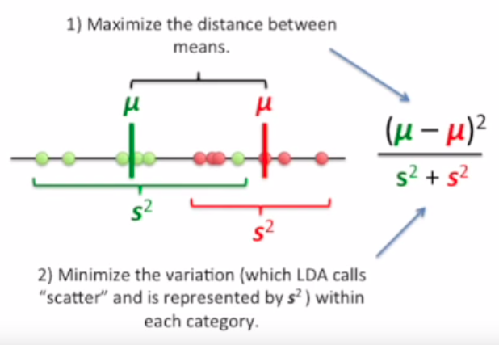
LDA

Slide 11
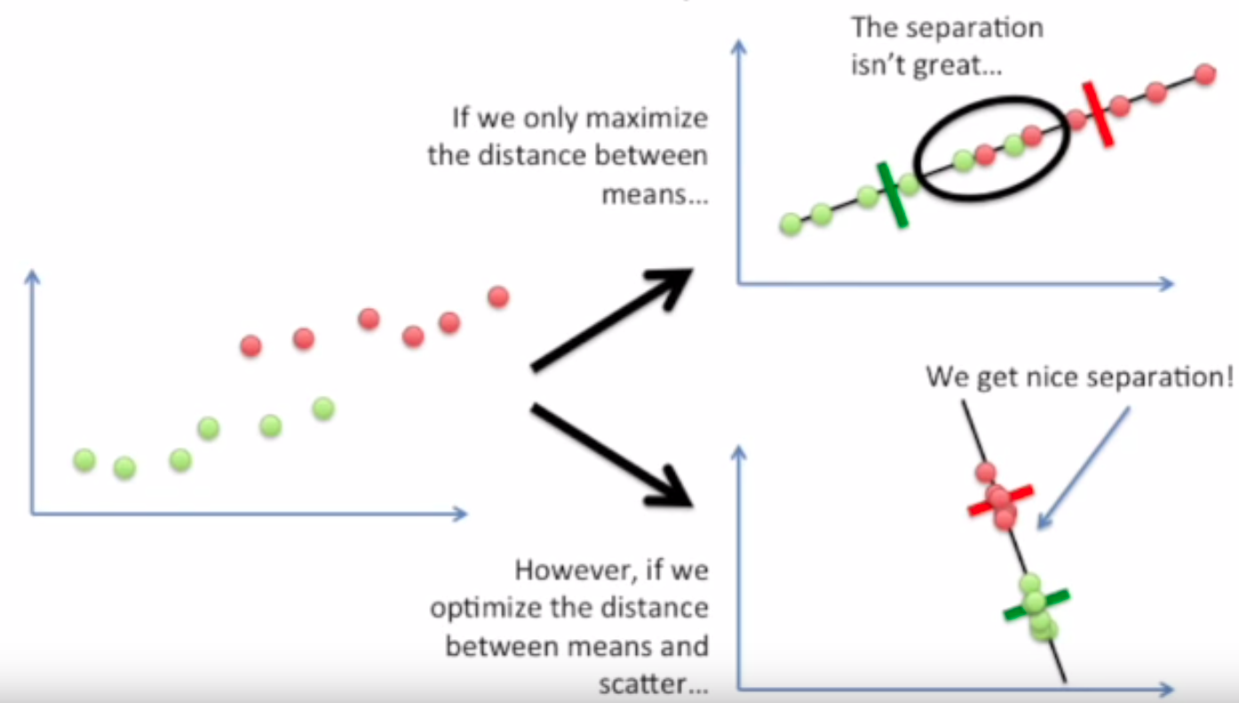
LDA

Slide 12
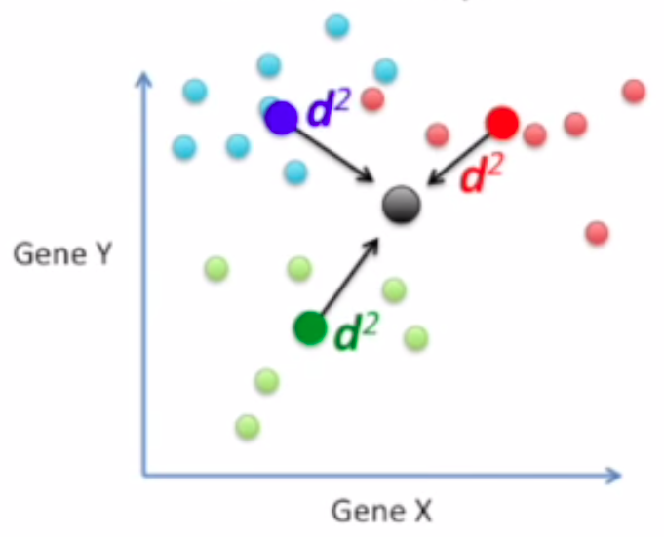

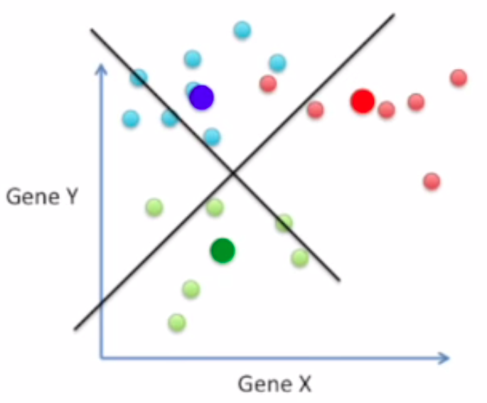
LDA

