Slide 1
Recall
An agent that reads every product recall published — so that one day it can tell you the one that is yours.
Everyday Agents
Built with the Strands Agents SDK on Amazon Bedrock
Notes:
Recall is an agent whose product is silence. It reads every recall published by three federal agencies and stays quiet until something you actually own is actually affected.

Slide 2
The reading nobody does
Three federal agencies publish every recall in full, for free, continuously.
CPSC
NHTSA
openFDA
Consumer products. Blenders, heaters,
cribs, treadmills, power tools.
Vehicles, tyres and child car seats.
Campaign by campaign.
Food, drugs and medical devices.
Enforcement reports as filed.
Reading them means cross-referencing a government bulletin against the contents of your own home, every week, forever. There is no hour in anyone's life set aside for that.
So people find out late, by accident, or never.
Recall · Agents for Humans
2
Notes:
The data is free and public. The labour of reading it is what nobody has.

Slide 3
Why keyword matching fails
THE RECALL NOTICE SAYS
YOUR RECEIPT SAYS
“Certain 4Ever DLX car seats, model numbers 2093054 and 2093055, sold January 2019 to March 2021.”
“Graco 4Ever car seat, March 2020.”
Keyword matching gets this wrong in both directions. It fires on every Graco product you own — and it misses this seat entirely if the receipt spells the brand “Graco Children's Products”.
Deciding whether that notice covers that seat is a judgement about product families, trade names, date windows and partial evidence. That is the whole problem.
Recall · Agents for Humans
3
Notes:
This single example is the reason the project needs a model at all.

Slide 4
What the agent actually does
1
Learns what you own
Paste an order confirmation. An extractor agent pulls out the durable goods and throws away the shipping and tax lines.
2
Reads every notice, forever
Sweeps CPSC, NHTSA and openFDA on a schedule. Hundreds of notices per pass.
3
Decides — and almost always says nothing
Every dismissal is recorded with a reason. Silence is the normal output.
4
Breaks the silence only when it is real
What happened, what to do about it, and a drafted message to the manufacturer.
Recall · Agents for Humans
4
Notes:
Four stages. Three of them are invisible on a normal day.

Slide 5
The hard part is deciding
not to tell you.
An agent that fires on every loose brand match gets ignored within a week. And then it is sitting there in the background, failing silently, on the day it actually matters.
So the product is silence — and the entire design is about earning the right to break it.
Notes:
This is the thesis slide. Everything technical downstream follows from it.

Slide 6
Two layers that fail in opposite directions
Public feeds
Deterministic pass
Strands agents
Outcome
CPSC · NHTSA
openFDA
brand aliases · model
numbers · sale windows
RecallMatcher
RecallTriage
an alert, or
the silence log
free · runs on every notice
paid · runs on survivors only
Rules are good at
Rules are blind to
Exact model numbers. Date arithmetic. Doing it a thousand times for nothing.
“Is a Ninja BN701 covered by a BlendJet recall?” So ambiguity is passed upward, never dropped.
Recall · Agents for Humans
6
Notes:
A pair wrongly dropped by a rule is never seen again and nobody learns it was missed. A pair wrongly kept costs one model call. So the cheap filter is deliberately permissive.

Slide 7
Three near-misses
Each one is why a layer exists.
Ryobi P215K
IKEA BILLY
Graco 4Ever DLX
against a P215Q recall
against an IKEA MALM recall
against its own recall
Bought Aug 2020. Affected units sold 2022–23. Ruled out on date arithmetic alone.
Same brand, same category, same retailer. No rule throws this out.
Covers specific model numbers printed on a label. A receipt cannot settle it.
Killed for free. No model call.
The matcher does.
So it asks you to read one label.
Recall · Agents for Humans
7
Notes:
Left: rules earning their place. Middle: the model earning its place. Right: neither can decide, so it asks.

Slide 8
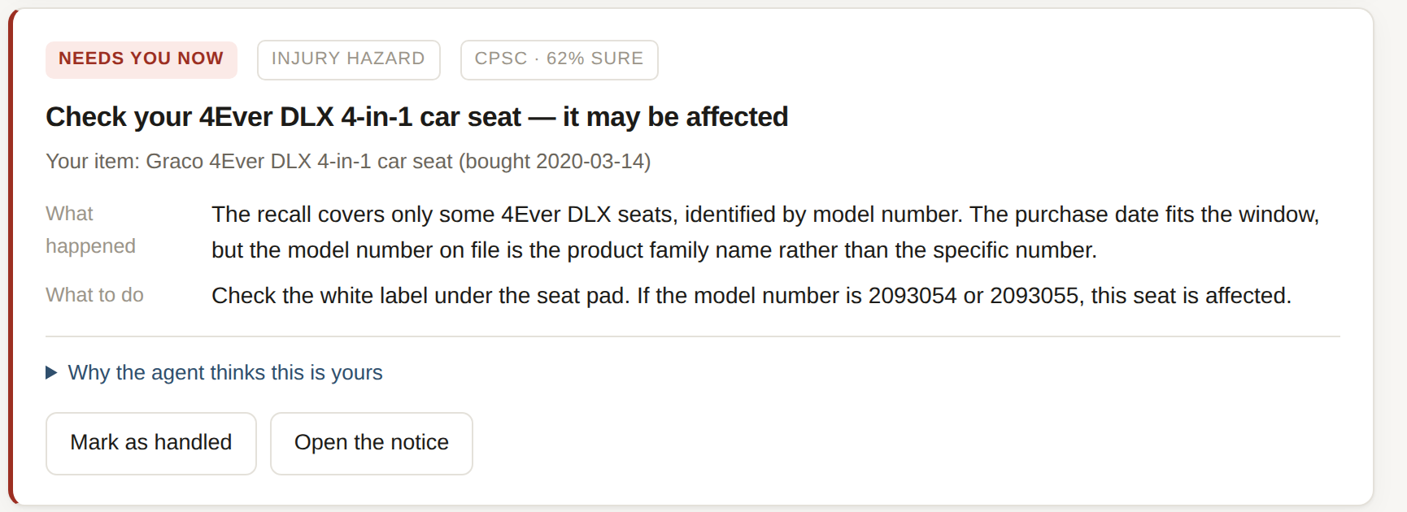
Most systems answer yes or no.
This one has a third answer — and it is the one that matters.
no_match
need_info
match
need_info — the agent cannot decide without something only you can see.
Guessing yes trains you to ignore it. Guessing no is how a child ends up in a recalled car seat.
That question is the real decision the agent exists to surface — and the only thing it wanted from you today.
Recall · Agents for Humans
8
Notes:
This is the differentiator. Most hackathon agents demo an agent that answers. This demos one that knows when it cannot.

Slide 9
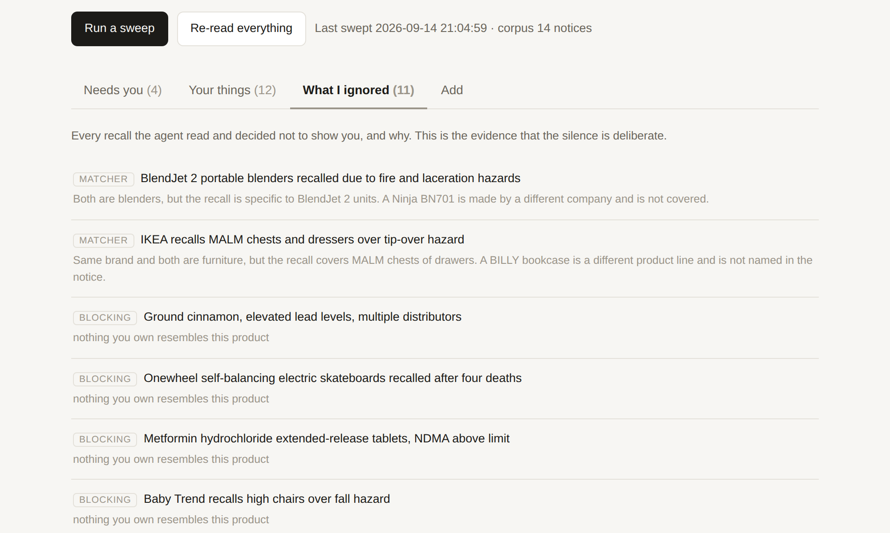
The silence log
Every notice read and deliberately not shown — with the reason.
Without it, there is no difference a user can see between an agent that read four hundred notices and found nothing —
— and an agent that has been quietly broken for a month.
It is the credibility artifact.
Recall · Agents for Humans
9
Notes:
The silence log is what makes the silence trustworthy rather than suspicious.

Slide 10
What the Strands SDK is doing here
4 agents
5 @tool functions
Extractor, Matcher, Triage — each with a narrow system prompt and a typed Pydantic return via structured_output. Plus a conversational agent.
search_inventory · list_open_alerts · why_was_this_ignored · coverage_summary · closest_recall_for_item
Typed output, not prose
18 tests, replay mode
RecallTriage returns a TriageDecision. An unexpected value degrades to “digest” rather than inventing an alert.
The full pipeline runs end to end with no credentials, so the demo is reproducible and the tests need no network.
Amazon Bedrock · FastAPI · three public government APIs, none of which need a key · MIT
Recall · Agents for Humans
10
Notes:
Deterministic work stays in Python. The model is used only where judgement is genuinely required.

Slide 11
On a normal day, this is
the entire interface:
All clear.
412 recalls read. None of them affect anything you own.
That is what it is supposed to look like.
github.com/ParishruthiGanesh/Agents-for-Humans
Notes:
Close on the silence. The agent's success condition is that you never think about it.

