Slide 1
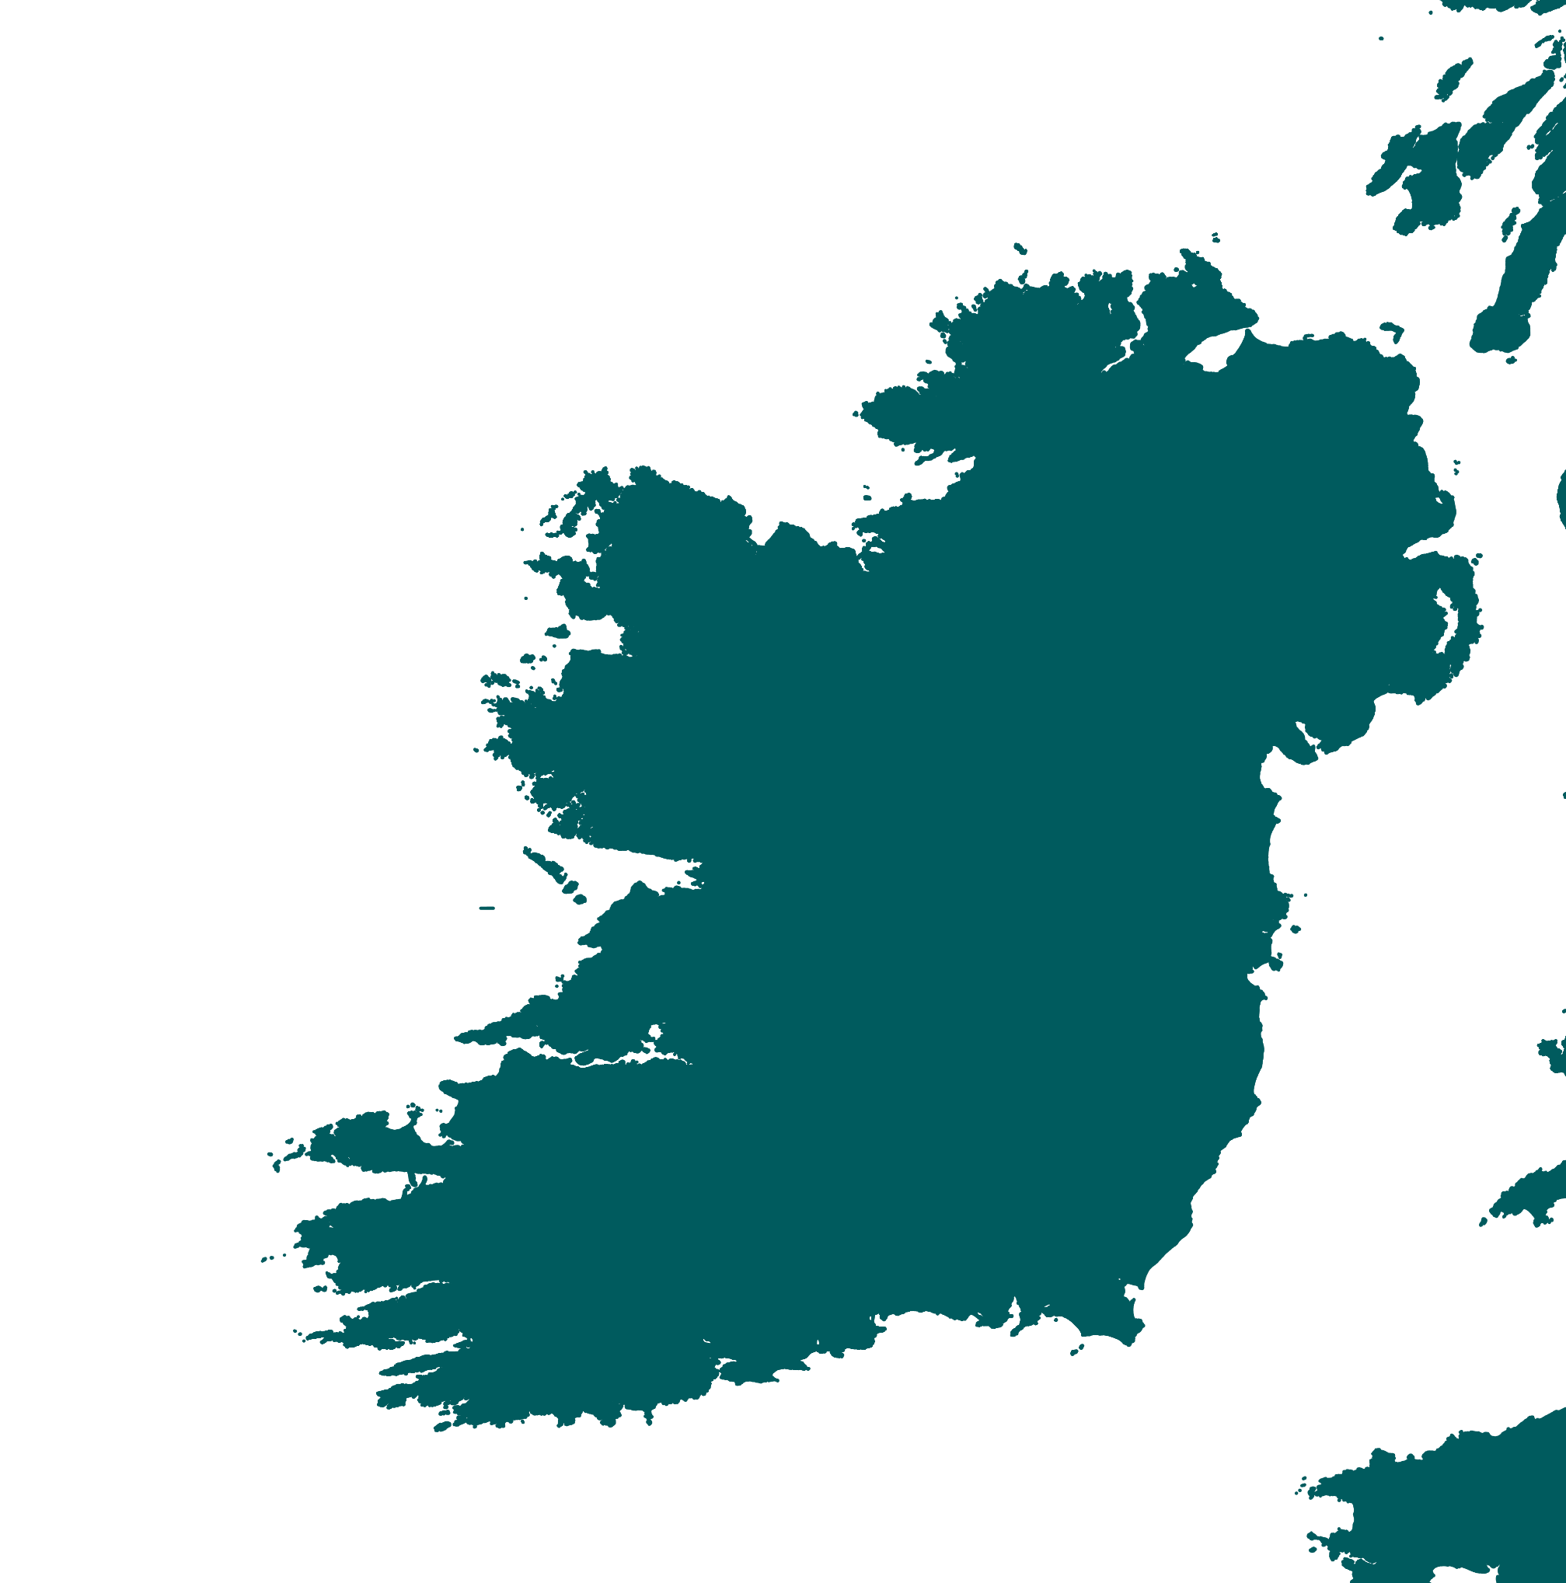
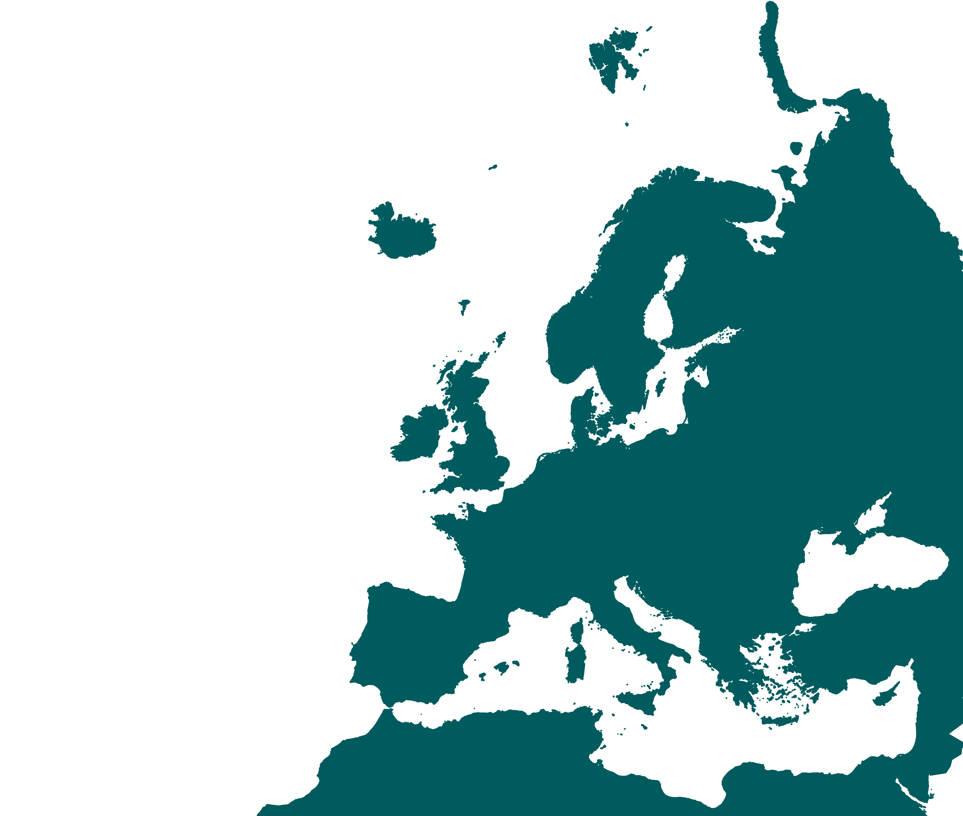







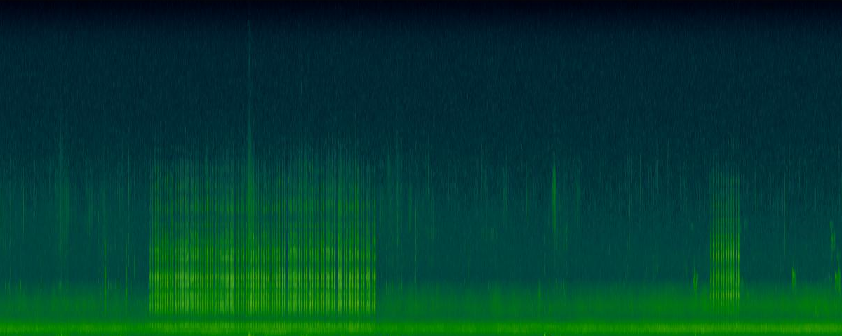







Extract environmental and temporal variables
Variables showed influence on the calling activity
CONCLUSIONS
To increase detectability, corncrake surveys on:
Cool T°
Calm wind
Bright nights
0100-0200hrs
May/June
Long-term recording in corncrake areas
Detect and extract duration of corncrake calls
crex crex crex
GAM
Calling activity ~
Temperature +
Cloud cover +
Wind speed +
Lunar fraction +
Hour +
Date +
Site (random effect)
431h of corncrake calling
2878h collected

