Slide 1
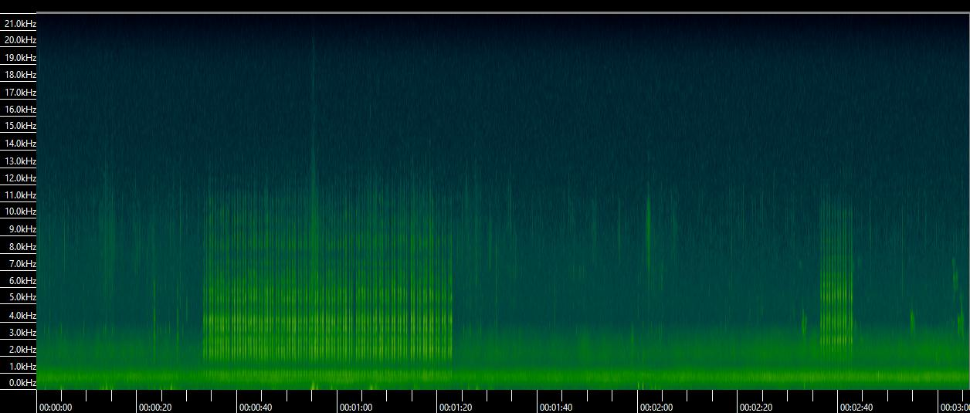
>1 minute
Start
End
Start
End
Event 1
Event 2

