Slide 1
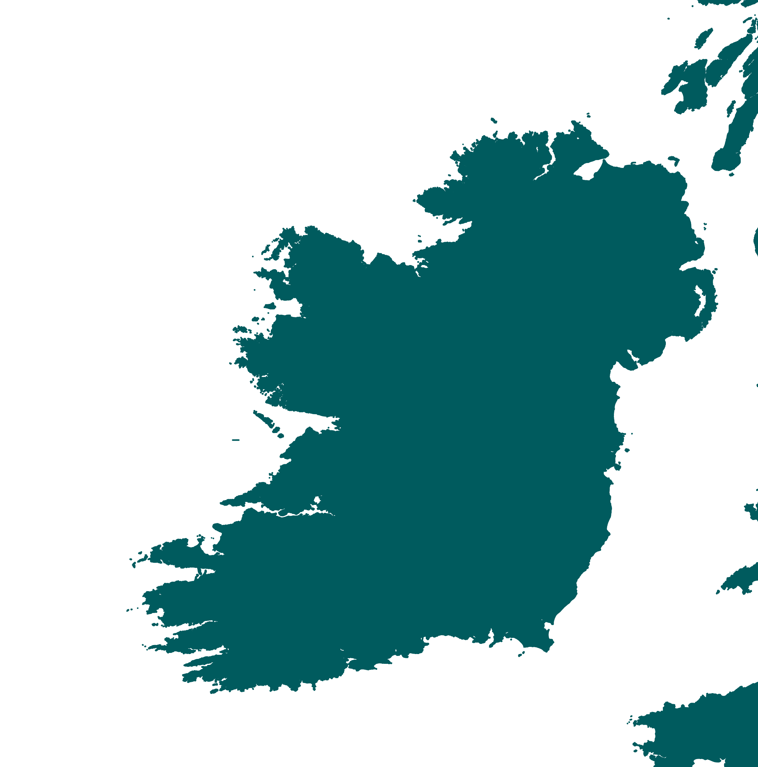






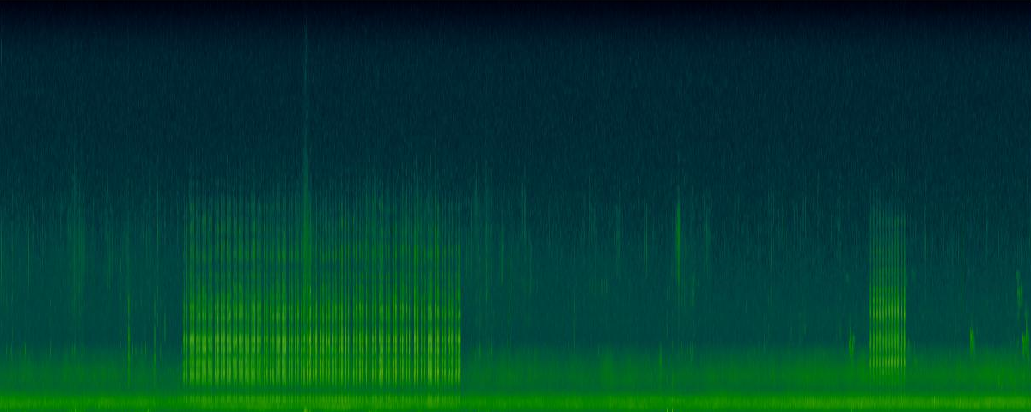








\
Variables showed influence on the calling activity
CONCLUSIONS
Surveys on:
Cool T°
Calm wind
Bright nights
0100-0200hrs
May/June
Extract environmental and temporal variables
Long-term recording in corncrake areas
Detect and extract duration of corncrake calls
crex crex crex
GAM
Calling activity ~
Environmental +
Temporal variables
431h of calling
2878h collected

