Slide 1




𝖣𝖠𝖳𝖠𝖲𝖤𝖳’25
ECDS
BHASHAVANI
Transparent, clinician-aligned speech assessment using ASR, rule-based scoring, and Explainable AI
TEAM NAME: ctrl+alt+elite

Slide 2
𝖣𝖠𝖳𝖠𝖲𝖤𝖳’25
ECDS
“PROBLEM STATEMENT”
“Multilingual Speech-Language Assessment Platform with Automated ASR
Scoring & Therapy Authoring Tools ”

Slide 3
𝖣𝖠𝖳𝖠𝖲𝖤𝖳’25
OUR SOLUTION:
“A speech-language assessment platform for pronunciation practice”
Mentor-authored assessments using predefined word set
Automated speech-to-text using ASR
Rule-based pronunciation scoring
Explainable AI generates learner-friendly summaries
Supports Indian Languages
ECDS

Slide 4
𝖣𝖠𝖳𝖠𝖲𝖤𝖳’25
ECDS
“INNOVATION & USP”
1. Explainable AI (Key USP)
Phoneme-level error detection
AI-generated summaries instead of black-box scores
2. Mentor-Authored Assessments
Assessments created using structured JSON files
No coding required to add or modify content
3. Clinically Aligned Design
Mirrors real speech-therapy workflows
Generates sample summaries / SOAP-style feedback
4. Hackathon-Safe & Scalable
Lightweight prototype
Easily extendable to full teletherapy systems

Slide 5
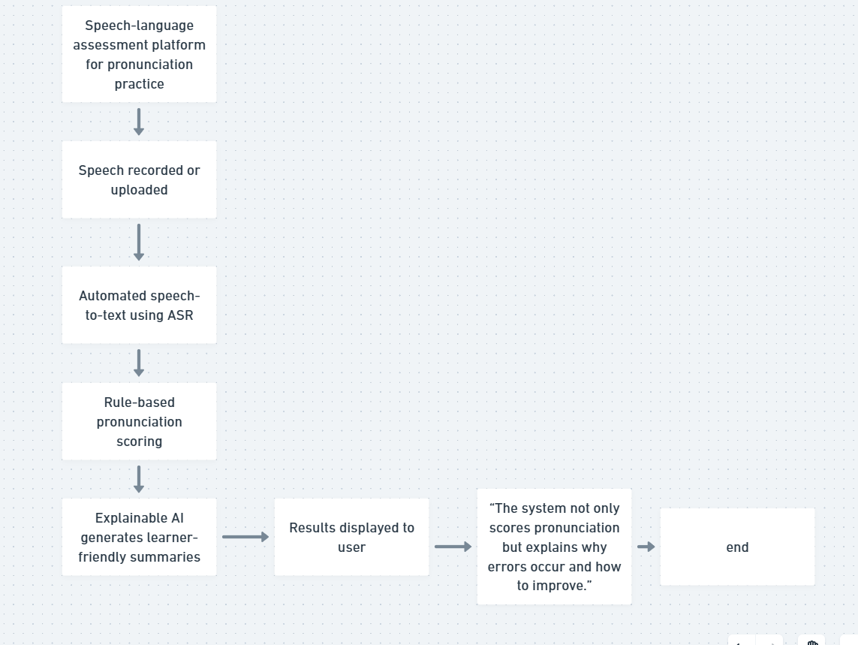
𝖣𝖠𝖳𝖠𝖲𝖤𝖳’25
ECDS
WORKFLOW DIAGRAM WITH TECH STACK:
UI: Streamlit
ASR: Whisper
Scoring: Rule-based logic
Explainable AI: RAG + LLM
Data: JSON (assessments), local storage

Slide 6
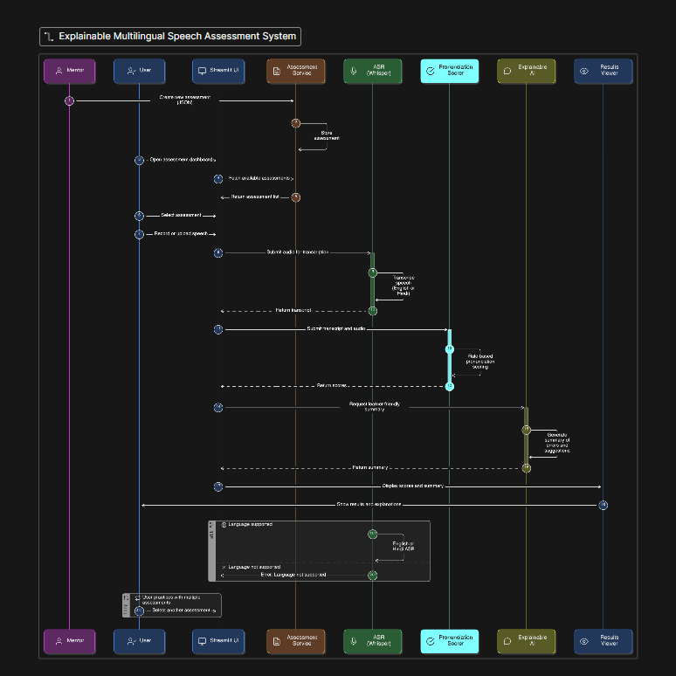
𝖣𝖠𝖳𝖠𝖲𝖤𝖳’25
Sequential Diagram
ECDS

Slide 7
𝖣𝖠𝖳𝖠𝖲𝖤𝖳’25
ECDS
Future Scope
Multi-language pronunciation assessment
Accent-aware ASR fine-tuning
Sentence & image-based tasks
Therapist & parent dashboards
Teletherapy integration

Slide 8
𝖣𝖠𝖳𝖠𝖲𝖤𝖳’25
ECDS
Key Features
Explainable Pronunciation Assessment
Phoneme-level error detection with clear explanations
Transparent Rule-Based Scoring
Deterministic, auditable scoring (no black-box ML)
Responsible Generative AI (RAG)
AI used only for summaries & SOAP-style feedback
Mentor-Authored Assessments
Topic-based assessments defined by mentors
Multilingual-Ready Design
English assessment + Hindi ASR proof-of-concept

Slide 9
𝖣𝖠𝖳𝖠𝖲𝖤𝖳’25
ECDS
“Satyanarayana Karthikeya Kuna(23BAI1178)
Parit Gupta(23BAI1240)
Keshav Sharma(23BAI1165)
Chaitanya Singh(23BAI1435)”

