Slide 1
Anomaly Detection
By - Paritosh Goel
Source for Dataset - http://kdd.ics.uci.edu/databases/entree/entree.html
Notes:
This PowerPoint Template includes a series of slide masters with predefined layouts and color schemes for formatting slides
Slide Masters are displayed when you right click on a slide and select Layout from menu

Slide 2
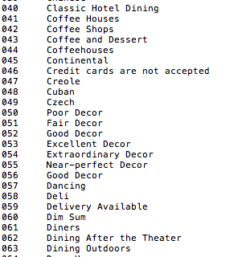
Dataset and Guiding Questions
Dataset - List of restaurants with their features (total 256 features) in Chicago city.
Total 675 restaurants, 256 features.
Guiding Questions -
What are the most unique types of restaurants in the chicago city which are different from the rest.
How many are such restaurants and what are the features of them.
Apart from cuisine, what other factors can make a restaurant unique in chicago

Slide 3
Process
Created a single data source - list of restaurants and their features
All the values of features were either 0 or 1
Used Below techniques for Anomaly Detection
Plotted the proximity matrix for 675 restaurants. (Euclidean Distance)
K Nearest Distance
Average of Knearest Distance
Local Outlier Factor
For all above apart from proximity matrix, plotted the Anomaly Score with datasets (restaurants)

Slide 4
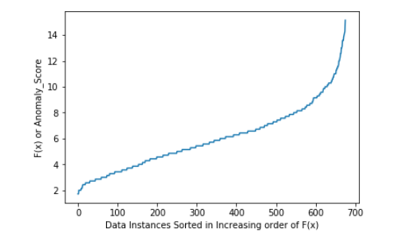
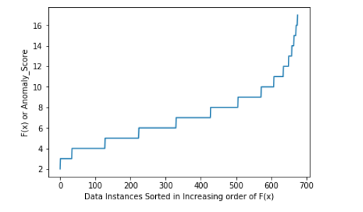
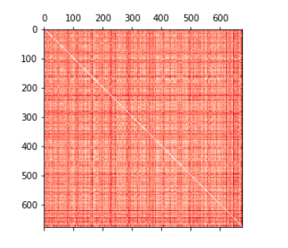
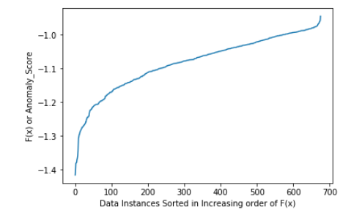
Results

Slide 5
Facts
One of the restaurants marked as outlier - Ed Debevic's Short Orders Deluxe
Features - Weekend Brunch, After Hours Dining, Good for Younger Kids, Excellent Decor etc.

