Slide 1
Reinforcement Learning
Reinforcement Learning supports automation by learning from the environment it is present in, so does Machine Learning and Deep Learning, not the same strategy, but both support automation. So, why Reinforcement Learning?

Slide 2
Deep Learning and Machine Learning, are learning processes as well, but which are most focused on finding patterns in the existing data
Reinforcement Learning, on the other hand, does this learning by trial and error method, and eventually, gets to the right actions or the global optimum. The significant additional advantage of Reinforcement Learning is that we need not provide the whole training data as in Supervised Learning. Instead, a few chunks would suffice.

Slide 3
Example: Teaching a Cat
cats don’t understand our language so we can’t tell them what we want to do with them
emulate a situation, and your cat tries to respond in many different ways. If the cat’s response is the desired one, we reward them with milk.
the next time the cat is exposed to the same situation, the cat executes a similar action with even more enthusiasm in expectation of more food
learning from positive responses, if they are treated with negative respo
this is how Reinforcement Learning works,
Input
Machine
Reward System
REWARD MAXIMISATION
End GOAL
Actions

Slide 4

Algorithm Cheat Sheet

Slide 5
Linear Regression
Regression is a technique used to model and analyze the relationships between variables and often times how they contribute and are related to producing a particular outcome together
In statistics, linear regression is a linear approach to modelling the relationship between a scalar response (or dependent variable) and one or more explanatory variables (or independent variables).
What is dependent variable?
What is independent variable?

Slide 6
Establishing a linear relationship between the input variables(X) and single output variable(Y)
Type of Linear Regression
Linear Regression
Simple Linear Regression
Multiple Linear Regression
there are multiple input variables(X)
input(X) is a single variable

Slide 7

Simple Linear Regression
We have one input variable - X and one output variable - Y
Goal is to build linear relationship between these variables
Input Variable-Independent Variable
Output Variable-Dependent Variable
Equation as follows
β1​ is called a scale factor or coefficient and β0​ is called bias coefficient.
Bias coefficient gives extra degree of freedom

Slide 8


Degree of Freedom: the number of independent values or quantities which can be assigned to a statistical distribution
Equation of Line
Comparison of equation of simple linear regression with equation of line
How to Find the coefficients?

Slide 9
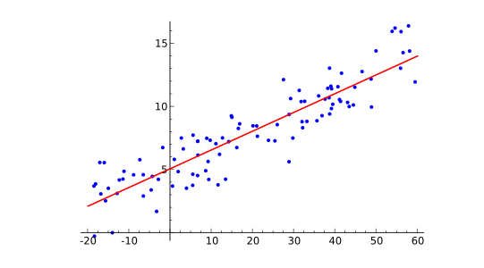
Ordinary Least Square Method
Let as suppose we have few inputs and outputs. And we plot these scatter points in 2D space
what we are going to accomplish-Line in the Image and we want to minimize the error of our model

Slide 10
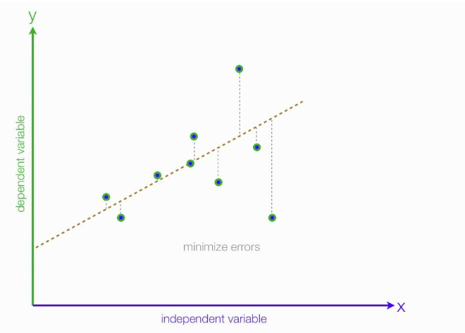
What is the error ?
-error of each point is the distance between line and that point

Slide 11
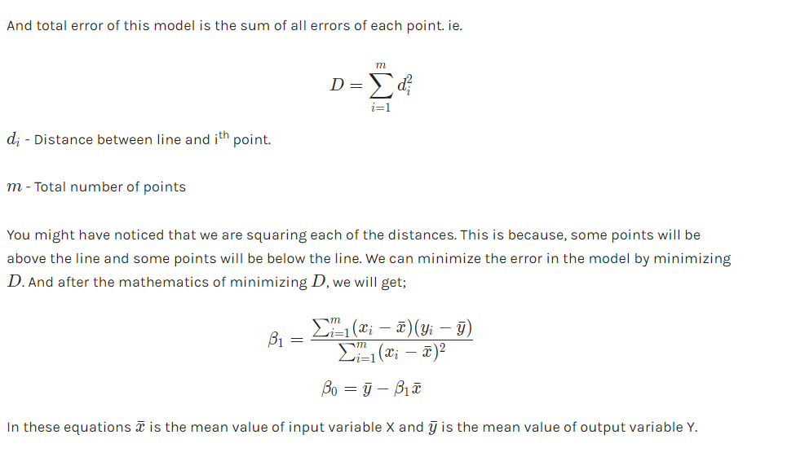

Slide 12
Python Implementation

Slide 13
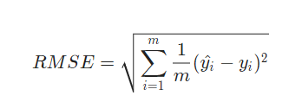
Model Evaluation
We will use Root Mean Squared Error and Coefficient of Determination(R2 Score).
Root Mean Squared Error is the square root of sum of all errors divided by number of values, or Mathematically,
Here yi​^​ is the i^{th} predicted output values..

Slide 14
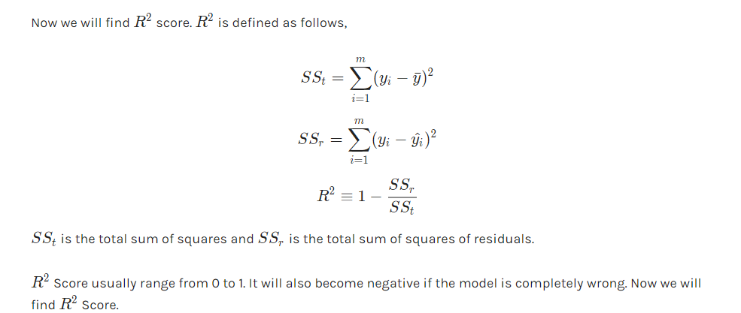

Slide 15
SCIKIT LEARN
Simple and efficient tools for data mining and data analysis
Accessible to everybody, and reusable in various contexts
Built on NumPy, SciPy, and matplotlib
Open source, commercially usable - BSD license

Slide 16
Basic Overview of Scikit Learn
Every algorithm in Scikit is exposed via an Estimator
First step will be importing model
General Form -- from sklearn.family import Model
example:
from sklearn.linear_model import LinearRegression
Estimators: All the parameters of an estimator can be set when it is initialized and have suitable default values
Splitting test and train data:
from sklearn.cross_validation import train_test_split
Training the Model:
model.fit(X_train,y_train)
The parameters depend on the type of estimator initiated
Prediction:
model.predict(X_test)

Slide 17
Linear Regression Implementation with Scikit Learn

Slide 18
Multiple Linear Regression

Slide 19
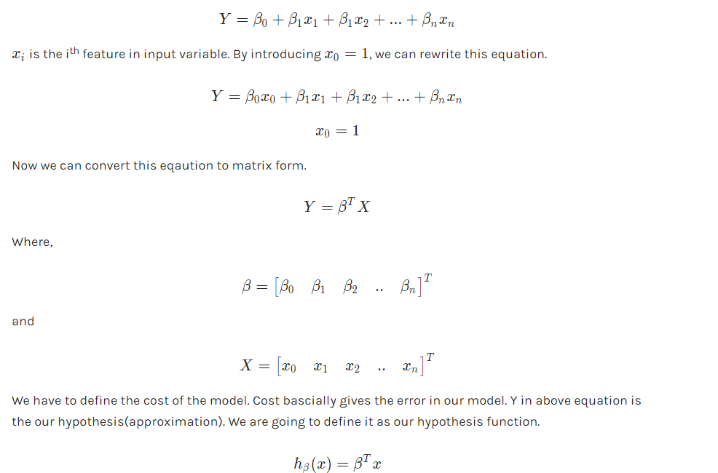
Model Representation

Slide 20
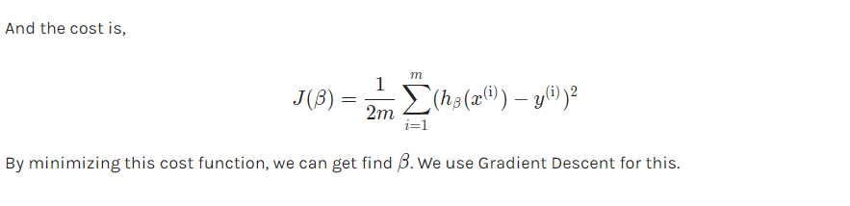

Slide 21
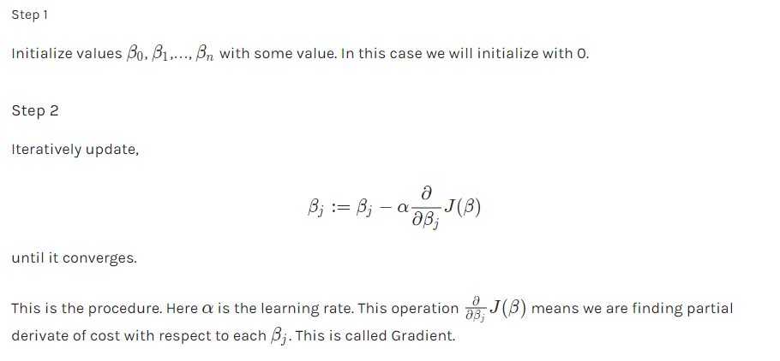
Gradient Descent
Gradient Descent is an optimization algorithm. We will optimize our cost function using Gradient Descent Algorithm.

Slide 22
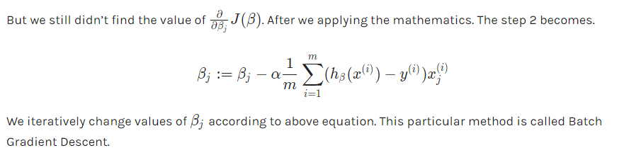

Slide 23
Python Implementation

Slide 24
Logistic Regression
In a classification problem, the target variable(or output), y, can take only discrete values for given set of features(or inputs), X.
target variable is categorical. Based on the number of categories
Logistic regression can be classified as:
binomial: target variable can have only 2 possible types: “0” or “1” which may represent “win” vs “loss”, “pass” vs “fail”, “dead” vs “alive”, etc.
multinomial: target variable can have 3 or more possible types which are not ordered(i.e. types have no quantitative significance) like “disease A” vs “disease B” vs “disease C”.
ordinal: it deals with target variables with ordered categories. For example, a test score can be categorized as:“very poor”, “poor”, “good”, “very good”. Here, each category can be given a score like 0, 1, 2, 3.

Slide 25

Consider an example dataset which maps the number of hours of study with the result of an exam. The result can take only two values, namely passed(1) or failed(0):
HOURS(X) | 0.50 | 0.75 | 1.0 | 1.25 | 1.50 | 1.75 | 2.0 | 2.25 | 2.50
PASS(Y) | 0 | 0 | 0 | 1 | 0 | 1 | 1 | 1 | 1

Slide 26
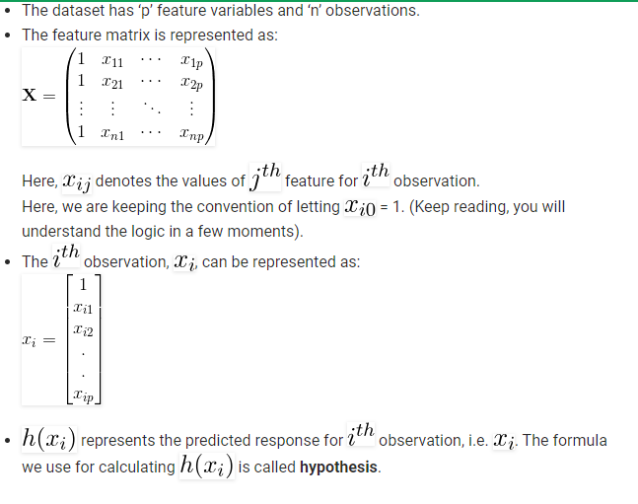
In order to generalize our model, we assume that:

Slide 27
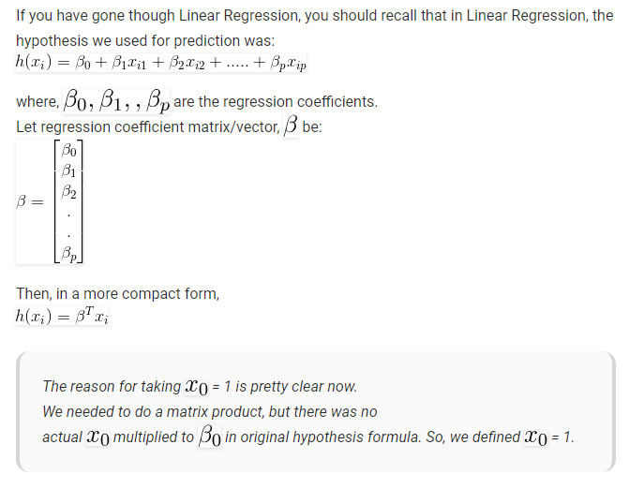

Slide 28
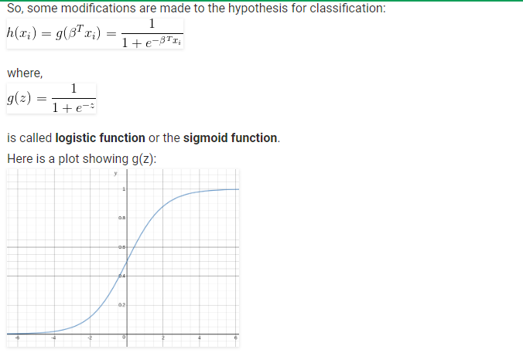
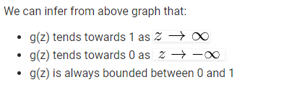

Slide 29
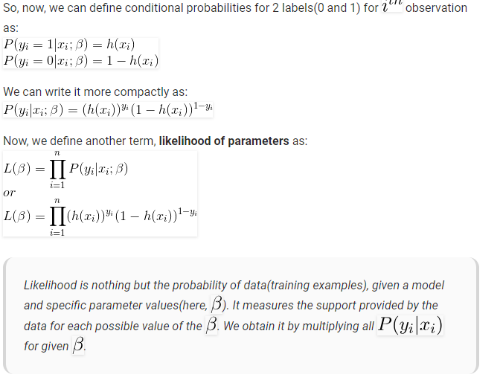
conditional probabilities:
the probability of an event ( A ), given that another ( B ) has already occurred.

Slide 30
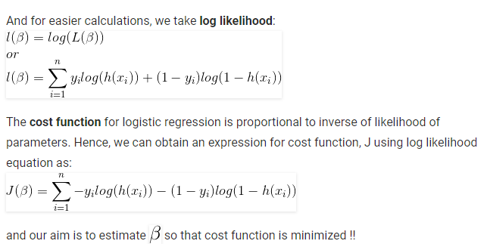

Slide 31
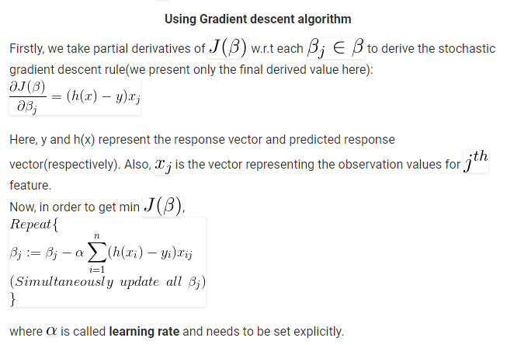

Slide 32
Python Implementation

Slide 33
K Nearest Neighbours
In pattern recognition, the k-nearest neighbors algorithm (k-NN) is a non-parametric method used for classification and regression.
In both cases, the input consists of the k closest training examples in the feature space. The output depends on whether k-NN is used for classification or regression:
In k-NN classification, the output is a class membership. An object is classified by a plurality vote of its neighbors, with the object being assigned to the class most common among its k nearest neighbors (k is a positive integer, typically small). If k = 1, then the object is simply assigned to the class of that single nearest neighbor.
In k-NN regression, the output is the property value for the object. This value is the average of the values of its k nearest neighbors.

Slide 34
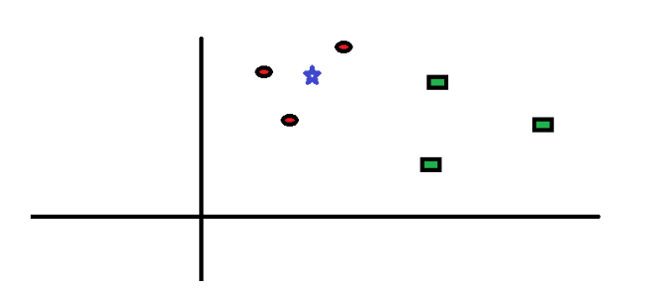
How does the KNN algorithm work?
red circles (RC)
green squares (GS)

Slide 35
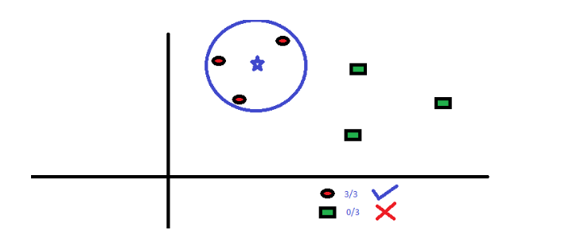
The “K” in KNN algorithm is the nearest neighbors we wish to take vote from. Let’s say K = 3. Hence, we will now make a circle with BS(Blue Star) as center just as big as to enclose only three data points on the plane.

Slide 36
