Slide 1
Reinforcement Learning
Reinforcement Learning supports automation by learning from the environment it is present in, so does Machine Learning and Deep Learning, not the same strategy, but both support automation. So, why Reinforcement Learning?

Slide 2
Deep Learning and Machine Learning, are learning processes as well, but which are most focused on finding patterns in the existing data
Reinforcement Learning, on the other hand, does this learning by trial and error method, and eventually, gets to the right actions or the global optimum. The significant additional advantage of Reinforcement Learning is that we need not provide the whole training data as in Supervised Learning. Instead, a few chunks would suffice.

Slide 3
Example: Teaching a Cat
cats don’t understand our language so we can’t tell them what we want to do with them
emulate a situation, and your cat tries to respond in many different ways. If the cat’s response is the desired one, we reward them with milk.
the next time the cat is exposed to the same situation, the cat executes a similar action with even more enthusiasm in expectation of more food
learning from positive responses, if they are treated with negative respo
this is how Reinforcement Learning works,
Input
Machine
Reward System
REWARD MAXIMISATION
End GOAL
Actions

Slide 4

Algorithm Cheat Sheet

Slide 5
Linear Regression
Regression is a technique used to model and analyze the relationships between variables and often times how they contribute and are related to producing a particular outcome together
In statistics, linear regression is a linear approach to modelling the relationship between a scalar response (or dependent variable) and one or more explanatory variables (or independent variables).
What is dependent variable?
What is independent variable?

Slide 6
Establishing a linear relationship between the input variables(X) and single output variable(Y)
Type of Linear Regression
Linear Regression
Simple Linear Regression
Multiple Linear Regression
there are multiple input variables(X)
input(X) is a single variable

Slide 7

Simple Linear Regression
We have one input variable - X and one output variable - Y
Goal is to build linear relationship between these variables
Input Variable-Independent Variable
Output Variable-Dependent Variable
Equation as follows
β1​ is called a scale factor or coefficient and β0​ is called bias coefficient.
Bias coefficient gives extra degree of freedom

Slide 8


Degree of Freedom: the number of independent values or quantities which can be assigned to a statistical distribution
Equation of Line
Comparison of equation of simple linear regression with equation of line
How to Find the coefficients?

Slide 9
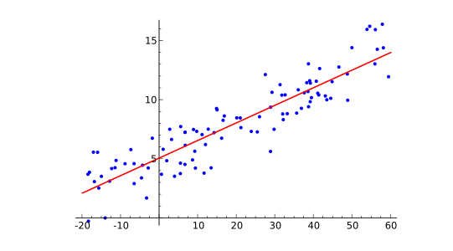
Ordinary Least Square Method
Let as suppose we have few inputs and outputs. And we plot these scatter points in 2D space
what we are going to accomplish-Line in the Image and we want to minimize the error of our model

Slide 10
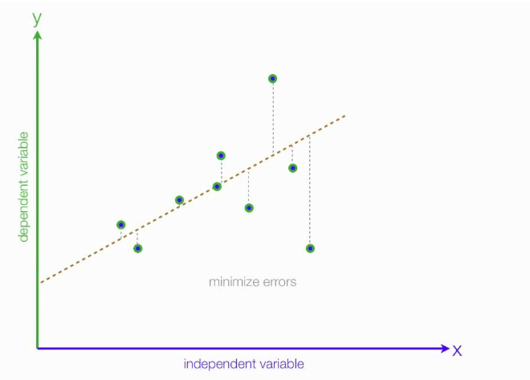
What is the error ?
-error of each point is the distance between line and that point

Slide 11
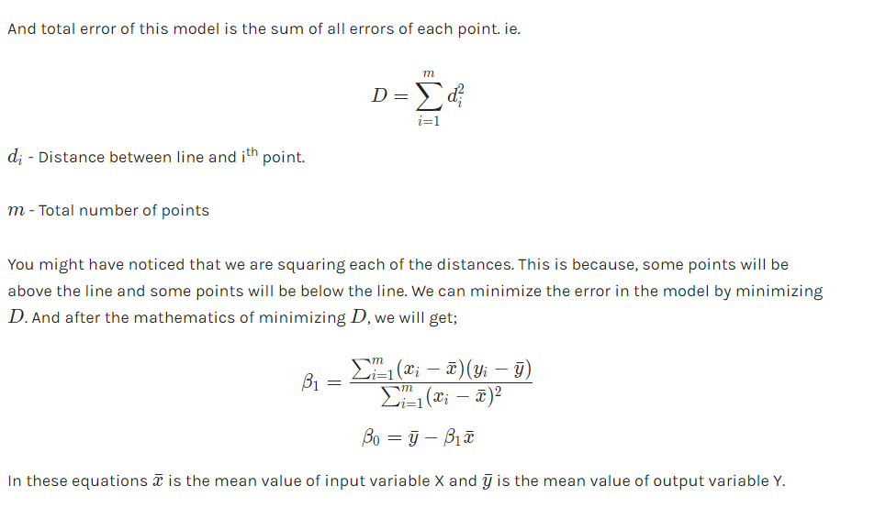

Slide 12
Python Implementation

Slide 13
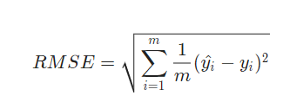
Model Evaluation
We will use Root Mean Squared Error and Coefficient of Determination(R2 Score).
Root Mean Squared Error is the square root of sum of all errors divided by number of values, or Mathematically,
Here yi​^​ is the i^{th} predicted output values..

Slide 14
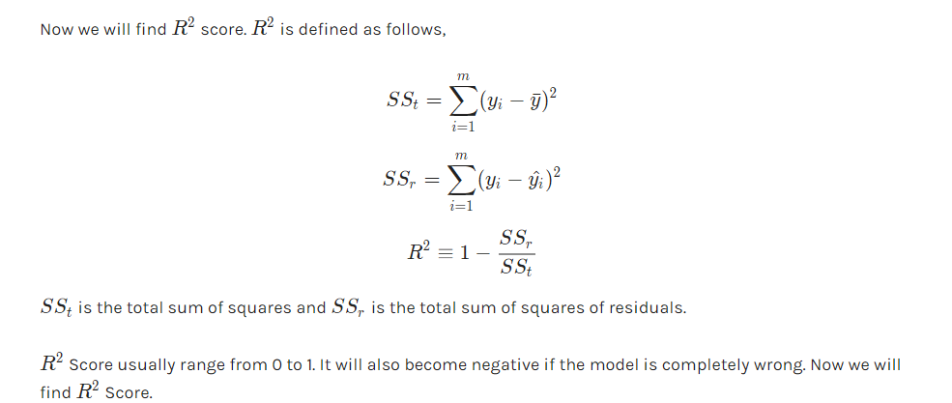

Slide 15
SCIKIT LEARN
Simple and efficient tools for data mining and data analysis
Accessible to everybody, and reusable in various contexts
Built on NumPy, SciPy, and matplotlib
Open source, commercially usable - BSD license

Slide 16
Basic Overview of Scikit Learn
Every algorithm in Scikit is exposed via an Estimator
First step will be importing model
General Form -- from sklearn.family import Model
example:
from sklearn.linear_model import LinearRegression
Estimators: All the parameters of an estimator can be set when it is initialized and have suitable default values
Splitting test and train data:
from sklearn.cross_validation import train_test_split
Training the Model:
model.fit(X_train,y_train)
The parameters depend on the type of estimator initiated
Prediction:
model.predict(X_test)

Slide 17
Linear Regression Implementation with Scikit Learn

Slide 18
Multiple Linear Regression

