Slide 1

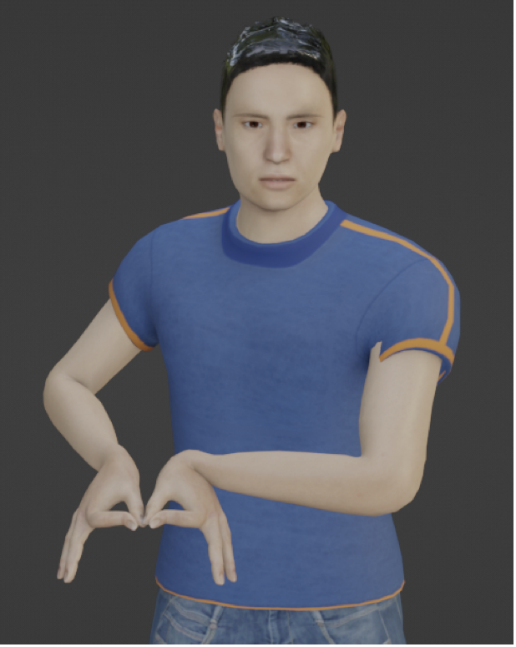
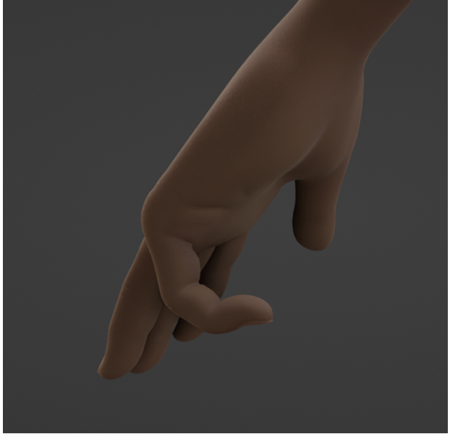
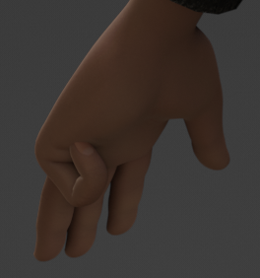
Category + Country + Iraq
BAD!!
GOOD!!
0.5
1
Morph: left-little-finger-closed

