Slide 1
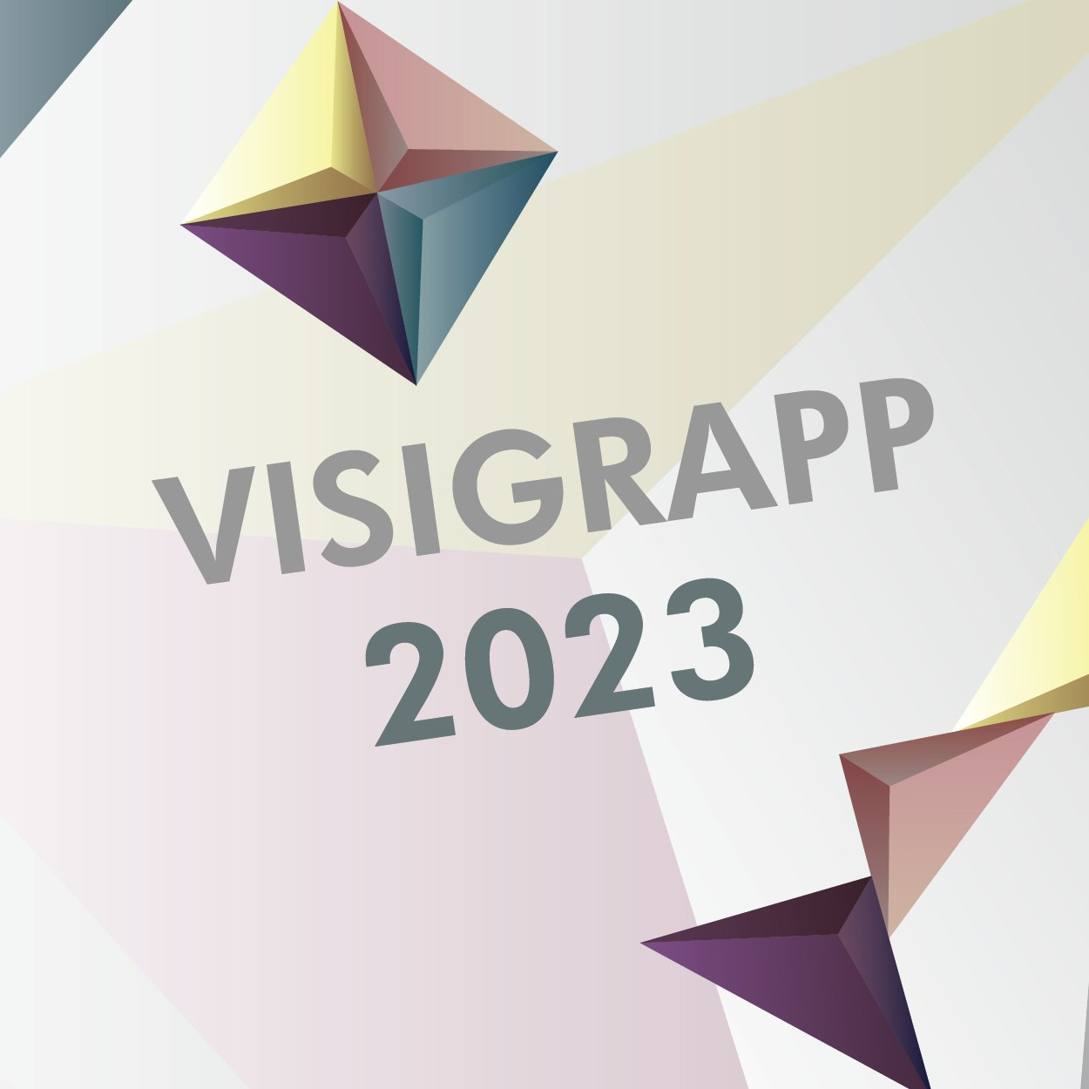




A Layered Approach to Constrain Signing Avatars
Paritosh Sharma February 21, 2023
Laboratoire Interdisciplinaire des Sciences du Numérique – LISN
paritosh.sharma@lisn.upsaclay.fr
1

Slide 2
About Me
Sign Language synthesis by a decreasing granularity system from AZee
Paritosh Sharma, PhD Computer Science
Advisor: Michael Filhol LISN, Université Paris-Saclay, Orsay, France
2

Slide 3
About Me: Goals
Synthesize sign language from a formal linguistic model
Increase the coverage of the synthesis
Naturalness of the synthesized animation
What does the animation model want from the linguistic model?
3

Slide 4
Background: Animating Sign Language
Create animation by concatenating(Pezeshkpour et al., 1999)
Example: Dog + I like
Problem: Need a pre-animated sign for every gloss
Solution: Procedural methods(GIBET et al., 2001)
Problem: Still linear
4

Slide 5
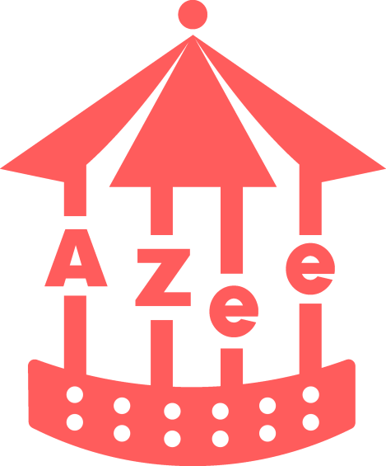
Background: AZee
Proposed by Filhol in 2014
Non-linear
Allows us to write parameterized signed forms for semantic functions
Generates a timeline
5

Slide 6
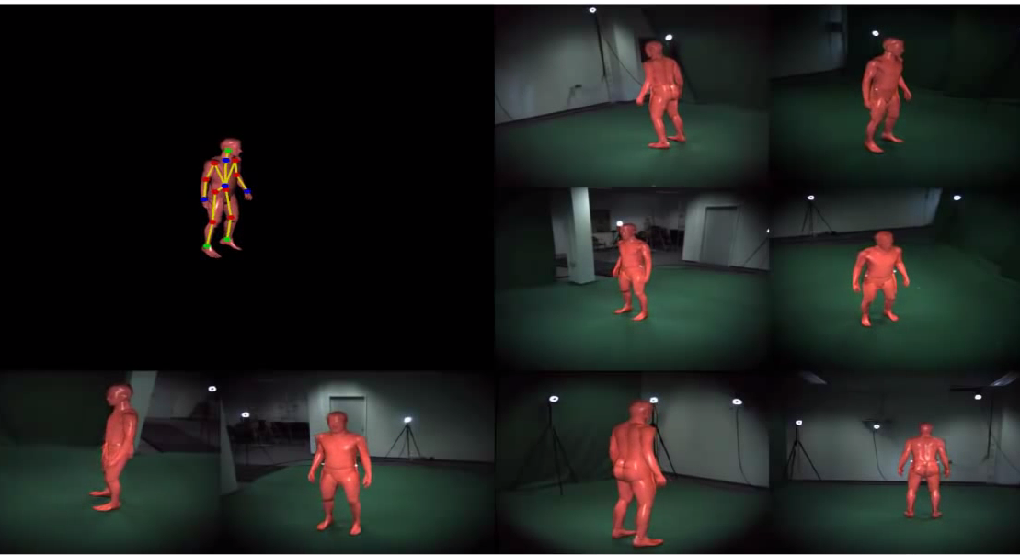
Background: Animation Techniques
Pre-animated(Mocap, Artist defined, etc.)
Labor intensive
Difficult to isolate signs(for Mocap)
Problems with Re-targeting
Silhouette tracking
Building from low-level(Bottom-Up)
Robotic
6

Slide 7
Background: Animating with AZee
TOPIC
Cat
:info-about
'topic
:cat
'info
:cute
HAND_PLACE_TRILL.INFO
INFO
Cute
HAND_CONFIG.INFO
HOLD1
HOLD2
BLINK
7

Slide 8
Background: Bottom-up synthesis of :cute
More Blocks
Posture Constraints
:dog
(static)
(dynamic)
Place hand on abdomen
Orient…
Transition
Transpath
Trill or Shake the hand along an axis
8

Slide 9
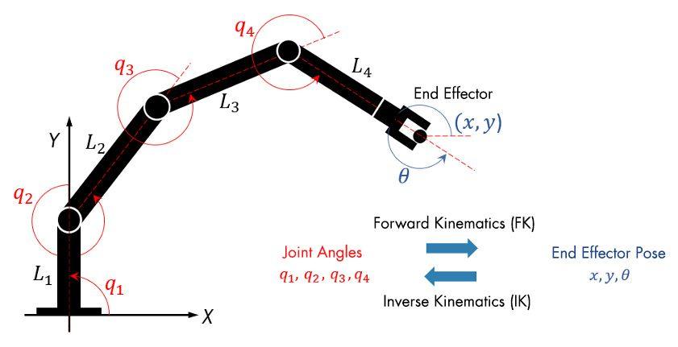
Background: Bottom-up synthesis: IK vs FK
Inverse Kinematics Problems contained in a block
9
Source: https://www.mathworks.com/discovery/inverse-kinematics.html

Slide 10
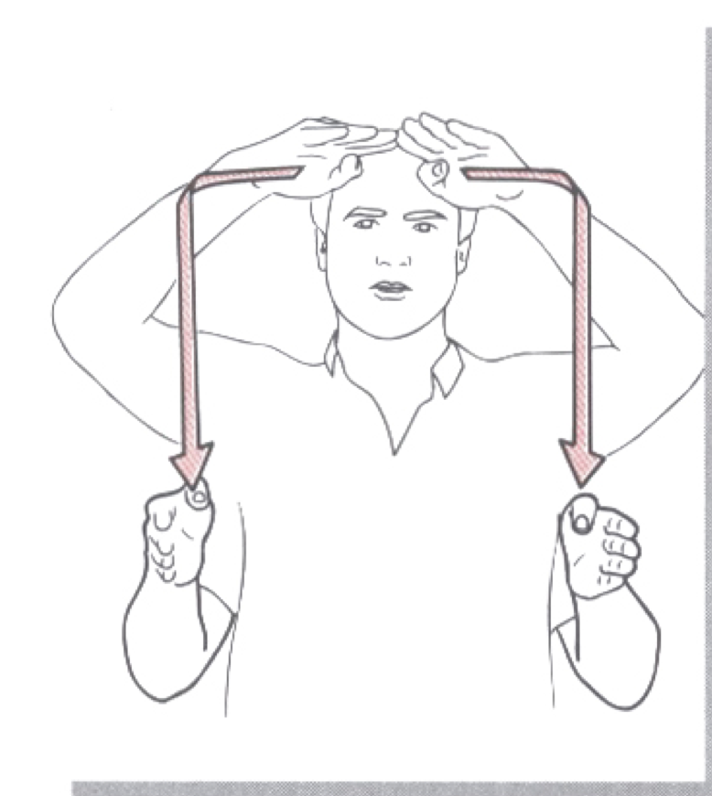
Problem
Restriction using IK and joint limits only
Loss of chain when evaluating transpaths
How to extend low-level constraints?
Marionette effect during IK
Source: Moody(1997
10

Slide 11
Solution: Layers
Define separate layers based on the constraint evaluation.
Order constraints in the blocks based on dependencies.
Apply constraint on a specific layer and update the layer.
11

Slide 12
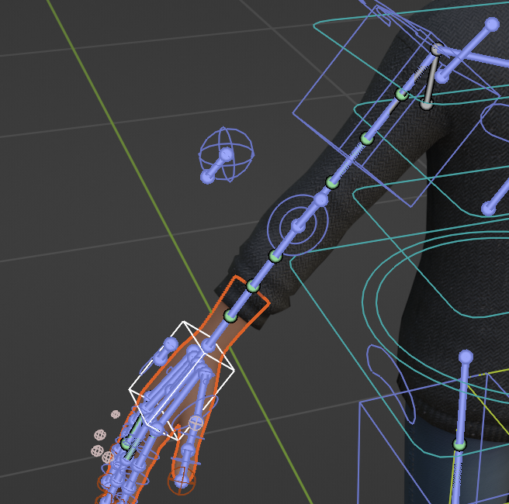
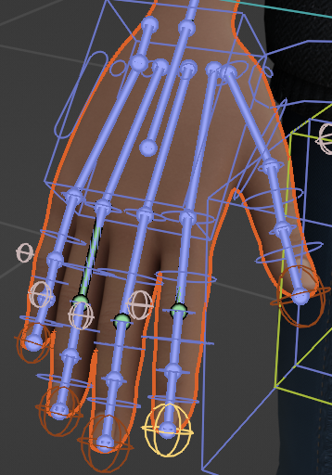
IK Layer
IK layer for hands, fingers and spine.
Reuse the same chain for transpath evaluation.
Hand IK chain
Finger IK chain
12

Slide 13
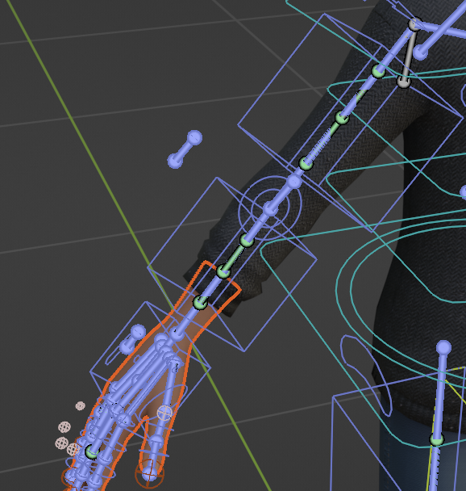
FK Layer
Used for evaluating forward kinematics such as orient, trill.
FK for hand
13
11/22

Slide 14
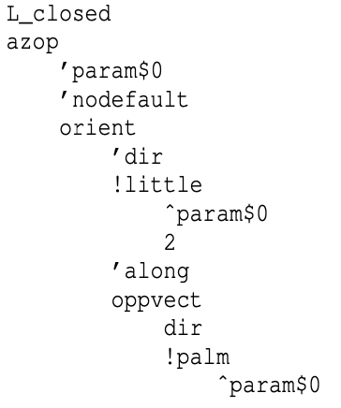
Morph Layer
Morph layer when motion space is 1D
Facial expressions using shape keys
Morph for index_r
14
11/22

Slide 15
Ordering the blocks
Create a dependency acyclic graph based on block dependencies.
Topologic sorting for evaluation order.
Wrist movement 1
Transition(interpolation ) 1
Configuration
…
Wrist movement 2
15
11/22

Slide 16
Results
1

Slide 17
Future Work
Evaluation
Parameterizing the pre-animated motion data
Projection of low-level constraints to the motion space of pre-animated blocks.
Increasing the naturalness of our bottom-up.
Combining pre-animated and bottom-up
Testing and debugging our blender add-on for longer discourses.
17
11/22

Slide 18
Thank you
And
Questions?
1

