Slide 1
AZee Bottom-up Synthesis
By :
Paritosh Sharma
07/04/2022

Slide 2
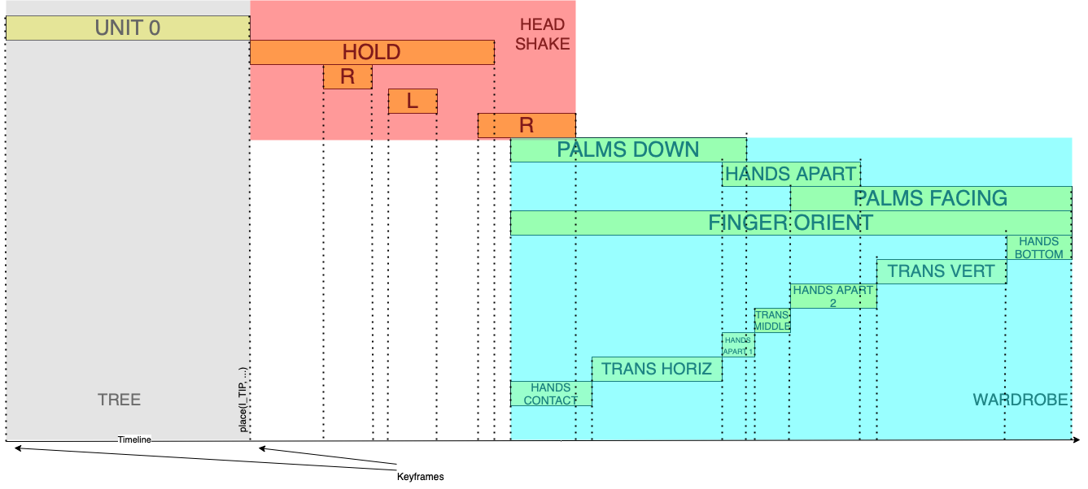
Bottom-up synthesis before

Slide 3
Conflicting cases
Untimely evaluation of block
Orient blocks evaluated earlier
Transpaths and Holds

Slide 4
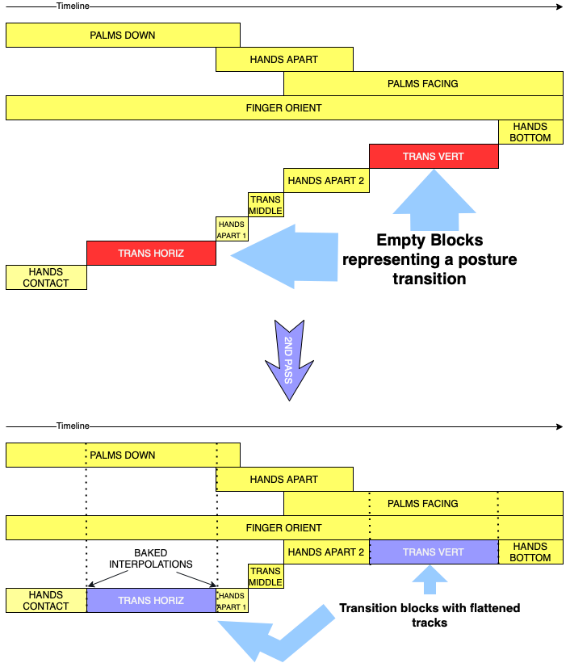
Animator 2nd pass

Slide 5
Results

Slide 6
Limitations
Evaluation
Other constraints, morph, trill, etc.
Testing on larger expressions
Ambient animation

