Slide 1

The Cortana Intelligence Suite
Building Solutions with the Cortana Intelligence Suite – Business Understanding
Microsoft Machine Learning and Data Science Team
CortanaIntelligence.com
Notes:
Main page -http://cortanaanalytics.com
To begin this module, you should have:
Basic Math and Stats skills
Business and Domain Awareness
General Computing Background
NOTE: These workbooks contain many resources to lead you through the course, and provide a rich set of references that you can use to learn much more about these topics. If the links do not resolve properly, type the link address in manually in your web browser. If the links have changed or been removed, simply enter the title of the link in a web search engine to find the new location or a corollary reference.

Slide 2
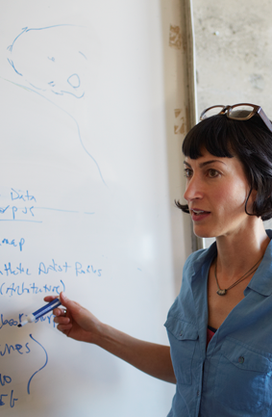
Learning Objectives
Determine questions from Business Requirements
Locate and document data sources for Advanced Analytics
Use patterns to create Solution Frameworks
Notes:
At the end of this Module, you will:
Determine questions from Business Requirements
Locate and document data sources for Advanced Analytics
Use patterns to create Solution Frameworks

Slide 3
The Data Science Process and Platform
Notes:
This process largely follows the CRISP-DM model - http://www.sv-europe.com/crisp-dm-methodology/

Slide 4
The Team Data Science Process
Business Understanding
Define Objectives
Identify Data Sources
Data Acquisition and Understanding
Ingest Data
Explore Data
Modeling
Feature Selection
Create and Train Model
Deployment
Customer Acceptance
Operationalize
Testing and Validation
Update Data
Handoff
Re-train and re-score
Notes:
It also references the Cortana Intelligence process - https://azure.microsoft.com/en-us/documentation/articles/data-science-process-overview/
A complete process diagram is here - https://azure.microsoft.com/en-us/documentation/learning-paths/cortana-analytics-process/
Some walkthrough’s of the various services - https://azure.microsoft.com/en-us/documentation/articles/data-science-process-walkthroughs/
An integrated process and toolset allows for a more close-to-intent deployment
Iterations are required to close in on the solution – but are harder to manage and monitor
Data Science Blog - https://buckwoody.wordpress.com/

Slide 5
The Cortana Intelligence Platform
Big Data
Intelligence and Advanced Analytics
Information Management
Solutions
Visualization
Data Catalog
Data Factory
Event Hubs
Data Lake
SQL Data Warehouse
Cosmos DB
Cortana, Bot Service, Cognitive Framework
HDInsight
Data Lake
Azure Storage
Stream Analytics
Analysis Services
Power BI
R
Templates and Gallery
Machine Learning
Notes:
Azure Data Catalog - http://azure.microsoft.com/en-us/services/data-catalog (Doc It)
Azure Data Factory - http://azure.microsoft.com/en-us/services/data-factory/ (Move It)
Azure Event Hubs - http://azure.microsoft.com/en-us/services/event-hubs/ (Bring It)
Platform and Storage - Microsoft Azure – http://microsoftazure.com Storage - https://azure.microsoft.com/en-us/documentation/services/storage/ (Host It)
Azure Data Lake - http://azure.microsoft.com/en-us/campaigns/data-lake/ (Store It)
Azure SQL Data Warehouse - http://azure.microsoft.com/en-us/services/sql-data-warehouse/ (Relate It)
Azure Cosmos DB - https://docs.microsoft.com/en-us/azure/cosmos-db/introduction
Cortana - http://blogs.windows.com/buildingapps/2014/09/23/cortana-integration-and-speech-recognition-new-code-samples/ and https://blogs.windows.com/buildingapps/2015/08/25/using-cortana-to-interact-with-your-customers-10-by-10/ and https://developer.microsoft.com/en-us/Cortana (Say It)
Cognitive Services - https://www.microsoft.com/cognitive-services
Bot Framework - https://dev.botframework.com/
Azure Machine Learning - http://azure.microsoft.com/en-us/services/machine-learning/ (Learn It)
Azure HDInsight - http://azure.microsoft.com/en-us/services/hdinsight/ (Scale It)
Azure Stream Analytics - http://azure.microsoft.com/en-us/services/stream-analytics/ (Stream It)
Analysis Services - https://docs.microsoft.com/en-us/azure/analysis-services/analysis-services-overview
Power BI - https://powerbi.microsoft.com/ (See It)
All of the components within the suite - https://www.microsoft.com/en-us/server-cloud/cortana-intelligence-suite/what-is-cortana-intelligence.aspx
Templates - https://gallery.cortanaintelligence.com/browse?orderby=freshness%20desc&skip=0&categories=%5B%2210%22%5D and https://caqs.azure.net/#gallery

Slide 6
Defining your Objectives
Notes:
Depends on the customer - https://www.microsoft.com/en-us/cloud-platform/cortana-intelligence-suite-industry-solutions
If you’re building a Cognitive Solution, it should be:
Interactive
Adaptive
Iterative with State
Contextual

Slide 7

Business Case
Wide World Importers is a company that imports and distributes products in multiple countries around the globe.
With several thousand employees, Information Technology is at the heart of our business operations, and has a significant cost.
Since we handle materials in multiple countries, we have a lot of private data, financial information, and other targets which have a high security profile. We are concerned with both external and internal attacks. In addition, many of our employees work in remote locations, some on ships and other challenging environments.
All of our IT systems have been modernized, and we’re taking in a significant amount of semi-structured data from computing devices – most of it real-time. After talking with our IT leadership, we need a way to determine anomalies within the data streams we get, and have a way to observe the anomalies in a dashboard so that we can respond to outages, threats, and changes quickly.
Notes:
More about Wide World Importers: https://docs.microsoft.com/en-us/sql/sample/world-wide-importers/overview
Anomaly Detection: https://gallery.cortanaintelligence.com/Solution/Anomaly-Detection-in-Real-time-Data-Streams

Slide 8

Design Statements
Wide World Importers is a company that imports and distributes products in multiple countries around the globe.
With several thousand employees, Information Technology is at the heart of our business operations, and has a significant cost.
Since we handle materials in multiple countries, we have a lot of private data, financial information, and other targets which have a high security profile. We are concerned with both external and internal attacks. In addition, many of our employees work in remote locations, some on ships and other challenging environments.
All of our IT systems have been modernized, and we’re taking in a significant amount of semi-structured data from computing devices – most of it real-time. After talking with our IT leadership, we need a way to determine anomalies within the data streams we get, and have a way to observe the anomalies in a dashboard so that we can respond to outages, threats, and changes quickly.
Notes:
More about Wide World Importers: https://docs.microsoft.com/en-us/sql/sample/world-wide-importers/overview
Anomaly Detection: https://gallery.cortanaintelligence.com/Solution/Anomaly-Detection-in-Real-time-Data-Streams

Slide 9
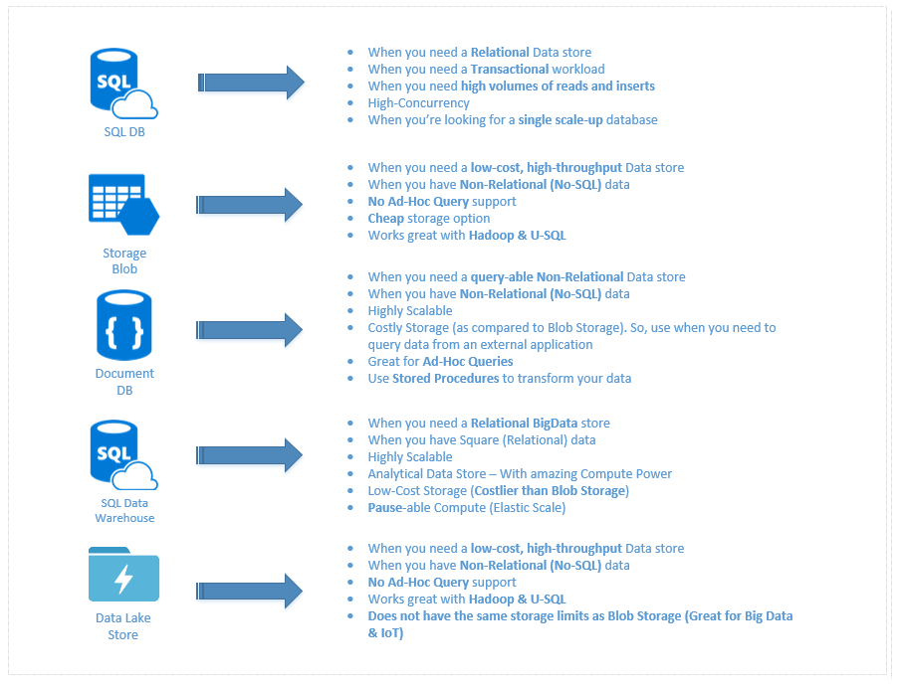
Data Storage Technologies
Notes:
A discussion of this graphic: https://buckwoody.wordpress.com/2016/05/16/the-cortana-intelligence-suite-what-to-use-when/

Slide 10
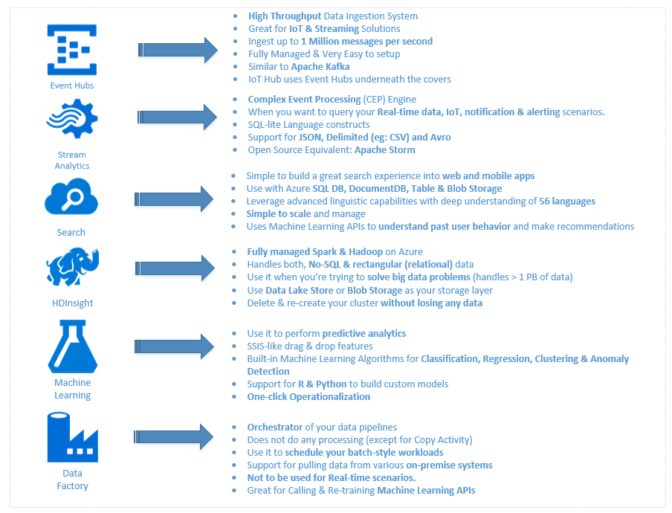
Data Processing Technologies
Notes:
A discussion of this graphic: https://buckwoody.wordpress.com/2016/05/16/the-cortana-intelligence-suite-what-to-use-when/

Slide 11
Decision Matrix
Decision | Technology | Elements | Rationale
Large amounts of semi-structured data | Azure Tables | Scale, KVP, Multi-access | Can be used by multiple technologies or queried
Fast, multiple sources of data | Event Hubs, Stream Analytics | Speed, complex processing | Fast Ingestion of massive datasets
Anomaly detection | Azure ML | API-Driven detection | Built-in algorithms, multi-dev
Reporting | SQL DB, Power BI | Ease of reporting, data visualization | Standard queries, action-based visualizations
System monitoring and management | Azure Data Factory, Application Insights | Actionable system metrics | OOB orchestration and reporting
Notes:
Another approach on decision matrices: http://www.businessnewsdaily.com/6146-decision-matrix.html

Slide 12
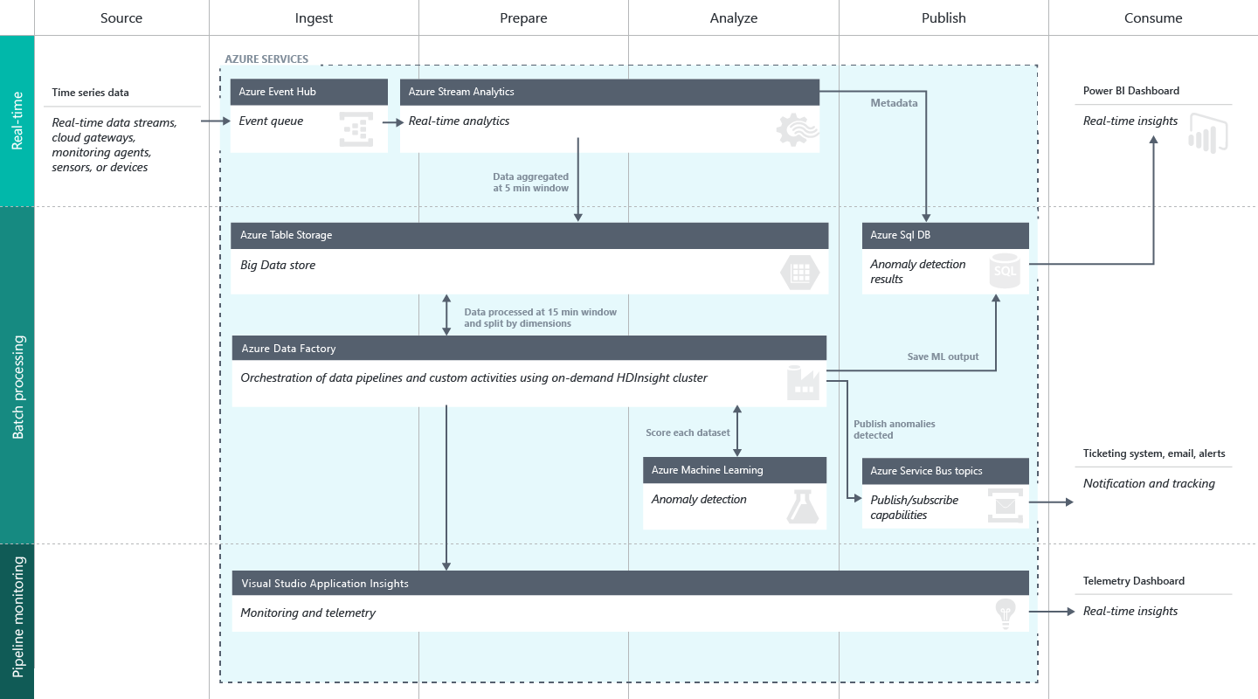
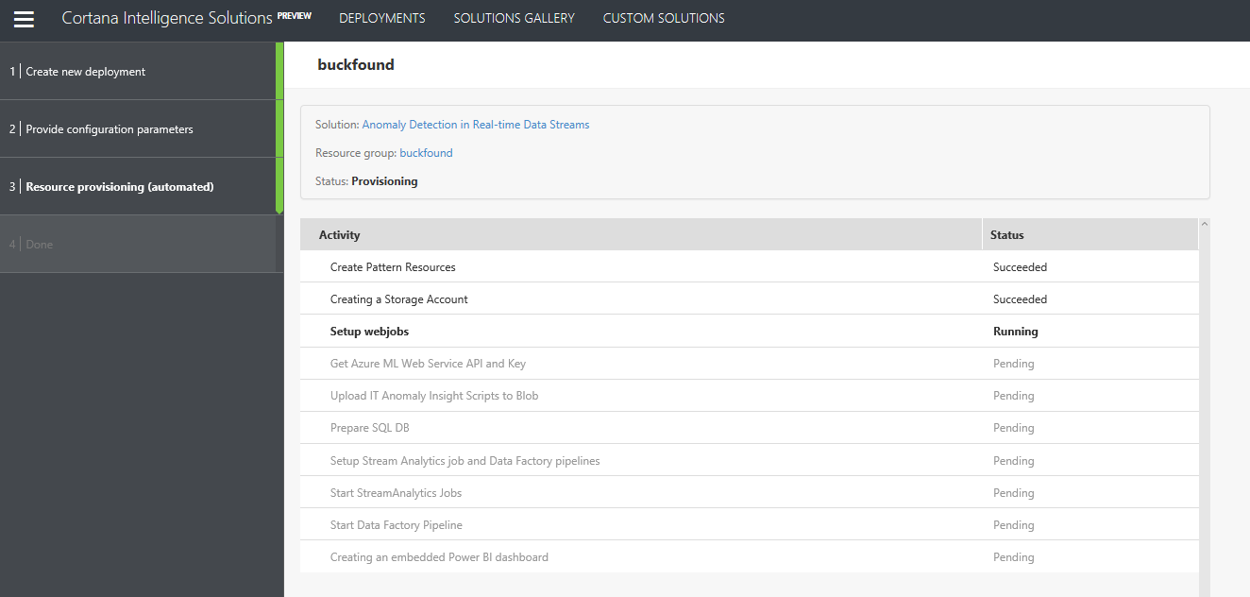
Create a Solution Workflow
Notes:
Full description is here: https://github.com/Azure/itanomalyinsights-cortana-intelligence-preconfigured-solution/blob/master/Docs/IT%20Anomaly%20Insights%20Post%20Deployment%20Instructions.md
Create your own Solution Templates: https://start.cortanaintelligence.com/CustomSolutions
More solution tutorials: https://gallery.cortanaintelligence.com/browse?categories=%5B%227%22%5D&skip=0&orderby=trending%20desc&tags=%5B%22Solution%22%5D

Slide 13
Identify Data Sources
Notes:
Data Validation: https://msdn.microsoft.com/en-us/library/aa291820(v=vs.71).aspx

Slide 14
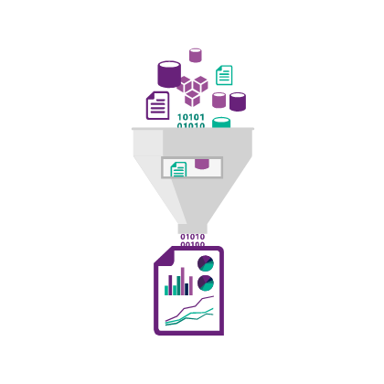
Locating and Inspecting data
Keys to quality source data
Authority
Spread
Consistency
Types and Units
Representation
Notes:
1. In reference to machine learning, but applicable to all data usage: https://azure.microsoft.com/en-us/documentation/articles/machine-learning-data-science-prepare-data/

Slide 15
Azure Data Catalog
Register data sources
Tag the data
Document the data
Search and connect
Notes:
Full example: https://azure.microsoft.com/en-us/documentation/articles/data-catalog-get-started/

Slide 16
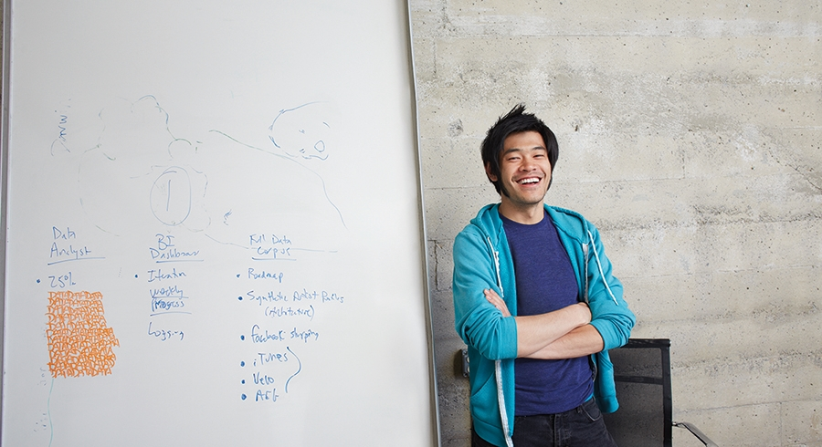


Lab:
Adding and searching data on the Azure Data Catalog
Notes:
Open this dataset: https://github.com/Azure/itanomalyinsights-cortana-intelligence-preconfigured-solution/blob/master/Samples/Data-Generator/ADGeneratorData/addemo_input_v1.csv
Note these headings:
"Time" : DATETIME (required) "The timestamp of the event in UTC or UNIX timestamp format (Seconds since Epoch)",
"Value" : FLOAT (required) "The metric value of the event",
"Metric" : VARCHAR(500) (required) "The unique identifier of a particular time series",
"Host" : VARCHAR(100) (required) "The name of the host where the event is fired",
"Region" : VARCHAR(100) (optional) "The region where the event occurs; can be empty",
"Scenario" : VARCHAR(100) (optional) "The scenario to which the event belongs to, can be empty,
"Category" : VARCHAR(100) (optional) "The category associated with the event; can be empty",
"Application" : VARCHAR(500) (optional) "Originating application of the event; can be empty“
3. Open this report reference: https://gallery.cortanaintelligence.com/Solution/Anomaly-Detection-in-Real-time-Data-Streams
4. Follow the instructions from the teacher

