Slide 1

The Cortana Intelligence Suite
Building Solutions with the Cortana Intelligence Suite – Data Acquisition and Understanding
Microsoft Machine Learning and Data Science Team
CortanaIntelligence.com
Notes:
Main page -http://cortanaanalytics.com
To begin this module, you should have:
Basic Math and Stats skills
Business and Domain Awareness
General Computing Background
NOTE: These workbooks contain many resources to lead you through the course, and provide a rich set of references that you can use to learn much more about these topics. If the links do not resolve properly, type the link address in manually in your web browser. If the links have changed or been removed, simply enter the title of the link in a web search engine to find the new location or a corollary reference.

Slide 2

Learning Objectives
Ingest data into the Azure platform
Explore data using various tools
Update data documentation
Create a mechanism to orchestrate and manage data flows through a solution
Notes:
At the end of this Module, you will be able to:
Ingest data into the Azure platform
Explore data using various tools
Update data documentation
Create a mechanism to orchestrate and manage data flows through a solution
the CIS Process

Slide 3
The Data Science Process and Platform
Notes:
This process largely follows the CRISP-DM model - http://www.sv-europe.com/crisp-dm-methodology/

Slide 4
The Team Data Science Process
Business Understanding
Define Objectives
Identify Data Sources
Data Acquisition and Understanding
Ingest Data
Explore Data
Modeling
Feature Selection
Create and Train Model
Deployment
Customer Acceptance
Operationalize
Testing and Validation
Update Data
Handoff
Re-train and re-score
Notes:
It also references the Cortana Intelligence process - https://azure.microsoft.com/en-us/documentation/articles/data-science-process-overview/
A complete process diagram is here - https://azure.microsoft.com/en-us/documentation/learning-paths/cortana-analytics-process/
Some walkthrough’s of the various services - https://azure.microsoft.com/en-us/documentation/articles/data-science-process-walkthroughs/
An integrated process and toolset allows for a more close-to-intent deployment
Iterations are required to close in on the solution – but are harder to manage and monitor
Data Science Blog - https://buckwoody.wordpress.com/

Slide 5
The Cortana Intelligence Platform
Big Data
Intelligence and Advanced Analytics
Information Management
Solutions
Visualization
Data Catalog
Data Factory
Event Hubs
Data Lake
SQL Data Warehouse
Cosmos DB
Cortana, Bot Service, Cognitive Framework
HDInsight
Data Lake
Azure Storage
Stream Analytics
Analysis Services
Power BI
R
Templates and Gallery
Machine Learning
Notes:
Azure Data Catalog - http://azure.microsoft.com/en-us/services/data-catalog (Doc It)
Azure Data Factory - http://azure.microsoft.com/en-us/services/data-factory/ (Move It)
Azure Event Hubs - http://azure.microsoft.com/en-us/services/event-hubs/ (Bring It)
Platform and Storage - Microsoft Azure – http://microsoftazure.com Storage - https://azure.microsoft.com/en-us/documentation/services/storage/ (Host It)
Azure Data Lake - http://azure.microsoft.com/en-us/campaigns/data-lake/ (Store It)
Azure SQL Data Warehouse - http://azure.microsoft.com/en-us/services/sql-data-warehouse/ (Relate It)
Azure Cosmos DB - https://docs.microsoft.com/en-us/azure/cosmos-db/introduction
Cortana - http://blogs.windows.com/buildingapps/2014/09/23/cortana-integration-and-speech-recognition-new-code-samples/ and https://blogs.windows.com/buildingapps/2015/08/25/using-cortana-to-interact-with-your-customers-10-by-10/ and https://developer.microsoft.com/en-us/Cortana (Say It)
Cognitive Services - https://www.microsoft.com/cognitive-services
Bot Framework - https://dev.botframework.com/
Azure Machine Learning - http://azure.microsoft.com/en-us/services/machine-learning/ (Learn It)
Azure HDInsight - http://azure.microsoft.com/en-us/services/hdinsight/ (Scale It)
Azure Stream Analytics - http://azure.microsoft.com/en-us/services/stream-analytics/ (Stream It)
Analysis Services - https://docs.microsoft.com/en-us/azure/analysis-services/analysis-services-overview
Power BI - https://powerbi.microsoft.com/ (See It)
All of the components within the suite - https://www.microsoft.com/en-us/server-cloud/cortana-intelligence-suite/what-is-cortana-intelligence.aspx
Templates - https://gallery.cortanaintelligence.com/browse?orderby=freshness%20desc&skip=0&categories=%5B%2210%22%5D and https://caqs.azure.net/#gallery

Slide 6
Data Ingestion
Notes:
Example of a 3rd Party Solution: https://www.veeam.com/fastscp-azure-vm.html

Slide 7
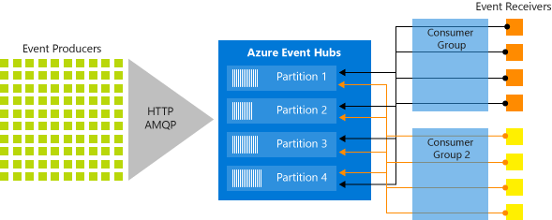
Azure Event Hubs
Notes:
Overview - https://docs.microsoft.com/en-us/azure/event-hubs/event-hubs-what-is-event-hubs
Authentication and Security - https://docs.microsoft.com/en-us/azure/event-hubs/event-hubs-authentication-and-security-model-overview
Full programming guide - https://docs.microsoft.com/en-us/azure/event-hubs/event-hubs-programming-guide

Slide 8
Options for data ingestion
PowerShell
Azure Data Factory
Azure Event Hubs
Azure storage SDKs (.NET, Node.js, python, C++, etc.)
AzCopy (blob, file, and table only)
Import/Export service
Notes:
PowerShell in Azure Storage - https://azure.microsoft.com/en-us/documentation/articles/storage-powershell-guide-full/
Azure Data Factory data movement - https://azure.microsoft.com/en-us/documentation/articles/data-factory-data-movement-activities/
Azure Automation - https://azure.microsoft.com/en-us/documentation/articles/automation-intro/
Azure storage SDKs – for examples see https://azure.microsoft.com/en-us/documentation/articles/storage-dotnet-how-to-use-blobs/
Azure tools and SDKs in general can be downloaded here - https://azure.microsoft.com/en-us/downloads/
MS Azure Storage Explorer - http://storageexplorer.com/
AzCopy - https://azure.microsoft.com/en-us/documentation/articles/storage-use-azcopy/
Import/Export service - https://azure.microsoft.com/en-us/documentation/articles/storage-import-export-service/

Slide 9
Connect on-prem to <anything>
VPN Gateway
Send network traffic from virtual networks to on-prem locations
Send network traffic between virtual networks within Azure
Site-to-site vs. Point-to-site
You can connect multiple on-prem locations to a virtual network (Multi-site)
ExpressRoute can directly connect your WAN to Azure
Tool-Specific
Notes:
VPN Information: https://azure.microsoft.com/en-us/documentation/articles/vpn-gateway-about-vpngateways/
Connecting to VPN’s: https://azure.microsoft.com/en-us/documentation/articles/vpn-gateway-vpn-faq/#connecting-to-virtual-networks
Using ExpressRoute: https://azure.microsoft.com/en-us/documentation/articles/expressroute-faqs/

Slide 10



Lab:
Work with Table Storage
Notes:
Start your Data Science Virtual Machine and connect to it
Navigate to this location: https://docs.microsoft.com/en-us/azure/storage/storage-powershell-guide-full
Scroll down to the section marked: “How to manage Azure tables and table entities”
Open Azure PowerShell on your DSVM and follow the steps through “How to delete a table”

Slide 11
Data Exploration
Notes:
Understanding the statistics of exploring data: http://danshuster.com/apstat/apstat_chap01.pdf

Slide 12
Exploring Data
Microsoft R
Azure ML
Excel
Other Tools
Notes:
Data Exploration and Predictive Modeling with R - https://msdn.microsoft.com/en-us/library/mt590947.aspx
Data Exploration with Azure ML - https://blogs.technet.microsoft.com/machinelearning/2015/09/24/data-exploration-with-azure-ml/
Statistics Using Excel – http://www.excelfunctions.net/Excel-Statistical-Functions.html
Sed, awk, grep (in Windows as well) - https://www.simple-talk.com/cloud/data-science/data-science-laboratory-system---testing-the-text-tools-and-sample-data/
Data Science Blog: https://buckwoody.wordpress.com/

Slide 13
Update the Azure Data Catalog
Search
Add Tags
Add Experts
Thoroughly document the data
Notes:
Full example: https://azure.microsoft.com/en-us/documentation/articles/data-catalog-get-started/

Slide 14
Lab:
Exploring your data
Notes:
Using the building.csv and HVAC.csv files in your \Resources folder, use R, Excel, Azure ML or any other exploration tools you’ve seen in the class to explore the shape, size, layout, distribution and other characteristics you can find in the data.
Document that in any format and be ready to discuss.
Examine the incoming data, noting the information you set up in the Data Catalog: https://github.com/Azure/itanomalyinsights-cortana-intelligence-preconfigured-solution/blob/master/Samples/Data-Generator/ADGeneratorData/addemo_input_v1.csv
Are there any insights you can gain from that data? Is there anything you would update in the Data Catalog?

Slide 15
Update Data
Notes:
Primary Site: https://azure.microsoft.com/en-us/services/data-factory/
2-minute overview video: https://channel9.msdn.com/Blogs/Windows-Azure/Introduction-to-Azure-Data-Factory/

Slide 16
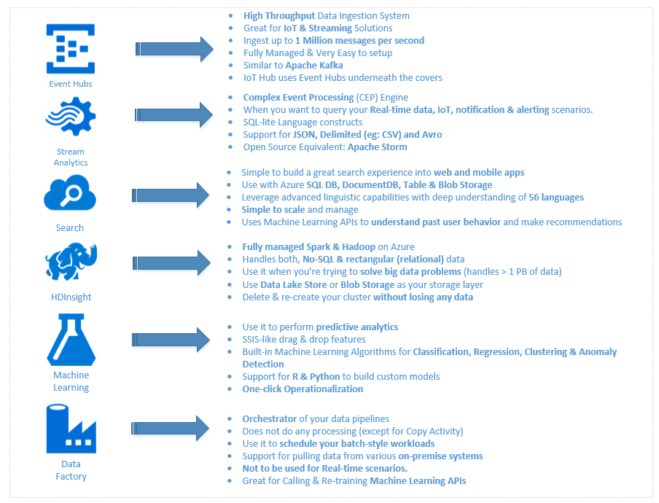
Options
Notes:
A discussion of this graphic: https://buckwoody.wordpress.com/2016/05/16/the-cortana-intelligence-suite-what-to-use-when/

Slide 17
Decision Matrix
Decision | Technology | Elements | Rationale
Large amounts of semi-structured data | Azure Tables | Scale, KVP, Multi-access | Can be used by multiple technologies or queried
Fast, multiple sources of data | Event Hubs, Stream Analytics | Speed, complex processing | Fast Ingestion of massive datasets
Anomaly detection | Azure ML | API-Driven detection | Built-in algorithms, multi-dev
Reporting | SQL DB, Power BI | Ease of reporting, data visualization | Standard queries, action-based visualizations
System monitoring and management | Azure Data Factory, Application Insights | Actionable system metrics | OOB orchestration and reporting
Notes:
Another approach on decision matrices: http://www.businessnewsdaily.com/6146-decision-matrix.html

Slide 18
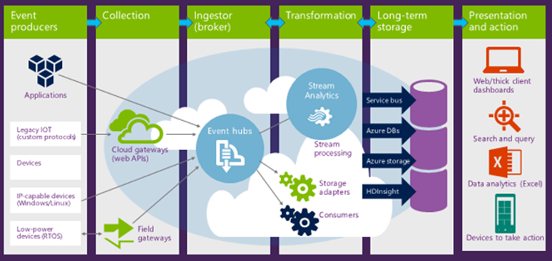
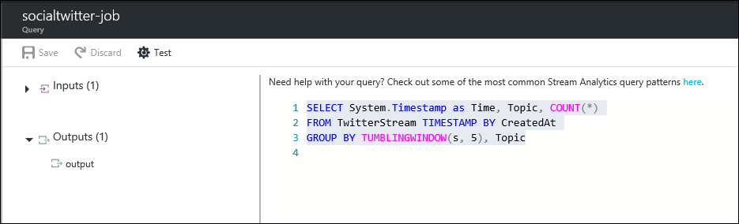
Azure Stream Analytics
1. Set up the environment for Azure Stream Analytics
2. Provision the Azure resources
3. Create Stream Analytics job(s)
3.1 Define input sources
3.2 Define output
4. Set up the Azure Stream analytics query
5. Start the Stream Analytics job
6. Check results
7. Monitor
Notes:
Main Reference: https://docs.microsoft.com/en-us/azure/stream-analytics/stream-analytics-introduction
Using Stream Analytics example: https://blogs.msdn.microsoft.com/kaevans/2015/02/26/using-stream-analytics-with-event-hubs/

Slide 19

Azure Data Factory
Create, orchestrate, and manage data movement and enrichment through the cloud
Notes:
Learning Path: https://azure.microsoft.com/en-us/documentation/articles/data-factory-introduction/
Developer Reference: https://msdn.microsoft.com/en-us/library/azure/dn834987.aspx

Slide 20
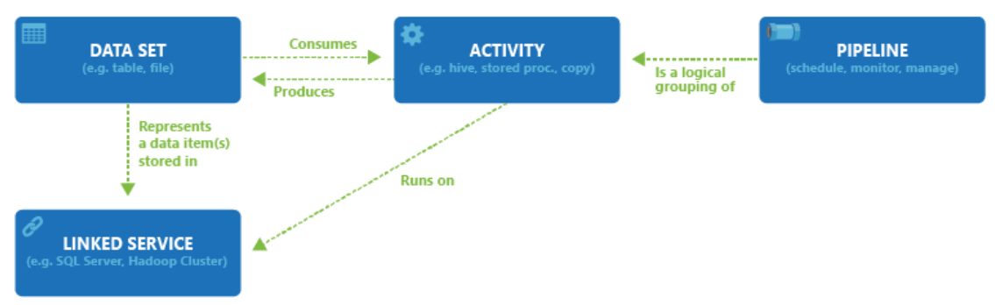
ADF Components
Notes:
Pricing: https://azure.microsoft.com/en-us/pricing/details/data-factory/

Slide 21
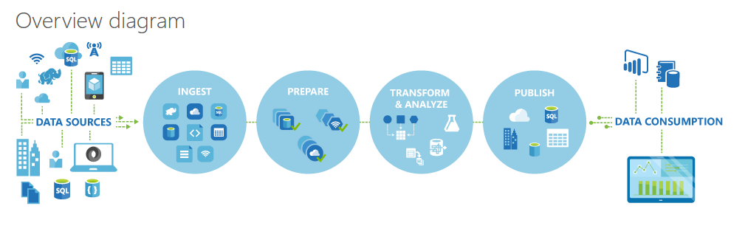
ADF Logical Flow
Notes:
Learning Path: https://azure.microsoft.com/en-us/documentation/articles/data-factory-introduction/
Quick Example: http://azure.microsoft.com/blog/2015/04/24/azure-data-factory-update-simplified-sample-deployment/

Slide 22
ADF Process
Define Architecture: Set up objectives and flow
Create the Data Factory: Portal, PowerShell, VS
Create Linked Services: Connections to Data and Services
Create Datasets: Input and Output
Create Pipeline: Define Activities
Monitor and Manage: Portal or PowerShell, Alerts and Metrics
Notes:
Full Tutorial: https://azure.microsoft.com/en-us/documentation/articles/data-factory-build-your-first-pipeline/

Slide 23
1. Design Process
Define data sources, processing requirements, and output – also management and monitoring
Notes:
More use-cases: https://azure.microsoft.com/en-us/documentation/articles/data-factory-customer-profiling-usecase/

Slide 24
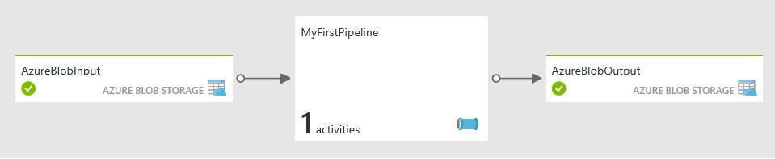

Simple ADF:
Business Goal: Transform and Analyze Web Logs each month
Design Process: Transform Raw Weblogs, using a Hive Query, storing the results in Blob Storage
Files ready for analysis and use in AzureML
HDInsight HIVE query to transform Log entries
Web Logs Loaded to Blob
Notes:
More options: Prepare System: https://azure.microsoft.com/en-us/documentation/articles/data-factory-build-your-first-pipeline-using-editor/ - Follow steps
Another Lab: https://azure.microsoft.com/en-us/documentation/articles/data-factory-samples/

Slide 25
2. Create the Data Factory
Portal, PowerShell and Visual Studio
Notes:
Setting Up: https://azure.microsoft.com/en-us/documentation/articles/data-factory-build-your-first-pipeline/

Slide 26
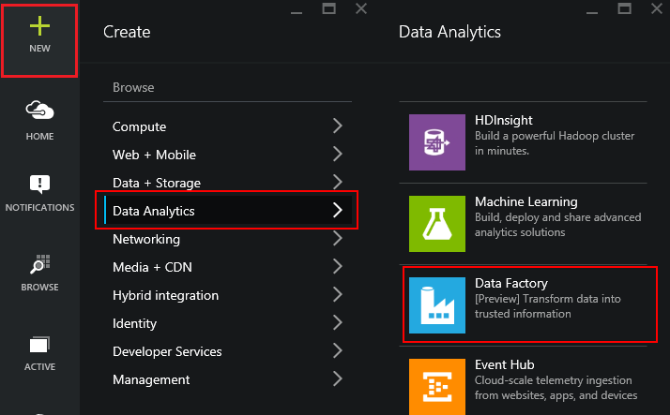
Using the Portal
Use in Non-MS Clients
Use for Exploration
Use when teaching or in a Demo
Notes:
Overview: https://azure.microsoft.com/en-us/documentation/articles/data-factory-build-your-first-pipeline/
Using the Portal: https://azure.microsoft.com/en-us/documentation/articles/data-factory-build-your-first-pipeline-using-editor/

Slide 27
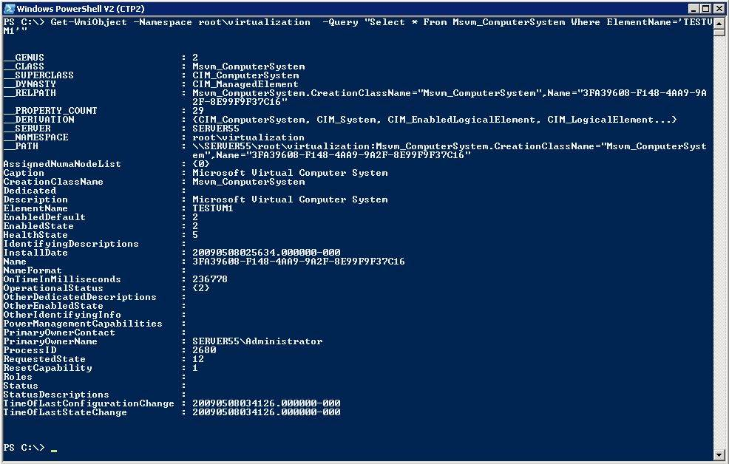
Using PowerShell
Use in MS Clients
Use for Automation
Use for quick set up and tear down
Notes:
Learning Path: https://azure.microsoft.com/en-us/documentation/articles/data-factory-introduction/
Full Tutorial: https://azure.microsoft.com/en-us/documentation/articles/data-factory-build-your-first-pipeline/

Slide 28
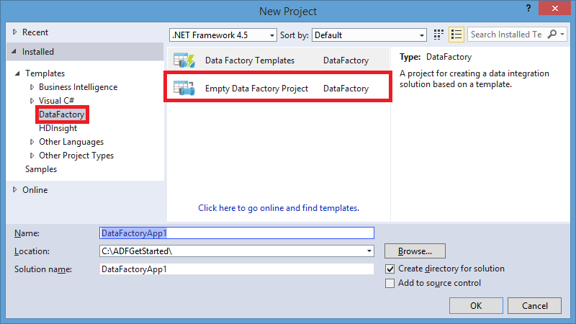
Using Visual Studio
Use in mature dev environments
Use when integrated into larger development process
Notes:
Overview: https://azure.microsoft.com/en-us/documentation/articles/data-factory-build-your-first-pipeline/
Using the Portal: https://azure.microsoft.com/en-us/documentation/articles/data-factory-build-your-first-pipeline-using-editor/

Slide 29
3. Create Linked Services
A Connection to Data or Connection to Compute Resource – Also termed “Data Store”
Notes:
Data Linking: https://azure.microsoft.com/en-us/documentation/articles/data-factory-data-movement-activities/
Compute Linking: https://azure.microsoft.com/en-us/documentation/articles/data-factory-compute-linked-services/

Slide 30


Data Options
Source | Sink
Blob | Blob, Table, SQL Database, SQL Data Warehouse, OnPrem SQL Server, SQL Server on IaaS, DocumentDB, OnPrem File System, Data Lake Store
Table | Blob, Table, SQL Database, SQL Data Warehouse, OnPrem SQL Server, SQL Server on IaaS, DocumentDB, Data Lake Store
SQL Database | Blob, Table, SQL Database, SQL Data Warehouse, OnPrem SQL Server, SQL Server on IaaS, DocumentDB, Data Lake Store
SQL Data Warehouse | Blob, Table, SQL Database, SQL Data Warehouse, OnPrem SQL Server, SQL Server on IaaS, DocumentDB, Data Lake Store
DocumentDB | Blob, Table, SQL Database, SQL Data Warehouse, Data Lake Store
Data Lake Store | Blob, Table, SQL Database, SQL Data Warehouse, OnPrem SQL Server, SQL Server on IaaS, DocumentDB, OnPrem File System, Data Lake Store
SQL Server on IaaS | Blob, Table, SQL Database, SQL Data Warehouse, OnPrem SQL Server, SQL Server on IaaS, Data Lake Store
OnPrem File System | Blob, Table, SQL Database, SQL Data Warehouse, OnPrem SQL Server, SQL Server on IaaS, OnPrem File System, Data Lake Store
OnPrem SQL Server | Blob, Table, SQL Database, SQL Data Warehouse, OnPrem SQL Server, SQL Server on IaaS, Data Lake Store
OnPrem Oracle Database | Blob, Table, SQL Database, SQL Data Warehouse, OnPrem SQL Server, SQL Server on IaaS, Data Lake Store
OnPrem MySQL Database | Blob, Table, SQL Database, SQL Data Warehouse, OnPrem SQL Server, SQL Server on IaaS, Data Lake Store
OnPrem DB2 Database | Blob, Table, SQL Database, SQL Data Warehouse, OnPrem SQL Server, SQL Server on IaaS, Data Lake Store
OnPrem Teradata Database | Blob, Table, SQL Database, SQL Data Warehouse, OnPrem SQL Server, SQL Server on IaaS, Data Lake Store
OnPrem Sybase Database | Blob, Table, SQL Database, SQL Data Warehouse, OnPrem SQL Server, SQL Server on IaaS, Data Lake Store
OnPrem PostgreSQL Database | Blob, Table, SQL Database, SQL Data Warehouse, OnPrem SQL Server, SQL Server on IaaS, Data Lake Store
Notes:
Data Movement requirements: https://azure.microsoft.com/en-us/documentation/articles/data-factory-data-movement-activities/
From on-premises, requires Data Management Gateway: https://azure.microsoft.com/en-us/documentation/articles/data-factory-move-data-between-onprem-and-cloud/

Slide 31
Activity Options
Transformation activity | Compute environment
Hive | HDInsight [Hadoop]
Pig | HDInsight [Hadoop]
MapReduce | HDInsight [Hadoop]
Hadoop Streaming | HDInsight [Hadoop]
Machine Learning activities: Batch Execution and Update Resource | Azure VM
Stored Procedure | Azure SQL
Data Lake Analytics U-SQL | Azure Data Lake Analytics
DotNet | HDInsight [Hadoop] or Azure Batch
Notes:
Main Document Site: https://azure.microsoft.com/en-us/documentation/articles/data-factory-data-transformation-activities/

Slide 32
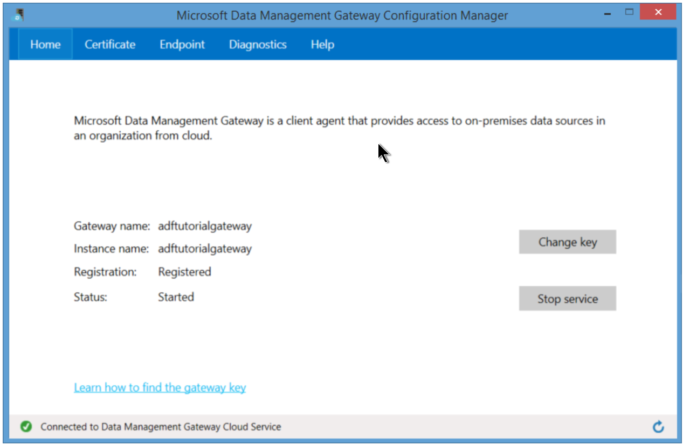
Gateway for On-Prem
Notes:
Activities: https://azure.microsoft.com/en-us/documentation/articles/data-factory-create-pipelines/

Slide 33
4: Create Datasets
Named reference or pointer to data
Notes:
Main Dataset Document Site: https://azure.microsoft.com/en-us/documentation/articles/data-factory-create-datasets/

Slide 34
Dataset Concepts
{
"name": "<name of dataset>",
"properties":
{
"structure": [ ],
"type": "<type of dataset>",
"external": <boolean flag to indicate external data>,
"typeProperties":
{
},
"availability":
{
},
"policy":
{
}
}.
Notes:
Using the Editor: https://azure.microsoft.com/en-us/documentation/articles/data-factory-build-your-first-pipeline-using-editor/

Slide 35
5. Create Pipelines
Logical Grouping of Activities
Notes:
Main Pipeline Documentation: https://azure.microsoft.com/en-us/documentation/articles/data-factory-create-pipelines/

Slide 36
Pipeline JSON
{
"name": "PipelineName",
"properties":
{
"description" : "pipeline description",
"activities":
[
],
"start": "<start date-time>",
"end": "<end date-time>"
}
}
Notes:
Activities: https://azure.microsoft.com/en-us/documentation/articles/data-factory-create-pipelines/

Slide 37
6. Manage and Monitor
Scheduling, Monitoring, Disposition
Notes:
Main Concepts: https://azure.microsoft.com/en-us/documentation/articles/data-factory-monitor-manage-pipelines/

Slide 38
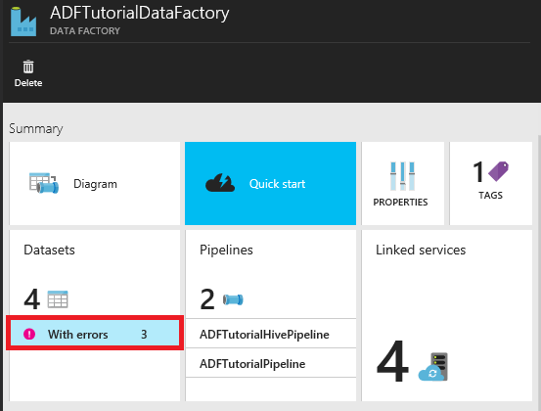
Locating Failures within a Pipeline
Notes:
PowerShell script to help deal with errors in ADF: http://blogs.msdn.com/b/karang/archive/2015/11/13/azure-data-factory-detecting-and-re-running-failed-adf-slices.aspx

Slide 39
Lab:
Create an ADF Project
Notes:
Open this reference and follow all steps you see there: https://docs.microsoft.com/en-us/azure/data-factory/data-factory-copy-activity-tutorial-using-azure-portal

