Slide 1
Online Linear Learning Tricks with Vowpal Wabbit

Slide 2
Contents
Batch vs Online Learning
Learning Rate Tricks
Invariant
Adaptive
Normalized

Slide 3

Batch vs Online Learning
Batch Learning
Input: {x, y} where x ∈ $R^{n}$ and y ∈R
Learn w ∈ $R^{n}$ s.t. error is minimized
Online Learning <- Vowpal Wabbit specializes in this!
for i..n
repeat:
Input: {$x_{i}$,$y_{i}$}
Update w s.t. ${\text{y}\text{̂}}_{w}$ is closer to y

Slide 4
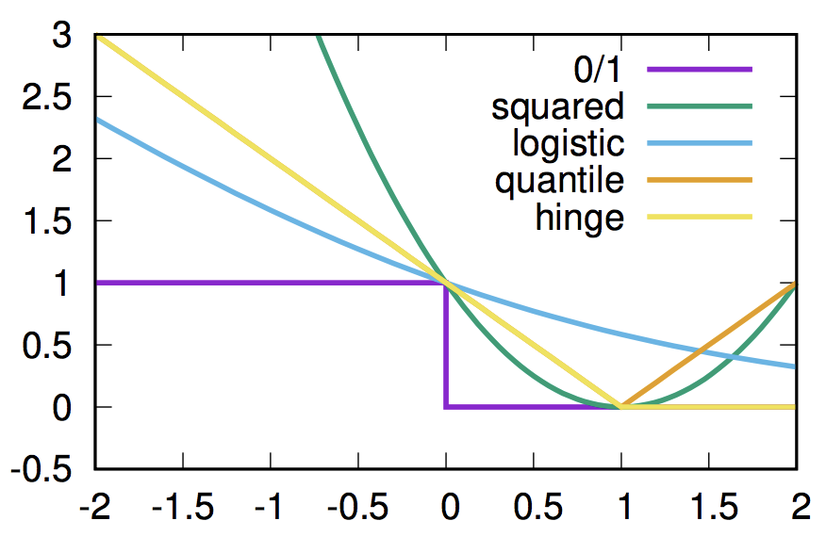

Batch vs Online Learning
Define a loss function $L( \hat{y_{w}}, y)$
Update via SGD $w_{i}=w_{i}−η \frac{dL( \hat{y_{w}}(x), y_{i })}{dw_{i}}$

Slide 5
Learning Rate Tricks
Vowpal Wabbit’s learning rate function does a few things by default
They are parameters that help the learner convergence
--invariant, use safe / importance aware updates
--adaptive, use adaptive, individual learning rates
--normalized, use per feature normalized updates

Slide 6

Learning Rate Tricks - Invariant
Often in classification problems, one choice is more expensive than the other
For instance, in spam classification, it’s a lot more expensive to classify a non-spam email as spam than to classify a spam email as non-spam
We want to give an importance weight, I, to the classes
How can we update the naïve SGD equation?
$w_{i}=w_{i}−η \frac{dL( \hat{y_{w}}(x), y_{i })}{dw_{i}}$

Slide 7
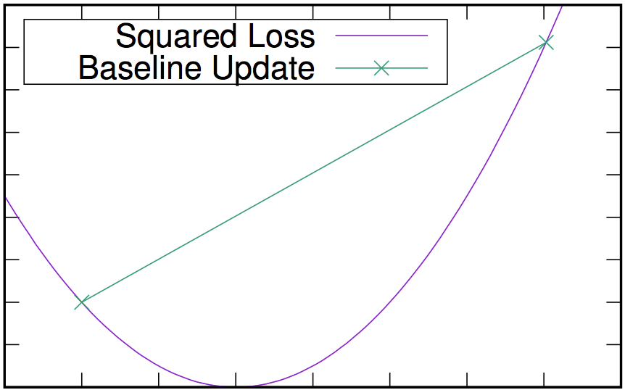

Learning Rate Tricks - Invariant
Baseline – Let’s scale the gradient by I
$w_{i}=w_{i}−η I\frac{dL( \hat{y_{w}}(x), y_{i })}{dw_{i}}$
Works in batch GD, but not online!

Slide 8
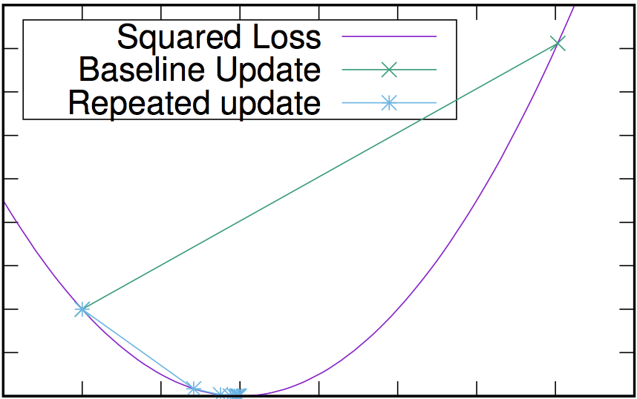

Learning Rate Tricks - Invariant
Better solution – Let’s just update I times
$w_{i}=w_{i}−η\frac{dL\left( \hat{y_{w}}\left(x\right), y_{i }\right)}{dw_{i}}$, I times
Converges a bit better

Slide 9

Learning Rate Tricks - Invariant
Invariant solution – Learn to derive the appropriate step size so that we can update in one step
$w_{i}=w_{i}−S(η I)\frac{dL\left( \hat{y_{w}}\left(x\right), y_{i }\right)}{dw_{i}}$
$s\left(h+1\right)=s\left(h\right)+η \frac{∂l}{∂p}$, where $p={\left(w_{t}−s\left(h\right)x\right)}^{T}x$
See convergence proof in Online Importance Weight Aware Updates, Karampatziakis et al, 2010

Slide 10
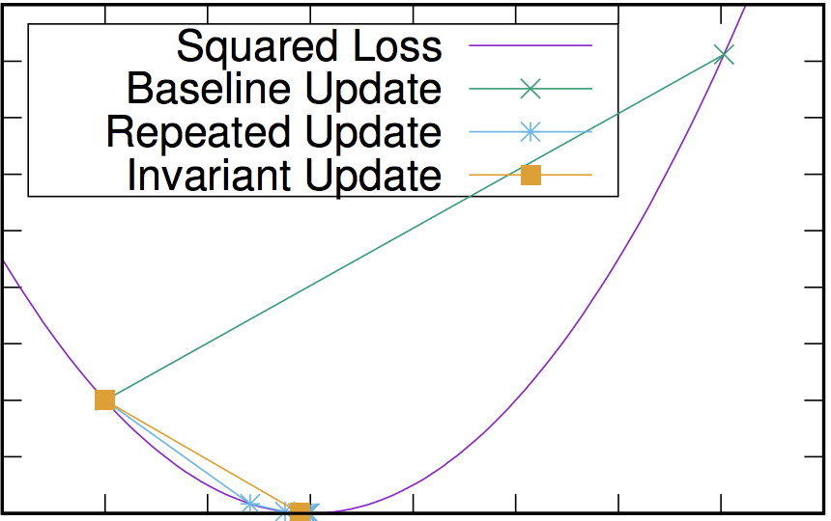
Learning Rate Tricks - Invariant

Slide 11

Learning Rate Tricks - Adaptive
In SGD, we need the learning rate $η$ to decay to converge
Naïve solution is to decay $η$ parametrically, $η_{t}= \frac{1}{t^{0.5}}$ or $\frac{1}{t}$
Adopts a partial derivative update strategy
$w_{it}=w_{it}−η \frac{g_{it}}{\sqrt{\sum_{t^{′}}^{t}{g_{it}^{2}}}}$
Where $g_{it}$ is a partial derivative
Common features stabilize quickly; Rare features have bigger updates
Very similar to RMSProp that’s currently popular in deep learning

Slide 12

Learning Rate Tricks - Normalized
The partial derivative $g_{it}=2\left(\hat{y_{w}}(x) −y\right)x_{i}$ can be rewritten
$w_{i}=w_{i}−Cx_{i}$
If a feature i has twice the magnitude of feature j, $w_{i}$ needs to have half the mangitude of $w_{j}$
In batch GD, we can simply standardize the features via
$x_{i}= \frac{x_{i} −μ}{σ}$
But not in Online GD…

Slide 13

Learning Rate Tricks - Normalized
As per Normalized Online Learning, Ross et al, UAI 2013., the scale free update function
$w_{i}=w_{i}−η \sqrt{\frac{t}{N}}\frac{1}{s^{2}}\frac{∂ l(\hat{y}, y)}{∂w_{i}}$
Where $s_{i}=\max_{t}{x_{it}}$
And $N=N+\sum_{i}^{t}{\frac{x_{i}^{2}}{s_{i}^{2}}}$

Slide 14
References
Vowpal Wabbit Command Line Arguments, https://github.com/JohnLangford/vowpal_wabbit/wiki/Command-line-arguments
John Langford, Machine Learning the Future, http://hunch.net/~mltf/online_linear.pdf

