Slide 1
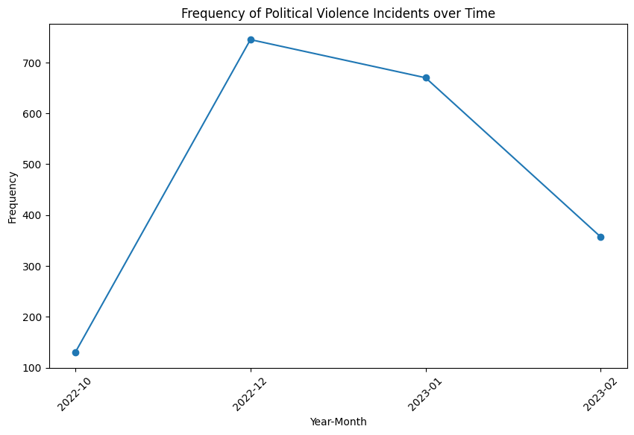
UNDP Information Management and Data Science Internship (Data Test)
Data Provided
Political Violence Data: recent data for various incidents in Nigeria
News Data: recent data for news in Nigeria
What is the violence profile in Nigeria in the given time period?

Slide 2
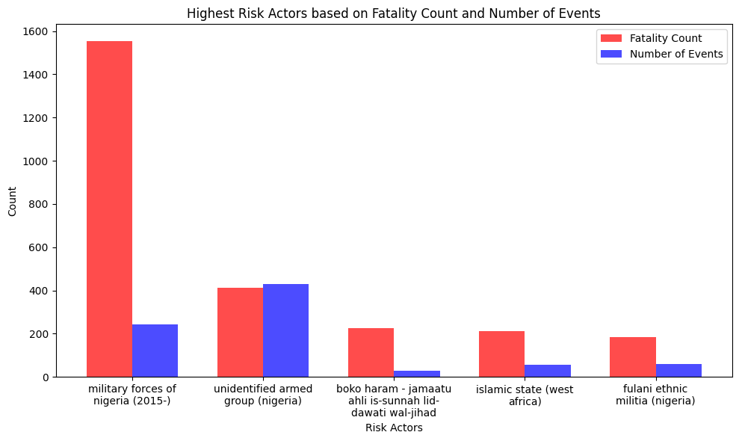
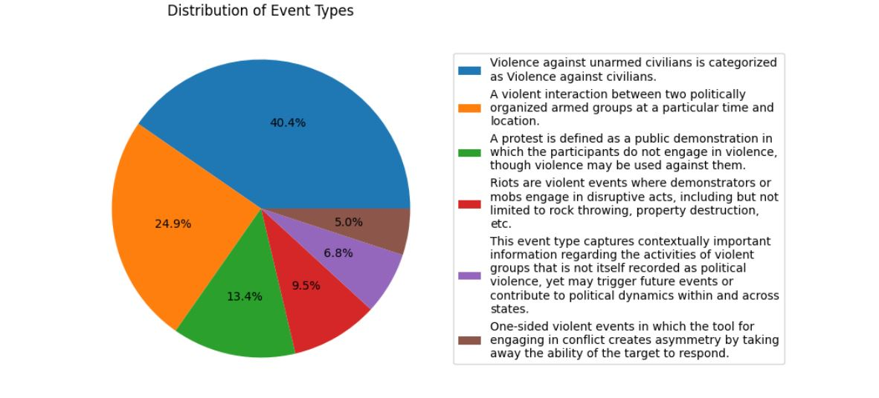
What are the most common Event Types of political violence?
Which actors are the highest risk actors? (Fatality vs Number of Events)

Slide 3
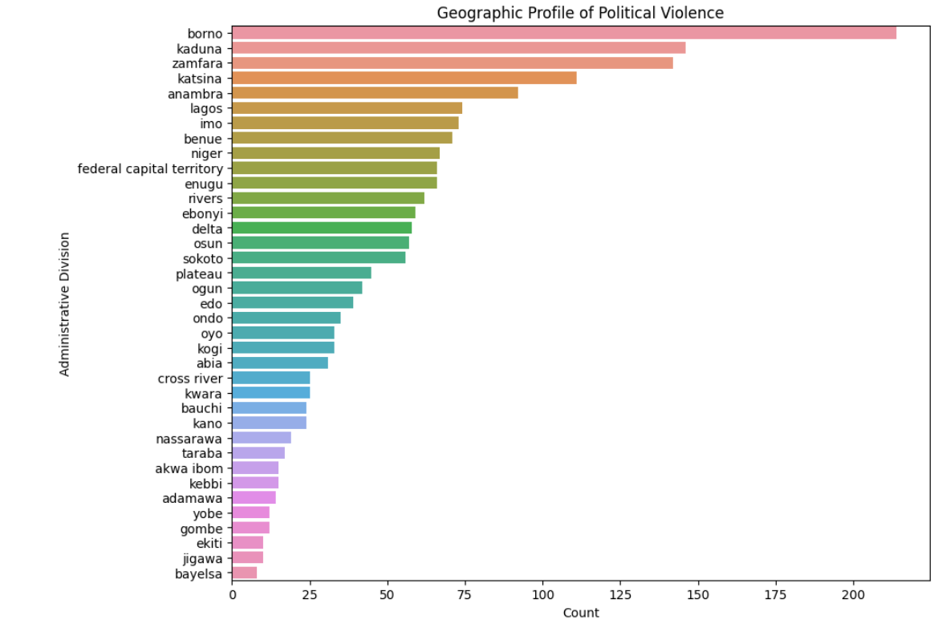
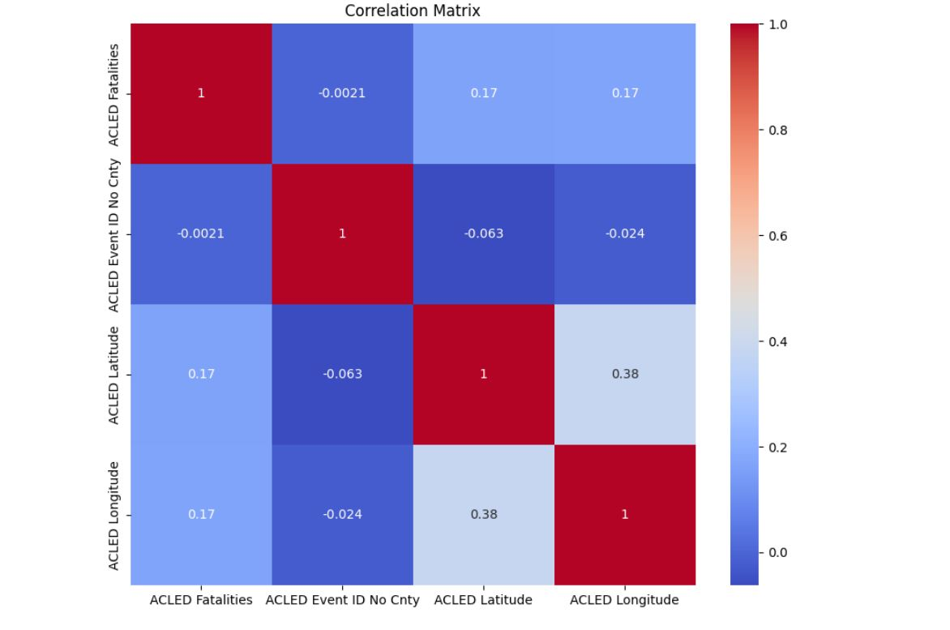
What is the geographic profile of the political violence?
What features of this data set have the most associative or predictive value?

Slide 4
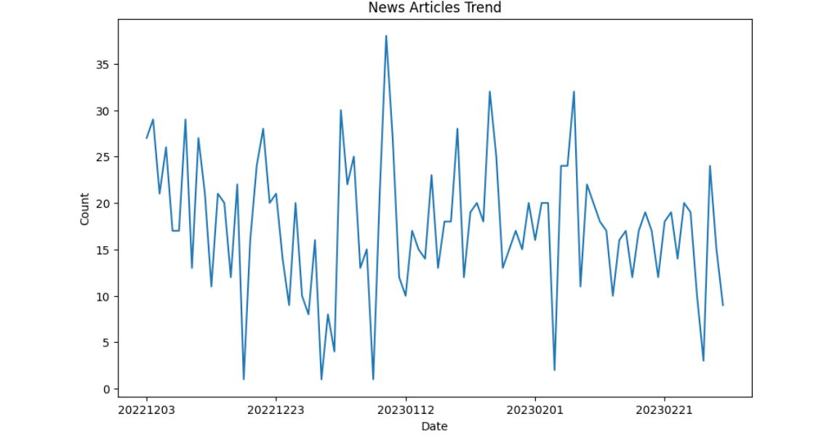
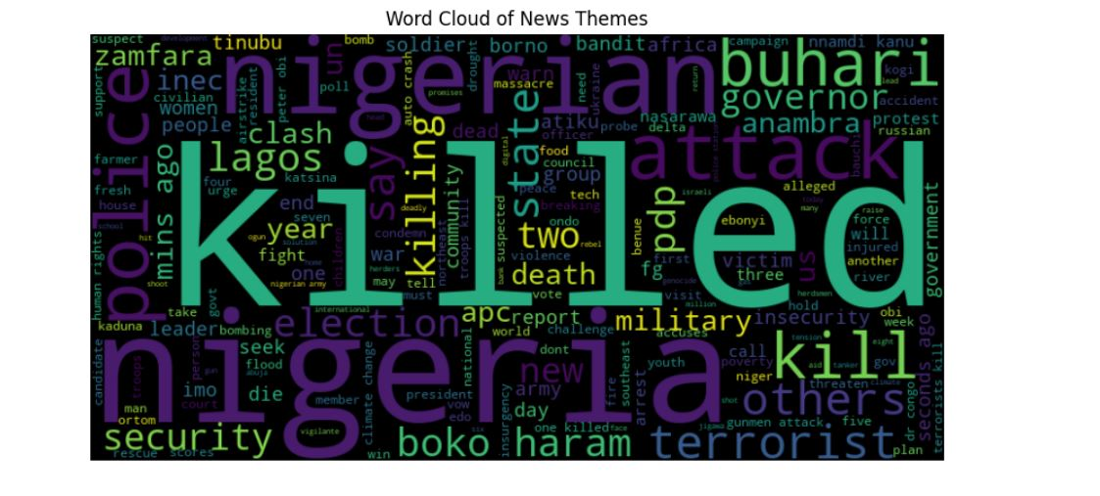
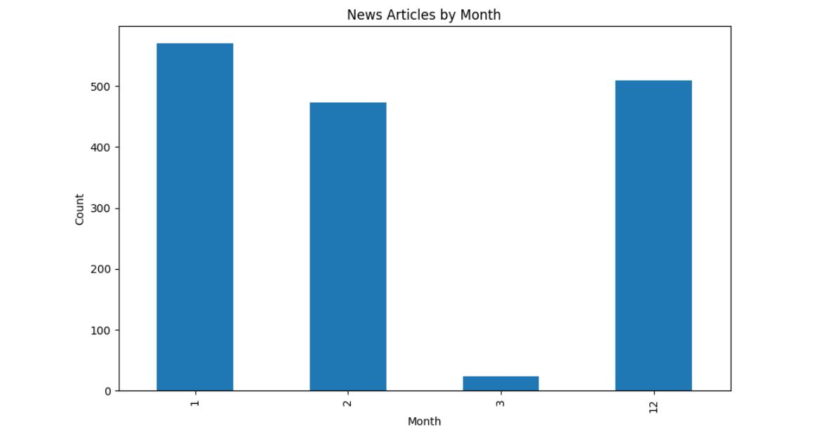
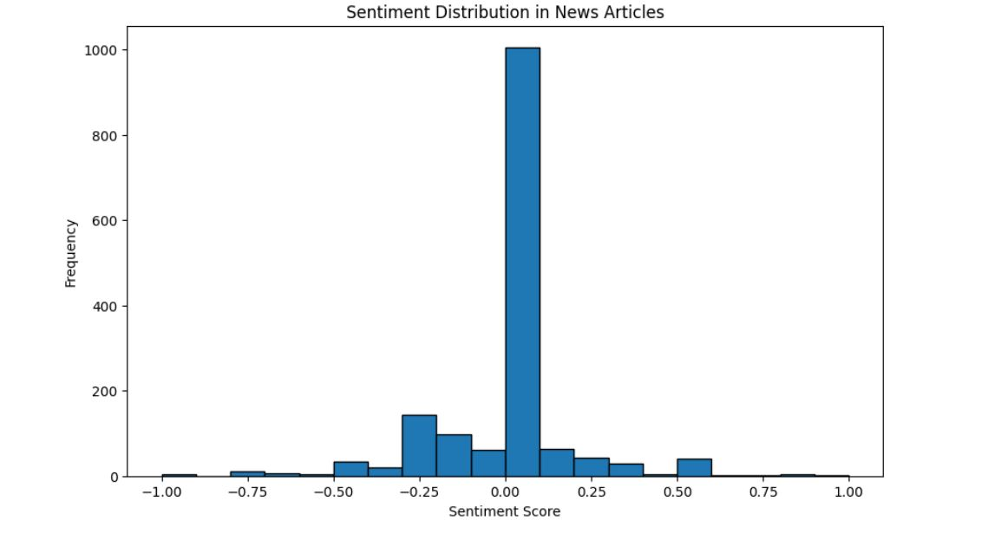
What are the key news trends during the period attached?
What are the key trending themes?
Is there a key sentiment in the news?

Slide 5
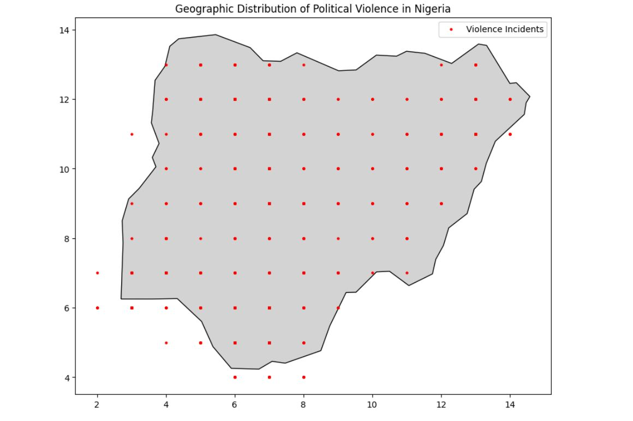
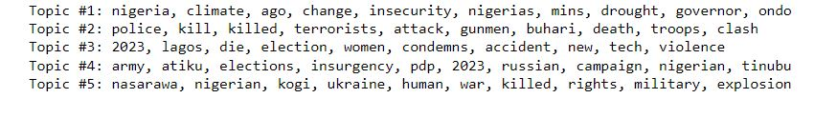
Is there a correlation between political violence event types and the key news trending in the region?
The chi-square statistic : 7880.000000000001,
The p-value : 4.1251999926331865e-07.
Additional Analysis of Geographical Distribution and important Words

