Slide 1



Slide 2
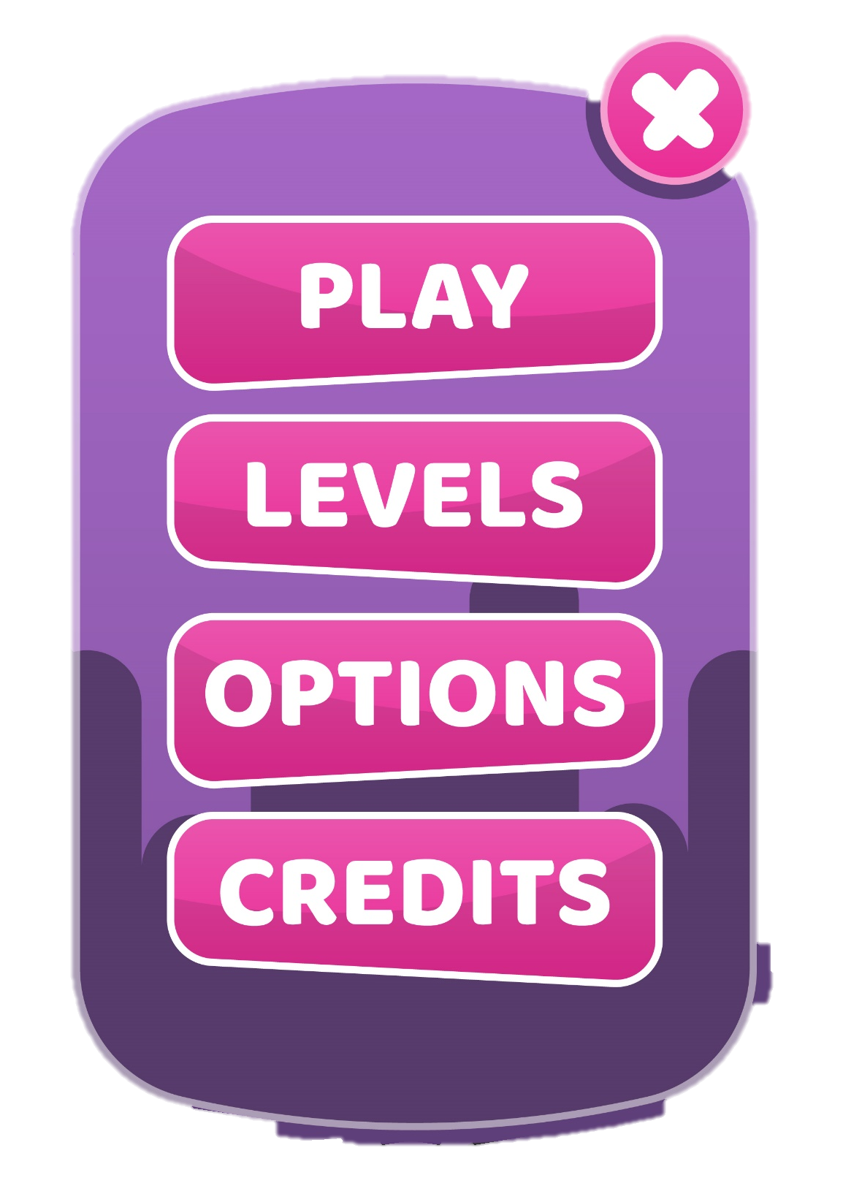


NICKNAME:
IP :
EXIT

