Slide 1



Slide 2
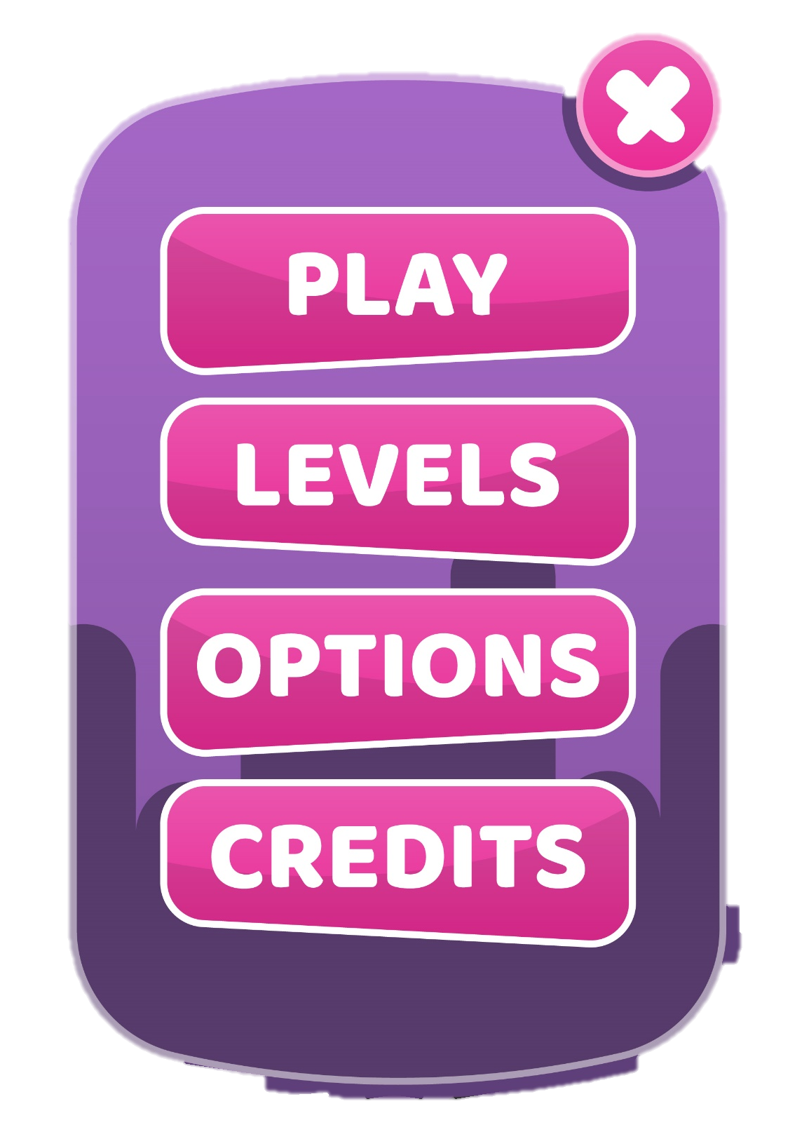



IP :
NICKNAME:
ROBBY

