Slide 1
JIU IT Major 20230124 PMJ, AEJ
Object-Oriented Programming
Practice Day1

Slide 2
Question 1. Kilometer Per Mile
2.7.2 Translate the following algorithm into Java code:
Step 1: Declare a double variable named
miles with an initial value 100.
Step 2: Declare a double constant named KILOMETERS_PER_MILE
with value 1.609.
Step 3: Declare a double variable named kilometers,
multiply miles and KILOMETERS_PER_MILE, and assign the
result to kilometers.
Step 4: Display kilometers to the console.
What is kilometers after Step 4?

Slide 3
Question 1-1. Kilometer Per Mile
2.7.2 Translate the following algorithm into Java code:
Step 1: Declare a double variable named
miles with an initial value 100.
Step 2: Declare a double constant named KILOMETERS_PER_MILE
with value 1.609.
Step 3: Declare a double variable named kilometers,
multiply miles and KILOMETERS_PER_MILE, and assign the
result to kilometers.
Step 4: Display kilometers to the console.
What is kilometers after Step 4?
How to receive miles from user instead of declare miles?

Slide 4
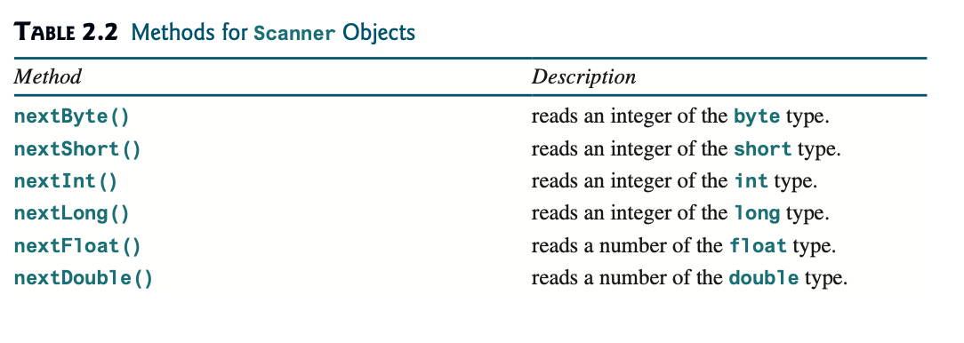
Question 1-1. Kilometer Per Mile
2.7.2 Translate the following algorithm into Java code:
Step 1: Declare a double variable named
miles with an initial value 100.
Step 2: Declare a double constant named KILOMETERS_PER_MILE
with value 1.609.
Step 3: Declare a double variable named kilometers,
multiply miles and KILOMETERS_PER_MILE, and assign the
result to kilometers.
Step 4: Display kilometers to the console.
What is kilometers after Step 4?
How to receive miles from user instead of declare miles?

Slide 5
Question 2. numbers
2.10.2 Which of the following are correct literals
for floating-point numbers?
12.3, 12.3e+2, 23.4e-2, -334.4, 20.5, 39F, 40D
2.10.3 Which of the following are the same as 52.534?
5.2534e+1, 0.52534e+2, 525.34e-1, 5.2534e+0
2.10.4 Which of the following are correct literals?
5_2534e+1, _2534, 5_2, 5_

Slide 6
Question 2. numbers
2.10.2 Which of the following are correct literals
for floating-point numbers?
12.3, 12.3e+2, 23.4e-2, -334.4, 20.5, 39F, 40D
2.10.3 Which of the following are the same as 52.534?
5.2534e+1, 0.52534e+2, 525.34e-1, 5.2534e+0
2.10.4 Which of the following are correct literals?
5_2534e+1, _2534, 5_2, 5_

Slide 7
Question 2. numbers
2.10.2 Which of the following are correct literals
for floating-point numbers?
12.3, 12.3e+2, 23.4e-2, -334.4, 20.5, 39F, 40D
2.10.3 Which of the following are the same as 52.534?
5.2534e+1, 0.52534e+2, 525.34e-1, 5.2534e+0
2.10.4 Which of the following are correct literals?
5_2534e+1, _2534, 5_2, 5_

Slide 8
Question 2. numbers
2.10.2 Which of the following are correct literals
for floating-point numbers?
12.3, 12.3e+2, 23.4e-2, -334.4, 20.5, 39F, 40D
2.10.3 Which of the following are the same as 52.534?
5.2534e+1, 0.52534e+2, 525.34e-1, 5.2534e+0
2.10.4 Which of the following are correct literals?
5_2534e+1, _2534, 5_2, 5_

Slide 9
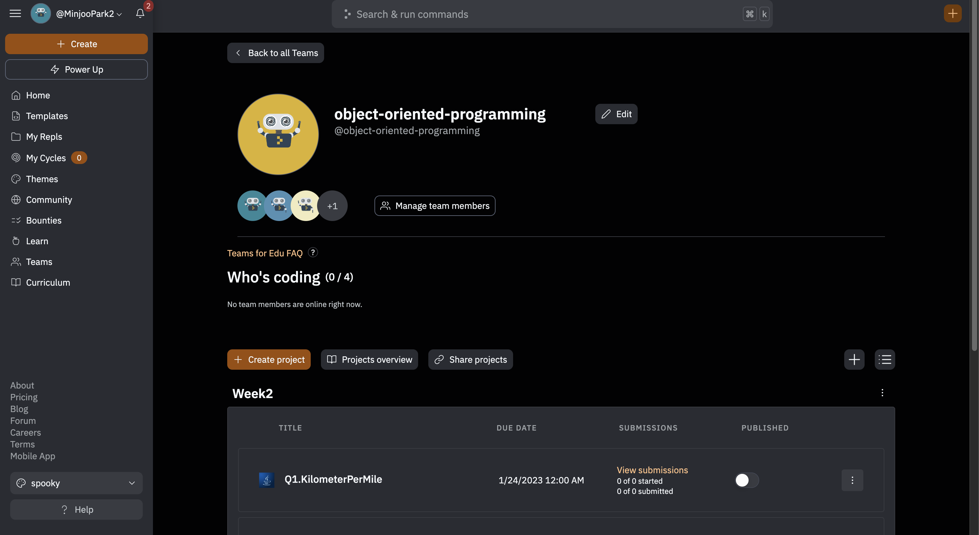
Question 3. Stdin and Stdout
https://replit.com/teams/join/
qfcyrawhaqvfuacbexyuypljxjmhrlqk
-object-oriented-programming

Slide 10
Question 3. Sum the digits
**2.6 (Sum the digits in an integer)
Write a program that reads an integer between 0 and 1000
and adds all the digits in the integer.
For example, if an integer is 932, the sum of all its digits is 14.
Hint: Use the % operator to extract digits, and use the / operator to remove the extracted digit.
For instance, 932 % 10 = 2 and 932 / 10 = 93.
Here is a sample run:

Slide 11

Question 3. Stdin and Stdout
https://www.hackerrank.com/

Slide 12

Question 3. Stdin and Stdout
https://www.hackerrank.com/

Slide 13
Introduction to Java
The term Java from Java island….
JIU IT Major 20230124 PMJ, AEJ

