Slide 1
JIU IT Major 20230124 PMJ, AEJ
Object-Oriented Programming
Practice Week5

Slide 2
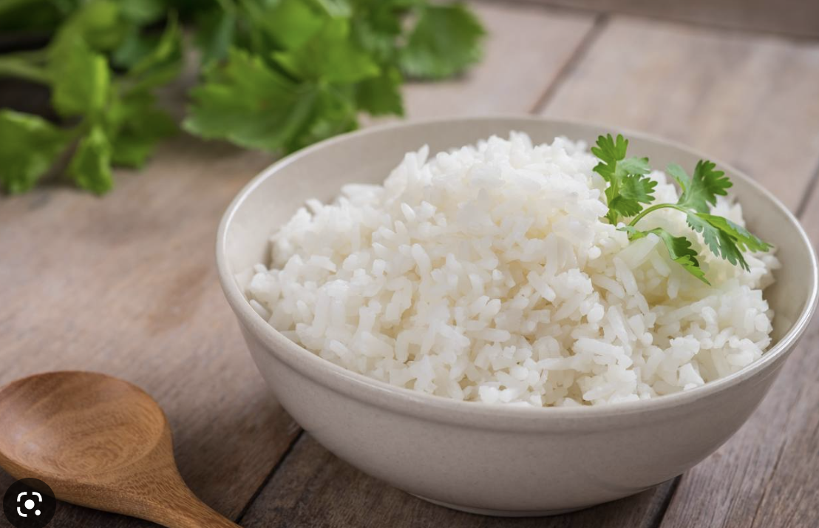
Today we have
NASI + Go
😚 😚 😚

Slide 3
Call by Value?
vs
Call by Reference?

Slide 5
Call By Reference (Pass-By-Reference)
the unique identifier of the object is sent to the method.
Any changes to the parameter’s instance members will
result in that change being made to the original value.

Slide 6
Call By Value (Pass-By-Value)
parameters passed to the callee method will be clones of the original parameters.
Any modification done in callee method will have no effect on the original parameters in caller method.

Slide 7
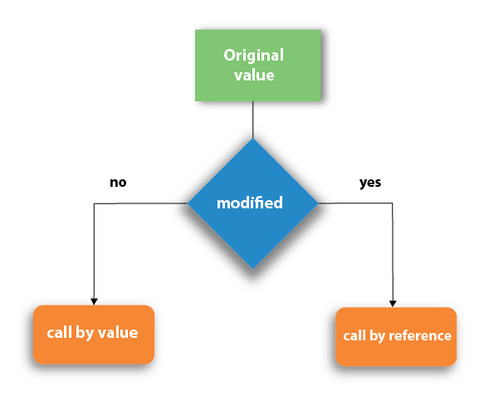

Slide 10
As far as Java is concerned,
everything is strictly Pass-by-Value.

Slide 11
As far as Java is concerned,
everything is strictly Pass-by-Value.

Slide 12
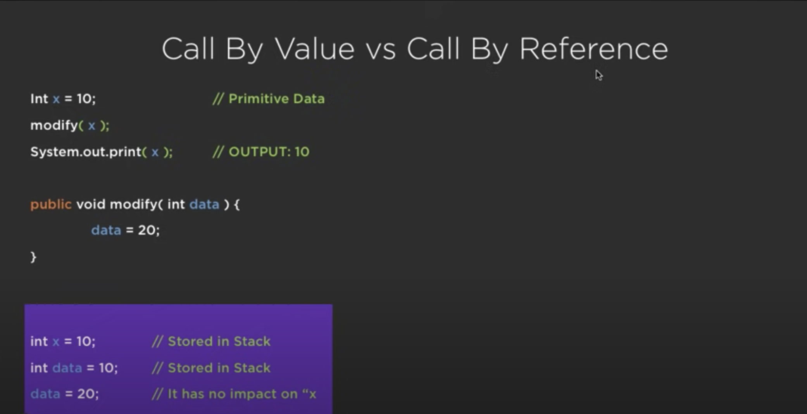
As far as Java is concerned,
everything is strictly Pass-by-Value.

Slide 13
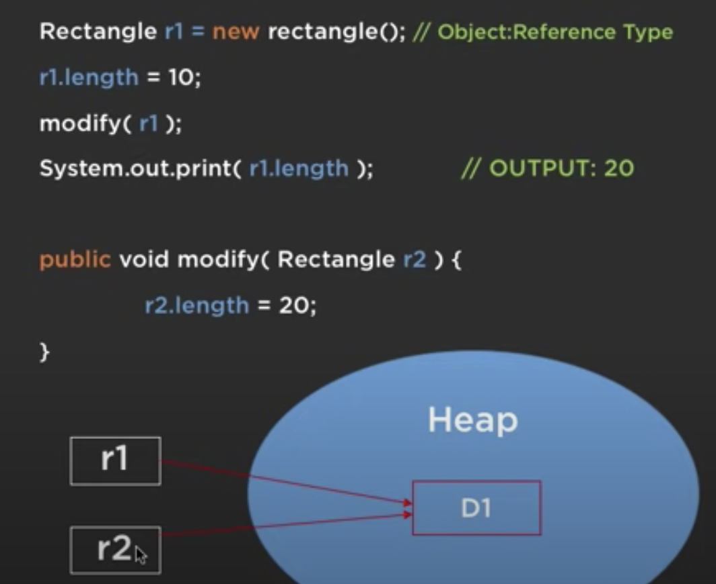
As far as Java is concerned,
everything is strictly Pass-by-Value.

Slide 14
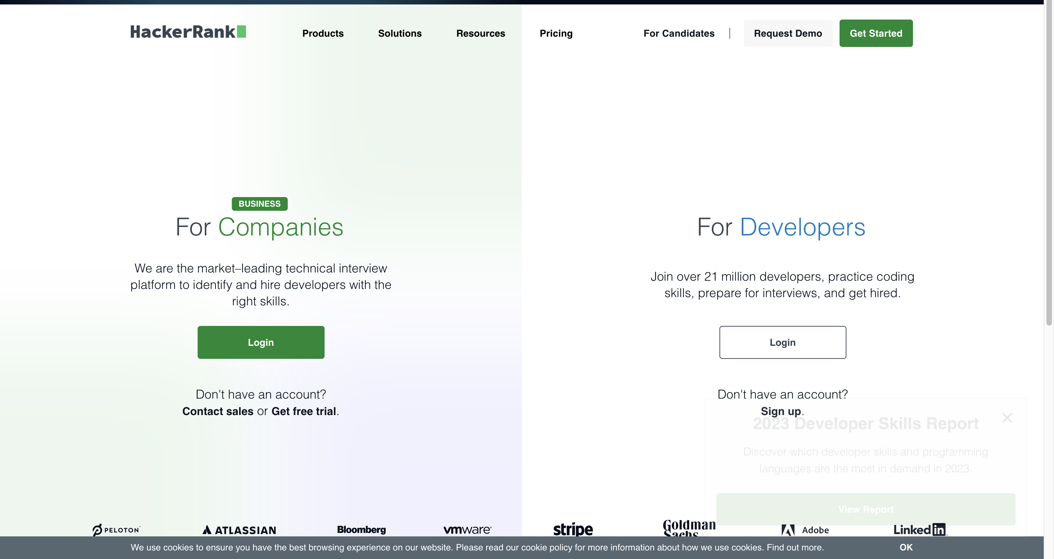
https://www.hackerrank.com/

Slide 15
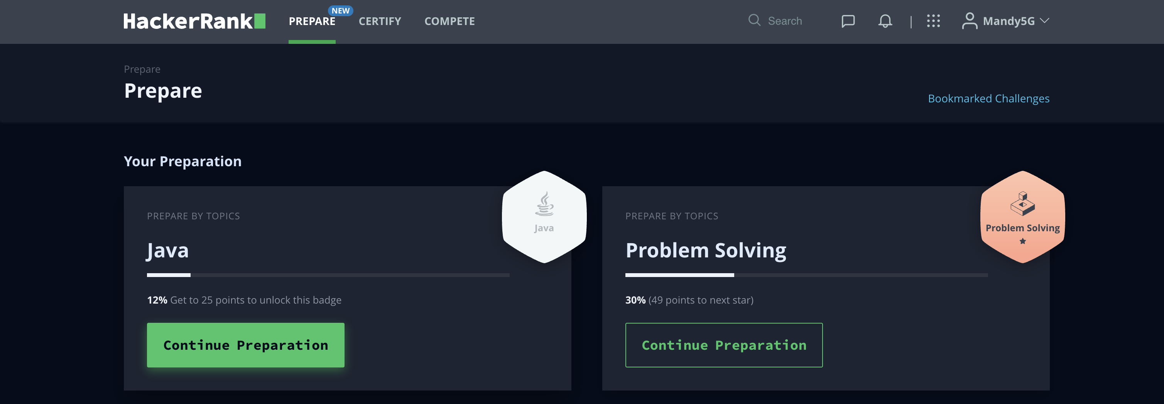
https://www.hackerrank.com/

Slide 16
Introduction to Java
The term Java from Java island….
JIU IT Major 20230124 PMJ, AEJ

