Slide 1
JIU IT Major 20230124 PMJ, AEJ
Object-Oriented Programming
Practice Week4

Slide 2
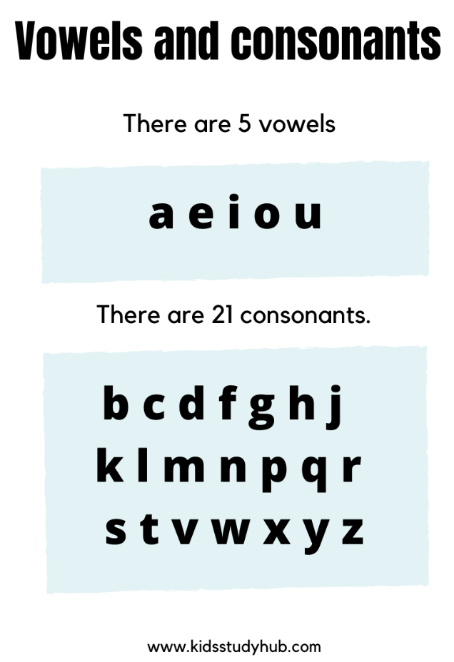
Question 1. Vowel or consonent

Slide 3
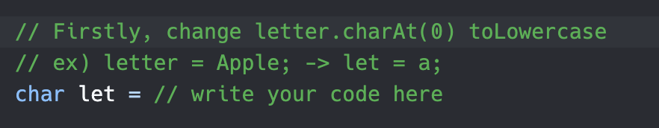
Question 1. Vowel or consonent
Apple

Slide 4

Question 1. Vowel or consonent
Apple
A

Slide 5
Question 1. Vowel or consonent
charAt(0)
Apple
A

Slide 6
Question 1. Vowel or consonent
charAt(0)
Apple
A
a

Slide 7
Question 1. Vowel or consonent
charAt(0)
toLowercase
Apple
A
a

Slide 8

Question 1. Vowel or consonent
charAt(0)
toLowercase
Apple
A
a

Slide 9
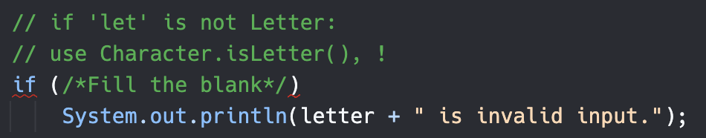
Question 1. Vowel or consonent

Slide 10

Question 1. Vowel or consonent

Slide 11
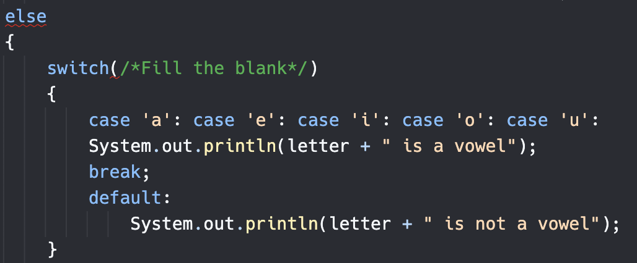
Question 1. Vowel or consonent

Slide 12

Question 1. Vowel or consonent

Slide 13
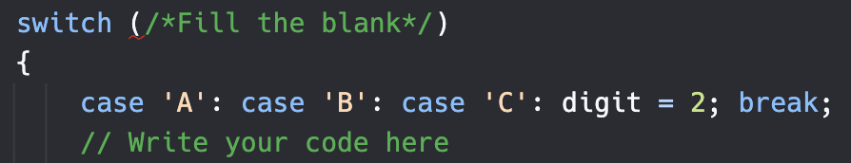
Question 2

Slide 14
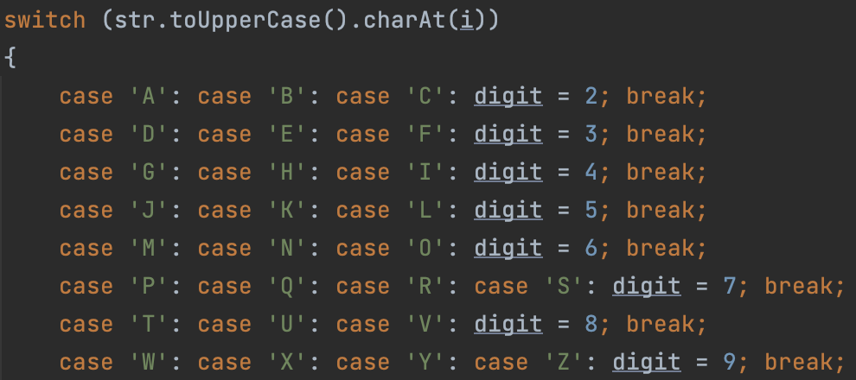
Question 2

Slide 15
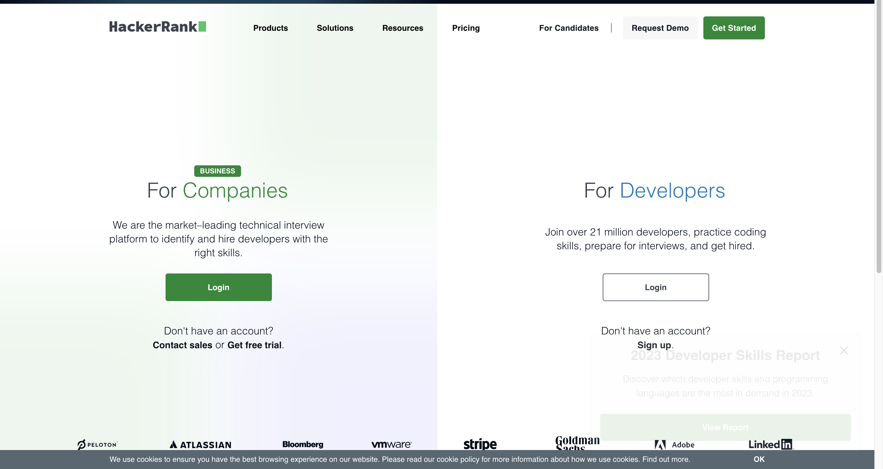
https://www.hackerrank.com/

Slide 16
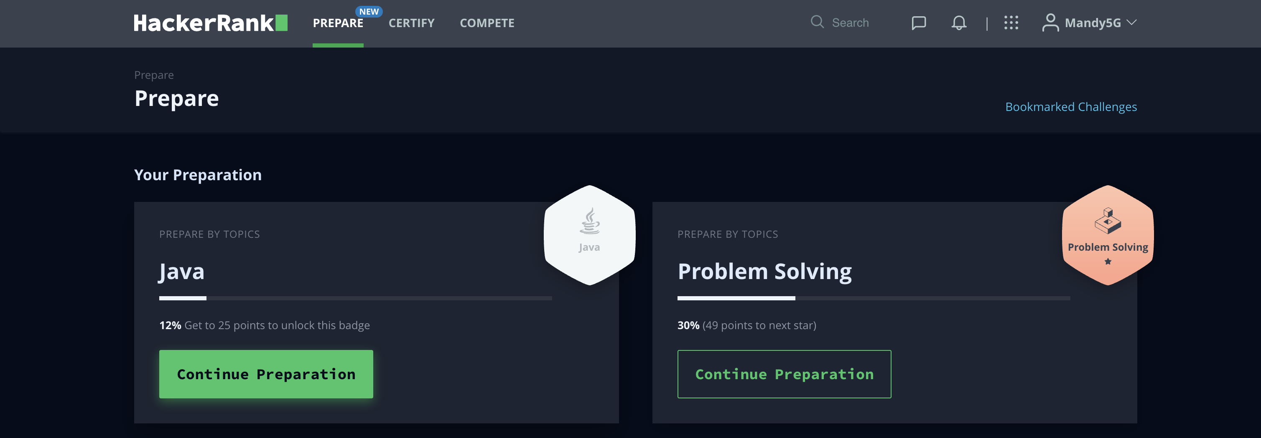
https://www.hackerrank.com/

Slide 17
Introduction to Java
The term Java from Java island….
JIU IT Major 20230124 PMJ, AEJ

