Slide 1
JIU IT Major 20230124 PMJ, AEJ
Object-Oriented Programming
Practice Week5

Slide 2
1.2 Computer can execute the code in ____________.
machine language
B. assembly language
C. high-level language
D. none of the above

Slide 3
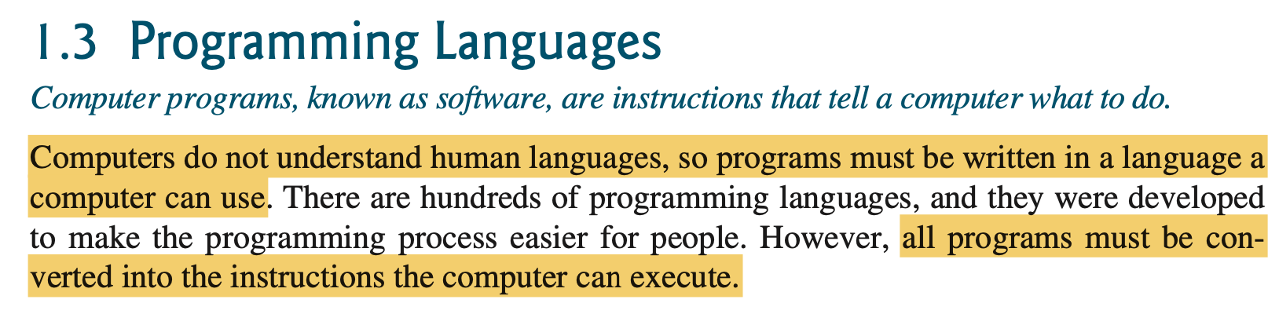
1.2 Computer can execute the code in ____________.
machine language
B. assembly language
C. high-level language
D. none of the above

Slide 4
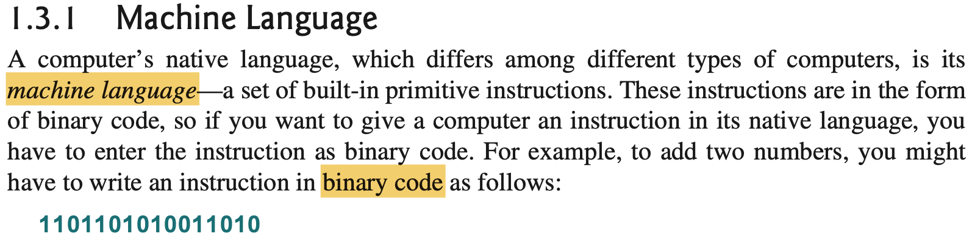
1.2 Computer can execute the code in ____________.
machine language
B. assembly language
C. high-level language
D. none of the above

Slide 5
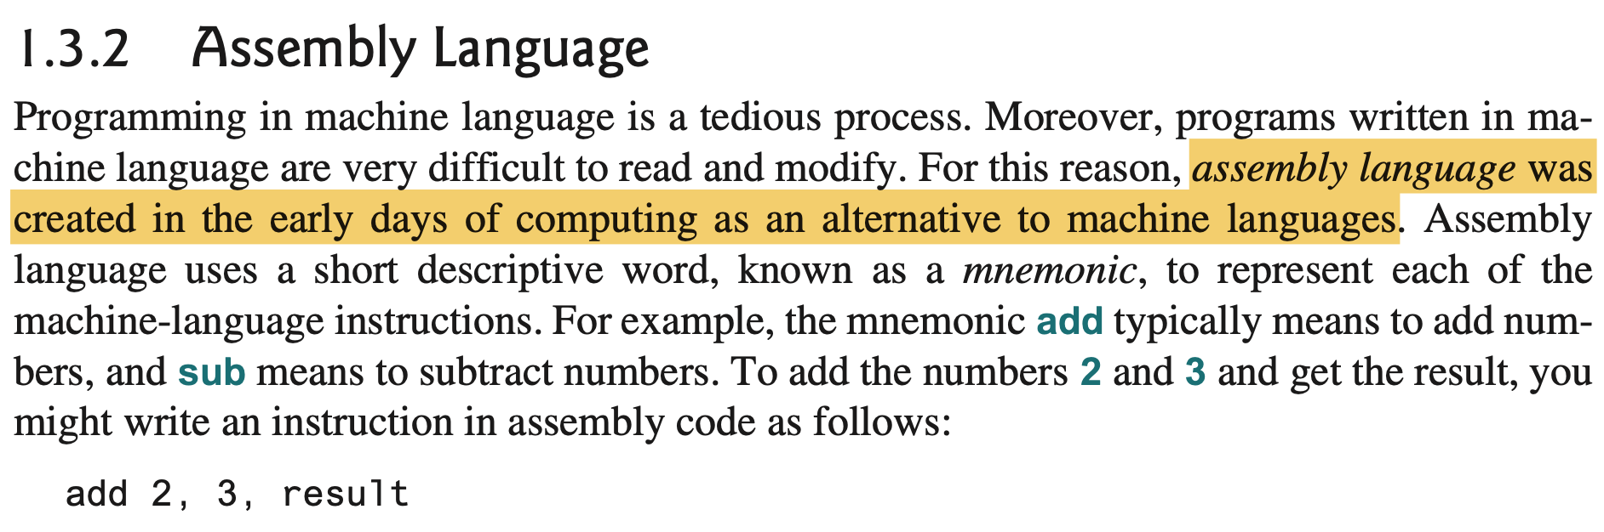
1.2 Computer can execute the code in ____________.
machine language
B. assembly language
C. high-level language
D. none of the above

Slide 6
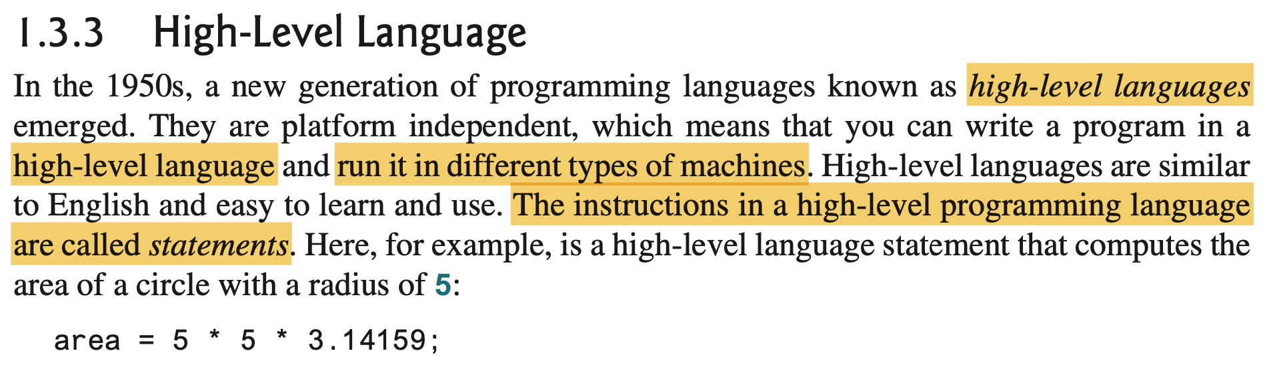
1.2 Computer can execute the code in ____________.
machine language
B. assembly language
C. high-level language
D. none of the above

Slide 7
1.2 Computer can execute the code in ____________.
machine language
B. assembly language
C. high-level language
D. none of the above

Slide 8
1.3 ___________ translates high-level language program into machine language program.
A. An assembler B. A compiler C. CPU D. The operating system

Slide 9
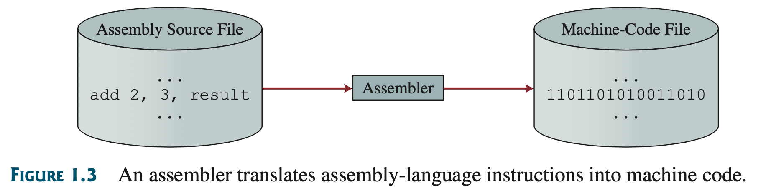
1.3 ___________ translates high-level language program into machine language program.
A. An assembler B. A compiler C. CPU D. The operating system

Slide 10
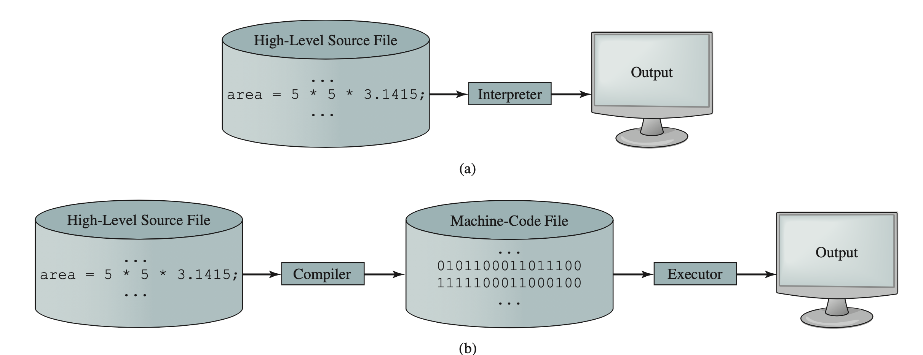
1.3 ___________ translates high-level language program into machine language program.
A. An assembler B. A compiler C. CPU D. The operating system

Slide 11
1.3 ___________ translates high-level language program into machine language program.
A. An assembler B. A compiler C. CPU D. The operating system

Slide 12
1.7 What is the output of the following code?
System.out.println("1 + 2 + 3");
System.out.println(1 + 2 + 3);
A. 1 + 2 + 3 followed by 6 B. "6" followed by 6 C. 1 + 2 + 3 followed by 1 + 2 + 3
D. 6 followed by 6

Slide 13
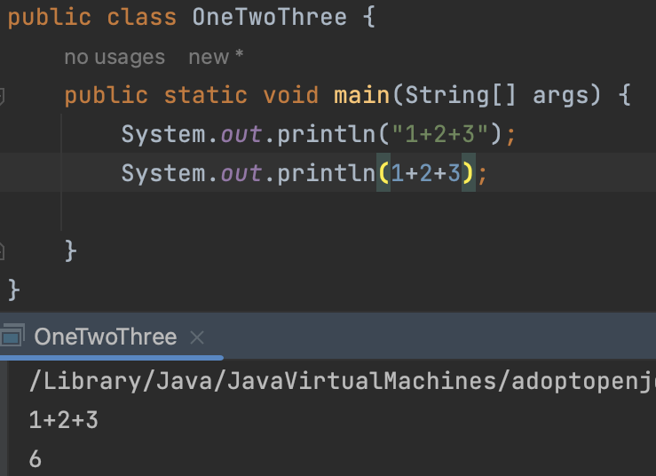
1.7 What is the output of the following code?
System.out.println("1 + 2 + 3");
System.out.println(1 + 2 + 3);
A. 1 + 2 + 3 followed by 6 B. "6" followed by 6 C. 1 + 2 + 3 followed by 1 + 2 + 3
D. 6 followed by 6
String ->
Number ->

Slide 14
1.7 What is the output of the following code?
System.out.println("1 + 2 + 3");
System.out.println(1 + 2 + 3);
A. 1 + 2 + 3 followed by 6 B. "6" followed by 6 C. 1 + 2 + 3 followed by 1 + 2 + 3
D. 6 followed by 6

Slide 15
1.8 The JDK command to just compile a class (not run) in the file Test.java is
java Test
java Test.java
C. javac Test.java
D. javac Test E. JAVAC Test.java
1.9 Which JDK command is correct to run a Java application in ByteCode.class?
java ByteCode
B. java ByteCode.class
C. javac ByteCode.java
D. javac ByteCode E. JAVAC ByteCode

Slide 16
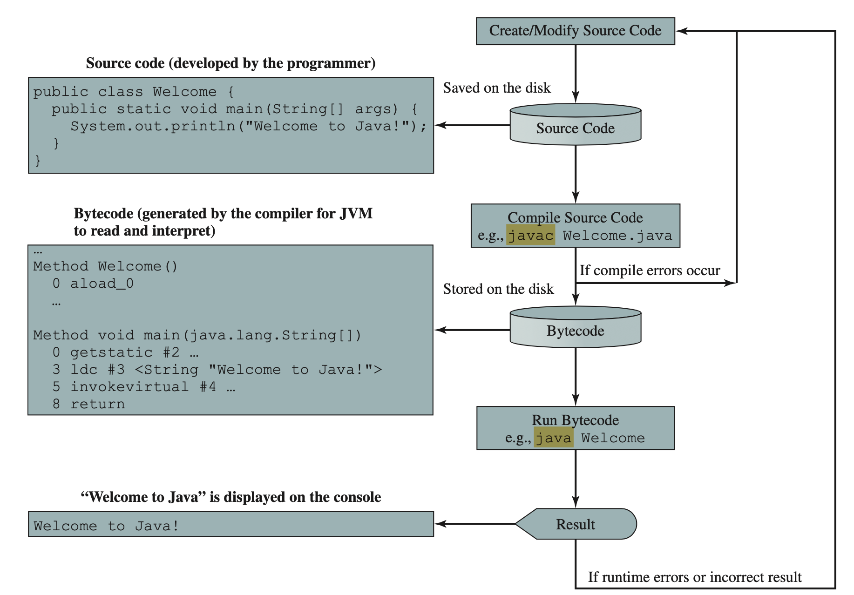
1.8 The JDK command to just compile a class (not run) in the file Test.java is
java Test
java Test.java
C. javac Test.java
D. javac Test E. JAVAC Test.java
1.9 Which JDK command is correct to run a Java application in ByteCode.class?
java ByteCode
B. java ByteCode.class
C. javac ByteCode.java
D. javac ByteCode E. JAVAC ByteCode

Slide 17
1.8 The JDK command to just compile a class (not run) in the file Test.java is
java Test
java Test.java
C. javac Test.java
D. javac Test E. JAVAC Test.java
1.9 Which JDK command is correct to run a Java application in ByteCode.class?
java ByteCode
B. java ByteCode.class
C. javac ByteCode.java
D. javac ByteCode E. JAVAC ByteCode

Slide 18
1.8 The JDK command to just compile a class (not run) in the file Test.java is
java Test
java Test.java
C. javac Test.java
D. javac Test E. JAVAC Test.java
1.9 Which JDK command is correct to run a Java application in ByteCode.class?
java ByteCode
B. java ByteCode.class
C. javac ByteCode.java
D. javac ByteCode E. JAVAC ByteCode

Slide 19
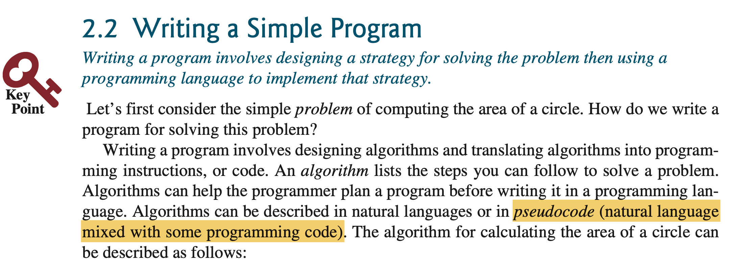
2.1 _______ is the code with natural language
mixed with Java code.
A. Java program B. A Java statement C. Pseudocode D. A flowchart diagram

Slide 20
2.1 _______ is the code with natural language
mixed with Java code.
A. Java program B. A Java statement C. Pseudocode D. A flowchart diagram

Slide 21
2.6 Every letter in a Java keyword is in lowercase?
true B. false
2.7 Which of the following is a valid identifier?
Please select all that apply.
$343
B. class C. 9X
D. 8+9
E. radius

Slide 22
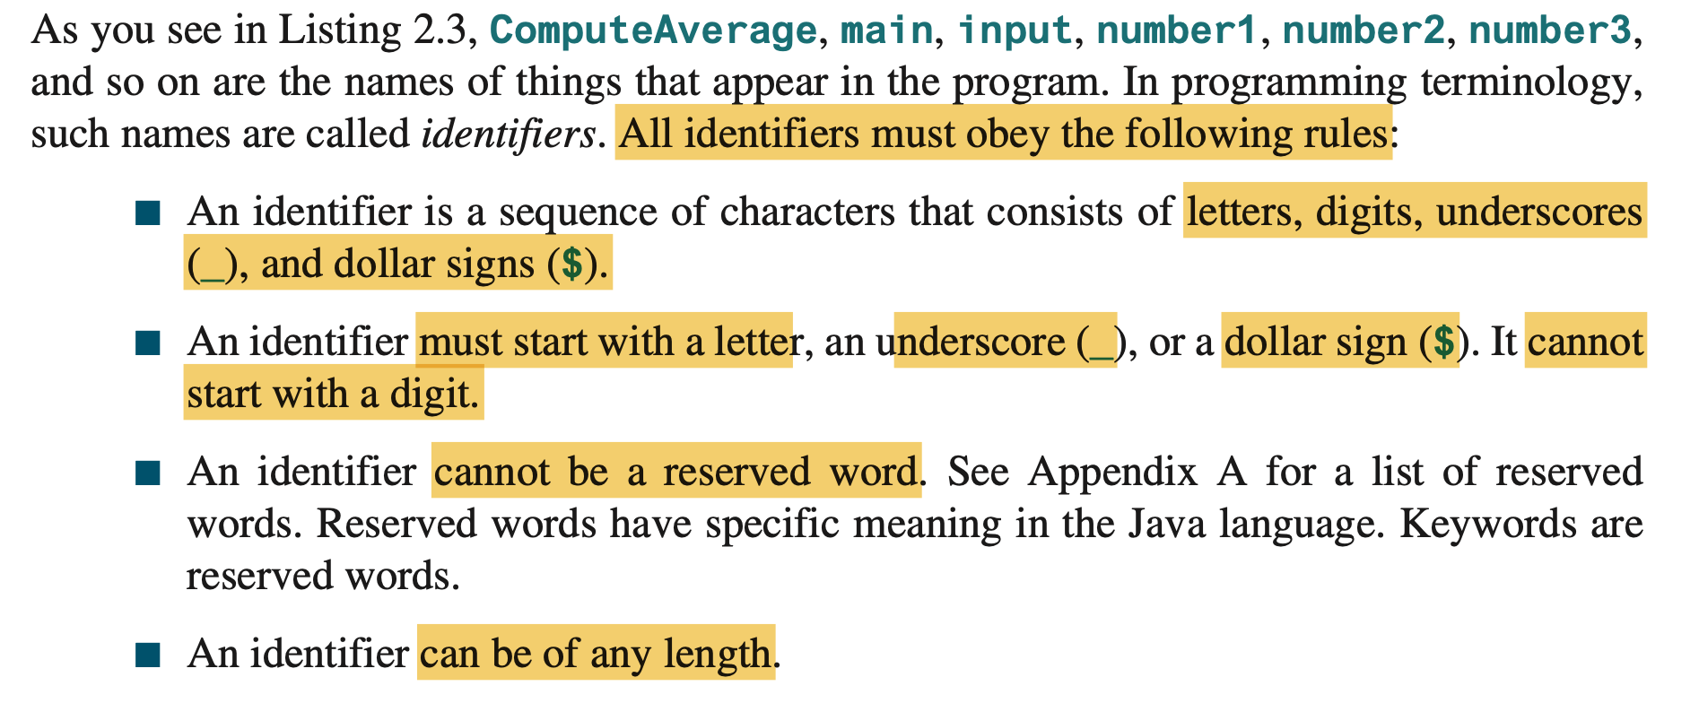

Slide 23
2.6 Every letter in a Java keyword is in lowercase?
true B. false
2.7 Which of the following is a valid identifier?
Please select all that apply.
$343
B. class C. 9X
D. 8+9
E. radius

Slide 24
2.17 Which of these data types requires the most amount of memory?
A. long B. int C. short D. byte

Slide 25
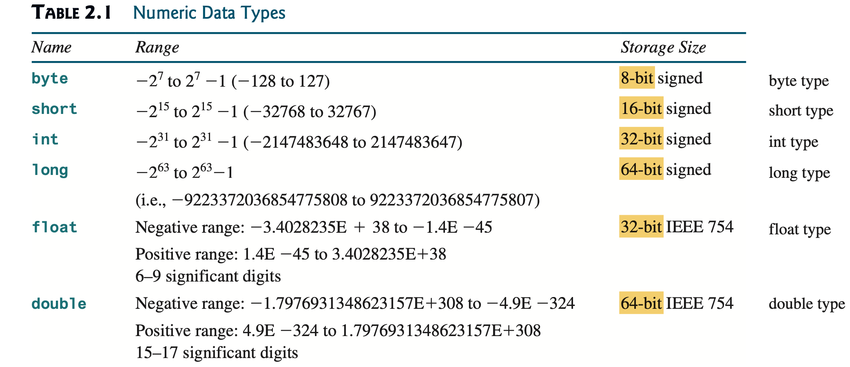
2.17 Which of these data types requires the most amount of memory?
A. long B. int C. short D. byte

Slide 26
2.37 To obtain the current second, use _________.
A. System.currentTimeMillis() % 3600 B. System.currentTimeMillis() % 60 C. System.currentTimeMillis() / 1000 % 60
D. System.currentTimeMillis() / 1000 / 60 % 60
E. System.currentTimeMillis() / 1000 / 60 / 60 % 24

Slide 27
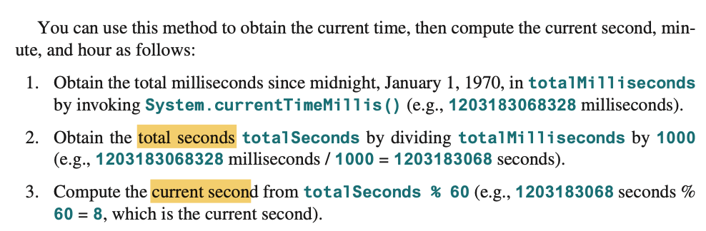
2.37 To obtain the current second, use _________.
A. System.currentTimeMillis() % 3600 B. System.currentTimeMillis() % 60 C. System.currentTimeMillis() / 1000 % 60
D. System.currentTimeMillis() / 1000 / 60 % 60
E. System.currentTimeMillis() / 1000 / 60 / 60 % 24

Slide 28
2.37 To obtain the current second, use _________.
A. System.currentTimeMillis() % 3600 B. System.currentTimeMillis() % 60 C. System.currentTimeMillis() / 1000 % 60
D. System.currentTimeMillis() / 1000 / 60 % 60
E. System.currentTimeMillis() / 1000 / 60 / 60 % 24

Slide 29
3.4 What is 1 - 0.1 - 0.1 - 0.1 - 0.1 - 0.1 == 0.5?
true
B. false C. There is no guarantee that
1 - 0.1 - 0.1 - 0.1 - 0.1 - 0.1 == 0.5 is true.

Slide 30
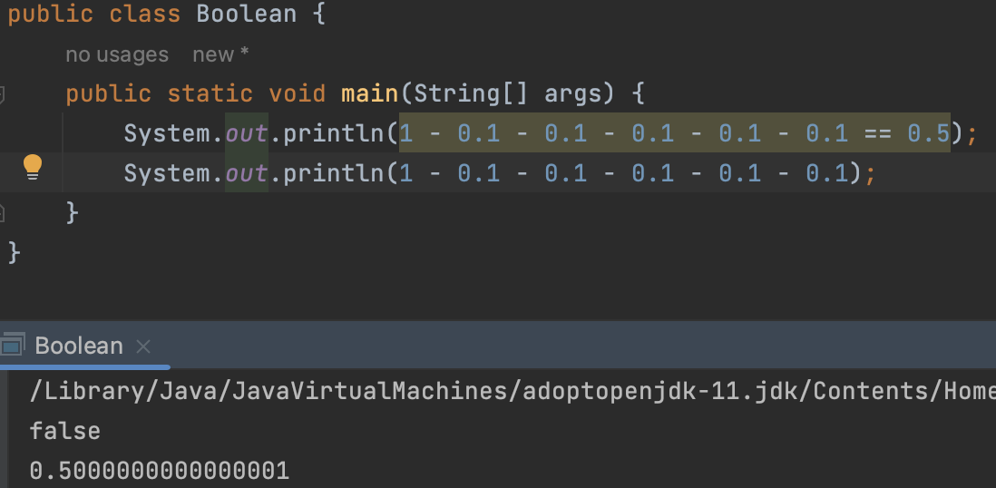
3.4 What is 1 - 0.1 - 0.1 - 0.1 - 0.1 - 0.1 == 0.5?
true
B. false C. There is no guarantee that
1 - 0.1 - 0.1 - 0.1 - 0.1 - 0.1 == 0.5 is true.

Slide 31
3.4 What is 1 - 0.1 - 0.1 - 0.1 - 0.1 - 0.1 == 0.5?
true
B. false C. There is no guarantee that
1 - 0.1 - 0.1 - 0.1 - 0.1 - 0.1 == 0.5 is true.

Slide 32
3.26 Given |x| <= 4, which of the following
is true?
x <= 4 && x >= 4
B. x <= 4 && x > -4
C. x <= 4 && x >= -4
D. x <= 4 || x >= -4

Slide 33
3.26 Given |x| <= 4, which of the following
is true?
x <= 4 && x >= 4
B. x <= 4 && x > -4
C. x <= 4 && x >= -4
D. x <= 4 || x >= -4
-4 <= x <= 4

Slide 34
3.26 Given |x| <= 4, which of the following
is true?
x <= 4 && x >= 4
B. x <= 4 && x > -4
C. x <= 4 && x >= -4
D. x <= 4 || x >= -4
-4 <= x <= 4

Slide 35
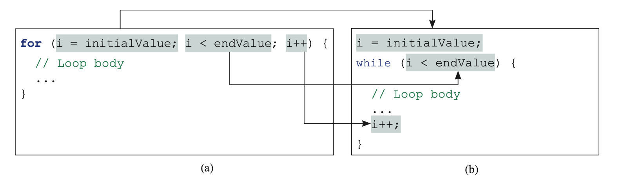
Difference between for and while

Slide 36
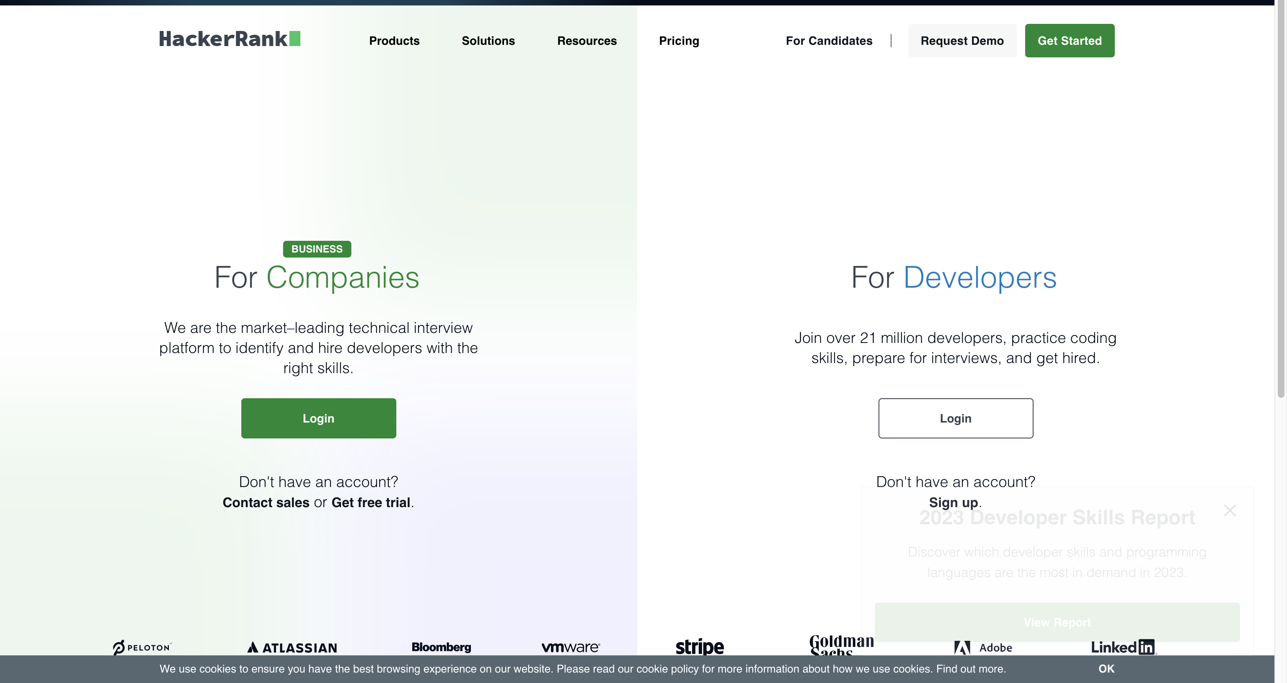
https://www.hackerrank.com/

Slide 37
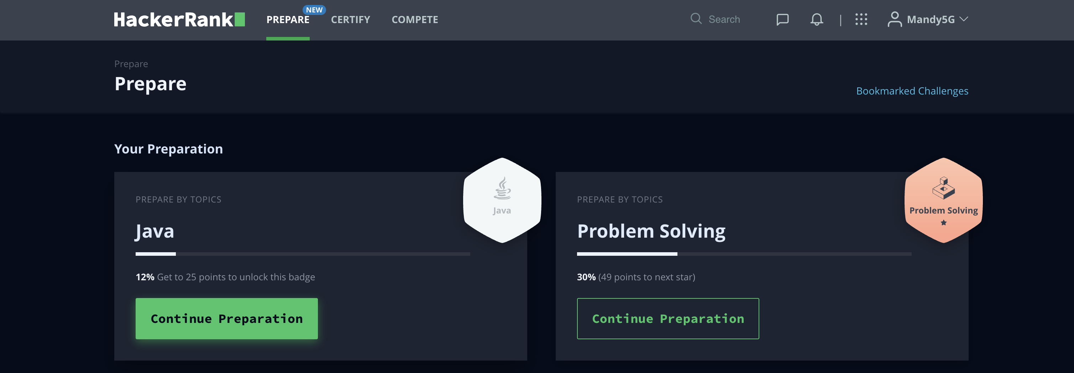
https://www.hackerrank.com/

Slide 38
Introduction to Java
The term Java from Java island….
JIU IT Major 20230124 PMJ, AEJ

