Slide 1
JIU IT Major 20230124 PMJ, AEJ
Object-Oriented Programming
Practice Week2

Slide 2
Question 1. If-elseif
What is wrong in the following code?
if (score >= 60) System.out.println("D");
else if (score >= 70) System.out.println("C");
else if (score >= 80) System.out.println("B");
else if (score >= 90) System.out.println("A");
else System.out.println("F");

Slide 3
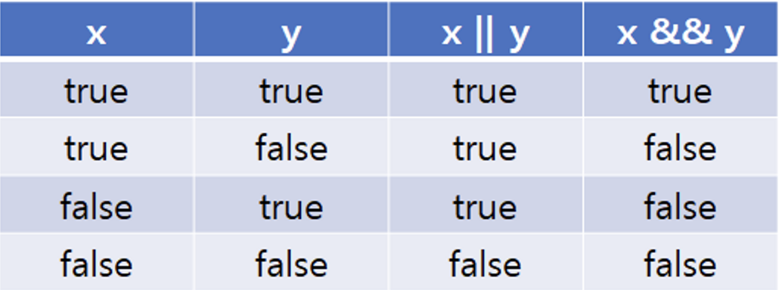
Question 2. Boolean

Slide 4
Question 2. Boolean
True = 1, False = 0
1
1
1
0
0
1
0
0

Slide 5
Question 2. Boolean
3.10.1 Assuming that x is 1,
show the result of the following Boolean expressions:
(true) && (3 > 4)

Slide 6
Question 2. Boolean
3.10.1 Assuming that x is 1,
show the result of the following Boolean expressions:
(true) && (3 > 4)
1
&&
0

Slide 7
Question 2. Boolean
True = 1, False = 0
1
1
1
0
0
1
0
0

Slide 8
Question 2. Boolean
3.10.1 Assuming that x is 1,
show the result of the following Boolean expressions:
!(x > 0) && (x > 0)

Slide 9
Question 2. Boolean
3.10.1 Assuming that x is 1,
show the result of the following Boolean expressions:
!(x > 0) && (x > 0)
0
&&
1

Slide 10
Question 2. Boolean
3.10.1 Assuming that x is 1,
show the result of the following Boolean expressions:
(x > 0) || (x < 0)

Slide 11
Question 2. Boolean
3.10.1 Assuming that x is 1,
show the result of the following Boolean expressions:
(x > 0) || (x < 0)
1
||
0

Slide 12
Question 2. Boolean
True = 1, False = 0
1
1
1
1
0
0
1
0
0
0

Slide 13
Question 2. Boolean
3.10.1 Assuming that x is 1,
show the result of the following Boolean expressions:
(x != 0) || (x == 0)

Slide 14
Question 2. Boolean
3.10.1 Assuming that x is 1,
show the result of the following Boolean expressions:
(x != 0) || (x == 0)
1
||
0

Slide 15
Question 2. Boolean
3.10.1 Assuming that x is 1,
show the result of the following Boolean expressions:
(x >= 0) || (x < 0)

Slide 16
Question 2. Boolean
3.10.1 Assuming that x is 1,
show the result of the following Boolean expressions:
(x >= 0) || (x < 0)
1
||
0

Slide 17
Question 2. Boolean
3.10.1 Assuming that x is 1,
show the result of the following Boolean expressions:
(x != 1) == !(x == 1)

Slide 18
Question 2. Boolean
3.10.1 Assuming that x is 1,
show the result of the following Boolean expressions:
(x != 1) == !(x == 1)
0
==
0

Slide 19
Question 3. Switch
System.out.println("switch(1)");
switch(1) { case 1: System.out.println("one"); break; case 2: System.out.println("two"); break; case 3: System.out.println("three"); break; default: System.out.println("default"); break; }

Slide 20

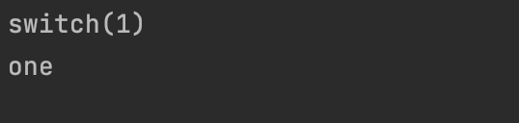

Question 3. Switch
System.out.println("switch(1)");
switch(1) { case 1: System.out.println("one"); break; case 2: System.out.println("two"); break; case 3: System.out.println("three"); break; default: System.out.println("default"); break; }

Slide 21
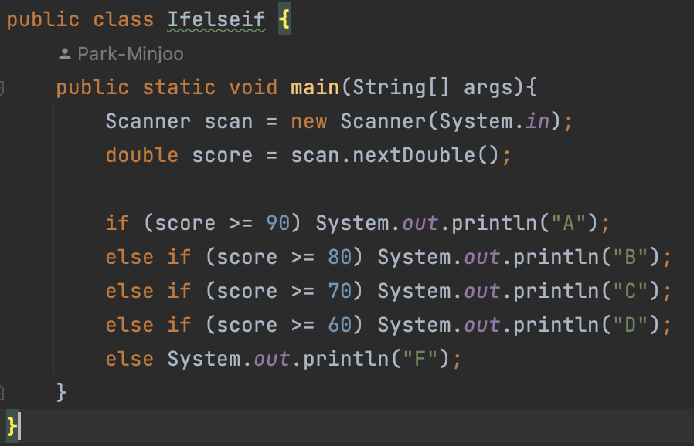
Question 1. If-elseIf

Slide 22
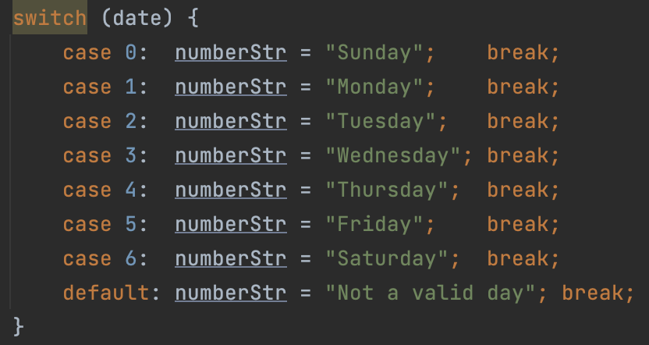
Question 2. Switch

Slide 23

Question 3. Day Of the Week
1 = Monday
1 (date) + 3(elapsed) = 4
4 % 7 = 4
4 = Thursday

Slide 24
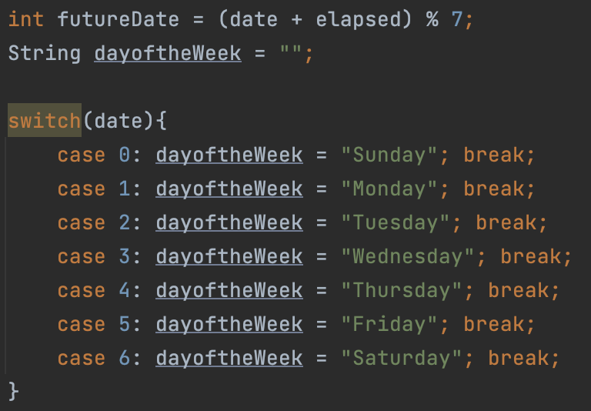
Question 3. Day Of the Week
1 = Monday
1 (date) + 3(elapsed) = 4
4 % 7 = 4
4 = Thursday

Slide 25
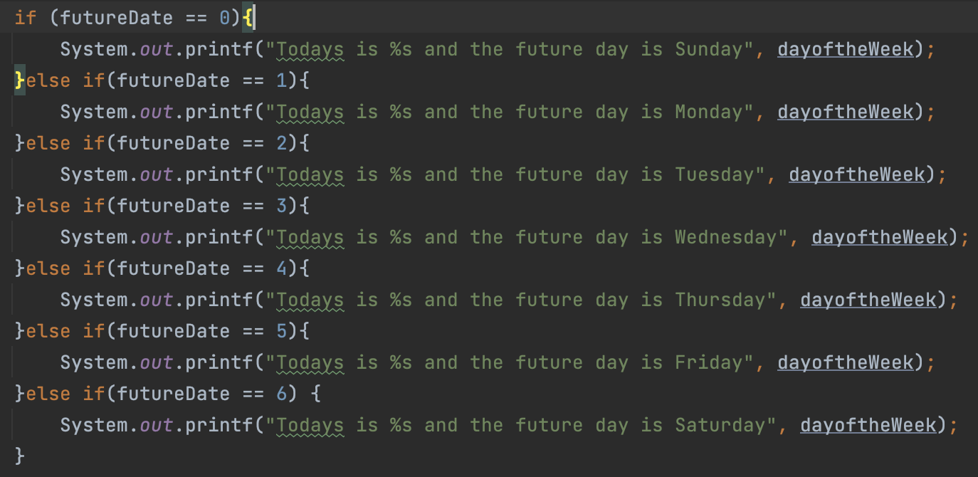
Question 3. Day of the Week

Slide 26

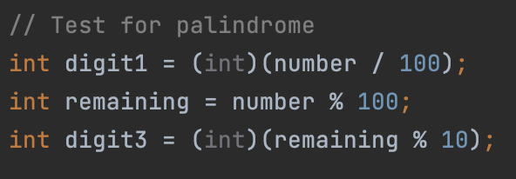
Question 4. Palindrome
-> 1 (ones place)
-> 2 (tens place)
-> 1 (hundreds place)

Slide 27
Question 4. Palindrome
-> 1 (ones place)
-> 2 (tens place)
-> 1 (hundreds place)

Slide 28
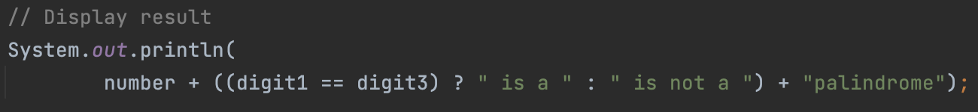
Question 4. Palindrome
-> 1 (ones place)
-> 2 (tens place)
-> 1 (hundreds place)

Slide 29
Question 4. Palindrome
1 (hundreds place)
==
1 (ones place)

Slide 30
Question 4. Palindrome
1 (hundreds place)
==
1 (ones place)

Slide 31
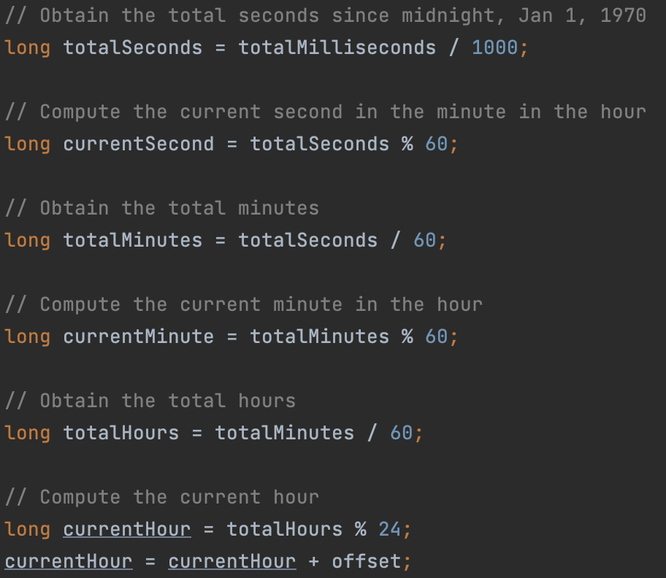
Question 5. 12-hour clock
1 sec = 1000 millis

Slide 32
Question 5. 12-hour clock
1 sec = 1000 millis

Slide 33
Question 5. 12-hour clock
Current = total % 60

Slide 34
Question 5. 12-hour clock
1 min = 60 s

Slide 35
Question 5. 12-hour clock
1 min = 60 s

Slide 36
Question 5. 12-hour clock

Slide 37
Question 5. 12-hour clock
1 hour = 60 m

Slide 38
Question 5. 12-hour clock
1 hour = 60 m

Slide 39
Question 5. 12-hour clock
1 hour = 60 m

Slide 40
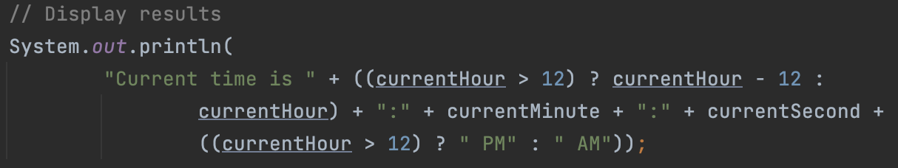
Question 5. 12-hour clock
If (currentHour) > 12
else If (currentHour) <= 12

Slide 41
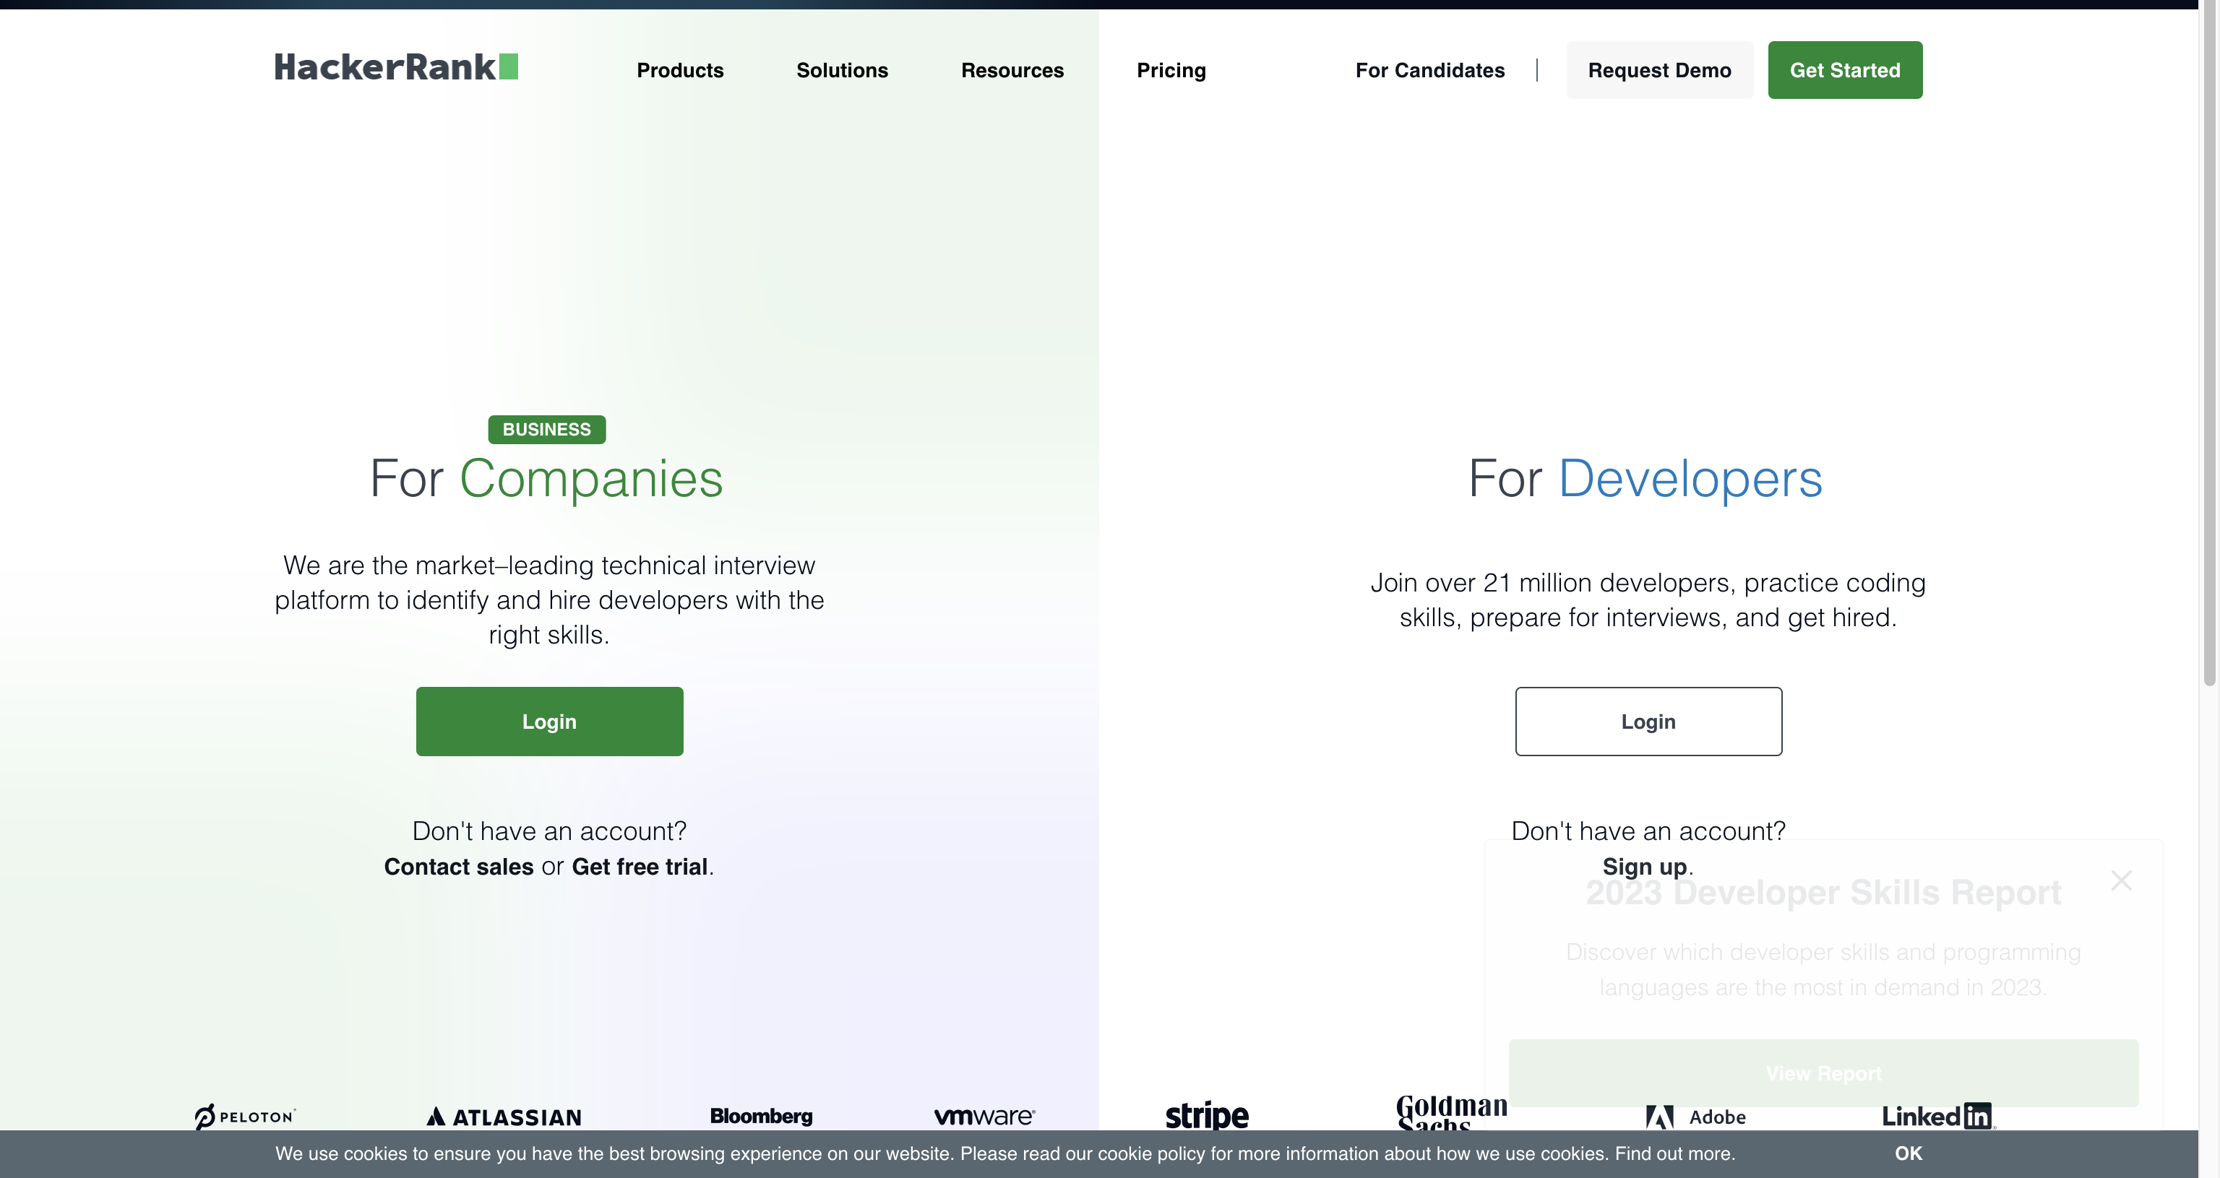
Question 3. Stdin and Stdout
https://www.hackerrank.com/

Slide 42
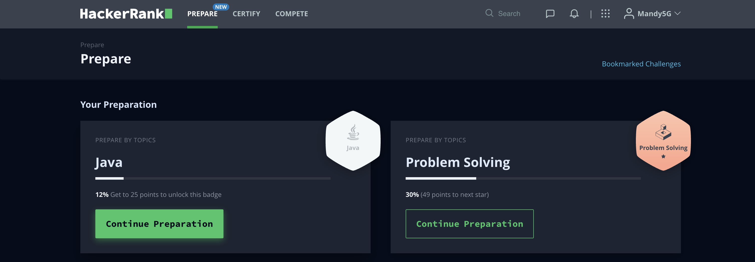
Question 3. Stdin and Stdout
https://www.hackerrank.com/

Slide 43
Introduction to Java
The term Java from Java island….
JIU IT Major 20230124 PMJ, AEJ

