Slide 1
Analysis of Factors Influencing
the Determination of Medical Expenditure
for the Elderly in Korea
Changsoo Lee, Department of Industrial and Management Engineering,
Gangneung-Wonju National University, Korea
Young Park, Department of Information Statistics,
Gangneung-Wonju National University, Korea
15th ICICIC2021 Online September 15, 2021
Notes:
Good morning, I’m 영빈 박
I’m delighted to present to give my presentation.
Today, I’m here to present Analysis of Factors Influencing the Determination of Medical Expenditure for the Elderly in Korea.

Slide 2
[Contents]
1. Introduction
2. Preliminary Investigation
3. Introduction to target data and variables
4. Target data quality diagnosis and data preprocessing
5. Multiple Regression Analysis
6. Conclusion & Limitation
7. References
Notes:
The order of presentation is as follows.

Slide 3
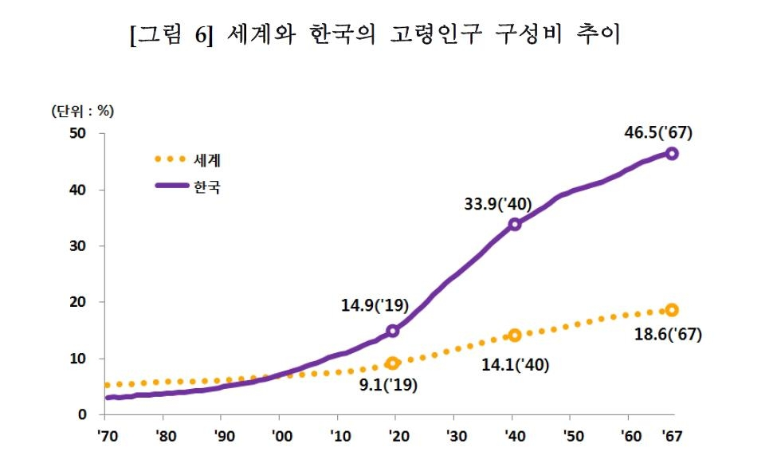
South Korea's aging population, citizens aged 65 years or older, is predicted to reach 37.0 percent by 2045.
It is expected to surpass Japan's 36.7 percent, thereby becoming the world's oldest population.
Projections show South Korea's elderly population will grow at the fastest pace in the world, going from 14.9 percent by 2019 to 46.5 percent by 2067.
(unit : %)
World
Korea
* Yanhap News, 2019
Fig1.The trend of the old age population in the World and Korea
3/20

Slide 4
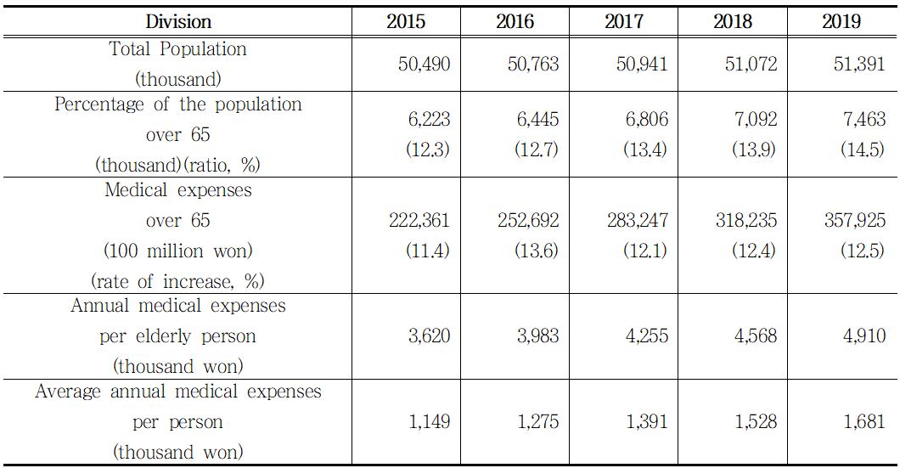
Elderly population and medical expenses for the elderly are increasing every year.
The average medical cost per person aged 65 and over in Korea was 4.91 million won per year.
This is about 2.9 times the average medical cost per capita namely, 1.68 million won per year.
* Health Insurance Review & Assessment Service
Table1. The Status of Medical Expenses for the Elderly aged 65 and Over
4/20
Notes:
As such, medical expenses are expected to increase further in the future due to a rapidly aging society and increasing life expectancy.
Consequently, rapidly increasing medical expenses will be a burden on society in the long run.

Slide 5
[ Objective ]
- To explore the factors influencing the medical expenses of the elderly
- To spend efficient medical expenses in consideration of the individual's condition or surrounding situation
* Factors that could affect medical expenses were selected as demographic/socioeconomic/health-related factors.
Demographic
Factors
Socioeconomic
Factors
Medical
expenses
+
Health-related
Factors
5/20
Notes:
The objective of study is to explore the factors influencing the medical expenses of the elderly.

Slide 6
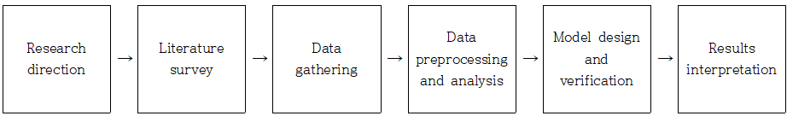
[ Procedure ]
1. Establishing the direction of the research through examining the data provided by Kaggle
2. Looking for statistical data and performing literature survey
3. Preprocessing data
4. Conducting a multi-regression analysis with R to design and validate the model
5. Interpreting the results
6/20
Notes:
The research procedure begins by establishing the direction of the research through examining the data provided by Kaggle.
We then look for statistical data related to the direction of the study and perform the literature survey. After selecting the appropriate dataset, we begin preprocessing the data.
Next, we conduct a multi-regression analysis with R to design and validate the model. The final stage of the study is the interpretation of the results.

Slide 7
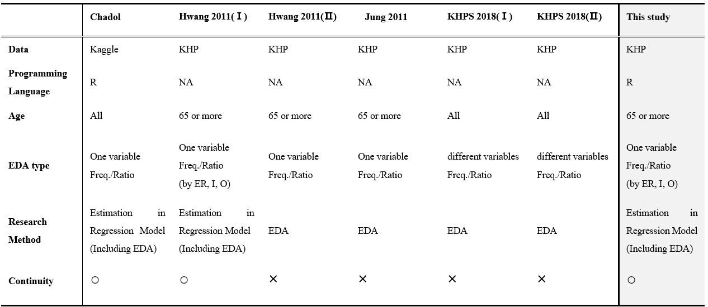
Continuity refers to whether one course of study affects the next.
This study was conducted with aged 65 and over, and EDA was conducted for each of the three medical services.
(KHP = Korea Health Panel, ER = Emergency room, I = Inpatient, O = Outpatient)
* Chadol: Naver blog owner(data marketing and study blog)
* Hwang 2011(Ⅰ): Analysis of Factors Affecting Medical Expenditure by Generation
* Hwang 2011(Ⅱ): Health Service Utilization and Expenditure of the Elderly based on KHP
* Jung 2011: A Report on the Korea Health Panel Survey: Health Care Utilizations and Out-of-Pocket Spending
* KHPS 2018(Ⅰ): 2016 Korea Medical Panel Basic Analysis Report(Ⅰ)
* KHPS 2018(Ⅱ): 2016 Korea Medical Panel Basic Analysis Report(Ⅱ)
Table2. Comparison of literature survey
7/20
Notes:
This shows the comparison of literature survey and this study.

Slide 8
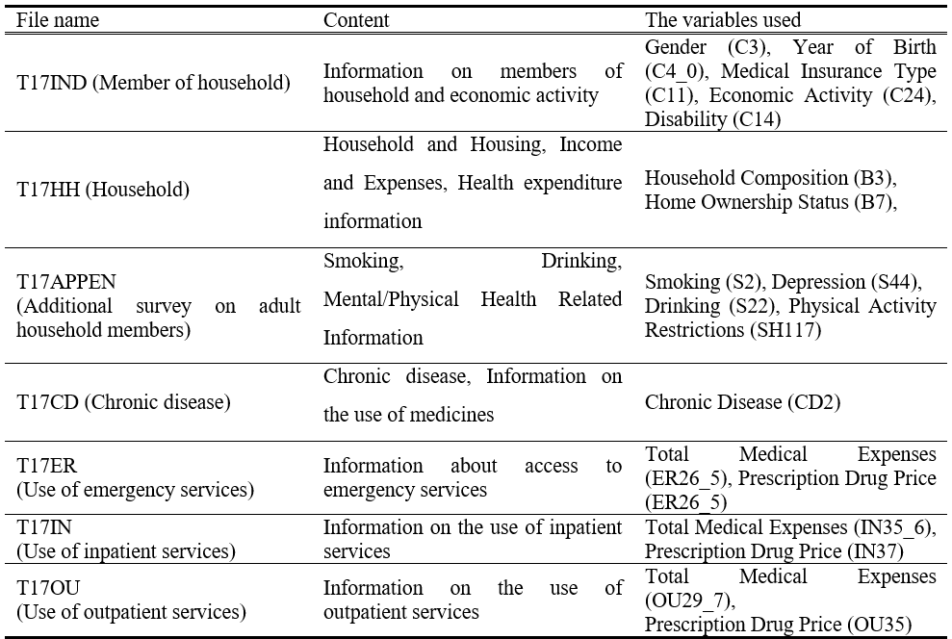
In this study, the variables specified in the under table were used through literature survey.
Table3. Target data and variables
8/20

Slide 9
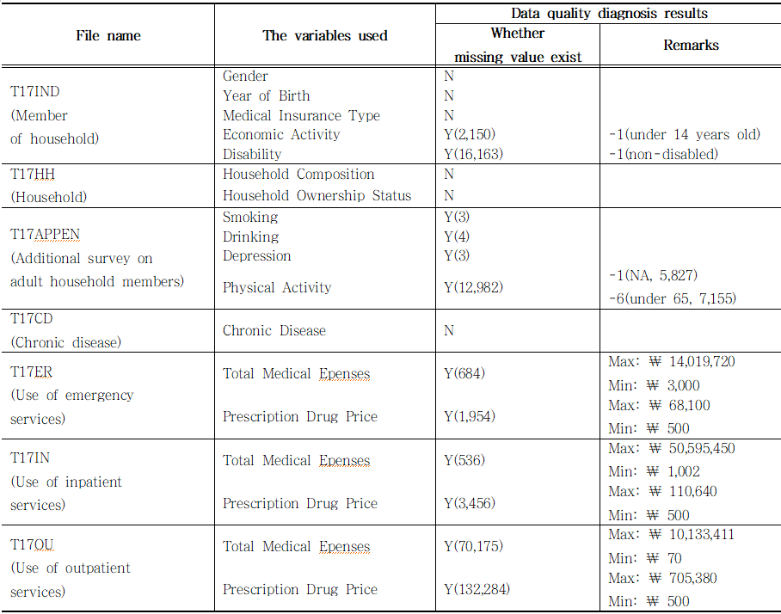
4.1 Data quality diagnosis
We examined the quality of the target data to confirm the organization of the variables of each data set and the existence of missing values.
Table4. Data Quality Diagnostic Table
9/20
Notes:
Now let’s look at the data quality diagnosis and preprocessing process.

Slide 10
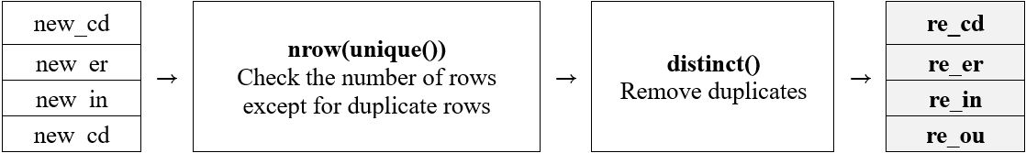
4.2 Data preprocessing
- The age variable was created using the year of birth, and the study was conducted for older adults, aged 65 years and older.
- In the emergency/hospitalization/outpatient data set, only Household Member Identification Number (PIDWON) and medical service use frequency variables (ERCOUNT, INCOUNT, OUCOUNT) were extracted and set as re_er, re_in, and re_ou data, respectively.
- To know the number of medical service use, IND data and re_er, re_in, and re_ou data were combined based on PIDWON variable.
Table5. Duplicate row removal process
10/20

Slide 11
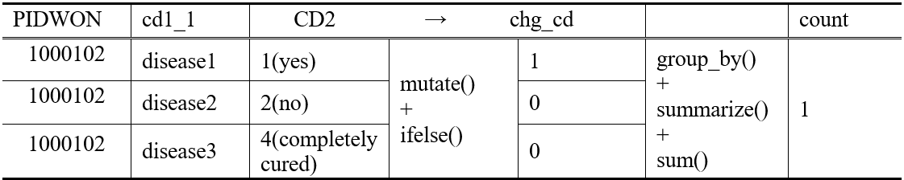
4.2 Data preprocessing
- From the chronic disease data, only PIDWON, Chronic Disease Code (cd1_1), and Chronic Disease (CD2) were extracted.
- Duplicate rows were removed and preprocessing was performed to determine the number of chronic diseases per individual.
Table6. re_cd data preprocessing process
11/20

Slide 12
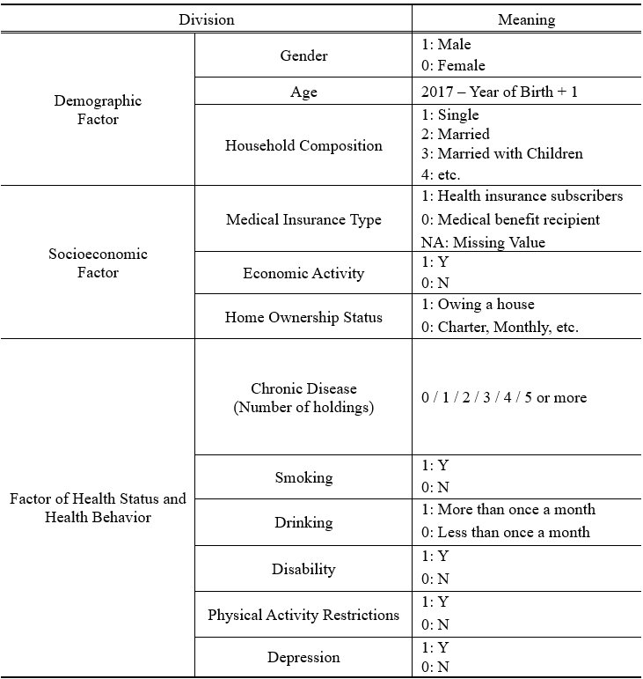
4.2 Data preprocessing
- Independent variables were classified as shown in the next table by merging IND, HH, APPEN, and re_cd data based on PIDWON variable.
- The data consisting only of independent variables was named 'b1'.
Table7. Independent variables list
12/20

Slide 13
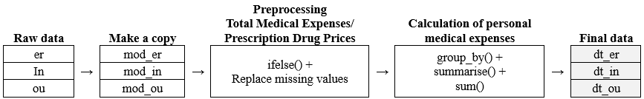
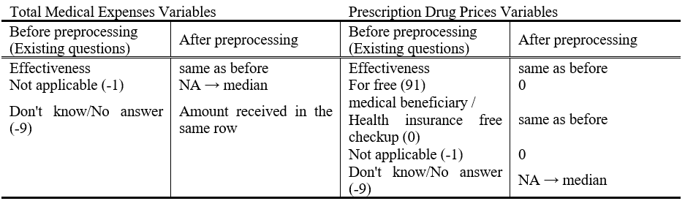
4.2 Data preprocessing
- Personal medical expenditure was defined as the sum of Total Medical Expenses and Prescription Drug Prices.
- Missing values of each variable were processed as follows.
- The preprocessed data were named dt_er, dt_in, and dt_ou by medical service.
Table8. Process of deriving missing values of personal expenditure medical expenses
13/20

Slide 14
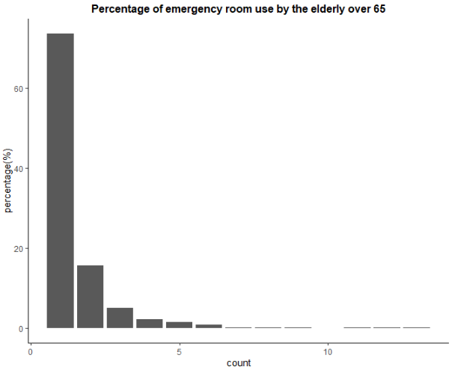
4.3 The number and rate of medical use by medical service in the elderly
In the case of emergency room use, 73.6% of the elderly used once a year, and the maximum number of use is 13 times a year.
Fig2. Percentage of emergency room use by the elderly over 65
14/20

Slide 15
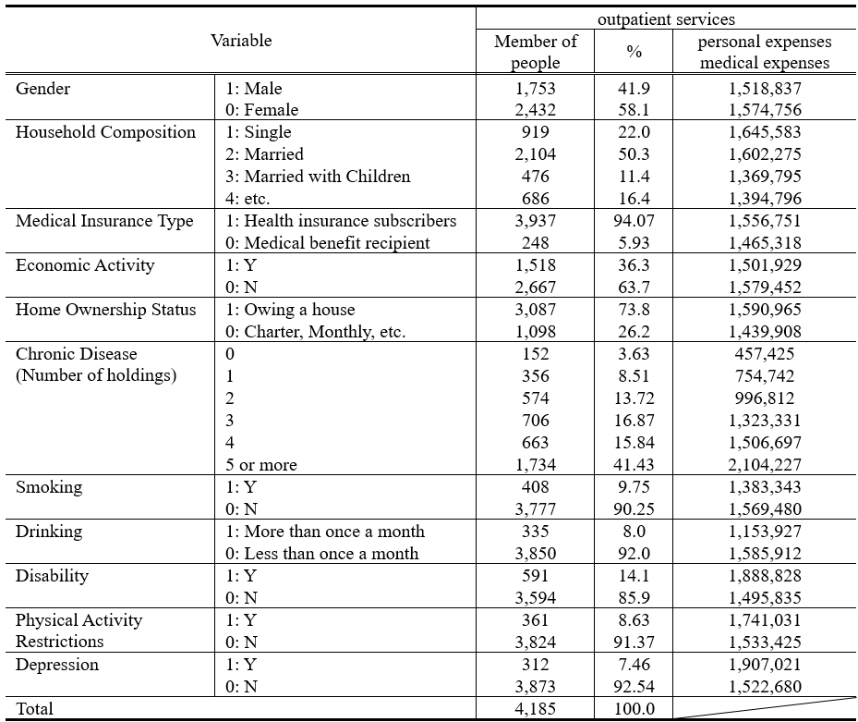
4.4 Status of medical use and average medical expenses for each factor of the elderly
In the case of outpatient service use,
- As the number of chronic diseases increases, medical expenses increase.
- Non-smokers or non-drinkers have higher medical expenses.
- We interpreted this as a variable representing the difference in health perception.
“the difference in health perception” means…
- If you care about your health, you will not smoke or drink too much, and you will pay more for medical expenses such as going to the hospital more often or having health checkups.
* unit: won
Table9. Outpatient medical use and medical expenses by each factor
15/20

Slide 16
[ Why Multiple Regression? ]
- Regression analysis is a method of verifying how the dependent variable changes with a change in the independent variable.
- Since there were more than two independent variables used in this study, we analyzed the data using a multiple regression analysis method.
[ Analysis Method ]
- By emergency, hospitalization, and outpatient medical services
- Using Stepwise Regression
- Significance level: 0.05
- Checking adjusted R-squared, Durbin-Watson statistic, etc.
Independent
variable 2
Independent
variable 4
Independent
variable 1
Dependent
variable
+
Independent
variable 5
Independent
variable 3
16/20
Notes:
Next is the analysis method.
The analysis was divided by three medical services, and a stepwise regression was used. the significance level was based on 0.05.
plus, we confirmed adjusted R-squared, Durbin Watson statistic, etc.

Slide 17
6.1 Conclusion
Although socioeconomic factors were statistically significant, their influence was small compared to the other factors.
Gender, age, and single-person households,
which are demographic factors, have a statistically significant effect on medical expenses.
Socioeconomic
Factors
Medical
expenses
Demographic
Factors
+
Health-related
Factors
Physical activity restriction and the number of chronic diseases have the greatest influence of the three factors and the medical expenses are also significant.
17/20
Notes:
Finally, conclusions and limitations.

Slide 18
6.1 Conclusion
Demographic Factors
In terms of gender, age, and single-person households have a statistically significant effect on medical expenses.
Socioeconomic Factors
Although socioeconomic factors were statistically significant, their influence was small compared to the other factors
Health-related Factors
Physical activity restriction and the number of chronic diseases have the greatest influence of the three factors and the medical expenses are also significant.
17/20
Notes:
Finally, conclusions and limitations.

Slide 19
6.2 Limitation
Limitations of human data
In general, human data are not regular.
Therefore, the limit is that adjusted R-squared did not exceed 1%.
Did not consider interaction
For some variables, each feature can be combined to have a greater effect on the dependent variable.
For example, a more suitable model can be obtained by considering the interaction between the number of chronic diseases and physical activity restriction variables.
Narrow medical expense range
To understand the current state of medical expenses more accurately,
it is necessary to expand the range of medical expenses including nursing / transportation / ambulance expenses.
18/20

Slide 20
“Almost half of South Koreans will be 65 or older by 2067”, Yonhap News, 2019.9.2.
“2019 Health Insurance Statistical Yearbook”, Health Insurance Review & Assessment Service, National Health Insurance Service, 2020.
Chadol, “R programming Multiple linear regression case with R programming (Medical Expense Prediction Modeling) (3)”, http://blog.naver.com/bestinall/221580078436, 2019.
Yeonhee Hwang, “Analysis of Factors Affecting Medical Expenditure by Generation”, The 3rd Korea Health Panel Conference, Seoul, Seoul Foundation of Women & Family, 2011.
Yeonhee Hwang, “Health Service Utilization and Expenditure of the Elderly based on KHP”, Health and welfare policy forum, Issue 182, Korea Institute for Health and Social Affairs, pp. 51-59, 2011.
Youngho Jung, “A Report on the Korea Health Panel Survey: Health Care Utilizations and Out-of-Pocket Spending”, Health and welfare policy forum, Issue 179, Korea Institute for Health and Social Affairs, 2011.
“2016 Korea Medical Panel Basic Analysis Report (Ⅰ) - Household-burdened medical expenses, medical use, private medical insurance, and medical expenses analysis by major disease”, Korean Health Panel Study, 2018.
“2016 Korea Medical Panel Basic Analysis Report (Ⅱ) – Contraction of a disease, chronic disease, health behavior and level of health”, Korean Health Panel Study, 2018.
Yanggyun Kim, “The risk of misuse of big data in health care may outweigh the value of its use”, ZDNet Korea, https://zdnet.co.kr/view/?no=20210430160554, 2021.
The Korean Federation of Science and Technology Societies, “COVID-19 and the Future of health care in Korea”, The 23rd KOFST- Academy of Medicine - Academy of Science and Technology Online joint forum, YouTube, https://www.youtube.com/watch?v=U9ycjK3nQIA&t=6764s, 2021.
19/20
Notes:
This section is a list of references of the study.

Slide 21
Thank You
This is
the end
of my presentation.
15th ICICIC2021 Online September 15, 2021

