Slide 1
CSED 312: Operating System Lab Project 1: Threads
Autumn 2020
Notes:
In this class we will introduce the project 1 for this course and guide you how to work out this project.

Slide 2
Overview
Goal: Implement the improved thread system in pintos
Alarm clock (5 points)
Priority scheduling (20 points)
Advanced scheduler (10 points)
Documents
Project 1.docx - Requirements of project 1, detailed explanation of requirements
Section 2, A.2, A.3, in pintos homepage
(http://web.stanford.edu/class/cs140/projects/pintos/pintos.html)
Overall contents of project 1
Description of thread system (A.2), synchronization (A.3), 4BSD scheduler (Appendix B)
Notes:
The goal of the project 1 is to implement the improved thread system in pintos.
Project 1 includes three main parts : alarm clock, priority scheduling and advanced scheduler.
Please read the documentation file for detailed explanation of requirements of project 1.
Also we recommend you to read carefully the description in pintos homepage to understand the overall process of project 1.
Part A.2 for thread system, A.3 for synchronization and appendix B for 4BSD scheduler will help you to design your project.

Slide 3
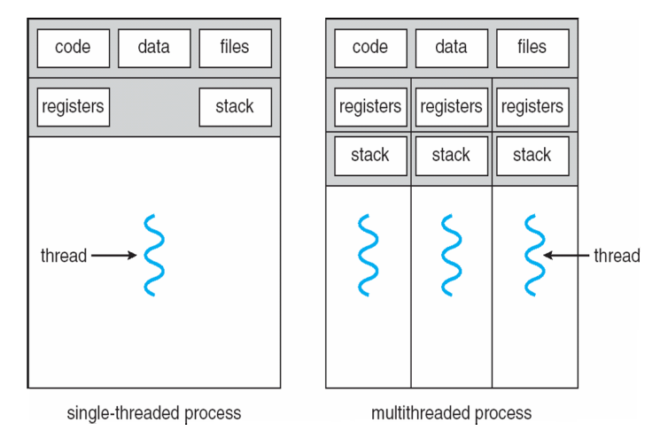
Background: Thread
Notes:
For this project, you should understand what is thread.
A thread is a flow of execution through the process code with system registers which hold its current working variables, and a stack which contains the execution history.
This figure shows the working of a single-threaded and multithreaded process.
In multithreaded process, a thread shares with its peer threads few information like code segment, data segment and open files.
When one thread changes a code segment memory item, all other threads see that.
By this resource sharing, using multithreads is more economical than using multiple processes.

Slide 4
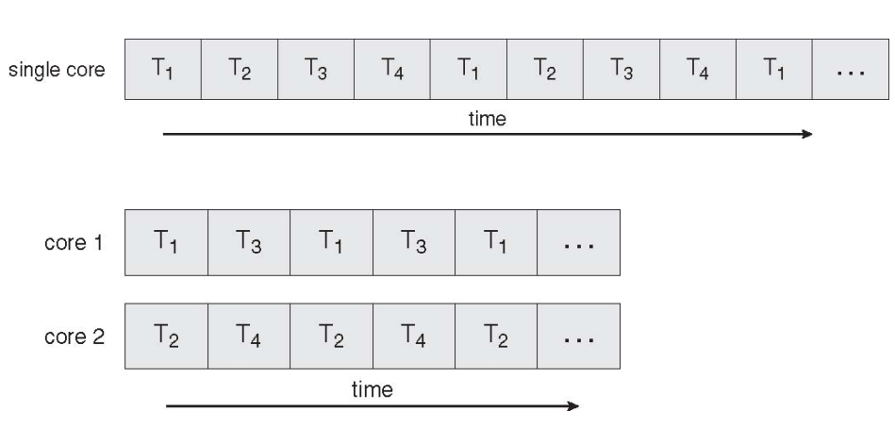
Background: Thread
Notes:
In a multi-core architecture, each thread can run on a difference processor in parallel using multithreading.
This increases concurrency of the system.
Compared to a single core system where only one process or thread can run on a processor at a time, multi-core system shows much faster running time.

Slide 5
Background: Thread
Understanding threads
Pintos already implements...
thread creation
thread completion
a simple scheduler to switch between threads (Round-Robin)
synchronized primitives (semaphores, locks, ...)
When a thread is created, you are creating a new context to be scheduled
provide function to be run in this context as an arguments to thread_create(...)
the given function acts like main() in that context
In pintos, each thread is assigned a small, fixed-size execution stack just under 4KB in size
You may cause problems, if you declare large data structures!
Notes:
Pintos already implements thread creation, thread completion, a simple scheduler to switch between treads and synchronized primitives.
You should know, when a thread is created, you are creating a new context to be scheduled.
Provide a function to be run in this context as an arguments to the function thread_create.
The given function acts like main function in that context.
Please be aware, each thread is assigned a small, fixed-size execution stack just under 4KB in size in pintos.
So, do not try to declare large data structures.

Slide 6
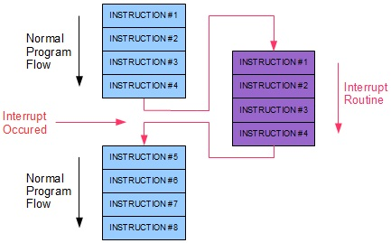
Background: Interrupt
See A.4 Interrupt handling
Internal (synchronous) interrupts, that is, interrupts caused directly by CPU instructions.
system calls, page faults, and divide-by-zero, and so on.
External (asynchronous) interrupts, that is, interrupts originating outside the CPU.
timer, keyboard, serial ports, and so on.
Notes:
In this section, we will explain about the interrupt.
Please read A.4 pintos description page about interrupt handling for details.
An interrupt is defined as an event that alters the sequence of instructions executed by a processor like following figure.
Such events correspond to electrical signals generated by hardware circuits both inside and outside the CPU chip.
Interrupts are often divided into internal and external interrupts.
Internal interrupts are produced by the CPU control unit while executing instructions.
These interrupts are also called synchronous because the control unit issues them only after terminating the execution of an instruction.
In internal interrupts, there are system calls, pages faults, divide-by-zero and so on.
External interrupts are generated by other hardware devices like timer, keyboard etc, at arbitrary times with respect to the CPU clock signals.

Slide 7
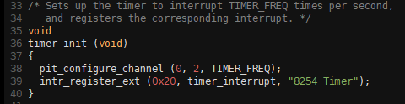
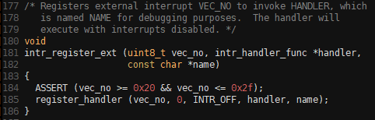

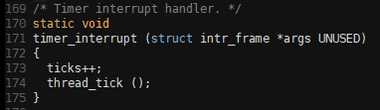


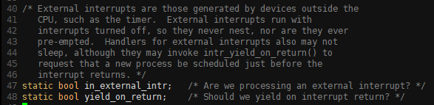
Background: Interrupt
devices/timer.c
timer_interrupt handler function is registered as a external interrupt handler
threads/interrupt.c
Notes:
Now let’s see how interrupt is implemented in pintos for thread switching.
In timer.c file, you can check the timer_interrupt handler function is registered as a external interrupt handler.
Now, please see interrupt.c file to see how the interrupt handler is implemented.
In this code section, by this handler function, timer_interrupt function is executed.
If timer_interrupt function return with yield_on_return value 1, than thread_yield function is called.
Finally thread_yield function does context switching process.

Slide 8
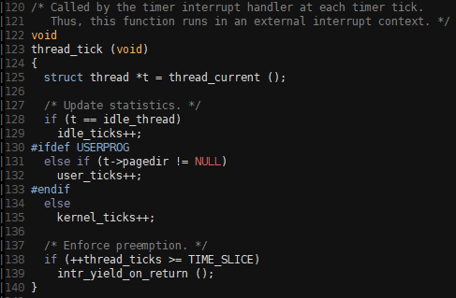
Background: Thread and Timer
devices/timer.c
timer_interrupt will be called externally per every tick and increases “ticks” by 1.
threads/thread.c
thread_tick increases “thread_ticks” and if “thread_ticks” exceeds TIME_SLICE, then yield.
Notes:
Now let’s see what actually happens in timer_interrupt function.
Timer_interrupt will be called externally per every tick and increased ticks by one.
And thread tick function increases thread ticks and if thread ticks exceeds time_slice, then yield.

Slide 9
Alarm clock
Re-implement timer_sleep(x) in "devices/timer.c"
Functionality
suspends execution of the calling thread for x timer ticks
Current Implementation: busy waits
spins in a loop checking the current time and calling thread_yield() until enough time has gone by
thread_yield() locates the thread at the last of ready queue (ready_list in "threads/thread.c")
New implementation
Unless the system is idle, put the thread at the ready queue after they have waited for the right amount of time
Notes:
And this is what you should implement in the project.
You need to re-implement timer_sleep function.
Current implementation is busy waiting, so it spins in a loop checking the current time and calling thread yield function until enough time has gone by.
Your new implementation should suspends execution of the calling threads for x timer ticks.
Unless the system is idle, the thread need not wake up after exactly x ticks.
Just put it on the ready queue after they have waited for right amount of time.

Slide 10
Priority scheduling
Implement priority scheduling
if a thread has a higher priority than the current thread, the current one should immediately yield the CPU to the higher one
current implementation: new thread is located at the last of the ready queue
Implement priority donation
understand the concept of priority inversion, priority inheritance
Implement extended donation
complicated case of priority donation
Implement examination and modification of priority
void thread_set_priority(int new_priority)
int thread_get_priority(void)
Notes:
And next subject you should implement is priority scheduling.
By priority scheduling, if a thread has a higher priority than the current thread, the current one should immediately yield the CPU to the higher one.
In current implementation, new thread is just located at the last of the ready queue.
And then, implement priority donation.
To implement this idea, you should understand the concept of priority inversion and priority inheritance.
Next, implement extended donation which is the complicated case of priority donation.
And finally, you should implement examination and modification of priority.
Please see the documentation file for details.

Slide 11
Priority
When a thread is added to the ready queue that has a higher priority than the currently running thread, the current running thread should immediately yield the processor to the new thread
Mid: 31
Low: 10
High: 60
Mid: 31
Low: 10
Running
Wait
Running
Wait
Wait
Notes:
In this section, we will briefly introduce what is priority.
Like following figure, let’s assume that a thread is added to the ready queue that has a higher priority with 60.
Than the currently running thread has lower priority with 31, it should immediately yield the processor to the new thread.
This is the priority scheduling.

Slide 12
Priority inversion
High
Lock A
Low
If a thread needs to wait for thread who has lower priority, then waiting thread will never get the CPU because the thread of lower priority will not give any CPU time!
acquired
code:
acquire
lock A
code:
acquire
lock A
code:
release
lock A
never
reached!
Running
Wait
Notes:
But let's think about more detailed case for priority scheduling.
We can see that two threads needs lock A for execution in this figure.
In this case, lower priority thread is on running time and so it already acquired lock A.
But after higher priority thread is added to ready queue, the green thread immediately yield the CPU to red thread.
Than, red thread is now on running time, but It will never be executed because it cannot get lock A which is already acquired by other thread.
Also, green thread cannot reach to the code that release lock A, because this thread is already in waiting state.
To escape from this situation, lower priority thread should be executed before the higher one.
This problem is called priority inversion.

Slide 13
Priority donation
High
but Low
Low
but High
High
Lock A
Low
Lock A
You will need to account for all different situations
multiple donations
nested donations
Implement priority donation for locks (not for semaphore, condition variable)
acquired
code:
acquire
lock A
acquired
code:
acquire
lock A
code:
acquire
lock A
code:
acquire
lock A
never
reached!
code:
release
lock A
eventually
reached
code:
release
lock A
Running
Wait
Wait
Running
donate priority!
Notes:
To solve the priority inversion problem, we can use priority donation.
When the previous situation is happened, we can donate priority from higher one to lower one.
By priority donation, lower thread eventually get higher priority, so we can reach to the release code block.
There can be many cases that needs priority donation.
You will need to account for these all different situations.
And implement priority donation only for locks for this project.

Slide 14
Advanced scheduler
Implement multilevel feedback queue scheduler (MLFQS) similar to 4BSD
by using ready queues per each priority, MLFQS manages the priority automatically
refresh the thread's priority per 4 ticks
MLFQS is selected by adding "-mlfqs" when running pintos
use the boolean variable thread_mlfqs in "threads/thread.c"
Implement priority scheduling in MLFQS
no priority donation
thread_set_priority() should not modify a priority
thread_set_nice() can modify the priority indirectly
priority = PRI_MAX - (recent_cpu / 4) - (nice * 2)
Notes:
Final subject is advanced scheduler.
You should implement multilevel feedback queue scheduler similar to 4BSD.
By using ready queues per each priority, MLFQS manages the priority automatically.
From 0 to 63, the total number of ready queue is 64.
And you should refresh the threads’ priority automatically per 4 ticks.
MLFQS should be selected by adding kernel option when running pintos.
Use the Boolean variable thread_mlfqs in thread.c.
And next subject is to implement priority scheduling in MLFQS.
Please notice that the advanced scheduler does not do priority donation.
Thus we recommended that you have the priority scheduler working, except possibly for priority donation, before you start on.
Please note that you should not modify priority directly.
By modifying nice value, you can modify the priority indirectly.
For details, please read the appendix in documentation file.

Slide 15
Development Suggestion
Read and design before implementation
pintos web page will help you a lot
not only project 1 page, but also general introduction
rash implementation will cause you to initialize the project
Many groups divided the assignments into pieces, then combine at the end
We do not recommend this approach because
often two changes conflict with each other
requires lots of last-minute debugging
Recommend integrating you team's changes early and often
use git
discuss often
Notes:
Before the implementation, we suggest you to read the pintos web page and documentation carefully.
Rash implementation may cause you to throw away all of your outputs and initialize all of your project.
And please do not divide the assignments into pieces and then combine at the end.
We recommend you to integrate teams’ changes early and often.
Use git and discuss about your implementations often with your teammate.

Slide 16
Design report should include
How to achieve each requirement
overall structure
data structures, functions to be added / modified
algorithms, rationales, and so on.
Analysis of the current thread system
structure, functions (thread_init(), ...), how to switch threads
see source codes ("threads/thread.h", "threads/thread.c") and section A.2
Analysis of synchronization
meaning of semaphore, lock, and implementation in pintos
see source codes ("threads/synch.h", "threads/synch.c") and section A.3
Notes:
Your design report should contain following contents.
Please read carefully and do not miss any of these.
Design your project carefully before the implementation.

