Slide 1



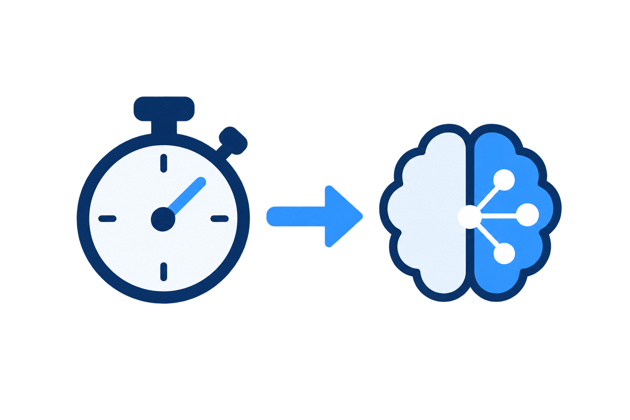


Parallel captures
Pending draft sequences
Run draft sequence
draft i
Optional stages
In capture order
Capture i
M
S
Capture i+1
Enqueue
draft i+1
draft i+2
delay
Capture i+2
Encoding & Saving
draft image
admit / skip
decidePacingDelay
decideAdmission
Budget-Aware Draft Controller
measured durations
Capture-Availability Pacing
Shared Duration Predictor
Remaining-Sequence Admission

