Slide 1




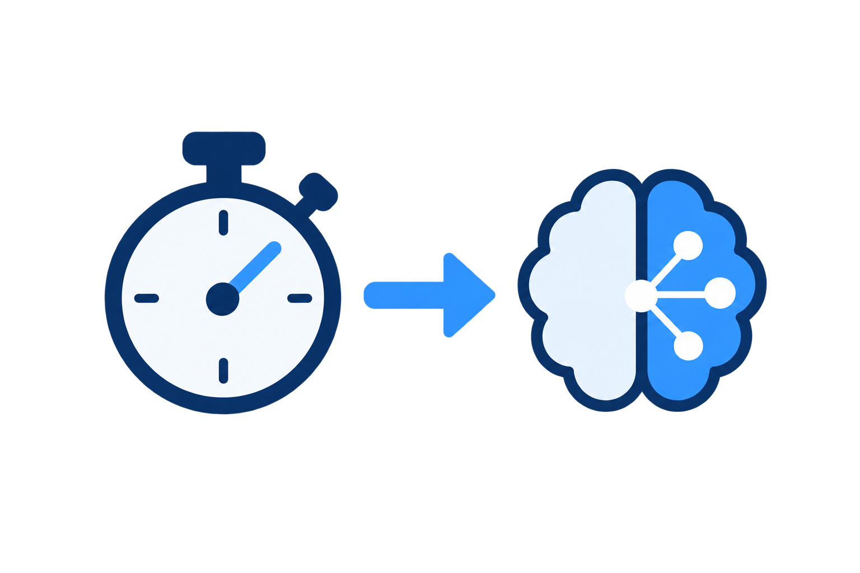


Parallel captures
Pending Draft Sequences
One active Draft Sequence
Draft i
Optional stages
in-order
Capture i
Capture i+1
Draft i+1
Draft i+2
delay
Capture i+2
Encoding & Saving
Draft image
admit / skip
decideDelay()
decideAdmission()
Budget-Aware Draft Controller
Capture-Availability Pacing
Workload Model &
Online Duration Estimates
Remaining-Sequence Admission

