Slide 1



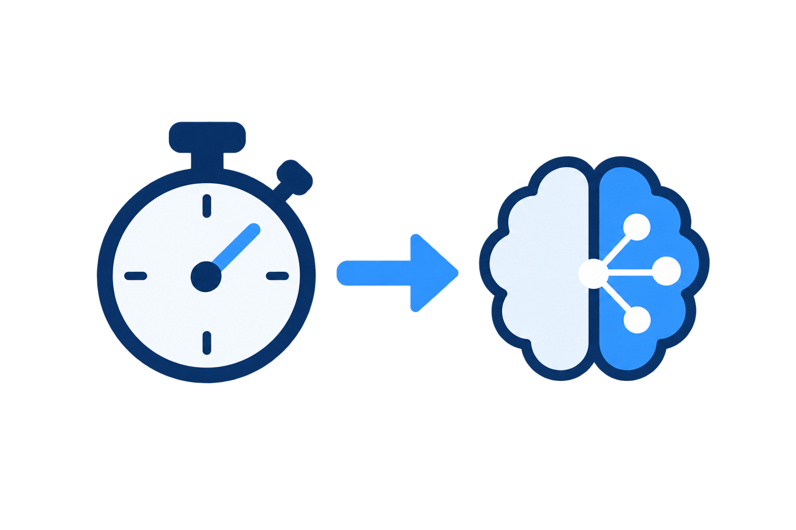


Parallel captures
Draft sequence Queue
One active draft sequence
draft i
Optional stages
Capture in-order
Capture i
M
S
Capture i+1
draft i+1
draft i+2
delay
Capture i+2
Encoding & Saving
draft image
admit / skip
decideDelay
decideAdmission
Budget-Aware Draft Controller
measured durations
Capture-Availability Pacing
Workload Model &
Online Duration Predictor
Remaining-Sequence Admission

