Slide 1

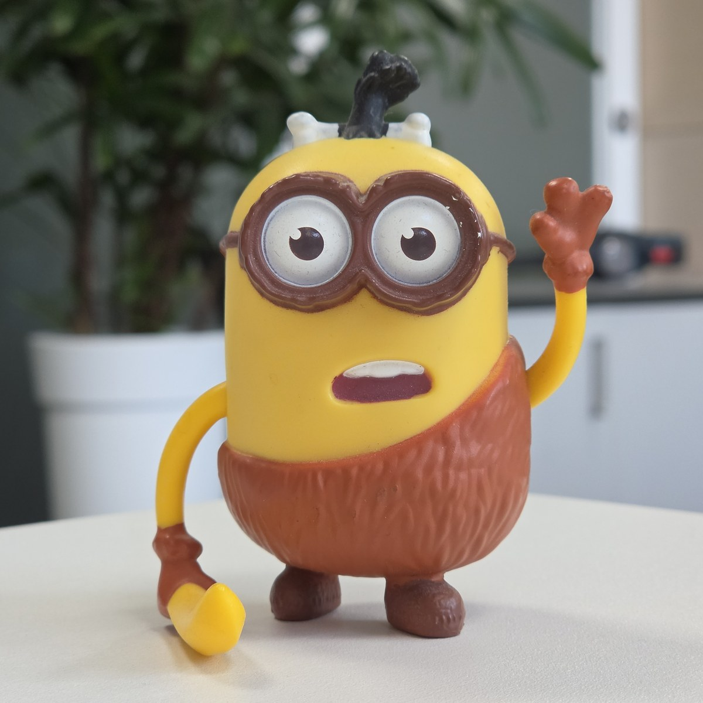




Samsung Gallery
Draft Sequence
replace
Draft image
Final image
Post-Processing

