Slide 1
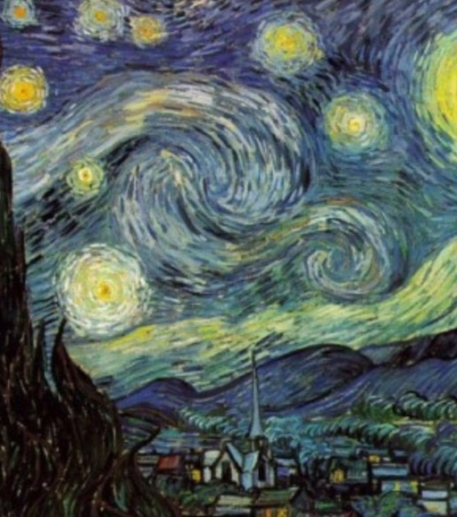
Turbulence and Kolmogorov’s Theory
Inspired by van Gogh’s
*The Starry Night*
Aragón, J. L., Naumis, G. G., Bai, M., Torres, M., & Maini, P. K. (2008). Turbulent luminance in impassioned van Gogh paintings. Journal of Mathematical Imaging and Vision, 30(3), 275–283.

Slide 2

Research question
If we generate many random, divergence-free velocity fields,
and enforce a Kolmogorov-like scaling in k-space,
will the ensemble-averaged energy spectrum converge to −5/3?
check this in a Monte Carlo style experiment.

Slide 3
Method overview
1) Random velocity field on N×N grid.
2) FFT → k-space representation.
3) Divergence-free projection (∇·u = 0).
4) Apply Kolmogorov-like scaling |û| ∼ k^{−4/3}.
5) Shell integration to obtain 1D E(k).
6) Repeat for many trials and average.
7) Fit slope on the inertial-range band.

Slide 4
Kolmogorov basics
High-Re turbulence: energy injected at large scales, eliminated at small scales.
In the inertial range, only the energy dissipation rate ε and k matter.
Dimensional analysis
→ E(k) = C ε^{2/3} k^{−5/3}.
So log(E) vs log(k) should have slope −5/3 ≈ −1.6667. (dimension)
Kolmogorov, A. N. (1941). The local structure of turbulence in incompressible viscous fluid for very large Reynolds numbers. Doklady Akademii Nauk SSSR, 30, 301–305.

Slide 5
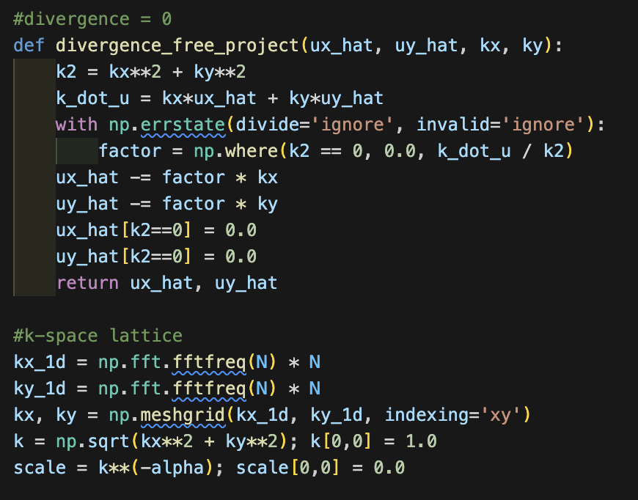
Goal: enforce incompressibility (∇·u = 0) in Fourier space and build a consistent k-grid.
Divergence=0 :
u^⊥​=u − (k⋅u)k // |k|^2
Sets the zero mode to avoid division-by-zero.
only solenoidal part remains → consistent with incompressible turbulence.
k-space grid:
np.fft.fftfreq(N) * N gives integer-like wavenumbers for an N×N FFT.
np.meshgrid(...) builds the 2D wavenumber field (kx,ky)
Magnitude k=kx^2​+ky^2​​ is used later for shell-averaging and for scaling.
Scaling:
scale = k**(-alpha) imposes the desired spectral decay (e.g. α=4/3).
Zero mode set to 0 because we don’t want a mean flow

Slide 6
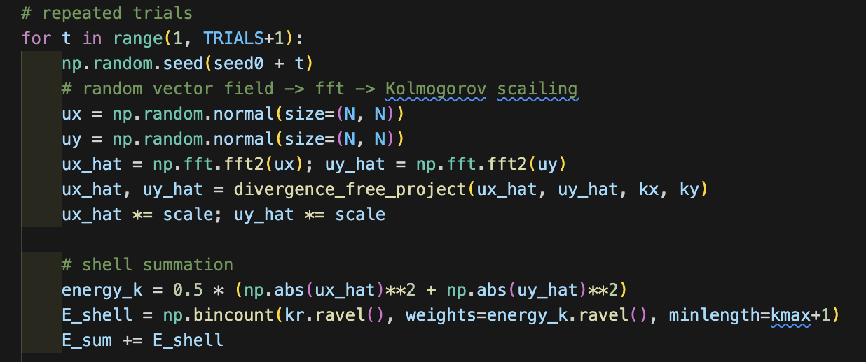
Outer loop = Monte Carlo ensemble
for t in range(1, TRIALS+1): generate many realizations.
np.random.seed(seed0 + t) → reproducible but still different sample each time.
Per trial pipeline
Random field in real space: ux, uy
Move to k-space: fft2(...)
Make it incompressible
Impose Kolmogorov scaling: ux_hat *= scale, uy_hat *= scale
Convert to energy and bin by |k|
Energy per Fourier mode:
Ek​=​(∣u^x​∣^2+∣u^y​∣^2)^(1/2)
np.bincount(...) groups all modes that have the same integer radius (kr) → this gives 1D shell spectrum for this trial.
Accumulate over trials
E_sum += E_shell → running sum of shell energies → later we will do E_avg = E_sum / t and fit the slope.

Slide 7
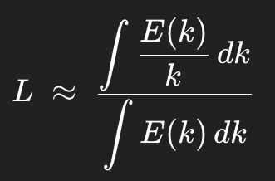
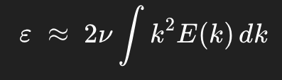
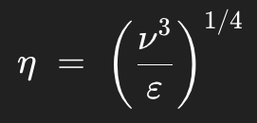
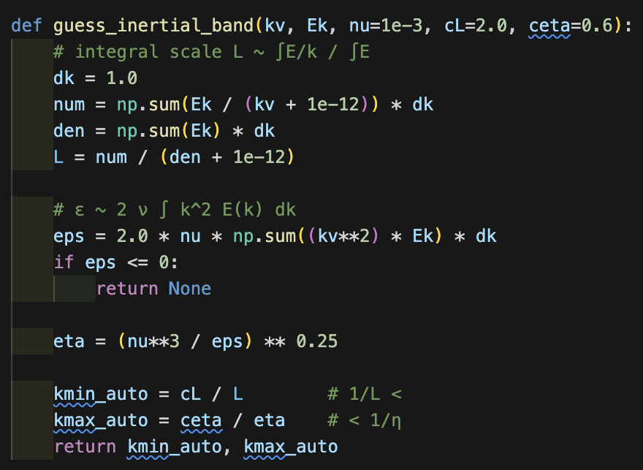
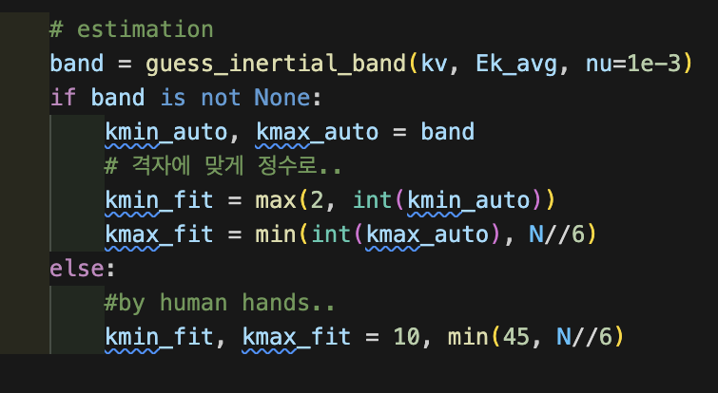
Inertial- range selection
Very small k and very large k are contaminated by domain/resolution effects.
We estimate k_min and k_max from ε and an integral scale
If estimation fails, use a safe band, (e.g. k ∈ [10, 45].
Fit log E(k) vs log k only on this band.

Slide 8
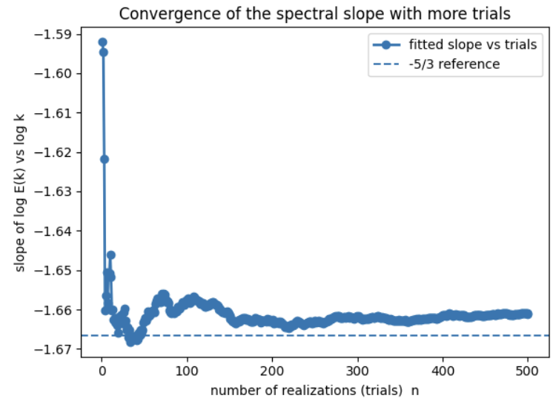
For every trial, fit log E(k) vs log k → slope.
Plot slope vs trial index.
As the number of trials increases, expect slope to approach −5/3.
→ evidence of statistical convergence toward Kolmogorov scaling.
Perhaps..
Finite grid → short inertial range.
Integer shell grouping → uneven shell population.
Automatic band detection not perfect on every trial.
2D synthetic setting vs 3D Kolmogorov theory.
Hence small (1–3%) deviations.
(converge at approximately -1.665)

Slide 9
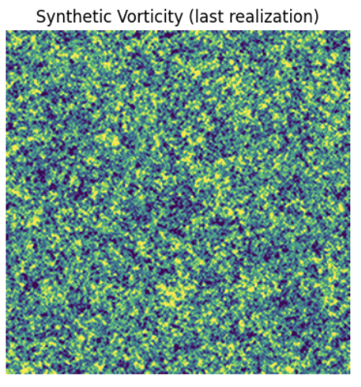
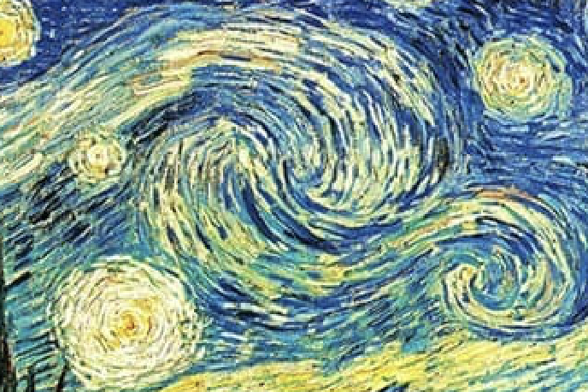
Shows that Kolmogorov-like spectra can emerge from simple random-field constructions.
Demonstrates Monte Carlo convergence of a turbulence-related statistic.

Slide 10

Q&A

