Slide 1


IoT based Virtual Reality Navigation Assistant for the Visually Impaired

Slide 2
INDEX
INTRODUCTION
CIRCUIT DIAGRAM
KEY FEATURES
FUNCTIONALITY
SIMULATION IN WOKWI
APPLICATIONS

Slide 3
In recent years, advancements in Internet of Things (IoT) and virtual reality (VR) technologies have opened new avenues for enhancing the lives of visually impaired individuals. This project leverages the capabilities of Wokwi, an online simulator for electronics, to develop an IoT-based virtual reality navigation assistant aimed at providing better mobility and navigation assistance to the visually impaired. By integrating various sensors and real-time data processing, the system offers an intuitive and interactive solution that enhances spatial awareness and navigational safety, thereby significantly improving the quality of life for its users. The primary objective of this project is to document the development, implementation, and evaluation of a Virtual Reality (VR) Navigation Assistant designed to assist visually impaired individuals.
INTRODUCTION

Slide 4
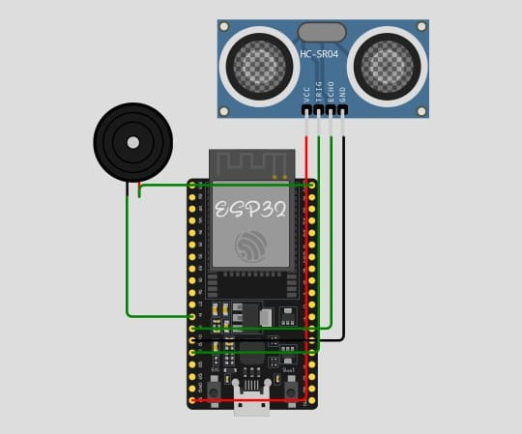
CIRCUIT DIAGRAM

Slide 5
KEY FEATURES
Wokwi Simulator: An online simulation tool used to design, test, and validate the IoT-based navigation assistant. It allows for virtual prototyping and debugging of the system before physical implementation.Weave relatable stories into your presentation using narratives that make your message memorable and impactful
Ultrasonic Sensors: Used for real-time obstacle detection, these sensors measure the distance to objects and help the system provide timely alerts to the user, ensuring safe navigation.
Buzzers: Buzzers are essential components in electronic circuits for providing audible feedback, alerts, and signals, and they come in various types and specifications to suit a wide range of applications.

Slide 6
FUNCTIONALITY
Obstacle Detection and Alert: The ultrasonic sensor detects obstacles in the user's path. Upon detection, the system triggers the buzzer to emit a sound alert, notifying the user of potential hazards in real-time to avoid collisions.
Real-Time Feedback: The ESP32 processes data from the ultrasonic sensor and controls the buzzer, ensuring immediate and continuous feedback as the user navigates their environment, thereby enhancing spatial awareness and safety.
Compact and Efficient Design: The combination of ESP32 and an ultrasonic sensor results in a compact, low-power, and efficient navigation assistant, making it practical and easy to use for visually impaired individuals in their daily activities.

Slide 7
Simulation on Wokwi
Wokwi allows for real-time simulation of microcontrollers, sensors, and other electronic components, enabling users to test and validate their projects without physical hardware. The platform supports various components, such as the ESP32 and ultrasonic sensors, making it easy to design and simulate complex IoT projects with accurate behavior.
APPLICATIONS
Robotics: Enhances robots and autonomous vehicles with obstacle detection for improved navigation.
Navigation Aid: Assists visually impaired individuals with real-time obstacle detection and alerts for safer navigation.
Smart Homes: Integrates into smart home systems to detect obstacles and enhance safety and security.

Slide 8
THANK YOU
Project created by:
Sakthi Petchiammal I - 2022504529 Saiarputha A -2022504509 Vedhavarshini M -2022504553 Parkavi M -2022504548
Project code: IoT 002
Team Name:IoT 1116

