Slide 1

Smart DeteKt
I4C ID: 19739 Team CRAZY GIRLS
Sri Krishna College of Technology
Coimbatore.

Slide 2
Problem Statement
Presently there is no system of monitoring the presence of staff posted in our 105 liquor vends in different parts of Delhi
We are looking for a cost effective solution for monitoring their physical presence at the vends on real time basis.
An alternative to Aadhar based authentication is needed because it is expensive and not real-time
Cost Sensitivity is considered.

Slide 3
Solution
Continuous monitoring & detection of staffs at liquor vends via video feed from existing cctv cameras through image detection kit.
Persistent recording of Staff absence at the vends.
Real time notifications about absence of staffs through Mobile Application & SMS.
Leave management automation as additionally requested.

Slide 4
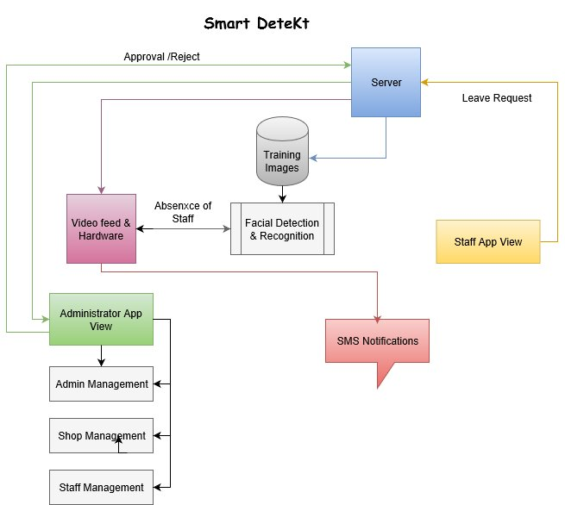
Work Flow

Slide 5
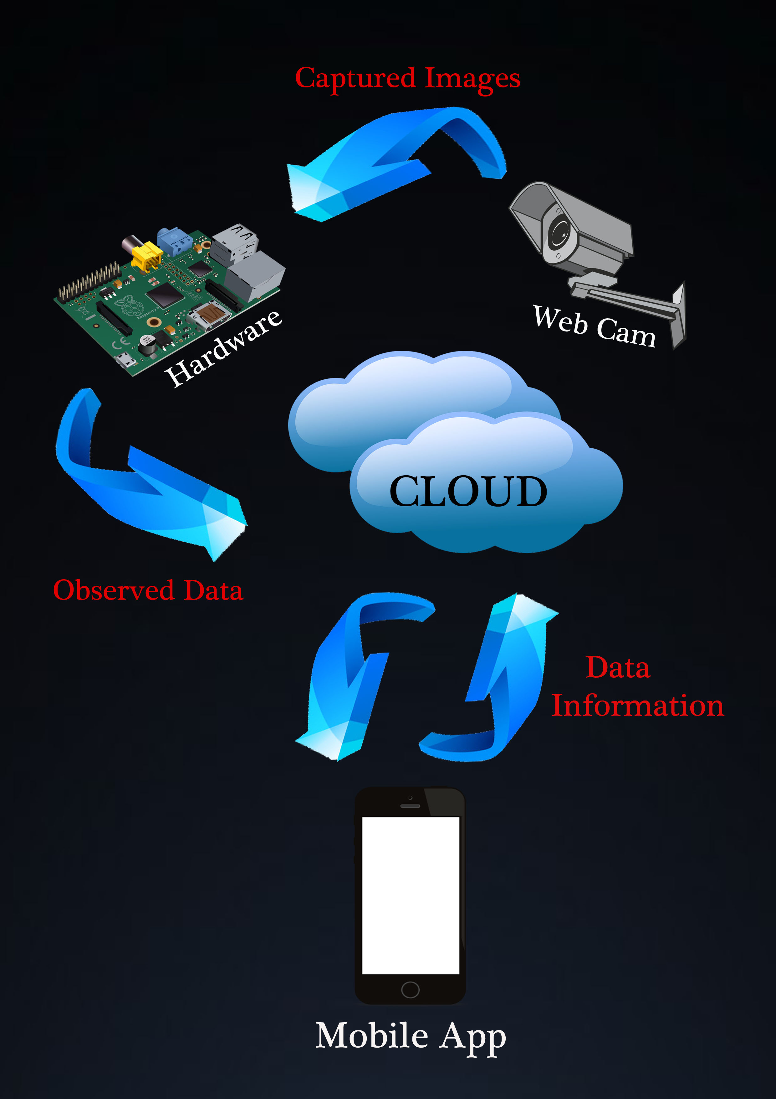
Smart DeteKt- Prototype

Slide 6
Smart DeteKt- Technology Stack
Front End
Back End
Meta
MEAN Stack
( API Server Platform)
Java
Mobile Application
Hardware
Component
Loopback
( Codeless Schema)
Python
REST
(API Services)
Java
Script

Slide 7
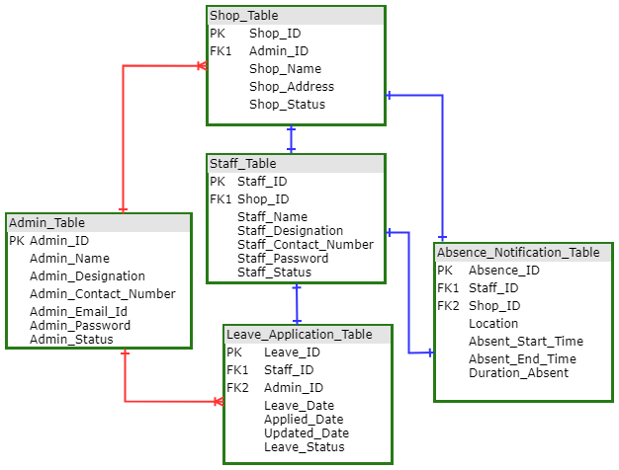
Smart DeteKt- Schema Design

Slide 8
Features
Multiuser tracking & Detection
Customized Admin rights
Real time notifications
Vendor neutral solution can be deployed on premises or cloud.

Slide 9
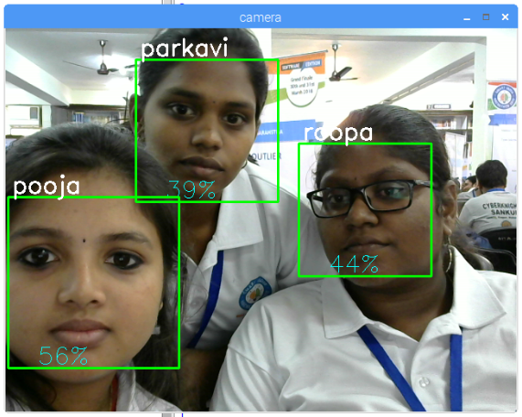
Face Recognition Module

Slide 10
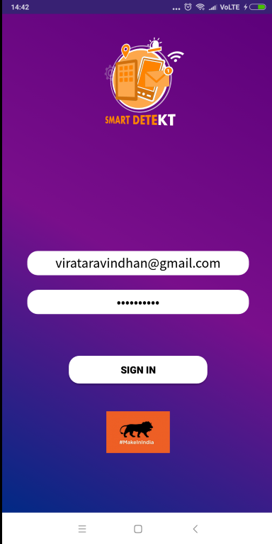
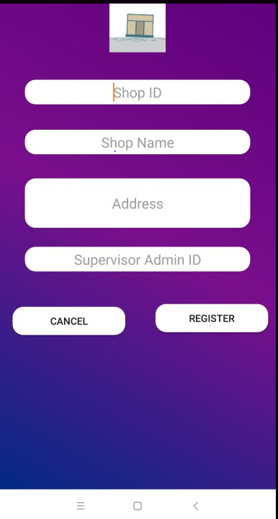
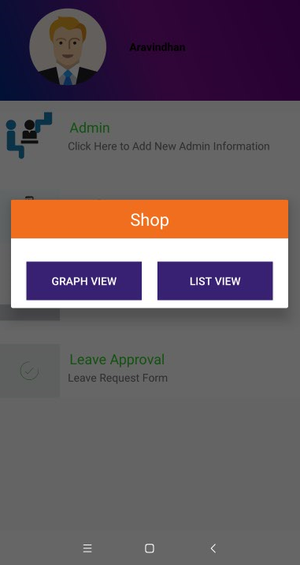
Smart DeteKt Mobile App

Slide 11
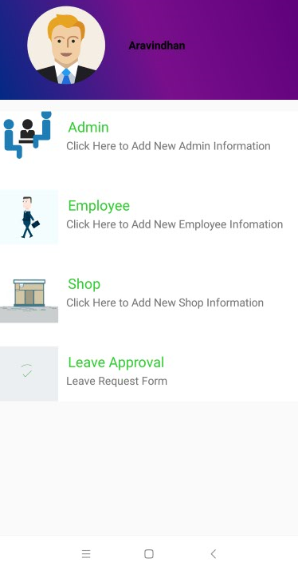
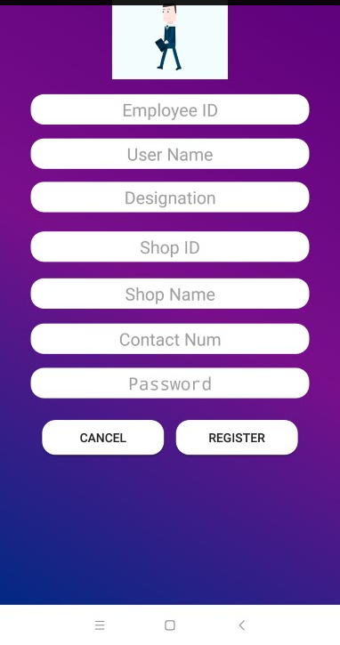
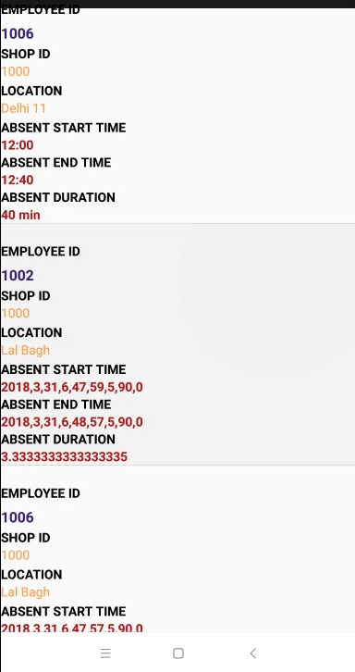
Smart DeteKt Mobile App

Slide 12
Business Plan
Target Cost
Kit: Rs.3000
Mobile app & Software: Open Source platform
Capital Asset Expenditure:
Server for Maintenance: Rs. 4000 (monthly) for 105 vends and scalable for any business market.
Customized Design
Custom hardware design >1000
Depending on user requirements.

Slide 13
Deployment Plan
Prototype
Few Days
SIH
Demo
Development
3 Months
Validation of Solution at Production Site
Hardware Alternatives to reduce cost
Rollout/Go Live
3 Months
HW Vendor select, Order & Purchase
Installation
Data Loading
End User Training
Design Validation of Solution at Test Site
Full Scale Software Development
Limited Series Production Testing

Slide 14
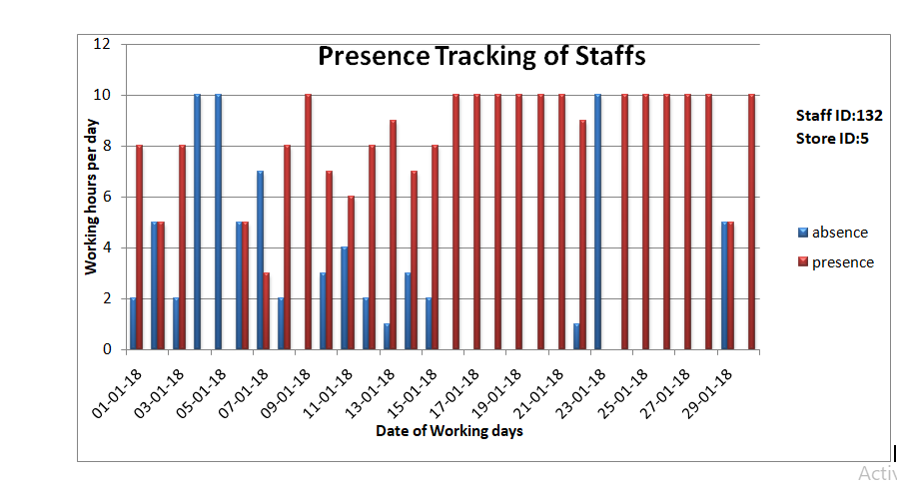
Outcome

Slide 15
Thank you

