Slide 1
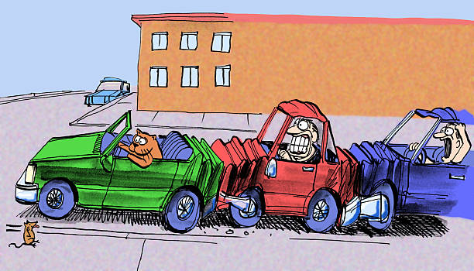
Road Safety
Presented By
Parkavi Jayachandran
Balvinder Rajbans

Slide 2
Project Overview and Source of Data
In this project we look into the history of crashes that took place over the period from 2012 to 2021 in South Australia and create a Data Model to predict whether a crash would be fatal or non-fatal.
The Data is sourced from:
The South Australian Government Data Directory: https://data.sa.gov.au/data/dataset/road-crash-data/resource/1057e9ae-4672-4123-9c1d-1877483da401 and using the csv files from 2012_DATA_SA_Crash to 2021_DATA_SA_Crash

Slide 3
Extract, Transform, Analyse
Extract
Importing dependencies: Pandas, Tensorflow, Numpy, Glob, Train_Test_Splitand StandardScaler from SciKit-Learn.
Storing CSV into Dataframe: CSV files were used from the main source, crash.csv with 152354 entries with data from 2012 to 2021.
Creating new data with select columns: New Data Frame is created with selected columns from crash.csv, called crash_df_filtered_1.

Slide 4

Extract, Transform, Analyse
Extract
Creating database: Using SQLite3, we created a database called crash_db which has the crash_table.
Connecting to local database: With sqlite3.connect, we connected to this local database created .

Slide 5
Extract, Transform, Analyse
Transform
The data is preprocessed to meet the requirements for the Machine Learning Model.
The ‘CSEF Severity’ column which will be our Target variable is converted to Numerical Values from String.
The Dtype of ‘Time’ column is changed to Datetime from Object and the 12 Hrs format is converted to 24 hrs format and is binned into 24 bins, one for every one hour.
The columns with object Dtype are then one_hot_encoded.

Slide 6

Extract, Transform, Analyse
Analyse
Dataset split into Features and Target array.
It is then split into Training and Testing dataset.

Slide 7
Extract, Transform, Analyse
Analyse
The split data is scaled using Standard Scaler.
The scaled and transformed data is then passed through the neural network model, the number of input features and the hidden node in each layer is defined.
Two hidden layers are added to the Neural network with the ‘ReLu’ activation function.
‘Softmax’ is used as the activation function for the Output Layer with 4 output units as per the unique values in our Target column.

Slide 8
Extract, Transform, Analyse
Analyse
The neural network model is then compiled with CategoricalCrossEntroy for the Loss and ‘Adam’ as Optimizer. The learning rate is set at 0.001 and the metrics is set for ‘Accuracy’.
The model is then trained using the fit-model function with the number of epochs set to 10.
The model_loss and model_accuracy is then calculated using the nn.evaluate function.

Slide 9
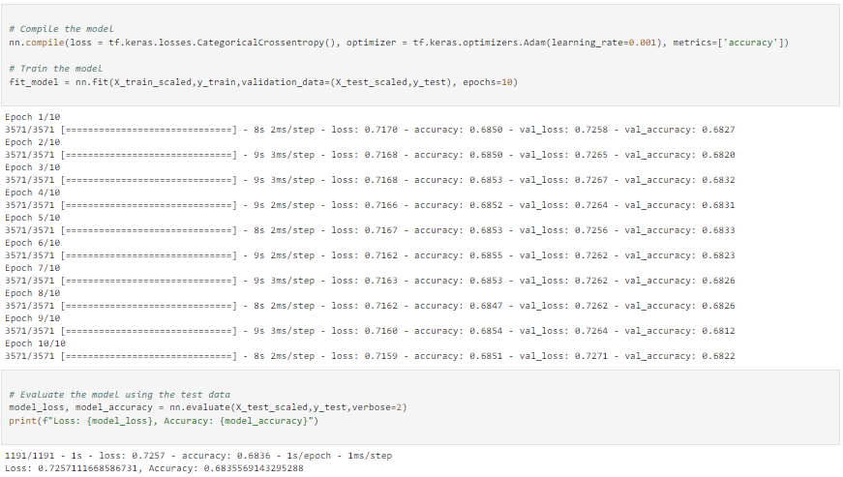

Slide 10
Objective: Road Safety Data Analysis
Number of crashes in South Australia 2012-2021
Number and type of crashes in South Australia 2012-2021
Crashes during Day Vs Night in South Australia 2021
Number and Type of Crashes depending on Weather in South Australia 2021
Suburbs with over 150 Crashes in South Australia
Map Showing Crashes in South Australia 2021

Slide 11
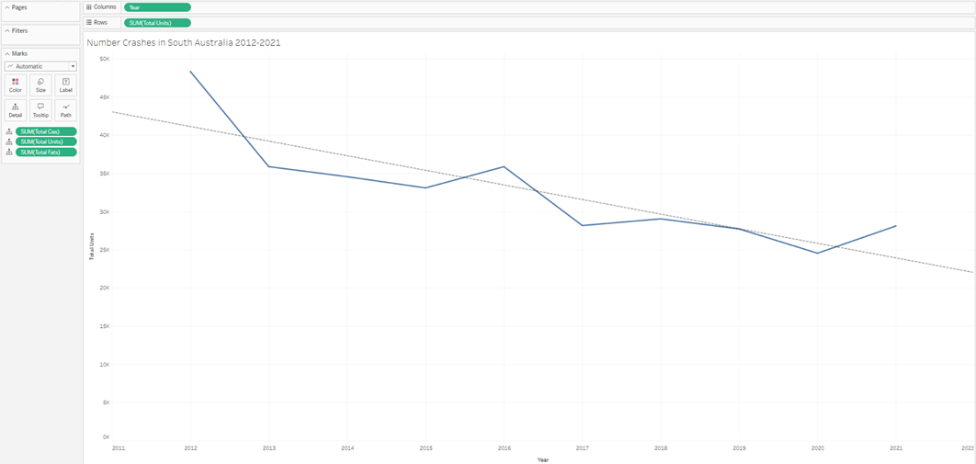
Number of crashes in South Australia 2012-2021

Slide 12
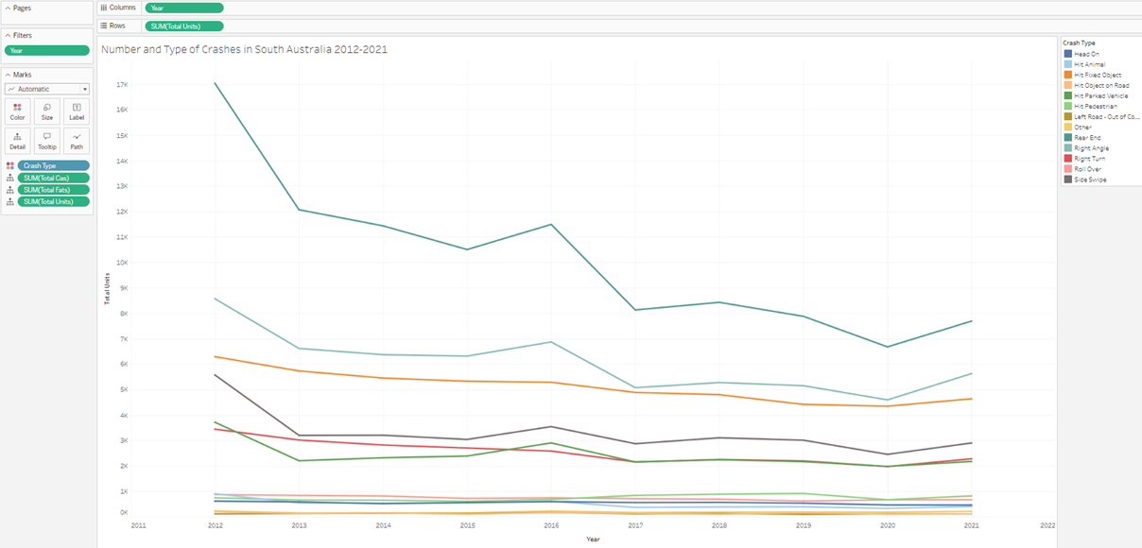
Number and type of crashes in South Australia 2012-2021

Slide 13
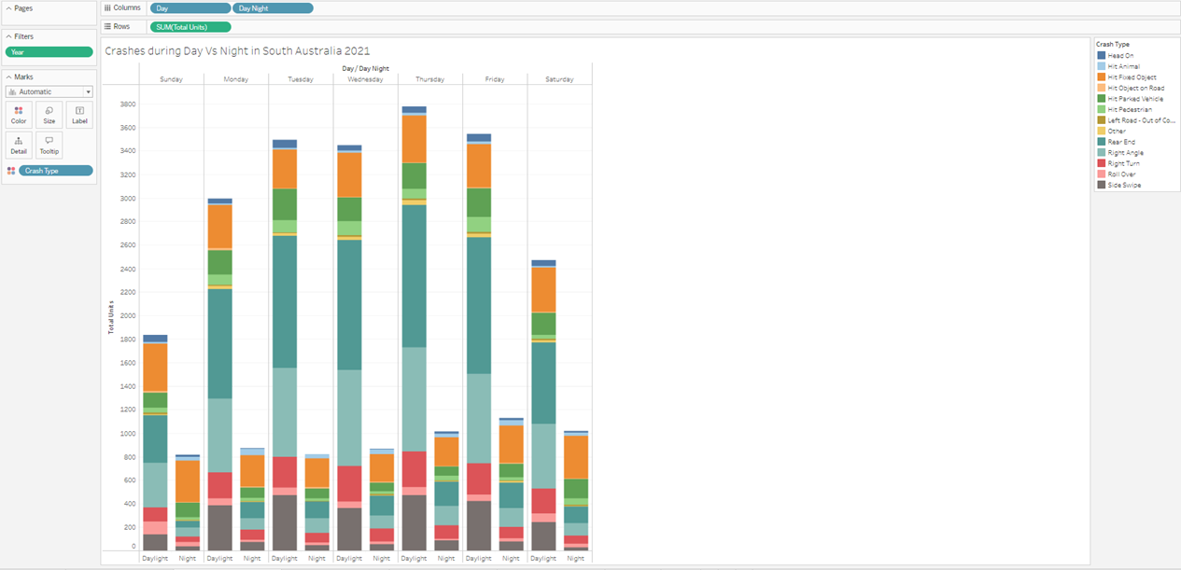
Crashes during Day Vs Night in South Australia 2021

Slide 14
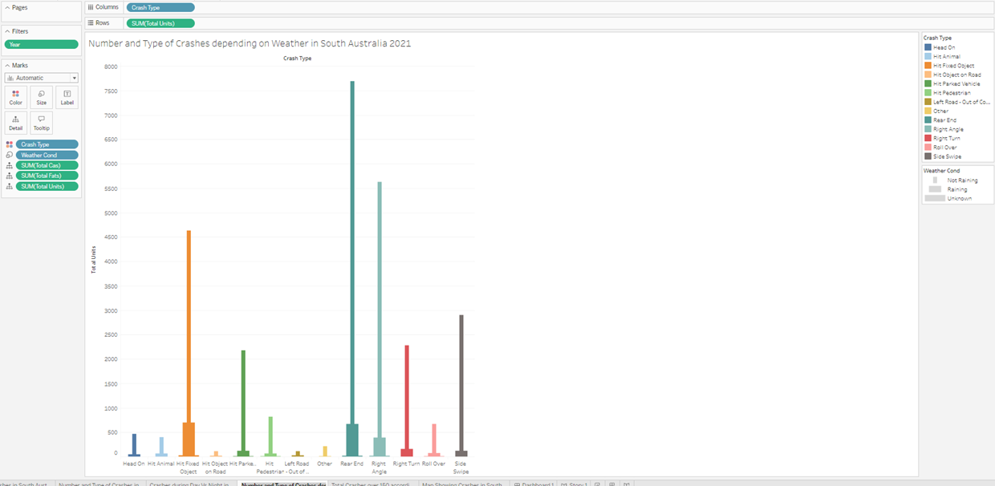
Number and Type of Crashes depending on Weather in South Australia 2021

Slide 15
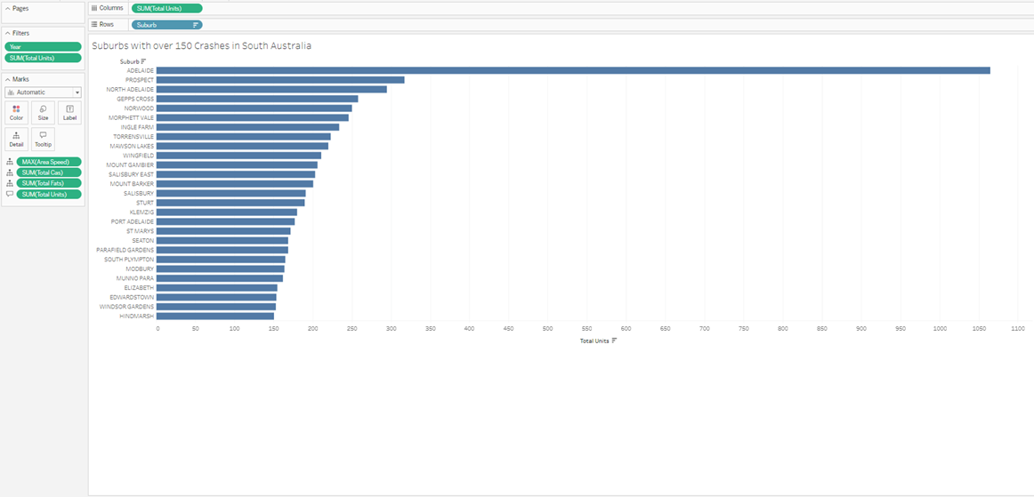
Suburbs with over 150 Crashes in South Australia

Slide 16
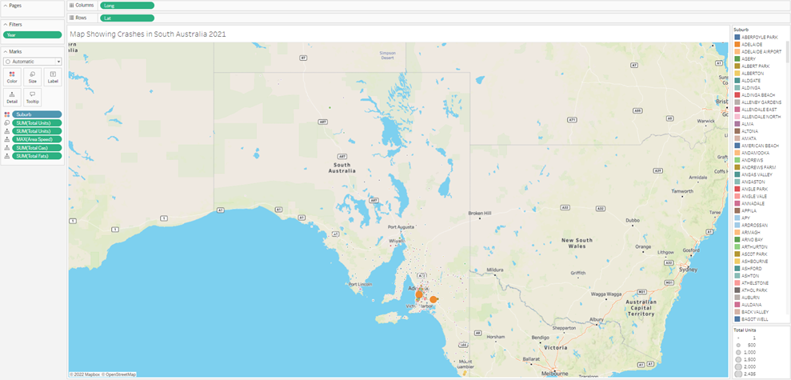
Map Showing Crashes in South Australia 2021

Slide 17
Thank you
Presented By
Parkavi Jayachandran
Balvinder Rajbans

