Slide 1
2025 Avangrid Hackathon
Parker Isaacson
Mason Cartier
Thomas Hogeboon

Slide 2
The Merchant Challenge
PPA Period
Merchant Period
Revenue Certainty
Exposure to Market Period
During the Power Purchase Agreement (PPA) period, the project sells energy at a fixed price per megawatt-hour (MWh) under a long-term contract with a utility or corporate buyer.
After the PPA expires, the project becomes a merchant asset, selling power directly into wholesale markets. Revenue now depends on hourly price movements, which adjust on supply, demand, and grid congestion.
Operational Simplicity
Risk and Opportunity
Because revenues are locked in, developers focus mainly on maintaining technical performance and availability. Market risks like congestion or negative prices are absorbed by the offtaker, not the asset owner.
Merchant operation offers potential upside when prices rise but carries downside risk during low or negative pricing events. Developers may choose to hedge through fixed-price contracts to manage this volatility and ensure stable returns.

Slide 3
Objective
Goal
Integrates historical generation, market prices, and forward curves
Produces 5-year risk-adjusted fixed prices for ERCOT, MISO, and CAISO
Reflects a 75 % confidence target
Supports hedging and recontracting decisions
Our goal: create a transparent, data-driven framework for valuing post-PPA renewable assets.

Slide 4
01
03
CSV
Clean
The final parsed data was output into a CSV so later programs could easily load it.
The data was manually cleaned the data to allow for seamless reading and for downstream code to run seamlessly
02
04
pandas
Provided
Pandas was used to interpret the data for ERCOT, MISO, and CAISO from the spreadsheet.
The provided spreadsheets are messy with regard to the data.

Slide 5
Analysis
Clean Data
Monthy Forward Curves
Monte Carlo Simulation
Extracted forward price curves (2026–2030)
Modeled monthly volatility from historical hub prices
Generated 1,000 stochastic price paths
Computed P25, P50, P75, and P90 percentiles per month

Slide 6
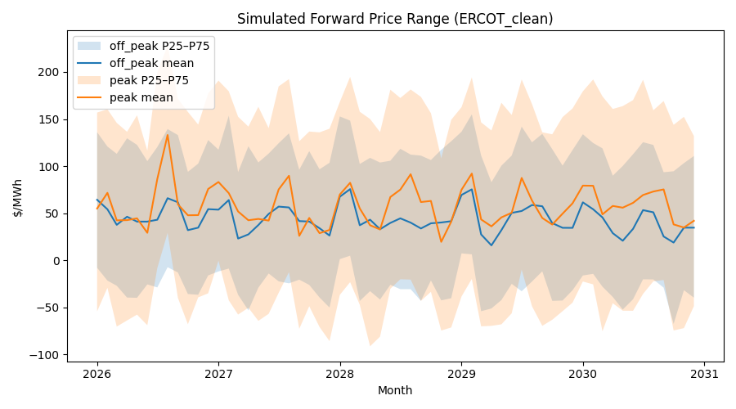

Slide 7
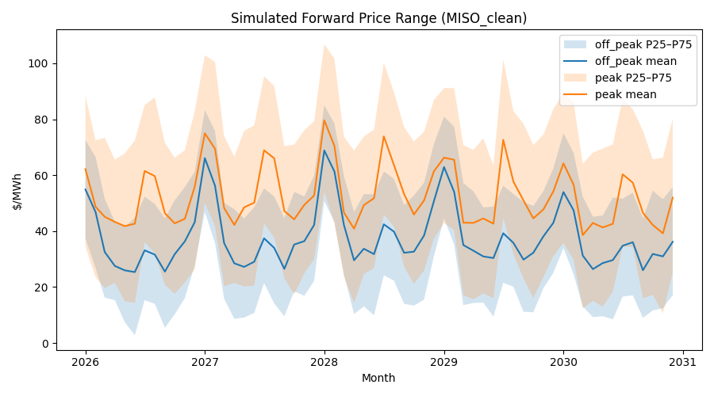

Slide 8
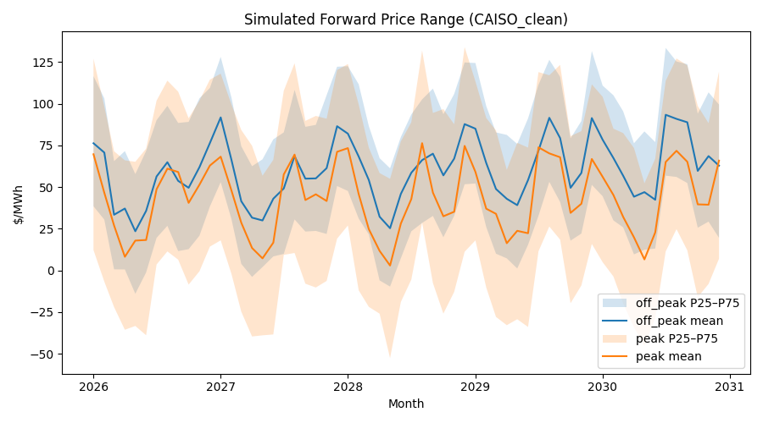

Slide 9
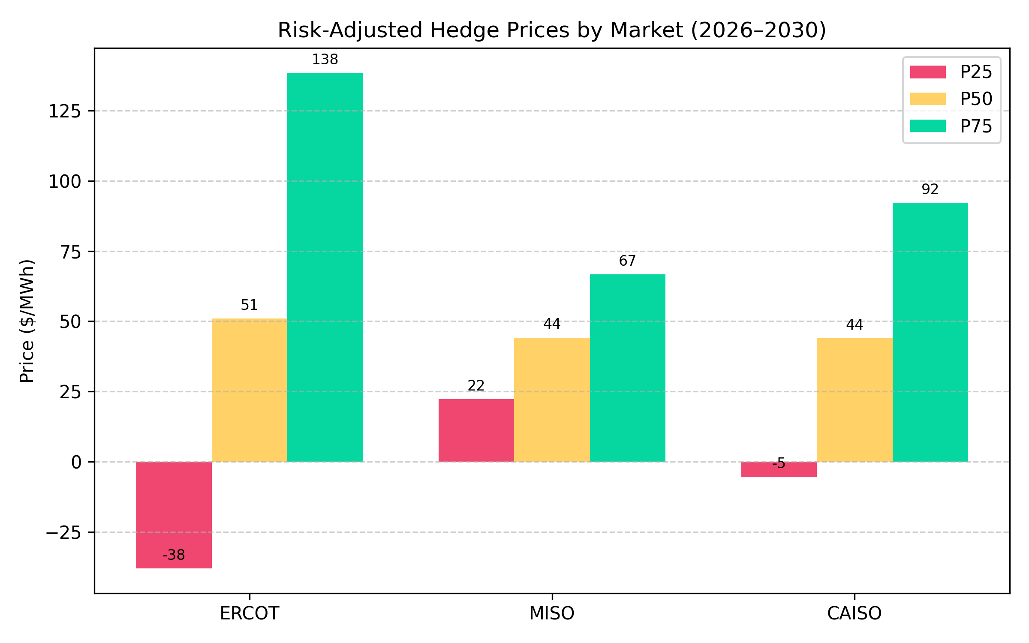
Risk-Adjusted Valuation Results
Market | P25 | P50 | P75 | Risk Premium
ERCOT | -36.3 | 53.4 | 143.5 | 179.8
MISO | 22.2 | 44.5 | 66.1 | 43.9
CAISO | -5.0 | 44.6 | 93.8 | 98.7

Slide 10
Thank You!

