Slide 1
Savannah Run
Peter McPadden
Stephen Funk
Jake Broadwater
Parker Beck
Austin Pearman

Slide 2
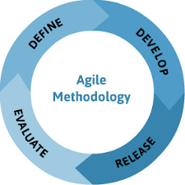
Agile Methodology
Usefulness: High
Many periods of high productivity
Results of some sprints improved upon features of previous sprints
Rating user stories helped prioritize tasks.
Challenges:
Conflicting ideas of how final product should look.
Getting ahead of ourselves before testing features of a sprint.

Slide 3



Tools Used
Unity API: 5
Unity Testing Tools (Testing): 1
GIMP: 4
Github (VCS Repository): 5
Trello (Project Tracker): 3
GroupMe: 5

Slide 4
Challenges
Unfamiliarity w/ Unity API and C#
Utilized online Unity Tutorials
Unity files cluttering up Github repository
Keeping all of our important assets in folders and cleaning up when we push.
Communication at the beginning
Started a team GroupMe

Slide 5
Demo
User Requirements:
Level Progression
Killing enemies
High Level of Challenge

Slide 6
Demo
Functional Requirements:
No mid-game bugs are crashes once the games starts
Non-Functional Requirements:
No latency issues

