Slide 1
Meridian Parts
European service-hub expansion
Board decision brief | 2025 shipped-sales base | returns cutoff 2026-01-31
Recommendation: gated funding for CZE+ESP

Slide 2
Decision: fund the highest feasible base-case option, with gates
CZE+ESP
Alternative: POL+ESP at €186,329 base annual contribution
Hard constraints: €450k capex, 7 FTE, max two hubs
Gate release on observed readiness and a measured uplift/savings bridge
Defer remains the correct action if the gate cannot evidence the premise
Base annual incremental contribution: €198,099
Year-zero capex: €225,000; staffing: 5 FTE
Simple payback: 1.14 years
Stress contribution: €32,180
Break-even volume uplift: 2.7%

Slide 3
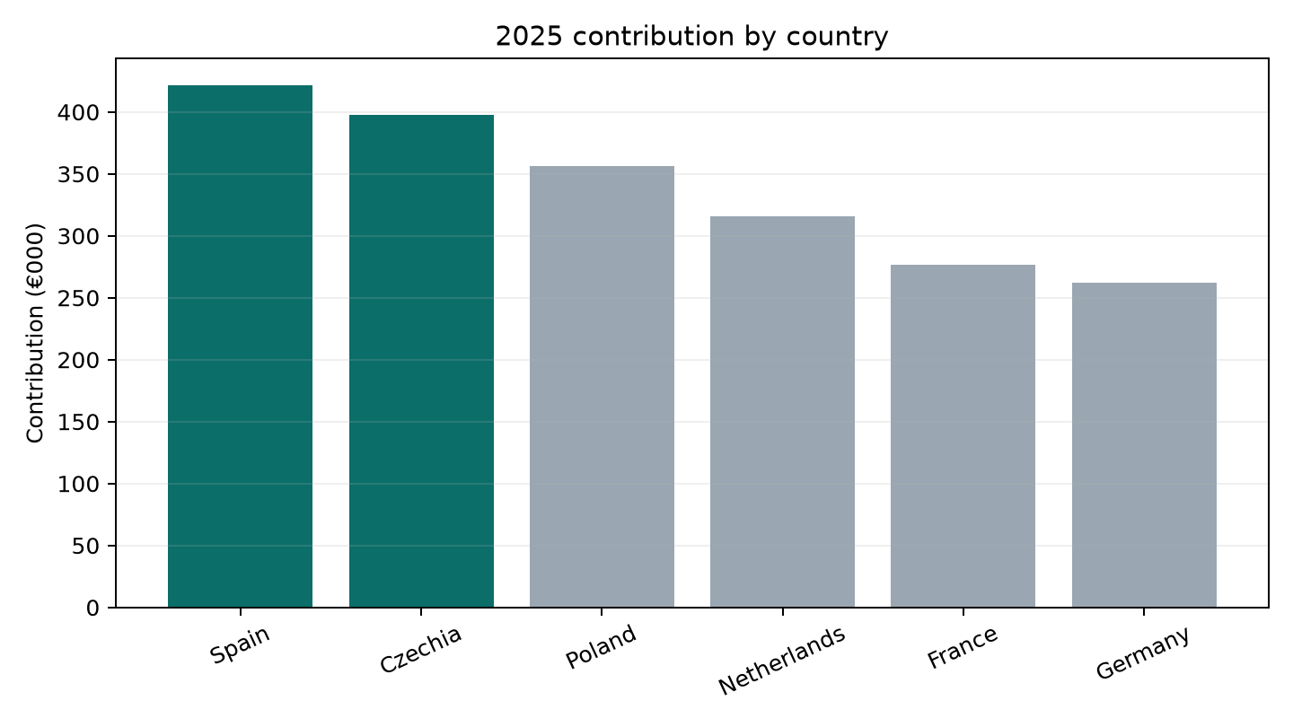
2025 baseline: profitable, but economics vary by market
1,254 shipped orders / 77,436 units
€4,383,792 net sales / €2,030,010 contribution
46.3% contribution margin
1,081 returned units
Contribution deducts net COGS and fulfillment; booked revenue and cash timing differ

Slide 4
Controls: the analysis reconciles revisions, duplicates, returns and historical FX
1328 raw order rows → 1297 unique order IDs
13 exact repeats removed; 18 correction revisions selected
24 cancelled, 18 test and 1 non-2025 shipment records excluded
264 raw return rows → 243 return IDs; 1 orphans quarantined
12 PLN and 12 CZK monthly ECB means; sale-month quote used for refunds too
Archived official snapshots are distinguished from synthetic client inputs; no customer interview or live account access was used.

Slide 5
Market context: scale and income are context, not demand proof
Market | Population | 2022–24 | GDP/person
Germany | 83,516,593 | 0.4% | $56,104
France | 68,551,653 | 0.5% | $46,103
Spain | 48,848,840 | 2.2% | $35,327
Poland | 36,559,233 | -0.7% | $25,104
Netherlands | 17,993,485 | 1.7% | $67,465
Czechia | 10,905,028 | 2.2% | $31,828
World Bank population and GDP per capita are preserved for 2022–2024
GDP per capita is current US$, not PPP or constant-price real income
Neither series measures product demand, service density, customer concentration or realized hub savings
Use them to frame scale and economic context only

Slide 6
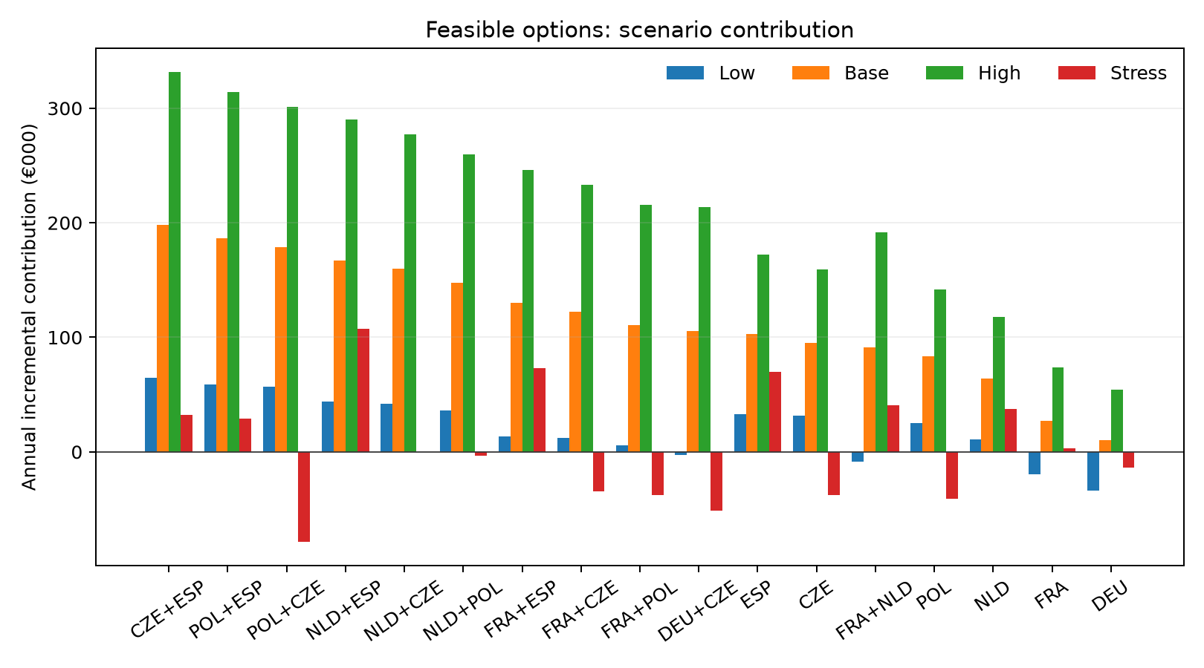
Scenario economics: the selected pair wins on base contribution within constraints
Low/base/high volume uplifts: 10% / 25% / 40%
Stress: 3% gross-sales refund shock + PLN/CZK 10% net-sales FX shock
Capex is year-zero; recurring fixed cost is in annual contribution
Pairs have no synergy in the model

Slide 7
90-day implementation: staged release with visible gates
0–30
COO + Finance
Lock baseline, site shortlist, labor/lease diligence
Gate: data and legal readiness
31–60
Operations + Procurement
Validate quotes, staffing, process and saving bridge
Gate: capex/FTE inside limits
61–90
Country lead + IT
Readiness test, training, order/return control
Gate: evidence supports uplift
Release capex only after KPI evidence: ≥99.5% order-ID reconciliation, ≥95% on-time dispatch, returns processed ≤48h, and a weekly contribution bridge.

Slide 8
Board ask and reopen conditions
Approve a gated CZE+ESP design envelope: €225,000 capex and 5 FTE
Authorize 90-day validation, not unconditional deployment
Reopen or defer if realized uplift is below 2.7%, savings/return KPIs fail, or capex/fixed-cost assumptions move materially
Treat the output as a supported estimate from synthetic inputs and archived official context; it is not causal proof
Source detail, calculation workbook and metrics JSON are delivered alongside this deck.

