Slide 1
MERIDIAN PARTS
European service-hub expansion
Recommendation: staged CZE+ESP envelope
€198,099 base annual contribution after recurring cost | €225,000 capex | 5 FTE | 1.14y simple payback
Board presentation | 2025 shipped sales and returns known through 31 Jan 2026 | Synthetic client
1

Slide 2
Board decision
Approve the CZE+ESP envelope, launch Czechia first, and gate Spain on pilot evidence
BASE INCREMENT
DEFINED STRESS
CAPEX
FTE
PAYBACK
€198,099
€32,180
€225,000
5
1.14y
Decision rule used
What the choice gives up
• Stay inside the explicit €450k capex, seven-FTE and two-hub limits.
• Require positive annual increment in the policy's defined joint stress.
• Among survivors, rank by base annual incremental contribution.
• Treat this risk screen as an assumed planning preference, not a board-supplied fact.
• NLD+ESP has the strongest stress result (€107.6k) but gives up €31.2k of base contribution, needs €45k more capex and one more FTE.
• POL+ESP is dominated by CZE+ESP on low/base/high/stress and needs more resources.
• If demand evidence is weak, defer the second release; the model is not a causal forecast.
Scenario policy, hub-options.csv, reconciled 2025 country totals
2

Slide 3
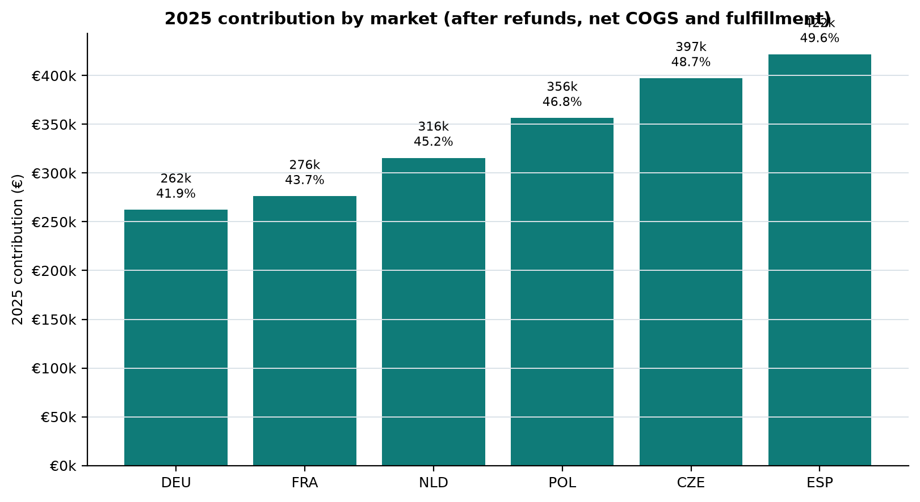
2025 baseline: ESP and CZE carry the largest contribution base
Computed from eligible orders after revision, status, test, cutoff and return controls
Market | Orders | Units | Net sales | Contribution | Margin | Returned units
DEU | 209 | 12,153 | €625,792 | €262,366 | 41.9% | 73
FRA | 209 | 11,880 | €632,231 | €276,271 | 43.7% | 144
NLD | 209 | 12,576 | €697,733 | €315,644 | 45.2% | 144
POL | 209 | 13,163 | €761,890 | €356,494 | 46.8% | 180
CZE | 209 | 13,733 | €815,307 | €397,335 | 48.7% | 288
ESP | 209 | 13,931 | €850,839 | €421,900 | 49.6% | 252
Accounting guardrails
• 1,328 raw order rows → 1,297 unique order IDs → 1,254 eligible 2025 shipped orders; 18 higher revisions replace prior rows.
• 241 usable linked returns after deduplication and the inclusive 31 Jan 2026 cutoff; orphan R-ORPHAN is quarantined.
• 12 valid zero-price eligible shipments are retained. Monthly totals reconcile to country totals to the cent.
Synthetic client exports and data-dictionary.md; no raw-row order counting
3

Slide 4
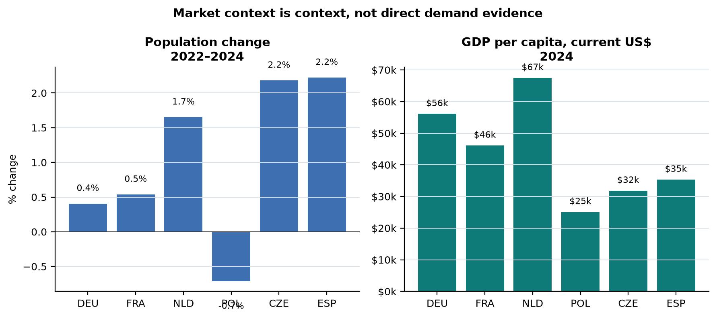
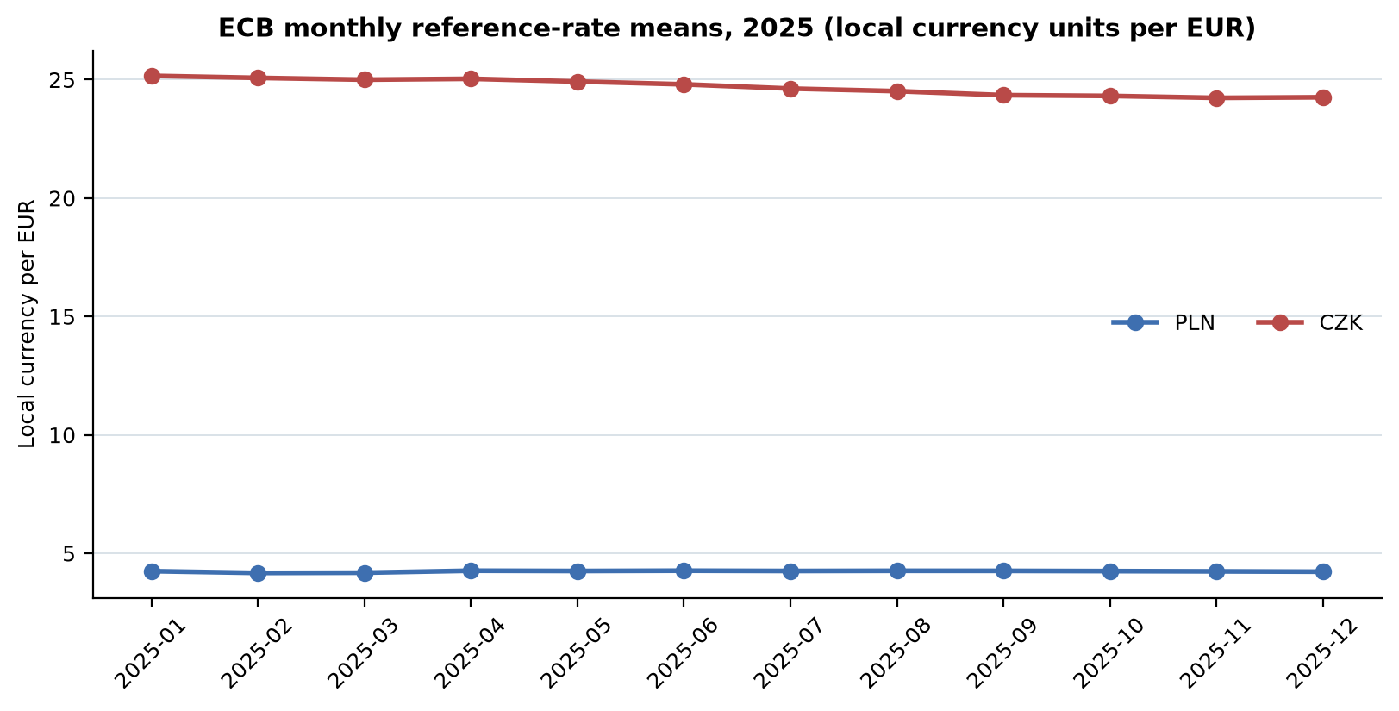
Context informs capacity — it does not prove demand
Archived official World Bank observations, preserved with retrieval vintage
Market read
FX discipline
• NLD and DEU have the highest 2024 GDP per capita in current US$.
• Population grows 2022–24 in DEU, FRA, NLD, CZE and ESP; POL declines.
• Population/GDP are context only, not direct replacement-assembly demand evidence.
• PLN/CZK use the original sale-month ECB mean of published business-day reference observations.
• Quotes are local currency units per EUR; EUR is 1.0. No inversion or today's rate.
• FX is an analytical translation assumption, not an actual transaction hedge result.
Archived World Bank population.json / gdp-per-capita.json; ECB ecb-history.zip and extracted CSV
4

Slide 5
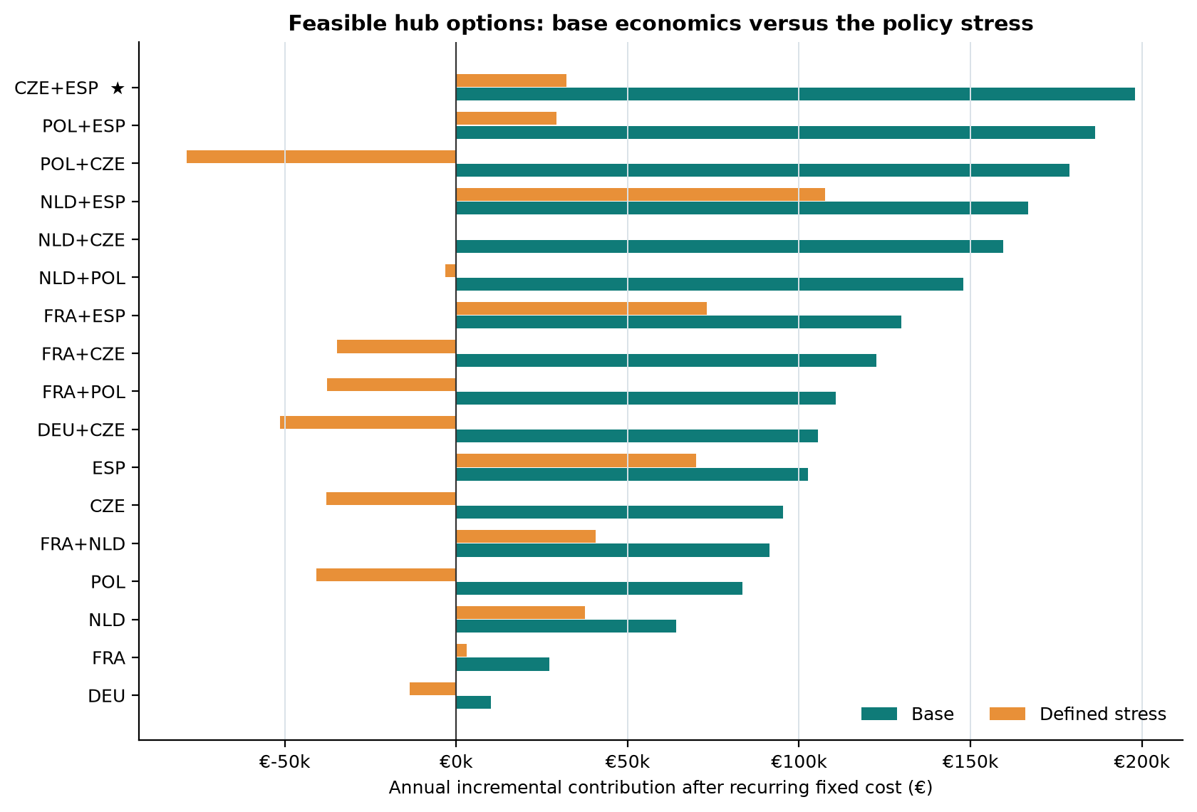
CZE+ESP leads the feasible base case and remains positive in defined stress
Annual incremental contribution after recurring fixed cost; capex is year-zero
Option | Base | Stress | Capex / FTE
CZE+ESP | €198,099 | €32,180 | €225,000 / 5
POL+ESP | €186,329 | €29,264 | €240,000 / 6
POL+CZE | €178,995 | €-78,570 | €205,000 / 5
NLD+ESP | €166,931 | €107,630 | €270,000 / 6
NLD+CZE | €159,598 | €-203 | €235,000 / 5
NLD+POL | €147,828 | €-3,119 | €250,000 / 6
FRA+ESP | €129,849 | €73,105 | €340,000 / 7
Scenario assumptions
• Low/base/high uplift: 10% / 25% / 40%.
• Stress: 3% gross-sales refund shock; 10% net-sales shock in PLN/CZK; base 25% uplift.
scenario-policy.md; pairs add country figures/capex/FTE without synergy
5

Slide 6
The decision is conditional, not certain
The largest uncertainty is the assumed hub uplift and timing of first-year realization
Flip conditions
Alternative comparison
• If normal volume uplift for CZE+ESP falls below ~2.7%, the steady-state formula falls below break-even before stress.
• If the board values stress resilience over base value, NLD+ESP becomes the preferred alternative.
• If quotes exceed €225k capex or five FTE, re-screen rather than waive the policy cap.
• If pilot uplift is below the 10% low case for two consecutive months, hold Spain.
 | Base | Stress | Capex/FTE
CZE+ESP | €198,099 | €32,180 | €225k / 5
NLD+ESP | €166,931 | €107,630 | €270k / 6
POL+ESP | €186,329 | €29,264 | €240k / 6
DEFER | €0 | €0 | €0 / 0
Accepted risk
• CZE+ESP gives up €75.5k of stress contribution versus NLD+ESP while using €45k less capex and one fewer FTE.
• Payback is undiscounted and steady-state; first-year ramp and working capital are not modelled.
Trade-off screen is an explicit planning assumption; outputs are computed, not causal proof
6

Slide 7
90-day plan: prepare both, launch CZE, gate ESP
Owners, dependencies and measurable release criteria
Days | Owner | Action | Gate
0–15 | COO / Finance / PMO | Baseline, quotes, leads, WMS/returns data ownership | Pilot charter; no irreversible commitments
16–30 | Ops / Proc / HR / IT | Sites, labour plan, inventory/returns design | Within €225k/5 FTE envelope
31–60 | Leads / WMS / Quality | Hire/train, configure, dry-run, control tests | CZE: ≥95% test-order accuracy
61–90 | COO / country leads / Finance | CZE soft launch; 30-day KPI review; Spain release pack | ≥10% uplift signal, OTIF ≥95%, returns ≤+3pp
KPI scoreboard
Dependencies
• Incremental shipped units versus 2025 run-rate; weekly/monthly.
• OTIF/service time; returned units ÷ shipped units; realized savings per unit.
• Contribution after fixed cost; capex/FTE readiness; zero orphan joins.
• Vendor quotes and legal/tax review before lease signature.
• Reliable event timestamps and WMS/returns data feeds before KPI gate.
• First-year cash/stock model before irreversible expansion.
Management thresholds are proposed operating gates, not observed facts
7

Slide 8
Board ask and limitations
Approve a staged option with a visible stop condition
Approve
Do not over-read
• CZE+ESP planning envelope: €225k capex / 5 FTE / up to two hubs.
• CZE first; Spain released only after Gate 3 KPI evidence.
• Finance/COO to reprice the model after vendor quotes and pilot data.
• Uplift, costs and savings are synthetic policy assumptions.
• Population/GDP are public context, not demand proof.
• Payback is simple/undiscounted and excludes ramp, working capital and tax.
Decision in one sentence: fund the CZE+ESP envelope because it is the strongest feasible base-and-low case that stays positive in the defined stress, but make Spain earn release through the 90-day KPI gate.
Evidence: frozen source room at http://127.0.0.1:55463/; archived official World Bank/ECB files with hashes; synthetic client exports and policy. Reproduce: python analysis/reproduce.py.
Report, workbook, metrics.json, source register and raw evidence delivered alongside this deck
8

