Slide 1
MERIDIAN PARTS | BOARD DECISION
Advance a gated investment case
Leading pair: Czechia + Spain | base €198,099/year
Low €64,619 | stress €32,180
€225,000 capex | 5 FTE | 1.14-year payback
Stage commitment behind 90-day evidence and operating gates.

Slide 2
MERIDIAN PARTS | BOARD DECISION
Contribution is not cash
1,254 eligible orders | 77,436 units
Gross €4,464,622 − refunds €80,831 = net sales €4,383,792
Less net COGS €2,246,919 + fulfillment €106,862 = contribution €2,030,010
Margin 46.3%; cash settlement and working capital are absent.

Slide 3
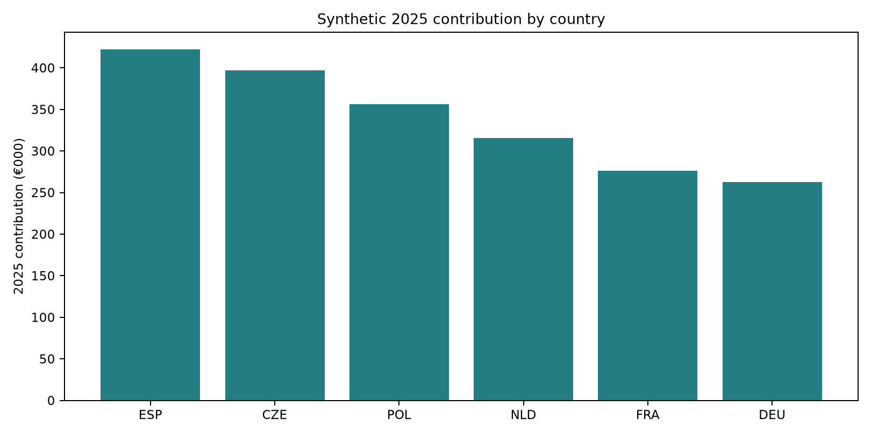
MERIDIAN PARTS | BOARD DECISION
Country contribution

Slide 4
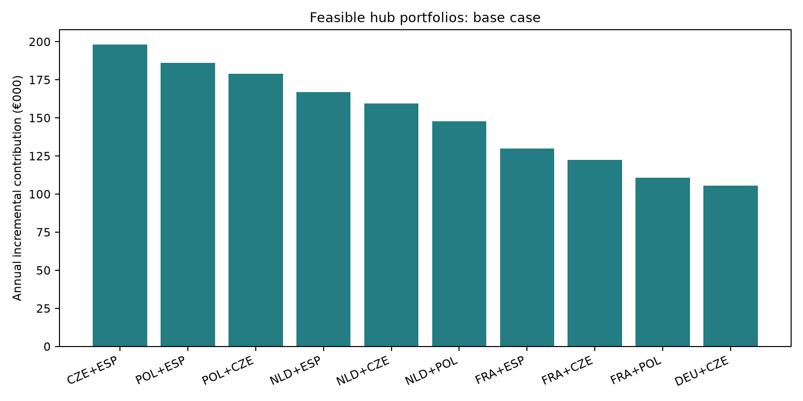
MERIDIAN PARTS | BOARD DECISION
Feasible portfolio economics

Slide 5
MERIDIAN PARTS | BOARD DECISION
90-day gates and weekly scorecard
0–30 days | CFO + Commercial Ops: ≥98% order/cost/return linkage; signed baseline.
31–60 days | COO + Service: validate catchment, avoidable cost and low/stress economics.
61–90 days | CEO/Board + CFO: staged commit after quote, SLA, owner and inventory sign-off.
Weekly: OTIF, delivery hours, expedite cost, return recovery, fill rate, units, contribution, capex, FTE.

Slide 6
MERIDIAN PARTS | BOARD DECISION
Evidence limits
Synthetic client inputs; no live account access or interviews.
WB 2022–24 population: Spain +2.22%, Czechia +2.18%, Poland -0.71%.
2024 GDP/capita current US$: Netherlands $67,465; Poland $25,104; context, not demand.
Frozen official ECB/WB archives; scenario math non-causal and undiscounted.

